Slide 1
Intro to Programming
Chapter 1

Slide 2

Setting up Python
You can download Python at no charge from www.python.org
Note: Make sure you install the latest version of Python 3.x. This course was designed Python 3.x.

Slide 3
Python as a Language

Slide 4
Python: A Computer Language
We need to learn the Python language so we can communicate our instructions to Python. In the beginning we will make lots of mistakes
When you make a mistake, the computer does not think you are “cute”. It says “syntax error” - given that it “knows” the language and you are just learning it.
You must remember that you are intelligent and can learn - the computer is simple and very fast - but cannot learn - so it is easier for you to learn Python than for the computer to learn English...

Slide 5
Talking to Python : The Interpreter

Slide 6
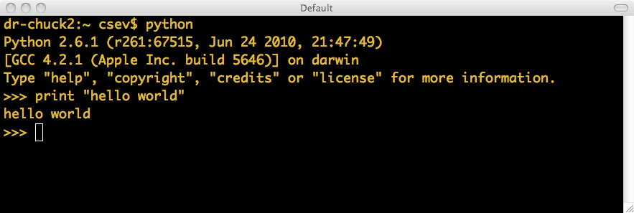
The Prompt ...

Slide 7
Elements of Python
Vocabulary / Words - Variables and Reserved words (Chapter 2)
Sentence structure - valid syntax patterns (Chapters 3-5)
Story structure - constructing a program for a purpose

Slide 8
Reserved Words
You can not use reserved words as variable names / identifiers
and del for is raise assert elif from lambda
return break else global not try class except
if or while continue exec import
pass yield def ﬁnally in print

Slide 9
Statements
x = 2
x = x + 2
print x
Assignment Statement
Assignment with expression
Print statement
Variable
Operator
Constant
Reserved Word

Slide 10
Python Scripts
Interactive Python is good for experiments and programs of 3-4 lines long
But most programs are much longer so we type them into a file and tell python to run the commands in the file.
In a sense we are “giving Python a script”
As convention, we add “.py” as the suffix on the end of these files to indicate they contain Python

Slide 11
Interactive vs. Script
Interactive
  - You type directly to Python one line at a time and it responds
Script
  - You enter a sequence of statements (lines) into a file using a text editor and tell Python to execute the statements in the file

Slide 12
Program Steps and Program Flow
Like a recipe or installation instructions, a program is a sequence of steps to be done in sequence
Some steps are conditional
Sometimes a step or group of steps are to be repeated
Sometimes we store a set of steps to be used over and over as needed several places throughout the program

Slide 13
Sequential Steps
x = 1
x = 1
print x
x = x + 1
print x
print x
x = x + 1
print x
When a program is running, it flows from one step to the next. We as programmers set up “paths” for the program to follow.
Chapter 2

Slide 14
Conditional Steps
x = 5
X < 10 ?
Yes
print 'Smaller'
X > 20 ?
Yes
print 'Bigger'
print 'Finis'
Chapter 3

Slide 15
Repeated Steps
n = 5
No
n > 0 ?
Yes
Program:
n = 5
while n > 0 :
print n
n = n – 1
print 'Blastoff!'
print n
n = n -1
print 'Blastoff'
Loops (repeated steps) have iteration variables that change each time through a loop. Often these iteration variables go through a sequence of numbers.
Chapter 5

Slide 16
Stored (and reused) Steps
Program:
def hello():
print 'Hello'
print 'Fun'
hello()
print 'Zip‘
hello()
def
hello():
print 'Hello'
Output:
Hello
Fun
Zip
Hello
Fun
print 'Fun'
hello()
print 'Zip'
hello()
We call these reusable pieces of code “functions”.
Chapter 4

Slide 17
Summary
This is a quick overview of Chapter 1
We will revisit these concepts throughout the course
Focus on the big picture

