Slide 1
J2SE
Introduction

Slide 2
Java’s History
James Gosling and Sun Microsystems
Oak
Java, May 20, 1995, Sun World
HotJava
The first Java-enabled Web browser

Slide 3
Java Version History
JDK 1.0 (January 23, 1996)
Codename Oak. Initial release
JDK 1.1 (February 19, 1997)
Major additions included:
An extensive retooling of the AWT event model
Inner classes added to the language
JavaBeans , JDBC , RMI
J2SE 1.2 (December 8, 1998)
Codename Playground. This and subsequent releases through J2SE 5.0 were rebranded retrospectively Java 2 and the version name "J2SE" (Java 2 Platform, Standard Edition) replaced JDK to distinguish the base platform from J2EE (Java 2 Platform, Enterprise Edition) and J2ME (Java 2 Platform, Micro Edition).

Slide 4
Java Version History
J2SE 1.3 (May 8, 2000)
Codename Kestrel.
J2SE 1.4 (February 6, 2002)
Codename Merlin.
J2SE 5.0 (September 30, 2004)
Codename Tiger. Originally numbered 1.5, which is still used as the internal version number. This version was developed under JSR 176.
Tiger added a number of significant new language features:
Generics, Metadata, Auto boxing/un boxing, Enumerations, Varargs, for each loop and etc.

Slide 5
Java Version History
Java SE 6 (December 11, 2006)
Codename Mustang. As of this version, Sun replaced the name "J2SE" with Java SE and dropped the ".0" from the version number. Internal numbering for developers remains 1.6.0. This version was developed under JSR 270.
Java SE 7
Java 7 (codename Dolphin) is an upcoming major update to Java.. The Dolphin Project began in August 2006 and is tentatively scheduled for release in late 2010.

Slide 6
JDK Versions
JDK 1.02 (1995)
JDK 1.1 (1996)
JDK 1.2 (1998)
JDK 1.3 (2000)
JDK 1.4 (2002)
JDK 1.5 (2004) a. k. a. JDK 5 or Java 5
JDK 1.6 (2006) a. k. a. JDK 6 or Java 6

Slide 7
JDK Editions (Previously)
Java Standard Edition (J2SE)
J2SE can be used to develop client-side standalone applications or applets.
Java Enterprise Edition (J2EE)
J2EE can be used to develop server-side applications such as Java servlets and Java ServerPages.
Java Micro Edition (J2ME).
J2ME can be used to develop applications for mobile devices such as cell phones.

Slide 8
JDK Editions (Current – From v1.5 onwards)
Java Standard Edition (JSE)
JSE can be used to develop client-side standalone applications or applets.
Java Enterprise Edition (JEE)
JEE can be used to develop server-side applications such as Java servlets and Java ServerPages.
Java Micro Edition (JME).
JME can be used to develop applications for mobile devices such as cell phones.

Slide 9
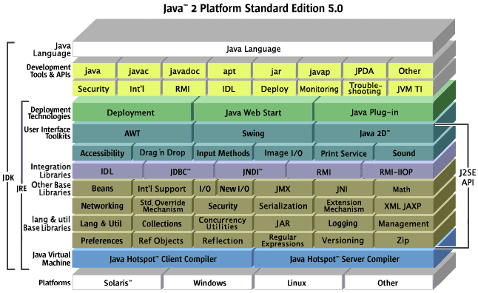
Java 2 Platform

Slide 10
Characteristics of Java (Buzzwords)
Java Is Simple
Java Is Object-Oriented
Java Is Distributed
Java Is Interpreted
Java Is Robust
Java Is Secure
Java Is Architecture-Neutral
Java Is Portable
Java's Performance
Java Is Multithreaded
Java Is Dynamic

Slide 11
Characteristics of Java (Buzzwords)
Java Is Simple
Java Is Object-Oriented
Java Is Distributed
Java Is Interpreted
Java Is Robust
Java Is Secure
Java Is Architecture-Neutral
Java Is Portable
Java's Performance
Java Is Multithreaded
Java Is Dynamic
Java is partially modeled on C++, but greatly simplified and improved. Some people refer to Java as "C++--" because it is like C++ but with more functionality and fewer negative aspects.

Slide 12
Characteristics of Java (Buzzwords)
Java is inherently object-oriented. Although many object-oriented languages began strictly as procedural languages, Java was designed from the start to be object-oriented. Object-oriented programming (OOP) is a popular programming approach that is replacing traditional procedural programming techniques.
One of the central issues in software development is how to reuse code. Object-oriented programming provides great flexibility, modularity, clarity, and reusability through encapsulation, inheritance, and polymorphism.
Java Is Simple
Java Is Object-Oriented
Java Is Distributed
Java Is Interpreted
Java Is Robust
Java Is Secure
Java Is Architecture-Neutral
Java Is Portable
Java's Performance
Java Is Multithreaded
Java Is Dynamic

Slide 13
Characteristics of Java (Buzzwords)
Distributed computing involves several computers working together on a network. Java is designed to make distributed computing easy. Since networking capability is inherently integrated into Java, writing network programs is like sending and receiving data to and from a file.
Java Is Simple
Java Is Object-Oriented
Java Is Distributed
Java Is Interpreted
Java Is Robust
Java Is Secure
Java Is Architecture-Neutral
Java Is Portable
Java's Performance
Java Is Multithreaded
Java Is Dynamic

Slide 14
Characteristics of Java (Buzzwords)
You need an interpreter to run Java programs. The programs are compiled into the Java Virtual Machine code called bytecode. The bytecode is machine-independent and can run on any machine that has a Java interpreter, which is part of the Java Virtual Machine (JVM).
Java Is Simple
Java Is Object-Oriented
Java Is Distributed
Java Is Interpreted
Java Is Robust
Java Is Secure
Java Is Architecture-Neutral
Java Is Portable
Java's Performance
Java Is Multithreaded
Java Is Dynamic

Slide 15
Characteristics of Java (Buzzwords)
Java Is Simple
Java Is Object-Oriented
Java Is Distributed
Java Is Interpreted
Java Is Robust
Java Is Secure
Java Is Architecture-Neutral
Java Is Portable
Java's Performance
Java Is Multithreaded
Java Is Dynamic
Java compilers can detect many problems that would first show up at execution time in other languages.
Java has eliminated certain types of error-prone programming constructs found in other languages.
Java has a runtime exception-handling feature to provide programming support for robustness.

Slide 16
Characteristics of Java (Buzzwords)
Java Is Simple
Java Is Object-Oriented
Java Is Distributed
Java Is Interpreted
Java Is Robust
Java Is Secure
Java Is Architecture-Neutral
Java Is Portable
Java's Performance
Java Is Multithreaded
Java Is Dynamic
Java implements several security mechanisms to protect your system against harm caused by stray programs.

Slide 17
Characteristics of Java (Buzzwords)
Java Is Simple
Java Is Object-Oriented
Java Is Distributed
Java Is Interpreted
Java Is Robust
Java Is Secure
Java Is Architecture-Neutral
Java Is Portable
Java's Performance
Java Is Multithreaded
Java Is Dynamic
Write once, run anywhere
With a Java Virtual Machine (JVM), you can write one program that will run on any platform.

Slide 18
Characteristics of Java (Buzzwords)
Java Is Simple
Java Is Object-Oriented
Java Is Distributed
Java Is Interpreted
Java Is Robust
Java Is Secure
Java Is Architecture-Neutral
Java Is Portable
Java's Performance
Java Is Multithreaded
Java Is Dynamic
Because Java is architecture neutral, Java programs are portable. They can be run on any platform without being recompiled.

Slide 19
Characteristics of Java (Buzzwords)
Java Is Simple
Java Is Object-Oriented
Java Is Distributed
Java Is Interpreted
Java Is Robust
Java Is Secure
Java Is Architecture-Neutral
Java Is Portable
Java's Performance
Java Is Multithreaded
Java Is Dynamic
Java’s performance Because Java is architecture neutral, Java programs are portable. They can be run on any platform without being recompiled.

Slide 20
Characteristics of Java (Buzzwords)
Java Is Simple
Java Is Object-Oriented
Java Is Distributed
Java Is Interpreted
Java Is Robust
Java Is Secure
Java Is Architecture-Neutral
Java Is Portable
Java's Performance
Java Is Multithreaded
Java Is Dynamic
Multithread programming is smoothly integrated in Java, whereas in other languages you have to call procedures specific to the operating system to enable multithreading.

Slide 21
Characteristics of Java (Buzzwords)
Java Is Simple
Java Is Object-Oriented
Java Is Distributed
Java Is Interpreted
Java Is Robust
Java Is Secure
Java Is Architecture-Neutral
Java Is Portable
Java's Performance
Java Is Multithreaded
Java Is Dynamic
Java was designed to adapt to an evolving environment. New code can be loaded on the fly without recompilation. There is no need for developers to create, and for users to install, major new software versions. New features can be incorporated transparently as needed.

Slide 22
Popular Java IDEs
NetBeans Open Source by Sun
Eclipse Open Source by IBM
Borland JBuilder 2007 (Based on Eclipse)
Oracle JDeveloper
IBM Rational Application Developer (RAD)

Slide 23
A Simple Java Program
//This program prints Welcome to Java!
public class Welcome {
public static void main(String[] args) {
System.out.println("Welcome to Java!");
}
}

Slide 24

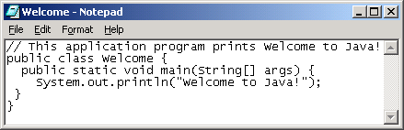
Creating and Editing Using NotePad
To use notepad, type
notepad Welcome.java
from the DOS prompt.

Slide 25

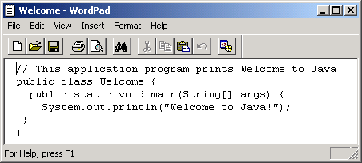
Creating and Editing Using WordPad
To use WordPad, type
write Welcome.java
from the DOS prompt.

Slide 26
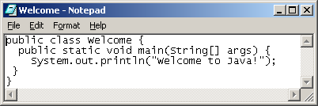
Creating, Compiling, and Running Programs

Slide 27
Trace a Program Execution
Enter main method
//This program prints Welcome to Java!
public class Welcome {
public static void main(String[] args) {
System.out.println("Welcome to Java!");
}
}

Slide 28
Trace a Program Execution
Execute statement
//This program prints Welcome to Java!
public class Welcome {
public static void main(String[] args) {
System.out.println("Welcome to Java!");
}
}

Slide 29
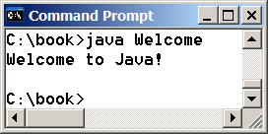
Trace a Program Execution
//This program prints Welcome to Java!
public class Welcome {
public static void main(String[] args) {
System.out.println("Welcome to Java!");
}
}
print a message to the console

Slide 30
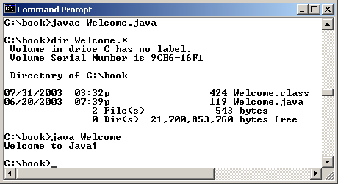
Compiling & Running from Command Window
Set path to JDK bin directory
set path=c:\Program Files\java\jdk1.6.0\bin
Set classpath to include the current directory
set classpath=.
Compile
javac Welcome.java
Run
java Welcome

Slide 31
Compiling and Running Java from Textpad

Slide 32
Anatomy of a Java Program
Comments
Package
Reserved words
Modifiers
Statements
Blocks
Classes
Methods
The main method

Slide 33
Comments
3 types of comments in Java.
- Line comment: A line comment is preceded by two slashes (//) in a line.
- Paragraph / Multi-line comment: A paragraph comment is enclosed between /* and */ in one or multiple lines.
- javadoc comment: javadoc comments begin with /** and end with */. They are used for documenting classes, data, and methods. They can be extracted into an HTML file using JDK's javadoc command.

Slide 34
Package
The second line in the program (package chapter1;) specifies a package name, chapter1, for the class Welcome.
Eg:
package chapter1;
Public Class Welcome{
}

Slide 35
Reserved Words
Reserved words or keywords are words that have a specific meaning to the compiler and cannot be used for other purposes in the program.
For example, when the compiler sees the word class, it understands that the word after class is the name for the class.
Other reserved words are public, static, and void.

Slide 36
Modifiers
Java uses certain reserved words called modifiers that specify the properties of the data, methods, and classes and how they can be used.
Examples of modifiers are public and static. Other modifiers are private, final, abstract, and protected.

Slide 37
Statements
A statement represents an action or a sequence of actions.
The statement System.out.println("Welcome to Java!") in the program in is a statement to display the greeting "Welcome to Java!"
Every statement in Java ends with a semicolon (;).

Slide 38
Blocks
A pair of braces in a program forms a block that groups components of a program.

Slide 39
Classes
The class is the essential Java construct.
A class is a template or blueprint for objects.
To program in Java, you must understand classes and be able to write and use them.

Slide 40
Methods
What is System.out.println? It is a method:
a collection of statements that performs a sequence of operations to display a message on the console.
It can be used even without fully understanding the details of how it works.
It is used by invoking a statement with a string argument. The string argument is enclosed within parentheses. In this case, the argument is "Welcome to Java!"
You can call the same println method with a different argument to print a different message.

Slide 41
main Method
The main method provides the control of program flow. The Java interpreter executes the application by invoking the main method.
The main method looks like this:
public static void main(String[] args) {
// Statements;
}

Slide 42
Java Runtime Environment
Java Runtime Environment includes a large number of development tools and hundreds of classes and methods.
The development tools are part of the system known as Java Development Kit (JDK).
Classes and methods are part of the Java Standard Library (JSL), also known as the Application programming interface (API).
Notes:
Java changed the very face of the Internet from being a mechanism to deliver static HTML pages to a platform that could host the execution of dynamic self-executing programs. Applets are the dynamic self-executing programs that Java made possible. An applet is actually a tiny Java program, dynamically downloaded across the Internet, and executed by a Java-compatible Web browser on the client. An applet is an intelligent program, not just an animation or a media file. It can react to user input, and dynamically change the content of Web pages in which they are embedded.

Slide 43
Java Development Kit - JDK
The Java Development Kit comes with collection of tools that are used for developing and running java programs.
Javac - Java compiler.
Java - Java interpreter.
Javap - Java disassembler
Enables us to convert byte code files into a program description.
Javah - Creates Header files.
Produces header files for use with native methods.
Javadoc - Creates HTML document.
Creates HTML format documentation from java source code files.
Jdb - Java debugger
Appletviewer - To run java applets.

Slide 44
Process of Building & Running Java Programs
Text Editor
Java Source Code
javadoc
HTML Files
Javac
Java Class File
Javah
Header Files
Java
Jdb
Java Program output

Slide 45
The Java API
The Java API files provide a Java program with a
Standard
Platform-independent interface to the underlying host
The internal design of the Java API is also geared toward platform independence
Notes:
For example, the GUI library of the Java API, Swing, is designed to facilitate user interfaces that look and work similarly on all platforms.

Slide 46
The Java Architecture
Bytecode is the key to both security & portability
Write source code.
Compile to bytecode contained in .class files
Bytecode is a highly optimized set of instructions
Bytecode executed by the Java Virtual Machine (JVM)
The JVM is an interpreter for bytecode.
Notes:
The key that allows Java to solve both the security and the portability problems is that the output of a Java compiler is not executable code. Rather, it is bytecode. You express the program in source files written in the Java programming language, compile the source to Java class files (bytecode), and run the class files on a Java virtual machine. Bytecode is a highly optimized set of instructions designed to be executed by the Java runtime system, which is called the Java Virtual Machine (JVM). In its standard form, the JVM is an interpreter for bytecode.

Slide 47
The Java Architecture
Source Code
Bytecode
JVM
Operating System
Hardware
Notes:
A Java virtual machine's main job is to load class files and execute the byte codes they contain. Only those class files from the Java API that are actually needed by a running program are loaded into the virtual machine. The byte codes are executed in an execution engine, which is one part of the Java Virtual Machine.

Slide 48
The Java Architecture – The JVM
Program Class Files
Class Loader
Java API classes
Execution Engine

Slide 49
The Java Architecture – The JVM
Most modern languages are designed to be compiled
Compilation is a one-time exercise and executes faster
Execution of compiled code over the Internet an impossibility
Executable code always generated to a CPU-OS combination
Interpreting a Java program into byte code facilitates its execution in a wide variety of environments
Notes:
Most modern languages are designed to be compiled, not interpreted, mostly out of performance concerns. However, the fact that a Java program is executed by the JVM helps solve the major problems associated with downloading programs over the Internet.

Slide 50
The Java Architecture – The JVM
Only the Java Virtual Machine (JVM) needs to be implemented for each platform
The JVM will differ from platform to platform, and is, platform-specific
All versions of JVM interpret the same Java byte code.
Interpreted code runs much slower compared to executable code
The use of byte code enables the Java runtime system to execute programs much faster
Java facilitates on-the-fly compilation of byte code into native code
Notes:
If a Java program were compiled to native code, then different versions of the same program would have to exist for each type of CPU and operating system connected to the Internet, which is not a feasible solution. Thus, the implementation of bytecode is the easiest way to create truly portable programs. Interpreted Java code also helps to make it secure. Since the execution of a Java program is under the control of the JVM, the JVM can control the program, and prevent it from generating side effects outside of it.
This makes it ideal for applets to be downloaded from across the Internet, and executed on any CPU and Operating System that has the corresponding JVM implementation.

