Slide 1
J2EE
Overview

Slide 2
Presentation Overview
Introduction to J2EE
Explain the major technologies within J2EE
J2EE applications
J2EE servers

Slide 3
The Java 2 Platform
Platform introduced June, 1999
J2SE – Java 2 Standard Edition
Java for the desktop / workstation
J2ME – Java 2 Micro Edition
Java for the consumer device
J2EE - Java 2 Enterprise Edition
Java for the server
Notes:
J2SE 1.4 just shipped in February!

Slide 4
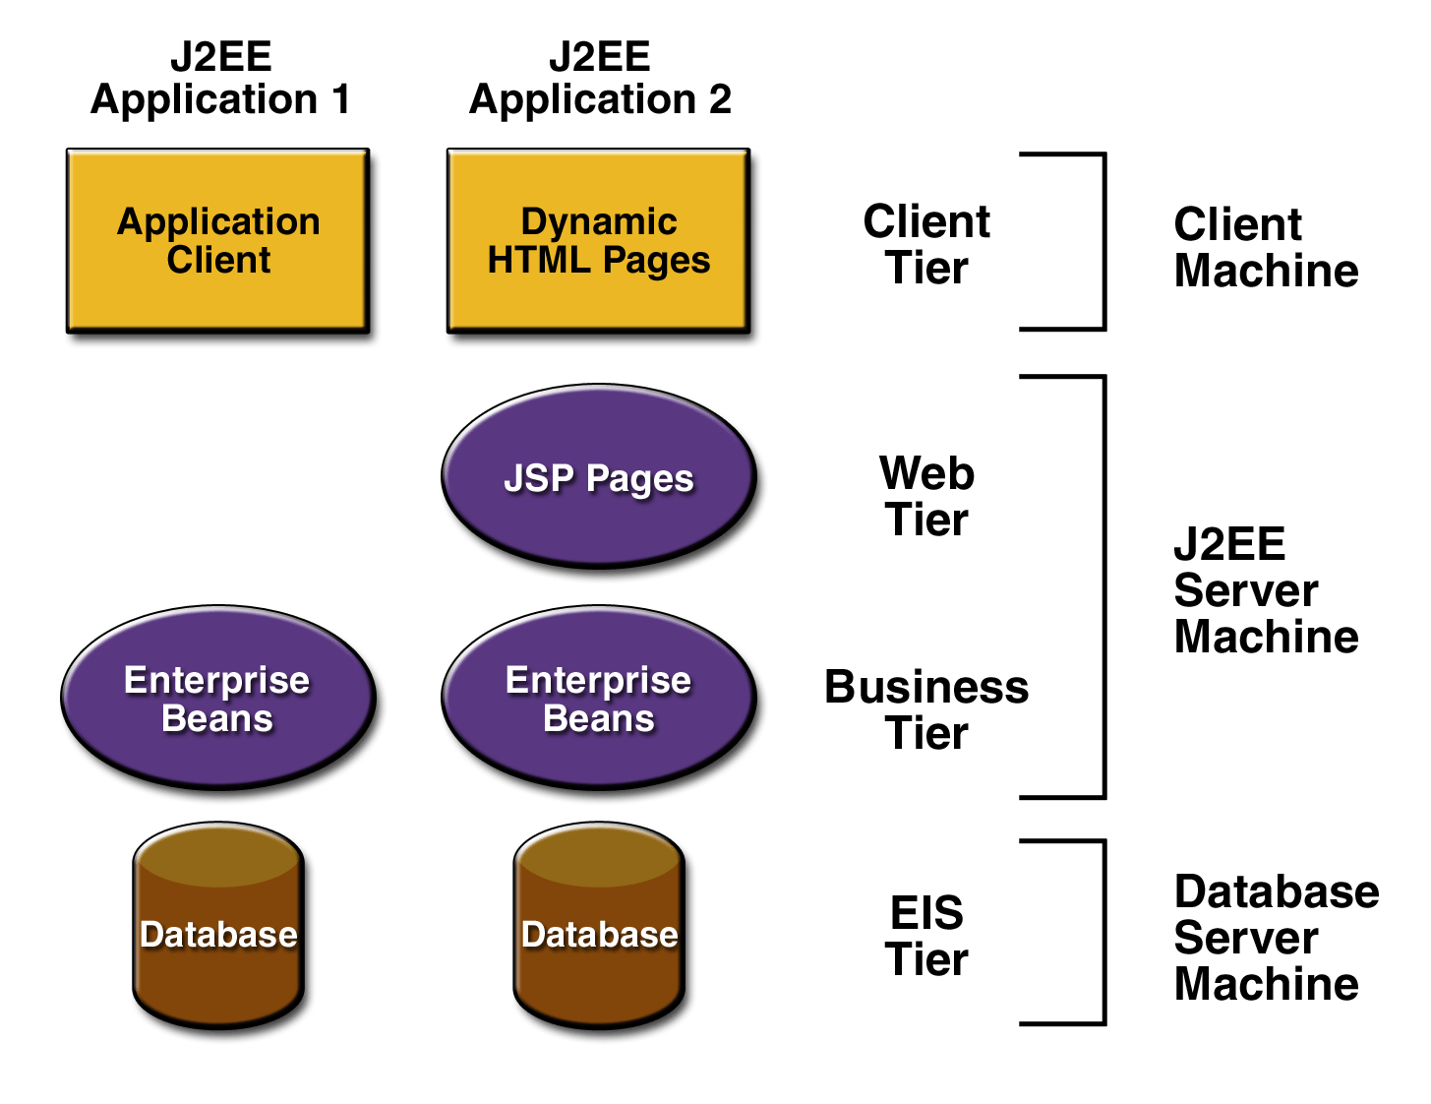
J2EE Architecture
J2EE multi-tiered applications are generally considered to be three-tiered applications because they are distributed over three different locations
client machines
the J2EE server machine
the database or legacy machines at the back end

Slide 5
J2EE Architecture
Three-tiered applications that run in this way extend the standard two-tiered client and server model by placing a multithreaded application server between the client application and back-end storage

Slide 6
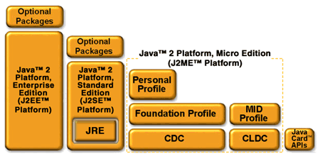
The Java 2 Platform

Slide 7
J2EE Technologies
Java Servlets
JSP
EJB
JMS
JDBC
JNDI
JTA / JTS
JavaMail
JAAS
XML
…
Notes:
Alphabet soup

Slide 8
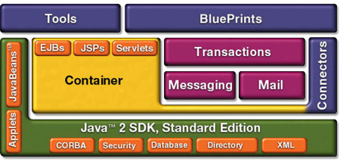
J2EE Components
Notes:
Java 2 Standard, is the foundation – J2EE is built on top, then there are tools & blueprints to help
Blueprint – “Guides, patterns and code for end-to-end Java applications”

Slide 9
Java Servlets
Servlets are the Java platform technology of choice for extending and enhancing web servers.
Servlets provide a component-based, platform-independent method for building web-based applications, without the performance limitations of CGI programs.
Notes:
Dynamic web pages – Parallel MS technology is Active Server Pages

Slide 10
Java Servlets
Servlets have access to the entire family of Java APIs, including the JDBCTM API to access enterprise databases.
Servlets can also access a library of HTTP-specific calls and receive all the benefits of the mature Java language, including portability, performance, reusability, and crash protection
Notes:
THEY ARE JAVA CLASSES! If you can do in a java class, you can do in a servlet – including inheritance

Slide 11
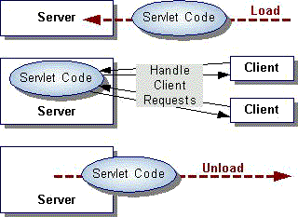
Anatomy of a Servlet
init() – the init() function is called when the servlet is initialized by the server. This often happens on the first doGet() or doPut() call of the servlet.
destroy() – this function is called when the servlet is being destroyed by the server, typically when the server process is being stopped.
Notes:
Init is a good place to create an inner class if the servlet is a wrapper. Init only happens ONCE, not for each call, session or client

Slide 12
Anatomy of a Servlet
doGet() – the doGet() function is called when the servlet is called via an HTTP GET.
doPost() – the doPost() function is called when the servlet is called via an HTTP POST.
POSTs are a good way to get input from HTML forms
Notes:
Get – Querystring – method is called once per client HTTP GET
Post – Form data - method is called once per client HTTP POST

Slide 13
Anatomy of a Servlet
HTTPServletRequest object
Information about an HTTP request
Headers
Query String
Session
Cookies
HTTPServletResponse object
Used for formatting an HTTP response
Headers
Status codes
Cookies

Slide 14
JSP – JavaServer Pages
JavaServer Pages technology uses XML-like tags and scriptlets written in the Java programming language to encapsulate the logic that generates the content for the page.
Any and all formatting (HTML or XML) tags are passed directly back to the response page.
By separating the page logic from its design and display and supporting a reusable component-based design, JSP technology makes it faster and easier than ever to build web-based applications.
Notes:
Very much like ASP – mix of HTML and code
Server actually compiles these down to actual servlets on the first call!
Taglibs

Slide 15
Sample JSP
<html>
<!- Apache Tomcat Samples ->
<!-- Copyright (c) 1999 The Apache Software Foundation. All rights reserved.-->
<body bgcolor="white">
<jsp:useBean id='clock' scope='page' class='dates.JspCalendar' type="dates.JspCalendar" />
<font size=4><ul>
<li> Day of month: is <jsp:getProperty name="clock" property="dayOfMonth"/>
<li> Year: is <jsp:getProperty name="clock" property="year"/>
<li> Month: is <jsp:getProperty name="clock" property="month"/>
<li> Time: is <jsp:getProperty name="clock" property="time"/>
<li> Date: is <jsp:getProperty name="clock" property="date"/>
<li> Day: is <jsp:getProperty name="clock" property="day"/>
<li> Day Of Year: is <jsp:getProperty name="clock" property="dayOfYear"/>
<li> Week Of Year: is <jsp:getProperty name="clock" property="weekOfYear"/>
<li> era: is <jsp:getProperty name="clock" property="era"/>
<li> DST Offset: is <jsp:getProperty name="clock" property="DSTOffset"/>
<li> Zone Offset: is <jsp:getProperty name="clock" property="zoneOffset"/>
</ul>
</font>
</body>
</html>

Slide 16
EJB – Enterprise Java Beans
Enterprise JavaBeansTM is the server-side component architecture for the J2EETM platform.
EJBTM enables rapid and simplified development of distributed, transactional, secure and portable Java applications.

Slide 17
EJB – Enterprise Java Beans
Enterprise Java Beans are components that are deployed into containers
The container provides services
Loading / Initialization
Transactions
Persistence
Communication with EJB clients
Enterprise Naming Context (JNDI name space)
Notes:
Slide 6 has container picture

Slide 18
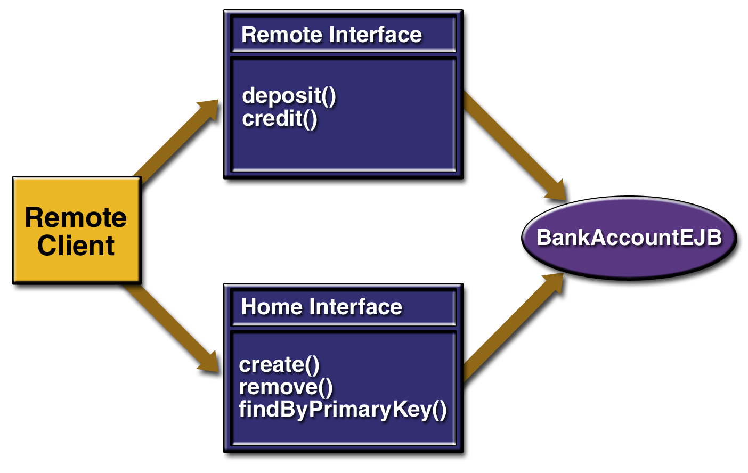
Client / EJB Relationship
How does a client application (Java class) utilize EJBs?
Lookup - JNDI ENC
Network protocol - RMI
EJB container creates object with RemoteHome and Home interfaces – this object passes calls to the bean class

Slide 19
EJB – Enterprise Java Beans
Session Beans
Entity Beans
Message Beans

Slide 20
EJB – Entity Beans
Entity beans are classes that map to individual entities – typically, an Entity bean references a row in a database table, providing an object representation of that database object.
For example, an entity bean could represent a customer, and changing the values in that entity bean would cause updates to that database row
Entity beans provide an abstraction layer so that working with the entity is not specific to the storage mechanism for that entity.

Slide 21
JMS – Java Message Service
Enterprise messaging provides a reliable, flexible service for the asynchronous exchange of critical business data and events throughout an enterprise.
The JMS API adds to this a common API and provider framework that enables the development of portable, message based applications in the Java programming language.
Notes:
But JMS can allow you to talk to non-java clients / servers!

Slide 22
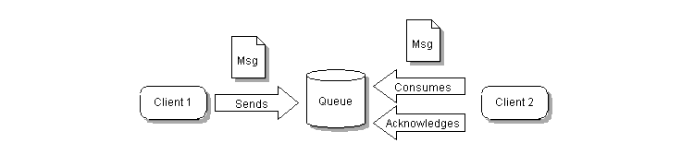
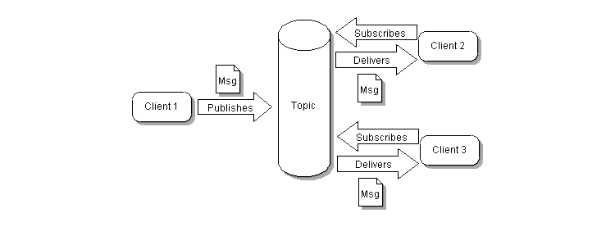
JMS – Java Message Service
JMS Queue
JMS Topic

Slide 23
JMS – Java Message Service
The JMS API in the J2EE 1.5 platform has the following new features:
A new kind of enterprise bean, the message-driven bean, enables the asynchronous consumption of messages.
Message sends and receives can participate in Java Transaction API (JTA) transactions.

Slide 24
JMS – Java Message Service
Why should I use JMS?
Loosely-coupled systems
Connectionless
Removes dependence on client and server platform / programming language / version
Publish / Subscribe metaphor
Send / receive information with many, unknown clients
Integration with other messaging systems
IBM MQ-Series
Microsoft Message Queue
Notes:
Active-jms activex control for JMS on sourceforge

Slide 25
JDBC – Data Access API
JDBCTM technology is an API that lets you access virtually any tabular data source from the JavaTM programming language.
Cross-DBMS connectivity to a wide range of SQL databases
Access to other tabular data sources, such as spreadsheets or flat files.

Slide 26
JNDI – Java Naming and Directory Interface
JNDI is an API specified in Java^{tm} that provides naming and directory functionality to applications written in Java. It is designed especially for Java by using Java's object model.
Using JNDI, Java applications can store and retrieve named Java objects of any type.
JNDI provides methods for performing standard directory operations, such as associating attributes with objects and searching for objects using their attributes.
JNDI allows Java applications to take advantage of information in a variety of existing naming and directory services, such as LDAP, NDS, DNS, and NIS(YP), and allows Java applications to coexist with legacy applications and systems.

Slide 27
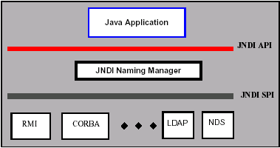
JNDI - Layers

Slide 28
JNDI – Common Uses
JNDI ENC – “enterprise naming context”
EJB lookup within a J2EE app server
LDAP integration
Dynamic registration of services and clients
Peer to Peer computing

Slide 29
JTA / JTS – Transactions
The Java Transaction API (JTA) and the Java Transaction Service (JTS) allow J2EE application servers to take the burden of transaction management off of the component developer.
Developers can define the transactional properties of Enterprise JavaBeansTM technology based components during design or deployment using declarative statements in the deployment descriptor.
The application server takes over the transaction management responsibilities.

Slide 30
JavaMail
The JavaMailTM 1.2 API provides a set of abstract classes that model a mail system.
The API provides a platform independent and protocol independent framework to build Java technology-based mail and messaging applications.
J2EE contains JAF – JavaBeans Activation Framework since it is required by JavaMail
Supports common mail protocols
IMAP
POP
SMTP
MIME

Slide 31
JAAS – Java Authentication and Authorization Service
Authentication of users, to reliably and securely determine who is currently executing Java code, regardless of whether the code is running as an application, an applet, a bean, or a servlet; and
Authorization of users to ensure they have the access control rights (permissions) required to do the actions performed.
Sample authentication modules using:
JavaTM Naming and Directory Interface (JNDI)
Unix Operating Environment
Windows NT
Kerberos
Keystore

Slide 32
XML
J2EE 1.3 includes JAXP 1.1 support, as well as Servlet Filters and XML JSPTM documents.
The JavaTM API for XML Processing ("JAXP") supports processing of XML documents using DOM, SAX, and XSLT.
The portability and extensibility of both XML and Java make them the ideal choice for the flexibility and wide availability requirements of this new web.

Slide 33
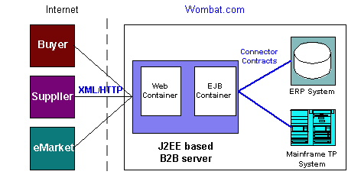
J2EE Connectors
The J2EE Connector architecture defines a standard architecture for connecting the J2EE platform to heterogeneous EISs (Enterprise Information Systems).
Examples of EISs include ERP, mainframe transaction processing, database systems, and legacy applications not written in the Java programming language.

Slide 34
J2EE Applications

Slide 35
J2EE Deployment
JAR – Java ARchive
Java class file
EJBs
WAR - Web ARchive
Servlets
JSPs
EAR - Enterprise ARchive
Contains other JARs and WARs to form an entire application
Deployment descriptors
XML
Required for EJB JARs, WARs, EARs

Slide 36






J2EE Servers
Application Server
As of Sept ’01 - MetaGroup Survey by sales $$
BEA Weblogic - 37%
IBM Websphere – 22%
Oracle – 11%
Iplanet – 5%
Other- 12%
Open-source
Jboss – www.jboss.org

Slide 37
J2EE Servers
Servlet / JSP Servers
Most of the commercial application servers also include servlet / JSP support
Open-Source
Apache Tomcat
Jetty
Sun’s listing of servlet / JSP servers -

Slide 38
J2EE Development Tools
Major IDEs support J2EE in some form
Wizards for EJB / Servlets
Custom editors for JSP
Deployment descriptor support
Deployment support for application servers
Embedded servers for testing within IDE

Slide 39
Learning more…
Enterprise JavaBeans – 3rd Edition
Richard Monson-Haefel
O’Reilly © 2001
JBoss documentation
http://www.jboss.org/online-manual/HTML/index.html
Designing Enterprise Applications with the Java 2 Platform, Enterprise Edition
Nicholas Kassem and the Enterprise Team
Addison Wesley © 2000
Core Servlets and JavaServer Pages (JSP)
Marty Hall
Prentice Hall © 2000

