Slide 1
Angular JS

Slide 2
AngularJS History
AngularJS version 1.0 was released in 2012.
Miško Hevery, a Google employee, started to work with AngularJS in 2009.
The idea turned out very well, and the project is now officially supported by Google.

Slide 3
Prerequisites
Before you learn AngularJS, you should have a basic understanding of:
HTML
CSS
JavaScript

Slide 4
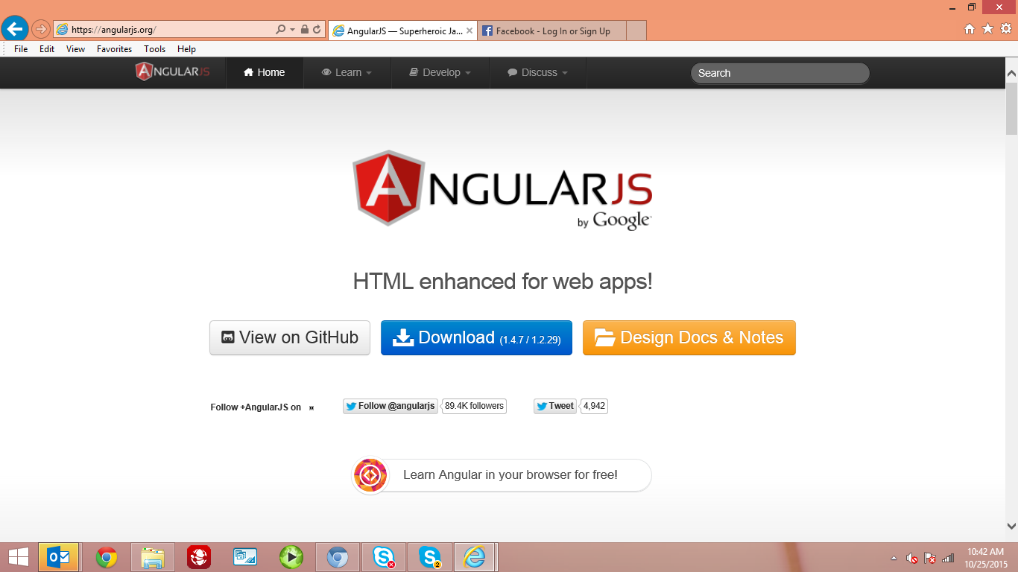
Angular JS library
AngularJS is a JavaScript framework.
It is a library written in JavaScript.
AngularJS is distributed as a JavaScript file, and can be added with a script tag:
<script src="http://ajax.googleapis.com/ajax/libs/angularjs/1.3.14/angular.min.js"></script>

Slide 5
Activity
First example
<!DOCTYPE html> <html lang="en-US"> <script src="http://ajax.googleapis.com/ajax/libs/angularjs/1.3.14/angular.min.js">
</script> <body> <div ng-app=""> <p>Name : <input type="text" ng-model="name"></p> <h1>Hello {{name}}</h1> </div> </body> </html>

Slide 6
Features
Filters
Directives
Scope
DataBinding
Validators
Services
angularJS
Providers
Factories
Dependency Injection
Expressions
Modules
Controllers

Slide 7
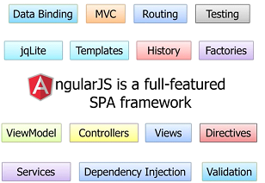
Angular JS SPA Framework

Slide 8
AngularJS general features
The most important general features of AngularJS are:
AngularJS is a MVC framework that can create Rich Internet Applications (RIA).
AngularJS enables to write client side applications using JavaScript in a clean Model View Controller (MVC) way.
Applications written in AngularJS support cross-browser .
AngularJS is open source, completely free, and used by thousands of developers around the world.
AngularJS is a framework to build large scale, high performance, and easy to-maintain web applications

Slide 9
Core features
The most important core features of AngularJS are:
Data-binding: It is the synchronization of data between model and view components.
Scope: These are objects that refer to the model. glue between controller and view.
Controller: These are JavaScript functions bound to a particular scope.
Services: AngularJS comes with several built-in services such as $http to make a XMLHttpRequests.
Filters: These select a subset of items from an array and returns a new array.
Directives: Directives are markers on DOM elements such as elements, attributes, css, and more. These can be used to create custom HTML tags that serve as new, custom widgets. AngularJS has built-in directives such as ngBind, ngModel etc.
Templates:These are the rendered view with information from the controller and model. These can be a single file (such as index.html) or multiple views in one page using partials.
Routing: It is concept of switching views.

Slide 10
Core features
Model View Whatever: MVW is a design pattern for dividing an application into different parts called Model, View, and Controller, each with distinct responsibilities. AngularJS does not implement MVC in the traditional sense, but rather something closer to MVVM (Model-View-ViewModel).
The Angular JS team refers it humorously as Model View Whatever.
Deep Linking: Deep linking allows you to encode the state of application in the URL so that it can be bookmarked. The application can then be restored from the URL to the same state.
Dependency Injection: AngularJS has a built-in dependency injection subsystem that helps the developer to create,understand, and test the applications easily.

Slide 11
AngularJS Directives
AngularJS extends HTML with ng-directives.
The ng-app directive defines and intialize an AngularJS application.
The ng-model directive binds the value of HTML controls (input, select, textarea) to application data.
The ng-bind directive binds application data to the HTML view.
The ng-init directive initializes application data.
The ng-repeat directive used to repeat HTML element like array of objects:
The ng-controller directive defines the application controller.

Slide 12
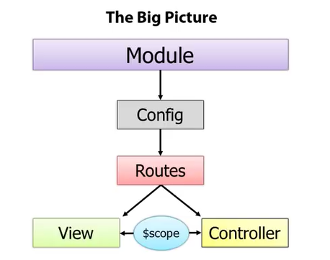
Angular JS

Slide 13
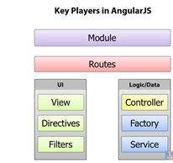
Angular JS Key players

Slide 14
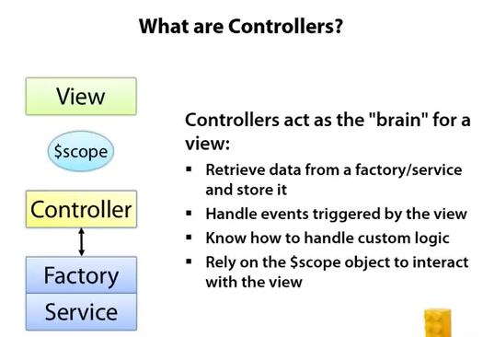
Angular JS

Slide 15
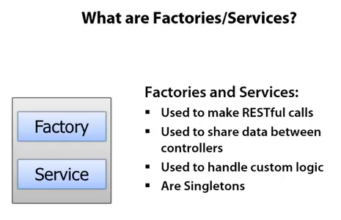
Angular JS Factories/Services

Slide 16
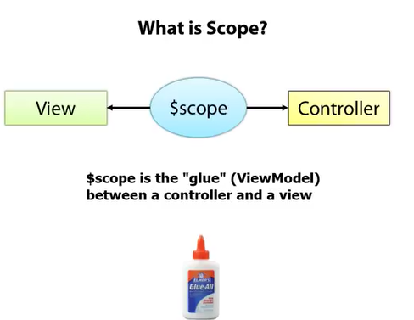
Angular JS $scope

Slide 17
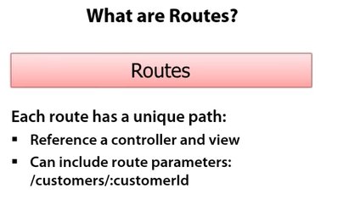
Angular JS route

Slide 18
Advantages
AngularJS creates Single Page Application in a very clean and maintainable way.
AngularJS provides data binding capability to HTML with a rich and responsive experience.
AngularJS code is unit testable.
AngularJS uses dependency injection and make use of separation of concerns.
AngularJS provides reusable components.
With AngularJS, the developers can achieve more functionality with short code.
In AngularJS, views are pure html pages, and controllers written in JavaScript
AngularJS applications can run on all major browsers and smart phones, including Android and iOS based phones/tablets.

Slide 19
Disadvantages
Not Secure : Being JavaScript only framework, application written in AngularJS are not safe. Server side authentication and authorization is must to keep an application secure.
Not degradable: If the user of your application disables JavaScript, then nothing would be visible, except the basic page.

Slide 20
Angular JS Directives
ng-app : This directive defines and links an AngularJS application to HTML.
ng-model : This directive binds the values of AngularJS application data to HTML input controls.
ng-bind : This directive binds the AngularJS application data to HTML tags.

Slide 21
Angular JS Directives
Steps to set up AngularJS library to use in web application development. It also briefly describes the directory structure and its contents.
When you open the link https://angularjs.org/, you will see there are two options to download AngularJS library:
View on GitHub- By clicking on this button, you are diverted to GitHub and get all the latest scripts.
Download- By clicking on this button, a screen you get to see a dialog box shown as:

Slide 22
Activity
<!DOCTYPE html>
<html>
<script src= "http://ajax.googleapis.com/ajax/libs/angularjs/1.3.14/angular.min.js">
</script>
<body>
<div ng-app="">
<p>My first expression: {{ 5 + 5 }}</p>
</div>
</body>
</html>

Slide 23
Activity
<div ng-app="myApp" ng-controller="myCtrl"> First Name: <input type="text" ng-model="firstName"><br> Last Name: <input type="text" ng-model="lastName"><br> <br> Full Name: {{firstName + " " + lastName}} </div> <script> var app = angular.module('myApp', []); app.controller('myCtrl', function($scope) { $scope.firstName= "John"; $scope.lastName= "Doe"; }); </script>

Slide 24
AngularJS Expressions
AngularJS expressions are like : {{ expression }}.
AngularJS expressions binds data to HTML same as ng-bind directive.
AngularJS will display data "output" place where the expression is written.
AngularJS expressions are much like JavaScript expressions:
Expression in Angular JS can contain literals, operators, and variables.
Example {{ 5 + 5 }} or {{ firstName + " " + lastName }}

Slide 25
Expression
<!DOCTYPE html>
<html>
<script src= "http://ajax.googleapis.com/ajax/libs/angularjs/1.3.14/angular.min.js"></script>
<body>
<div ng-app="" ng-init="qty=25;price=15">
<p>Total in Rs.: {{ qty * price }}</p>
</div>
</body>
</html>

Slide 26
Angular JS objects
<!DOCTYPE html>
<html>
<script src= "http://ajax.googleapis.com/ajax/libs/angularjs/1.3.14/angular.min.js"></script>
<body>
<div ng-app="" ng-init="person={firstName:'John',lastName:'Doe'}">
<p>The name is {{ person.lastName }}</p>
<p>The name is <span ng-bind="person.lastName"></span></p>
</div>
</body>
</html>

Slide 27
JavaScript Vs Angular JS Expressions
AngularJS expressions can contain literals, operators, and variables as in Javascript.
Angular JS expressions can be written inside HTML but cannot be in Javascript
AngularJS expressions do not support conditionals, loops, or exceptions but Java script supprts.
AngularJS expressions support filters but not Javascript.

Slide 28
AngularJS variabels as Function names
The example with two properties: lastName and firstName.
A controller can also have methods (variables as functions): fullname()
<div ng-app="myApp" ng-controller="personCtrl"> First Name: <input type="text" ng-model="firstName"><br> Last Name: <input type="text" ng-model="lastName"><br> <br> Full Name: {{fullName()}} </div> <script> var app = angular.module('myApp', []); app.controller('personCtrl', function($scope) { $scope.firstName = "John"; $scope.lastName = "Doe"; $scope.fullName = function() { return $scope.firstName + " " + $scope.lastName; }}); </script> controller can b ewritten external file.
<!--<script src="personController.js"></script>→

Slide 29
Angular JS objects
<!DOCTYPE html>
<html>
<script src= "http://ajax.googleapis.com/ajax/libs/angularjs/1.3.14/angular.min.js"></script>
<body>
<div ng-app="" ng-init="person={firstName:'John',lastName:'Doe'}">
<p>The name is {{ person.lastName }}</p>
<p>The name is <span ng-bind="person.lastName"></span></p>
</div>
</body>
</html>

Slide 30
Thank You
This document contains information that is proprietary and confidential to HCL TalentCare Private Limited and shall not be disclosed outside the recipient's company or duplicated, used or disclosed in whole or in part by the recipient for any purpose other than to evaluate this document. Any other use or disclosure in whole or in part of this information without the express written permission of HCL TalentCare Private Limited is prohibited. Further, this document does not constitute a contract to perform services
The reader should not act upon the information contained in this document without obtaining specific professional advice. No representation or warranty (express or implied) is given as to the accuracy or completeness of the information contained in this presentation, and, to the extent permitted by law; HCL TalentCare Private Limited, its consultants, its members, employees and agents accept no liability, and disclaim all responsibility, for the consequences of reader or anyone else acting, or refraining to act, in reliance on the information contained in this document or for any decision based on it.

