Slide 1
Software Development Life Cycle ( SDLC)
Notes:
Why is it important to follow an SDLC process?
Don't you just get a bunch of really smart software developers in a room and have them write code and
then presto, you have software ready to use?
Kind of like when you pick up your phone in the morning and you look and you see that it's been magically
updated while you were sleeping.
Well, I wish it were that simple, but if you took that approach, you would quickly run into some
important questions that need to be answered and you would need everyone to agree on those answers.

Slide 2
SDLC Introduction
SDLC stands for Software Development Life Cycle.
Simply put, this is the process by which software goes from a need or an idea to a finished fully functioning product.
There are two main software development methodologies and we're going to learn them.
The first is called Waterfall and the second is called Agile.
Note: There are other models such as Spiral, V-Shaped Model, Big Bang etc. which are not widely practised.
Notes:
Why is it important to follow an SDLC process?
Don't you just get a bunch of really smart software developers in a room and have them write code and
then presto, you have software ready to use?
Kind of like when you pick up your phone in the morning and you look and you see that it's been magically
updated while you were sleeping.
Well, I wish it were that simple, but if you took that approach, you would quickly run into some
important questions that need to be answered and you would need everyone to agree on those answers.

Slide 3
SDLC Introduction
Before we look into these methodologies, there are few important questions that need to answered and need everyone involved to agree upon.
What are we building?
﻿﻿Who are we building it for?
﻿﻿How should it behave?
﻿﻿How do we know if it works?
﻿﻿How do we know when we're done?
﻿﻿How much time do we have?
﻿﻿How much can we spend?
Having a structured, repeatable process helps ensure reliability and high quality.
Notes:
And let's take a look at the questions up on screen.
The first is, what are we building?
And you have to be really specific when we talk about what are we building?
Who are we building it for?
And, you know, the question isn't shown here.
But related to that, how will they use it?
How should it behave?
And that also has to be really specific.
How do we know if it works?
How do we know when we're done?
How much time do we have?
And this is really important in the corporate environment when you have multiple software projects happening
at the same time.
And equally important, in a corporate environment, how much money can we spend?
Because again, you have multiple priorities, right?
All competing with each other.
So think of it this way.
Software is a product and building a product, whether it's software, an automobile, a refrigerator,
it's complicated.
To be successful, you need to follow a structured process that is repeatable, facilitates collaboration
within the team and idea generation and emphasizes quality.
When you're building software, the SDLC is that process, regardless of whether we're talking about
waterfall or Agile.
Think of it this way.
Some software performs critical functions in our daily lives.
Think about the software that runs your car, maintains your bank account, or if you're addicted to
coffee like me.
The software that runs your coffee maker.
You want it to run perfectly every time.
Having a structured, repeatable process helps ensure reliability and high quality.

Slide 4
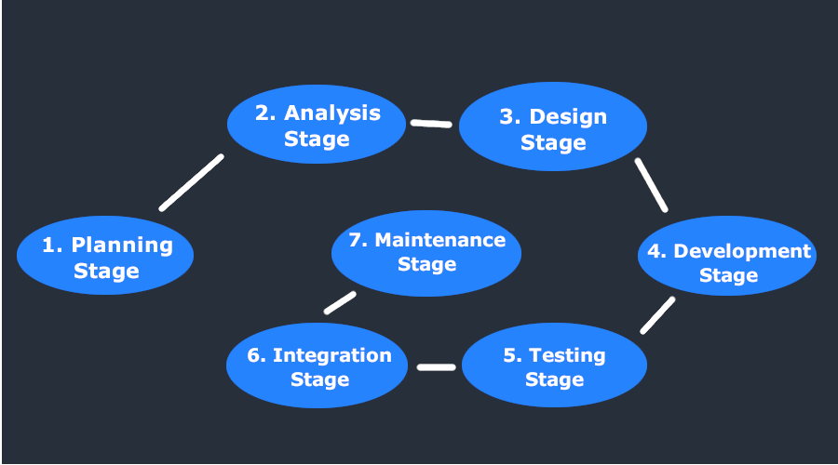
SDLC Stages/Phases

Slide 5
SDLC Phases & Activities
Stage 1: Project Planning
The planning stage (also called the feasibility stage) is exactly what it sounds like: the phase in which developers will plan for the upcoming project.
It helps to define the problem and scope of any existing systems, as well as determine the objectives for their new systems.
By developing an effective outline for the upcoming development cycle, they'll theoretically catch problems before they affect development and help to secure the funding and resources they need to make their plan happen.
Perhaps most importantly, the planning stage sets the project schedule, which can be of key importance if development is for a commercial product that must be sent to market by a certain time.
Notes:
https://www.clouddefense.ai/blog/system-development-life-cycle
Stage 1: Project Planning

Slide 6
SDLC Phases & Activities
Stage 2: Gathering Requirements & Analysis
The analysis stage includes gathering all the specific details required for a new system as well as determining the first ideas for prototypes.
Developers may:
Define any prototype system requirements
Evaluate alternatives to existing prototypes
Perform research and analysis to determine the needs of end-users
Furthermore, developers will often create a software requirement specification or SRS document.
This includes all the specifications for software, hardware, and network requirements for the system they plan to build. This will prevent them from overdrawing funding or resources when working at the same place as other development teams.
Notes:
https://www.clouddefense.ai/blog/system-development-life-cycle
Stage 1: Project Planning

Slide 7
SDLC Phases & Activities
Stage 3: Design
The design stage is a necessary precursor to the main developer stage.
Developers will first outline the details for the overall application, alongside specific aspects, such as its:
User interfaces
System interfaces
Network and network requirements
Databases
They’ll typically turn the SRS document they created into a more logical structure that can later be implemented in a programming language. Operation, training, and maintenance plans will all be drawn up so that developers know what they need to do throughout every stage of the cycle moving forward.
Once complete, development managers will prepare a design document to be referenced throughout the next phases of the SDLC.
Notes:
https://www.clouddefense.ai/blog/system-development-life-cycle
Stage 1: Project Planning

Slide 8
SDLC Phases & Activities
Stage 3: Development Stage
The development stage is the part where developers actually write code and build the application according to the earlier design documents and outlined specifications.
This is where Static Application Security Testing or SAST tools come into play.
Product program code is built per the design document specifications. In theory, all of the prior planning and outlined should make the actual development phase relatively straightforward.
Developers will follow any coding guidelines as defined by the organization and utilize different tools such as compilers, debuggers, and interpreters.
Notes:
https://www.clouddefense.ai/blog/system-development-life-cycle
Stage 1: Project Planning

Slide 9
SDLC Phases & Activities
Static Application Security Testing or SAST
Static application security testing, also known as white-box testing, is a method, or tool, by which you can test code without running it.
Any developer who has worked with an IDE is familiar with the fundamental concept of static application testing. IDEs often alert developers about potential issues such as a section of code not being reachable or a method never being called.
Static application security testing is a subset of those tools that focus on security. Some of the most common issues that can be found using SAST are SQL injection vulnerabilities.
Notes:
https://spectralops.io/blog/top-10-static-application-security-testing-sast-tools-in-2021/
SAST has many benefits. You can integrate these tools into a CI/CD pipeline and alert developers about potential issues early in the development cycle. SAST tools are also very fast, as they do not require compiling or running the code. They simply scan the text for potential concerns and highlight them for developers.
Stage 1: Project Planning

Slide 10
SDLC Phases & Activities
Stage 5: Testing
Once the developers build the software, then it is deployed in the testing environment. Then the testing team tests the functionality of the entire system. In this fifth phase of SDLC, the testing is done to ensure that the entire application works according to the customer requirements.
After testing, the QA and testing team might find some bugs or defects and communicate the same with the developers. The development team then fixes the bugs and send it to QA for a re-test.
Notes:
https://www.clouddefense.ai/blog/system-development-life-cycle
Stage 1: Project Planning

Slide 11
SDLC Phases & Activities
Stage 6: Deployment
After testing, the overall design for the software will come together. Different modules or designs will be integrated into the primary source code through developer efforts, usually by leveraging training environments to detect further errors or defects.
The information system will be integrated into its environment and eventually installed. After passing this stage, the software is theoretically ready for market and may be provided to any end-users.
Notes:
https://www.clouddefense.ai/blog/system-development-life-cycle
Stage 1: Project Planning

Slide 12
SDLC Phases & Activities
Stage 7: Maintenance
The SDLC doesn’t end when software reaches the market. Developers must now move into a maintenance mode and begin practicing any activities required to handle issues reported by end-users.
Furthermore, developers are responsible for implementing any changes that the software might need after deployment.
This can include handling residual bugs that were not able to be patched before launch or resolving new issues that crop up due to user reports. Larger systems may require longer maintenance stages compared to smaller systems
Notes:
https://www.clouddefense.ai/blog/system-development-life-cycle
Stage 1: Project Planning

Slide 13
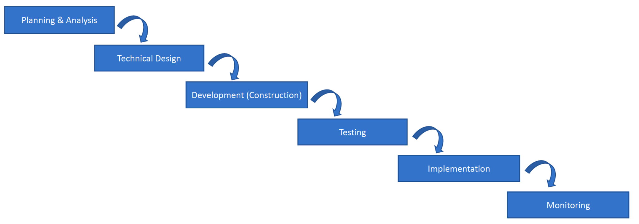
Waterfall Methodology
The Waterfall methodology — also known as the Waterfall model — is a sequential development process that flows like a waterfall through all phases of a project (analysis, design, development, and testing, for example), with each phase completely wrapping up before the next phase begins.
Notes:
Well, in a traditional waterfall approach, the project team follows the phases exactly as we've illustrated
on the.
Diagram in a linear fashion.
So the completion of each phase is a gating event that triggers entry into the next phase.
Although there is some overlap as one phase ends and the next one begins, all of the features and functions
of the software that's going to be delivered are included simultaneously in one large delivery.
As the project team works through each phase, or to put it another way, you walk through the phases
one time only.
Now, later in the course, we're going to drill into each of these phases in great detail with examples,

Slide 14
Waterfall Methodology
The waterfall model is the oldest of all SDLC methodologies. It’s linear and straightforward and requires development teams to finish one phase of the project completely before moving on to the next.
Each stage has a separate project plan and takes information from the previous stage to avoid similar issues (if encountered). However, it is vulnerable to early delays and can lead to big problems arising for development teams later down the road.
Notes:
Advantages of the Waterfall Model:
Waterfall model is the simple model which can be easily understood and is the one in which all the phases are done step by step.
Deliverables of each phase are well defined, and this leads to no complexity and makes the project easily manageable.
Disadvantages of Waterfall model:
Waterfall model is time-consuming & cannot be used in the short duration projects as in this model a new phase cannot be started until the ongoing phase is completed.
Waterfall model cannot be used for the projects which have uncertain requirement or wherein the requirement keeps on changing as this model expects the requirement to be clear in the requirement gathering and analysis phase itself and any change in the later stages would lead to cost higher as the changes would be required in all the phases.
https://www.softwaretestinghelp.com/software-development-life-cycle-sdlc/#4_Testing
Waterfall model is the very first model that is used in SDLC. It is also known as the linear sequential model.
In this model, the outcome of one phase is the input for the next phase. Development of the next phase starts only when the previous phase is complete.
First, Requirement gathering and analysis is done. Once the requirement is freeze then only the System Design can start. Herein, the SRS document created is the output for the Requirement phase and it acts as an input for the System Design.
In System Design Software architecture and Design, documents which act as an input for the next phase are created i.e. Implementation and coding.
In the Implementation phase, coding is done and the software developed is the input for the next phase i.e. testing.
In the testing phase, the developed code is tested thoroughly to detect the defects in the software. Defects are logged into the defect tracking tool and are retested once fixed. Bug logging, Retest, Regression testing goes on until the time the software is in go-live state.
In the Deployment phase, the developed code is moved into production after the sign off is given by the customer.
Any issues in the production environment are resolved by the developers which come under maintenance.

Slide 15
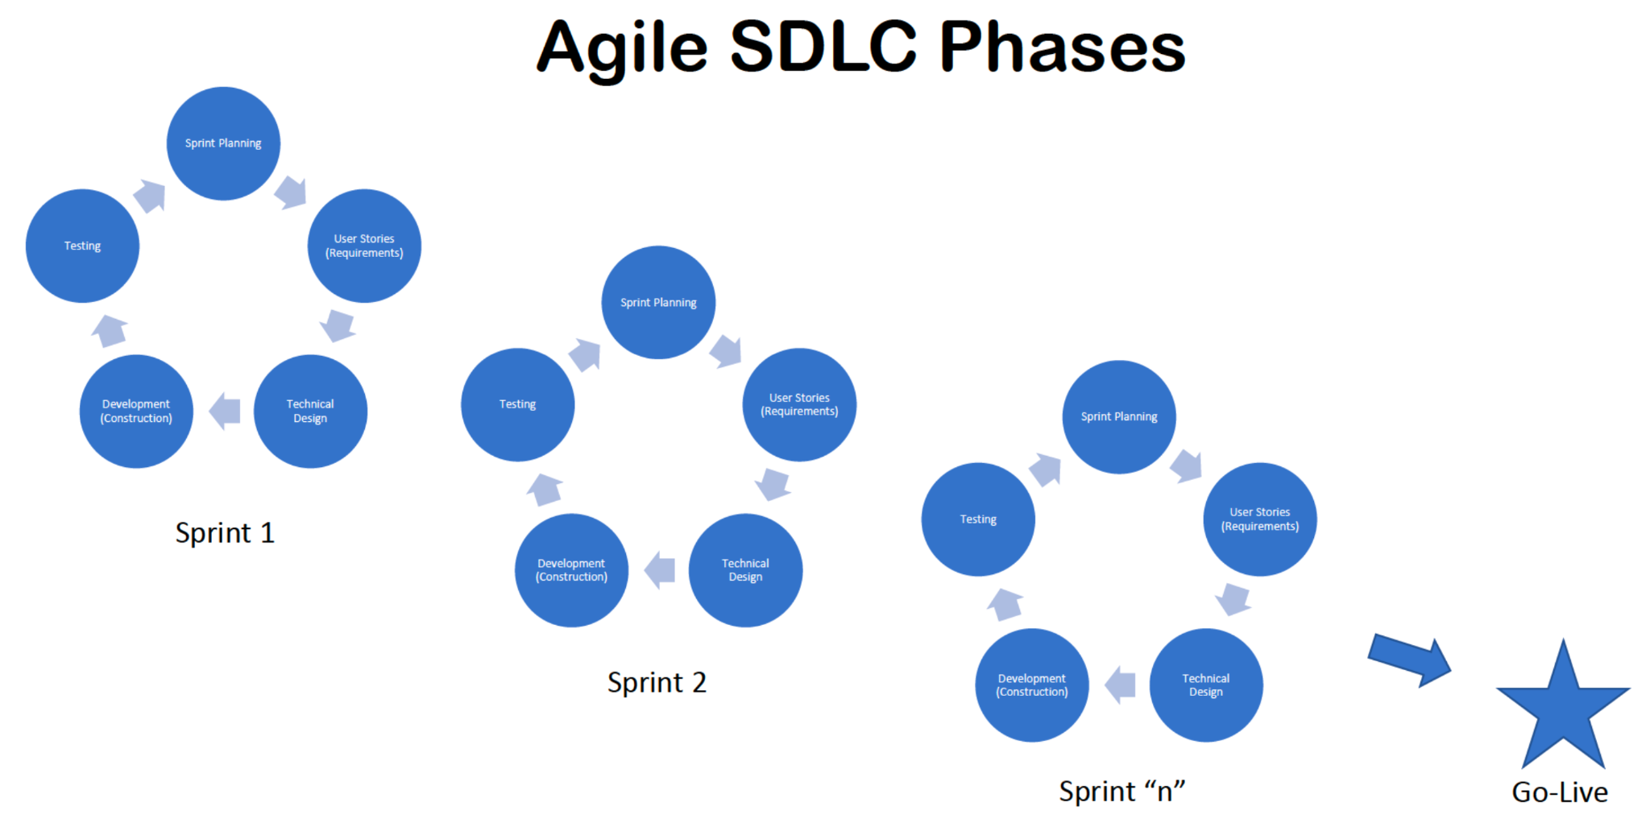
Agile Methodology
Notes:
The second software development methodology is called Agile.
Here up on screen, we're about to put up a typical Agile diagram.
As you can see, it is circular because Agile is iterative and the flow is repeated multiple times in
the project.
The team prioritizes a subset of features into something called a sprint.
Within a sprint, the team completes requirements, design, development and testing for that subset
of features.
Then when the team moves to the next subset of features or the next sprint, it repeats the process.
Now, here's an important point.
While the testing team, for example, is testing Sprint one, the development team has already moved
on and they're coding Sprint two.
So you have parallel simultaneous activity on multiple sprints.
The idea behind this is to deliver a testable product faster in smaller chunks to surface issues sooner
and keep the entire team engaged.
So instead of having teams sort of waiting downstream for the team over here to finish their work,
you keep everyone busy.
Supporters of Agile Development think it encourages collaboration and allows the team to respond quickly
to changes.
While Waterfall is perceived to be slower moving and more rigid.
Now, to be fair, critics of Agile development think the project team loses sight of the big picture,
resulting in disjointed software deliveries, making it difficult to respond to defects found on the
previous sprint because the development team is busy working on the next sprint.

Slide 16
Agile Methodology
Agile Model is a combination of the Iterative and incremental model. This model focuses more on flexibility while developing a product rather than on the requirement.
In Agile, a product is broken into small incremental builds. It is not developed as a complete product in one go. Each build increments in terms of features. The next build is built on previous functionality.
In agile iterations are termed as sprints. Each sprint lasts for2-4 weeks. At the end of each sprint, the product owner verifies the product and after his approval, it is delivered to the customer.
Customer feedback is taken for improvement and his suggestions and enhancement are worked on in the next sprint. Testing is done in each sprint to minimize the risk of any failures.
Notes:
Advantages of Agile Model:
It allows more flexibility to adapt to the changes.
The new feature can be added easily.
Customer satisfaction as the feedback and suggestions are taken at every stage.
Disadvantages:
Lack of documentation.
Agile needs experienced and highly skilled resources.
If a customer is not clear about how exactly they want the product to be, then the project would fail.

Slide 17
Which Methodology
If you have a small application that only has 1 or 2 developers who are familiar with it, that's probably a good candidate for waterfall.
But a larger, more complicated application that's made up of multiple discrete modules might be a good candidate for agile development.

Slide 18


