Slide 1
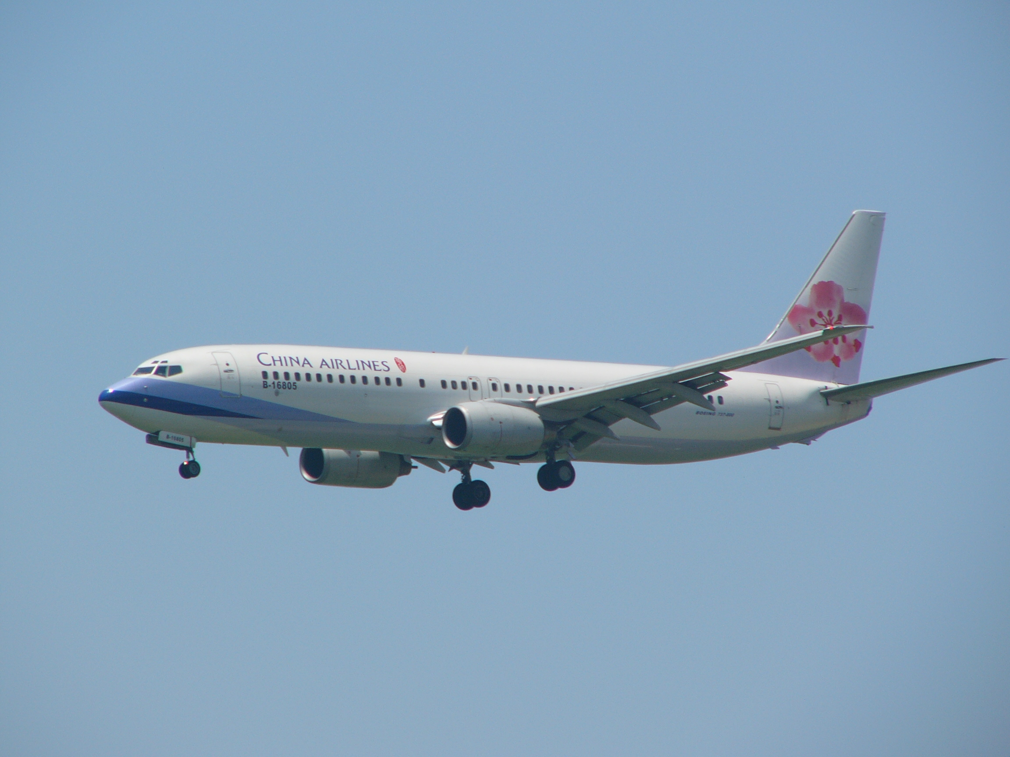
Analyzing FLIGHT DATA
By
Yeshwant Sai sandeep guntupalli(1002318)
Aruna Veeramreddy(1004293)
Hassan musafer(917307)

Slide 2

Introduction:
Every year there are almost 37.4 million flights scheduled and it means almost 100,000 flights per day.
There are 50,000 routes being served daily.
This data consists of the flight arrival data for the year 2008 in United States.
This data consists of more than a million records.
For one reason or the other many of the flights gets delayed.
By studying this data, we can easily detect the anomalies responsible for the delay in time.

Slide 3

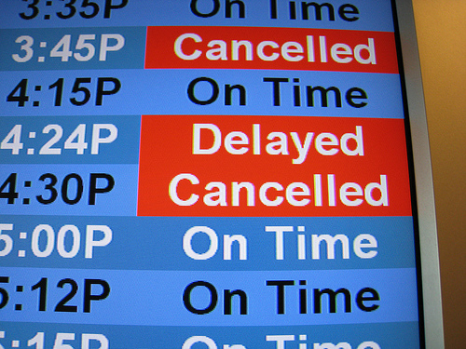
Airways is one of the way of transportation.
Delay is one of the issues. There will be many delays caused by many circumstances such as weather, security etc.
The delay of one flight effects the other flight schedules and makes the entire airport stand on.
Finally, department that causing the delays. So that necessary steps to improve on those.
For example, the air route between chicago and knoxville get delayed by whopping 44.1%, the same is between chicago and wichita where the delay is 43.9%.

Slide 4

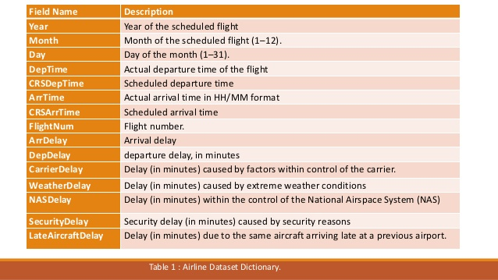
Dataset:
http://stat-computing.org/dataexpo/2009/the-data.html
The data set consists of 29 attributes, and includes 20- years (1987-2008) ,

Slide 5

SOFTWARES and tools
microsoft Excel 2016
Apache Hadoop
Hive
Spark
java
Python
Sql script
matlab

Slide 6
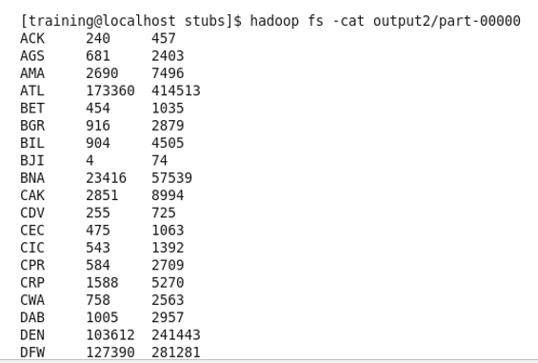

MAPREDUCE Query: To show the origin flight , total number of flight and delay flights.

Slide 7
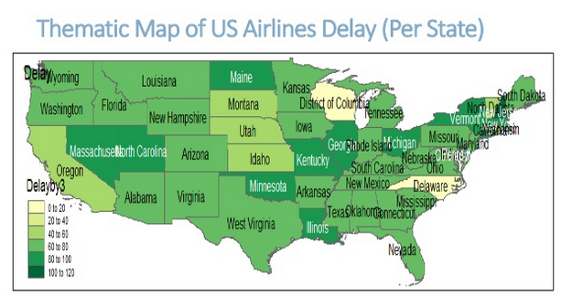

Slide 8
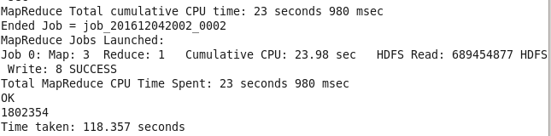
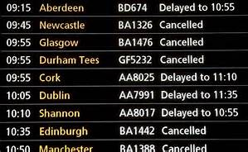
HIVE : 1) Finding the number of flights where the delay the more than 10 minutes.

Slide 9
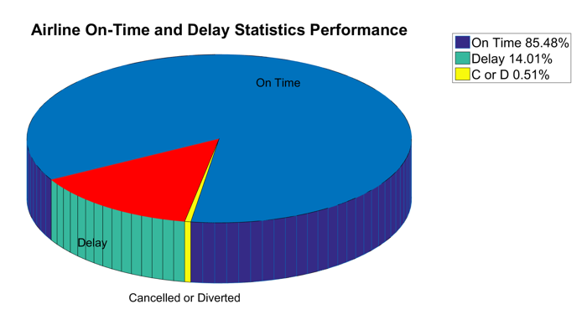
Result

Slide 10
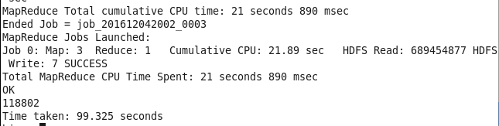

2) finding the number of flights which have the destination airport as JFK

Slide 11
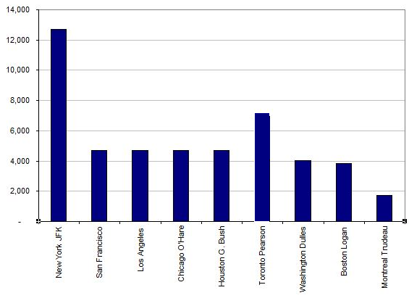
RESULT

Slide 12
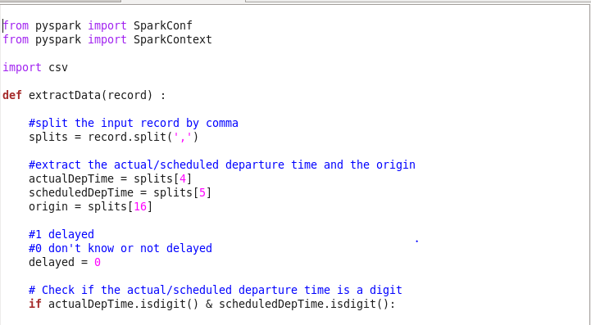
Spark: 1q) Different type of delay occurred in a particular airport

Slide 13
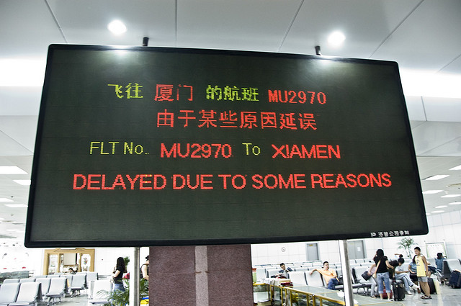
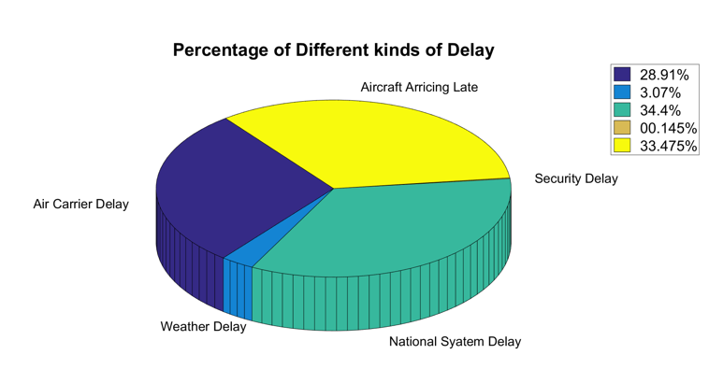
Result:

Slide 14
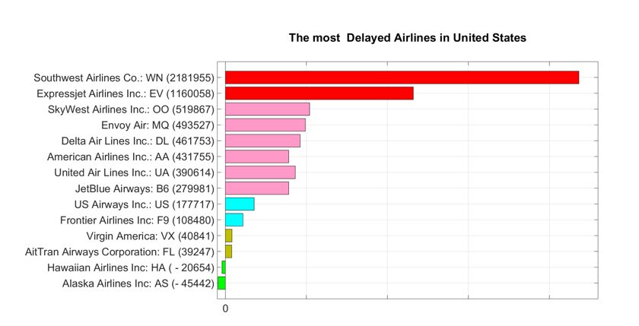
2q) find the most delayed airlines in the United States

Slide 15
Thank You

