Slide 1
MINI PROJECT

Slide 2
JOB ALLOCATION SYSTEM

Slide 3
INTRODUCTION
Automatically allocates jobs.
Effective management.
Increases service levels.
Reduces the cost.
Evaluates each person.
Highly flexible.

Slide 4
SCOPE OF THE PROJECT
comprehensive tool .
manage the allocation processes.
Facilitated by the information management systems
Assign different tasks for their subordinates.
It also enables them to evaluate each task.

Slide 5
EXISTING SYSTEM
Allocation by the administrator.
Technicians reports the status to the administrator.
The working system is manual.
The status of the job is unknown to the staff.
Uneven distribution of jobs.
There is no way to rate them.
The administrator is heavily loaded with work.

Slide 6
PROPOSED SYSTEM
Automatic allocation.
Complex workloads get balanced.
The complaints are send by message to appropriate technician.
Registered technicians can report their status.
The registered employees can view the status of the work done by a bar graph.
The Administrator has the full authority to manage the entire system.

Slide 7
Design approach
Follows bottom up approach
Base elements are linked together to form larger subsystems
Mainly 4 modules:
Administrator module
User module
Job allocation module
Task evaluation module

Slide 8
Administrator module
Manages the entire software
Can do technician registration and maintain their details
Can view registration
Can add departments
Can add designations and qualifications of staffs
Redirection of job
Can add new job types
Status checking

Slide 9
Staff module
Options for
Complaint registration
has job type and subtype
Small description of job, and job type
Job automatically allocated
Administrator ,technician view the task

Slide 10
Status checking
Can view the current status of complaint registered
2D representation
Pending
Completed
Accepted

Slide 11
Technician module
View complaints
Accept/keep pending the allocated job
Accepted -update status
Pending
Completed
Working
Pending- admin redirects

Slide 12
Job allocation module
Jobs to technicians
Automatic allocation
Job count
Availability of technician with corresponding sub job type
Redirection by administrator
pending

Slide 13
Task evaluation module
Representation of status- 2D
Reports
2D viewed by staff and administrator

Slide 14
ADVANTAGES
Saves the time.
Improves the allocation processes.
Automatically schedule and assign jobs
Create an optimized work schedule
Complex workload balancing
Technicians can be rated
Status can be viewed
Can be implemented and administered easily

Slide 15
DISADVANTAGES
Job selection is not based on priority
Job selection based on the designation of the sender.

Slide 16
SOFTWARE SPECIFICATION
Platform – ASP. net
database – SQL server 2005
operating system – Windows XP

Slide 17
HARDWARE SPECIFICATION
5 GB RAM
40 GB HARD DISK

Slide 18
LANGUAGE DESCRIPTION
ASP.NET is a web application framework developed and marketed by MS.
ASP.NET is built on the Common Language Runtime (CLR)
allows programmers to write ASP.NET code using any supported .NET language.
server side scripting technology.
ASP.NET is a Microsoft Technology
ASP stands for Active Server Pages

Slide 19
An ASP.NET file can contain HTML, XML, and scripts
An ASP.NET file has the file extension ".aspx"
The ASP.NET engine reads the file, line by line, and executes the scripts in the file
ASP.NET file is returned to the browser as plain HTML

Slide 20
TOP DOWN DESIGN
design begins by specifying complex pieces and then dividing them into successively smaller pieces.
an overview of the system is first formulated, each subsystem is then refined, until the entire specification is reduced to base elements
the components are specific enough to be coded and the program is written

Slide 21
BOTTOM UP DESIGN
individual base elements of the system are first specified .
piecing together of systems to sub-systems of the emergent system.
individual base elements of the system are first specified in detail.
these elements are then linked together to form larger subsystems, until a complete top-level system is formed.

Slide 22
Structure diagrams
tbl_availability
techid | Varchar(50) | NOT NULL
Jobid | Varchar(50) | NOT NULL
Status | Varchar(50) | NULL
tbl_login
Uname | Varchar(50) | NULL
Password | Varchar(50) | NULL

Slide 23
tbl_registeration
Primary key: uname
uname | Varchar(50) | NOT NULL
Password | Varchar(50) | NOT NULL
name | varchar(50) | NULL
deptid | numeric(18, 0) | NULL
desid | numeric(18, 0) | NULL
qualid | numeric(18, 0) | NULL
email | varchar(50) | NULL
phoneno | numeric(18, 0) | NULL
status | varchar(50) | NOT NULL

Slide 24
tbl_jobentry
Primary key: jobid
Jobid | numeric(18, 0) | NOT NULL
jobtype | varchar(50) | NULL
tbl_subjobentry
Primary key: subjobid
subjobid | numeric(18, 0) | NOT NULL
jobid | numeric(18,,0) | NULL
subjobtype | varchar(50) | NULL
tbl_department
Primary key: deptid
deptid | numeric(18, 0) | NOT NULL
deptname | varchar(50) | NULL

Slide 25
tbl_designation
Primary key:designationid
designationid | numeric(18, 0) | NOT NULL
designationname | varchar(50) | NULL
tbl_qualification
Primary key:qualid
qualid | numeric(18, 0) | NOT NULL
qualification | varchar(50) | NULL

Slide 26
tbl_joballocation
Primary key:allocid
Allocid | numeric(18, 0) | NOT NULL
Uname | varchar(50) | NULL
Mailed | varchar(50) | NULL
Date | varchar(50) | NULL
Status | varchar(50) | NULL

Slide 27
tbl_techdetails
Primary key:techid
Techid | numeric(18, 0) | NOT NULL
Password | varchar(50) | NULL
Techname | varchar(50) | NULL
Email | varchar(50) | NULL
Job1 | varchar(50) | NULL
Job2 | varchar(50) | NULL
Job3 | varchar(50) | NULL
Deptid | numeric(18, 0) | NULL
Desigid | numeric(18, 0) | NULL
Qualid | numeric(18, 0) | NULL
Phoneno | numeric(18, 0) | NULL

Slide 28
tbl_mail
Primary key:mailid
Mailid | numeric(18, 0) | NOT NULL
Eidfrom | varchar(50) | NULL
Eidto | varchar(50) | NULL
subject | varchar(50) | NULL
body | varchar(50) | NULL
jobid | numeric(180) | NULL
subjobid | numeric(180) | NULL
date | varchar(50) | NULL
designationid | numeric(180) | NULL
duration | varchar(50) | NULL
Deptid | numeric(180) | NULL

Slide 29
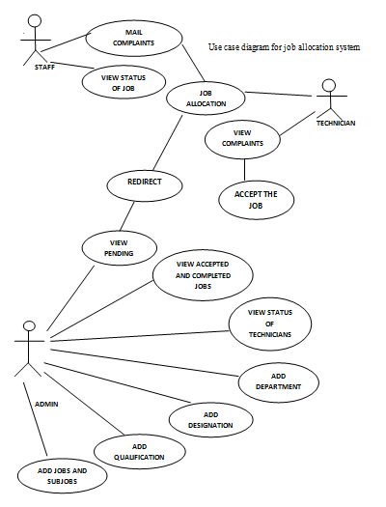
Use case diagram

Slide 30
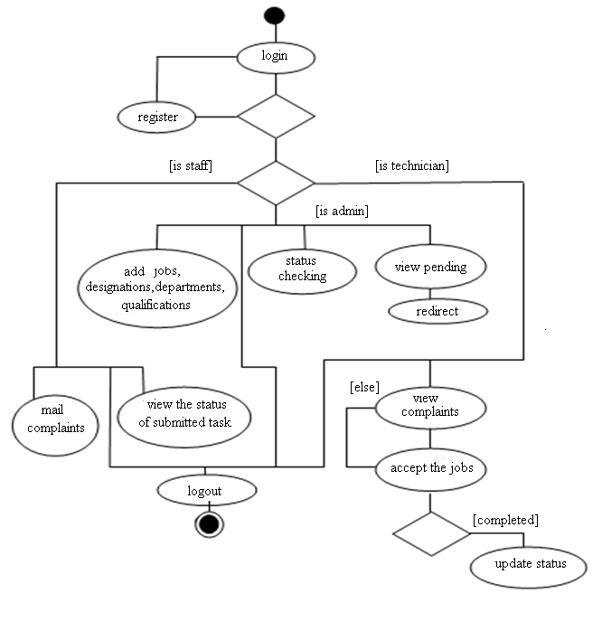
Activity diagram

Slide 31
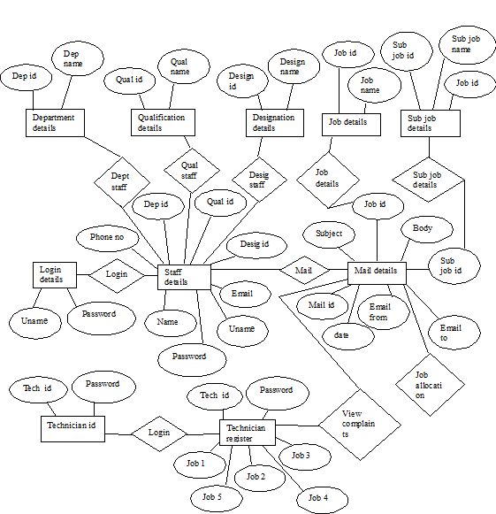
E R diagram

Slide 32
Data Flow Diagrams Level 0
TECHNICIAN
ADMIN
JOB ALLOCATION SYSTEM
TECHNICIAN
ADMIN
STAFF
STAFF

Slide 33
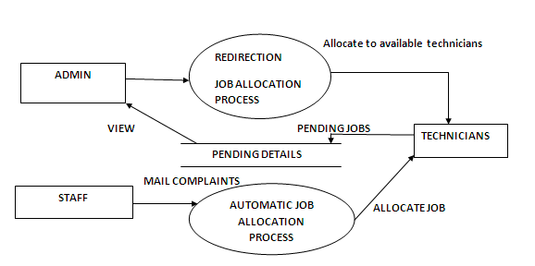
Level 1

Slide 34
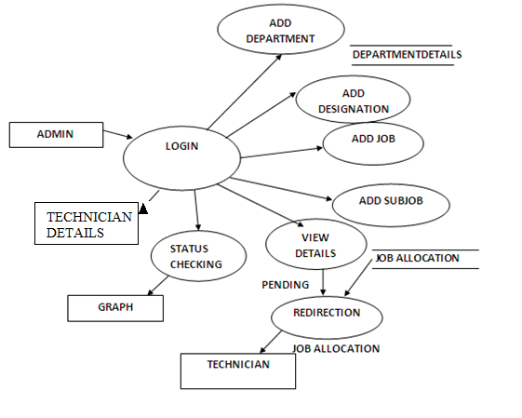
Level 2-administrator module

Slide 35
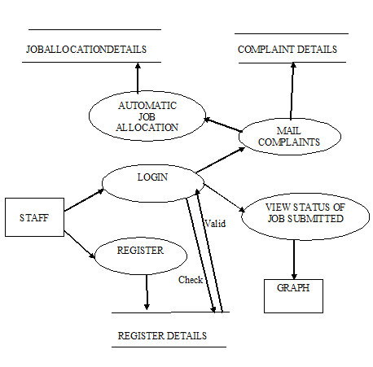
Level 2-staff module

Slide 36
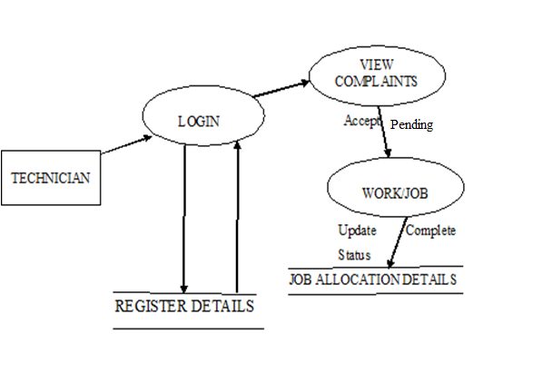
Level 2-technician module

Slide 37
Target Specification
Some screen shots…

Slide 38
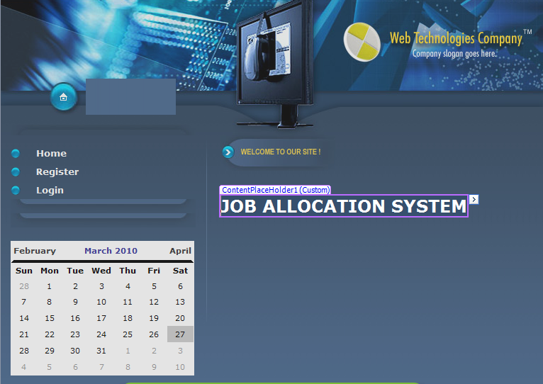
Start page

Slide 39
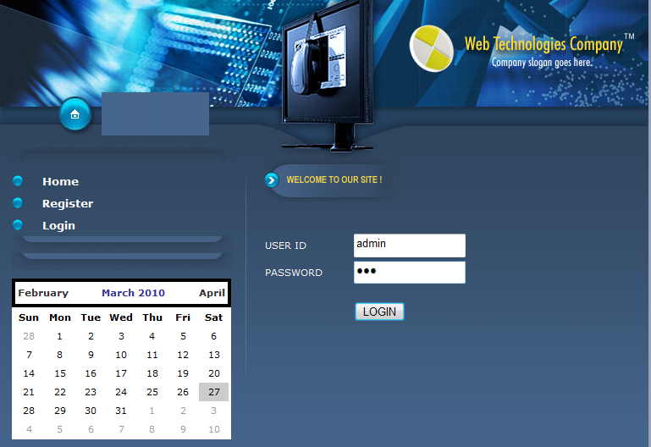
Admin Login

Slide 40
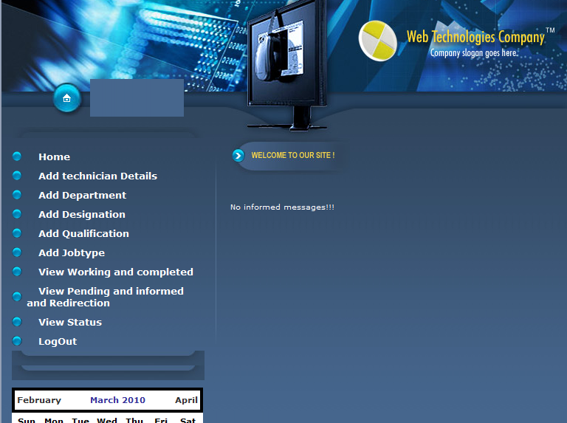
Admin home

Slide 41
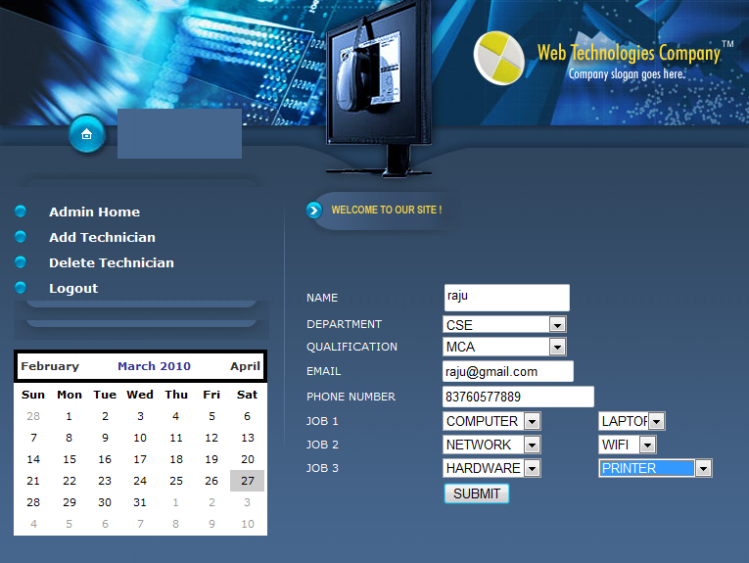
Add technician

Slide 42
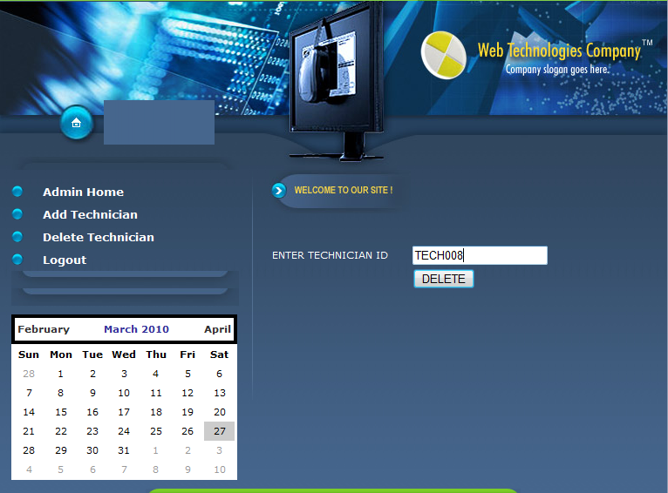
Delete technician

Slide 43
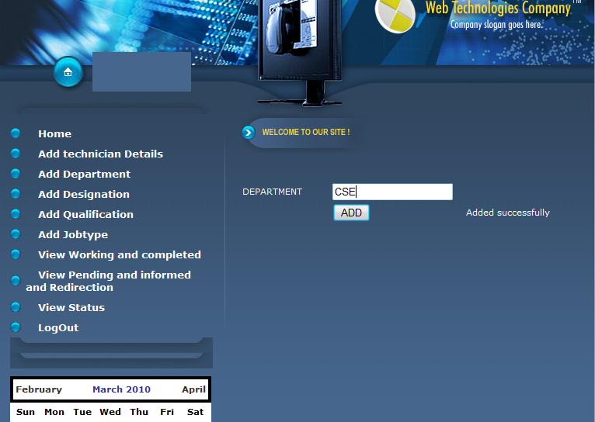
Add department

Slide 44
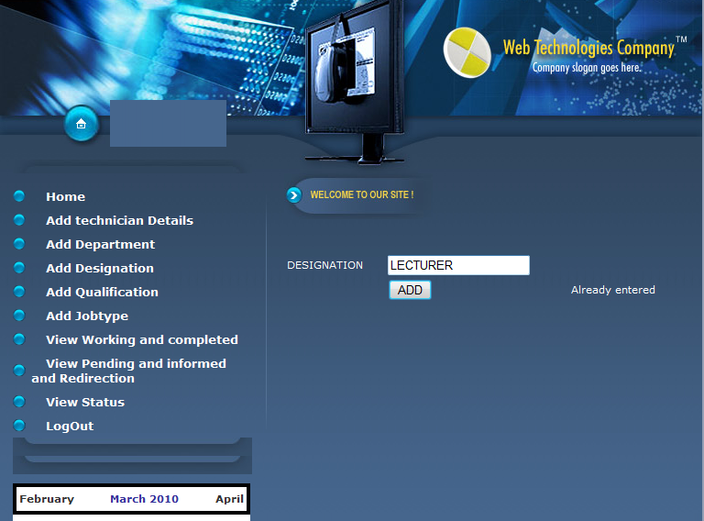
Add designation

Slide 45
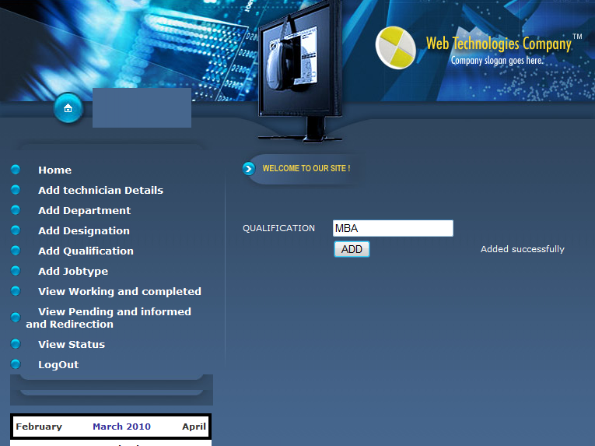
Add qualification

Slide 46
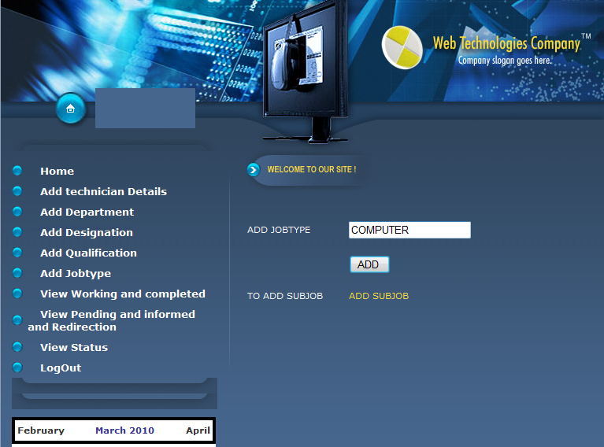
Add job type

Slide 47
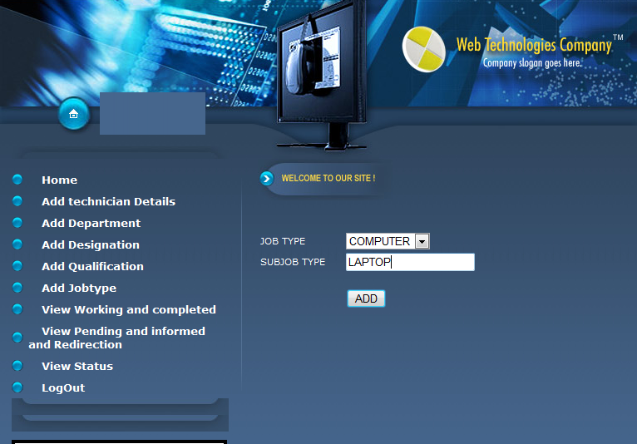
Add sub job type

Slide 48
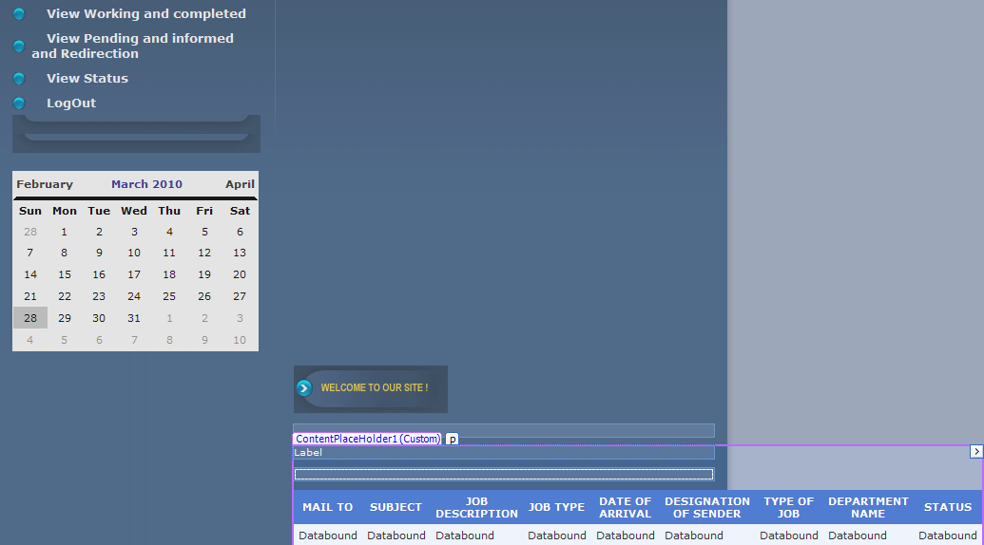
View working and completed

Slide 49
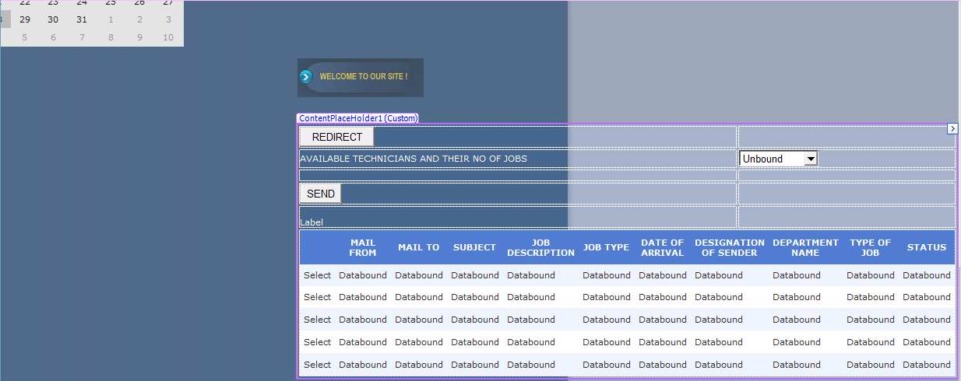
View pending , informed and redirection

Slide 50
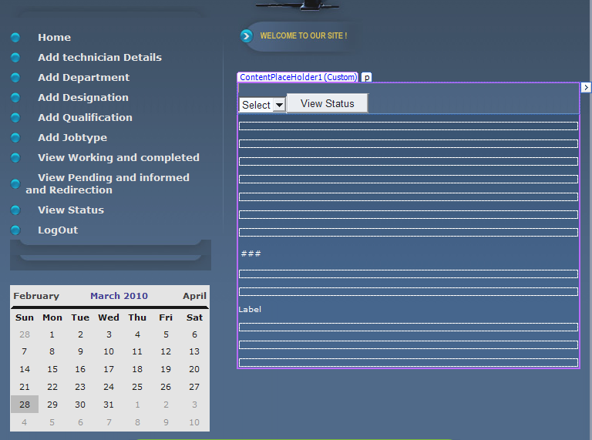
View status

Slide 51
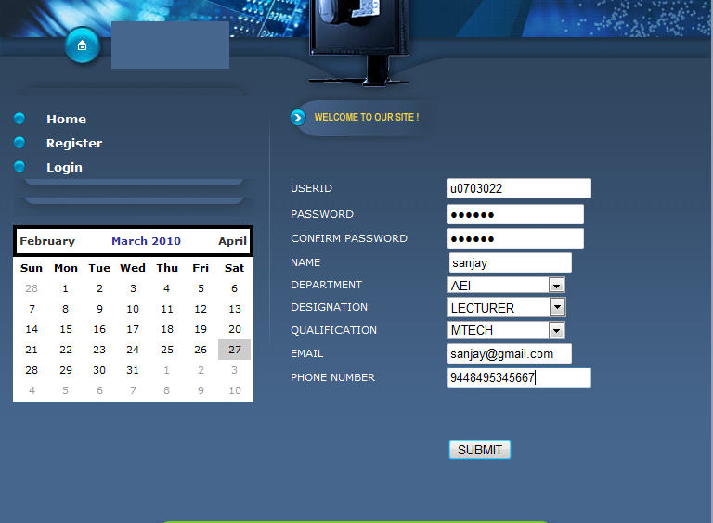
Registration

Slide 52
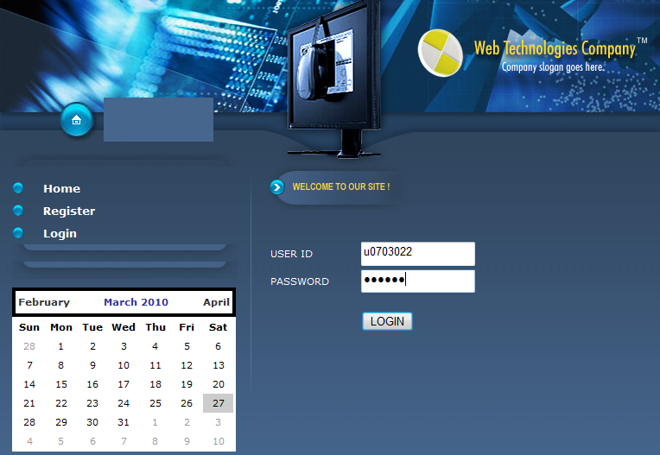
Staff login

Slide 53
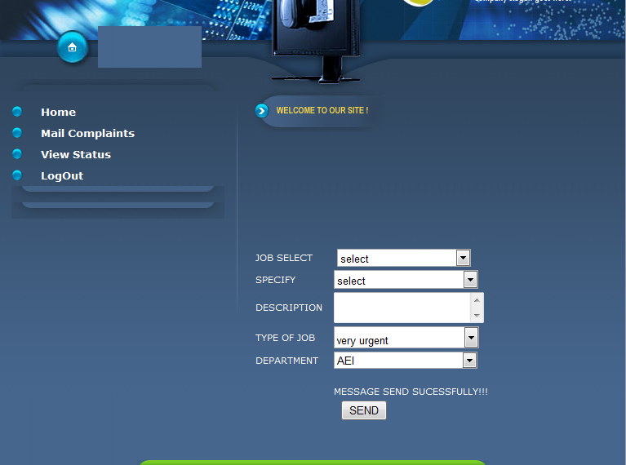
Mail complaints

Slide 54
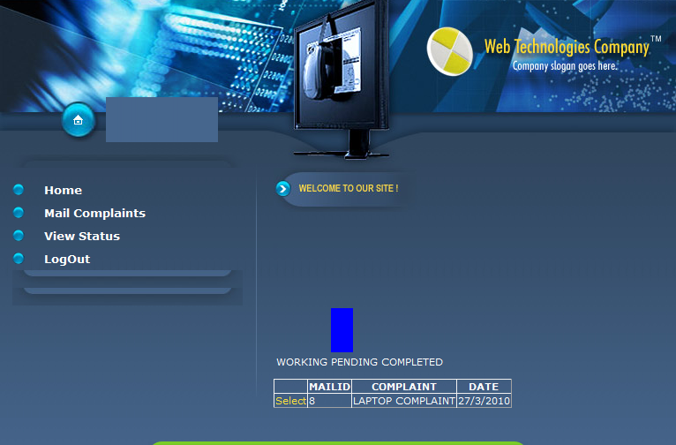
View status by technician

Slide 55
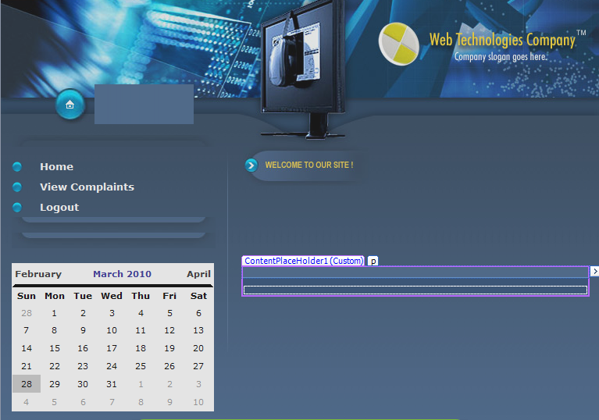
Technician home

Slide 56
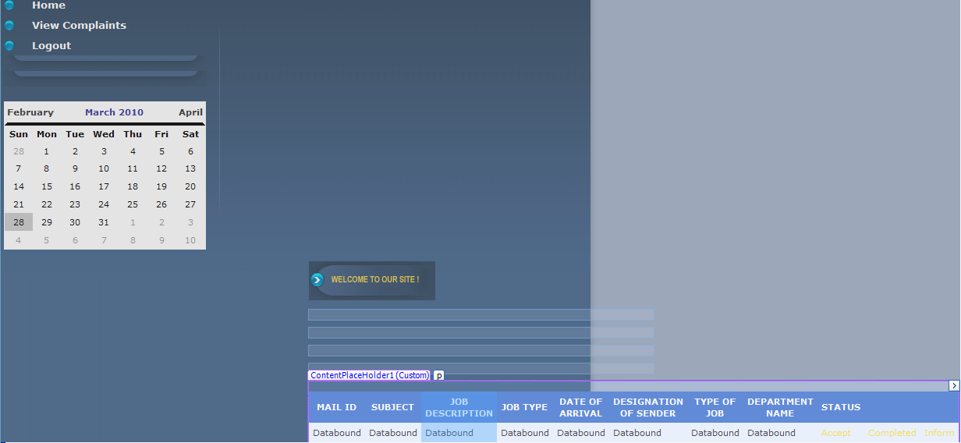
View complaints

Slide 57
White box testing
uses an internal perspective of the system to design test cases based on internal structure
tester chooses test case inputs to exercise paths through the code and determines the appropriate outputs
also know as glass, structural, open box or clear box testing
helps in optimizing code, which can bring hidden defects
skilled tester is required

Slide 58
Black box testing
takes an external perspective of the test object to derive test cases
test designer selects valid and invalid inputs and determines the correct output
there is no knowledge of the test object's internal structure
Also know as opaque testing, Skin Box testing or Closed Box Testing.
Tester must be thorough with requirement specification

Slide 59
Module testing
a software verification and validation method in which a programmer tests if individual units of source code are fit for use
each unit is tested separately before integrating them into modules to test the interfaces between modules
reduces difficulties of discovering errors contained in more complex pieces

Slide 60
Integrated testing
integrated design involves a “whole building design” approach
a building is viewed as an interdependent system, as opposed to an accumulation of its separate components
It makes sure they work in harmony rather than against each other
stakeholders gather to set goals and identify strategies for achieving the desired outcomes.

Slide 61
CONCLUSION
Project can be implemented in an institution to assign different tasks to the computer department technicians automatically
Admin module
Overall management of the software
Can maintain the details of technician
Can redirect jobs, if pending
Can view status of jobs allocated

Slide 62
Staff module
Can post complaints by specifying job and sub job type along with a description
View the status of the current job submitted
Technician module
View the complaints assigned to him
Can update the status as working, pending or completed

Slide 63
REFERENCES
[1] http://The evolution of Unit Testing Syntax and Semantics
[2] http://Roy Osherove's book (with free chapters)on Unit Testing: The Art Of Unit Testing
[3] http:// Fowler, Martin (2007-01-02). "Mocks aren't Stubs". http://martinfowler.com/articles/mocksArentStubs.html. Retrieved 2008-04-01.

Slide 64
[4]http://^ Kolawa, Adam; Huizinga, Dorota (2007). Automated Defect Prevention: Best Practices in Software Management. Wiley-IEEE Computer Society Press. p. 75. ISBN 0470042125. http://www.wiley.com/WileyCDA/WileyTitle/productCd-0470042125.html.
[5] http://^ Cramblitt, Bob (2007-09-20). "Alberto Savoia sings the praises of software testing". http://searchsoftwarequality.techtarget.com/originalContent/0,289142,sid92_gci1273161,00.html. Retrieved 2007-11-29.

Slide 65
BOOKS
[1] Essential ASP.NET with examples in Visual Basic .NET‎ BY FRITZ ONION
[2] Professional ASP.NET 2.0‎
Bill Evjen, Scott Hanselman, Farhan Muhammad, S. Srinivasa Sivakumar, Devin Rader - Computers
[3] ASP.NET in a nutshell: a desktop quick reference‎
G. Andrew Duthie, Matthew MacDonald -

Slide 66
THANK YOU

