Slide 1

RT503 – Database Management Systems
Module 1 – DBMS Basic Concepts
S5 CS-A
RAJAGIRI SCHOOL OF ENGINEERING & TECHNOLOGY
Rajagiri Valley, Kakkanad, Kochi, India
Class taken by
K.S.Mathew,
Professor, Dept. of CSE, RASET, Kochi, Kerala
July 2009

Slide 2
Topics
Basic Concepts
History of DBMS
Disadvantages of File System
Advantages of DBMS
Disadvantages of DBMS
DBMS Facilities
DBMS Users
DBMS Components
Data Models
DBMS Architecture and Data Independence
Entity Relationship Model

Slide 3
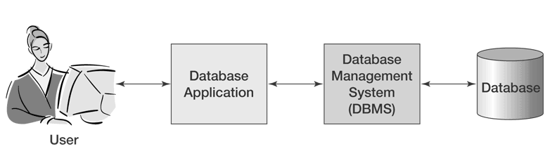
Basic Concepts
Data are raw facts and figures that constitute building blocks of some information.
  Example: Students Personal Info, Students Academic Info etc.
Database is a collection of information or “persistent” data that facilitate easy storage, processing and retrieval of data by users
  Example: Students Database, Employee Database, Accounts Database
Database Management System (DBMS) is a set of software that is used to define, store, manipulate and control the data in a database.
  Example: Oracle, MS SQL Server, IBM DB2, Sybase, MySQL, Postgres SQL etc.
A Database System is a computerized record keeping system whose overall purpose is to store information and to allow users to retrieve and update that information on demand. A database system consist of a database, DBMS and an application program.

Slide 4
History of DBMS
< 1960 – Data defined & stored in Random Access Memory (RAM) by programmers. One data set per program and custom methods / programs to retrieve and process data. Hence, there was no persistence of data and programmer productivity low.
Early 1960’s – File Based: Data maintained in flat files (in magnetic tape media) by programmers. One file per program and custom methods / programs to retrieve and process data. Data is persistent; but programmer productivity still low.
Early 1960’s – Charles Bachmann developed first DBMS at Honeywell called Integrated Data Store (IDS)
Mid 1960’s – First Hierarchical DBMS – IBM’s Information Management System (IMS)
1971 – Network DBMS - IDS was standardized by the CODASYL (Conference on Data Systems Languages) DBTG (Database Task Group)
Early 1970’s – Integrated Database Management System (IDMS) by Computer Associates

Slide 5
History of DBMS
1970 – Present: Era of Relational DBMS
  1970: Ted Codd at IBM proposed relational data model
  1974-79: IBM System R (1974), later evolved into SQL/DS (in 1979) and then to DB2 (in 1983)
  1976: Peter Chen defined the Entity-Relationship (ER) model
  1978: Larry Ellison released first version of Oracle (based on IBM’s papers on System R) just prior to IBM’s SQL/DS and DB2
  1979: INGRES commercially released by University of California followed by PostGres
  1980: RDBMS technology matured and many commercial RDBMS became available. SQL standard adopted by ISO and ANSI.
  1985: Development of Object-oriented DBMS concepts.
  1990: incorporation of object-orientation in RDBMS.
  1991: Microsoft released MS Access, a personal DBMS
  1995: First Internet database applications
  1997: Integration of XML into DBMS products

Slide 6
Disadvantages of File System
Difficulty in accessing information
Data redundancy and inconsistency
Data isolation
Integrity problems
Atomicity problems
Concurrent access anomalies
Security problems

Slide 7
Advantages of DBMS
Centralized Data Management
Easy to access information
Data redundancy and inconsistency can be removed
Data integrity can be improved
Security can be improved
Data independence

Slide 8
Disadvantages of DBMS
Cost of maintaining a database
Confidentiality, Privacy and Security
Complexity of Backup and Recovery

Slide 9
DBMS Facilities
The DBMS provides two main types of facilities called data definition facilities and data manipulation facilities. They are:
  Create database, tables and supporting structures
  Maintain database structures
  Read and maintain database data
  Enforce data integrity rules
  Control concurrent data access
  Provide data security
  Perform backup and recovery

Slide 10
DBMS Users
The people/users involved in a database system environment are:
  Actors on the scene
  Database administrators
  Database designers
  End users
    Casual end users
    Naïve or parametric end users
    Sophisticated end users
    Standalone users
  System Analysts and Application Programmers (Software Engineers)
  Actors behind the scene
  DBMS System Designers and Implementers
  Tool Developers
  Operators and Maintenance Personnel

Slide 11
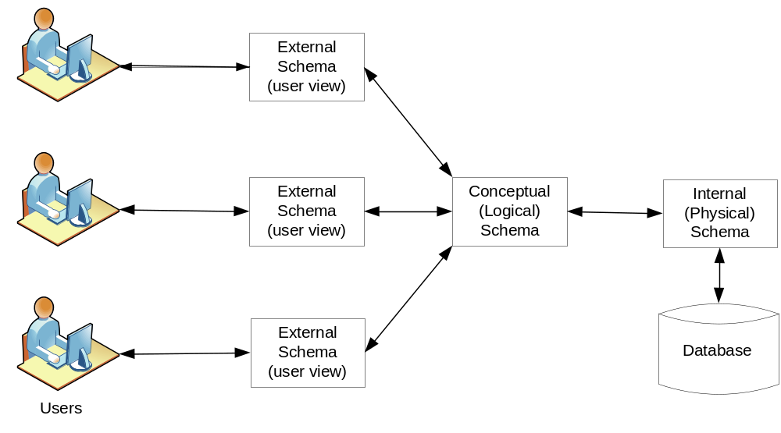
DBMS Architecture & Data Independence
The database systems has a three schema architecture that helps to achieve data independence, support of multiple user views and data dictionary. The three schema architecture is shown in diagram below:

Slide 12
Three-schema architecture
External schema (User view)
  External schema represents how a particular user group views the database. It exposes the data a particular user group is interested in and hides the rest of the data from that user group.
Conceptual schema (Logical Schema)
  The conceptual schema represents a logical view of the database containing a description of all the data and relationships. The logical schema usually contains all external schemas.
Internal Schema (Physical Schema)
  The internal schema is a representation of a conceptual schema as physically stored on a particular database. It describes the complete details of data storage and access paths for the database. DBMS maintains mappings between external schema and conceptual schema and between conceptual schema and internal schema in order to transform requests and results between external, conceptual and internal schemas.

Slide 13
Data Independence
The three schema architecture helps in providing data independence. ie. the ability to change schema at one level of a database without requiring any changes in the schema at next higher level.
Two types of data independence are:
  Logical data independence is the capacity to change the conceptual schema without having to change external schemas or application programs.
  Physical data independence is the capacity to change the internal schema without having to change the conceptual (or external) schemas.

Slide 14
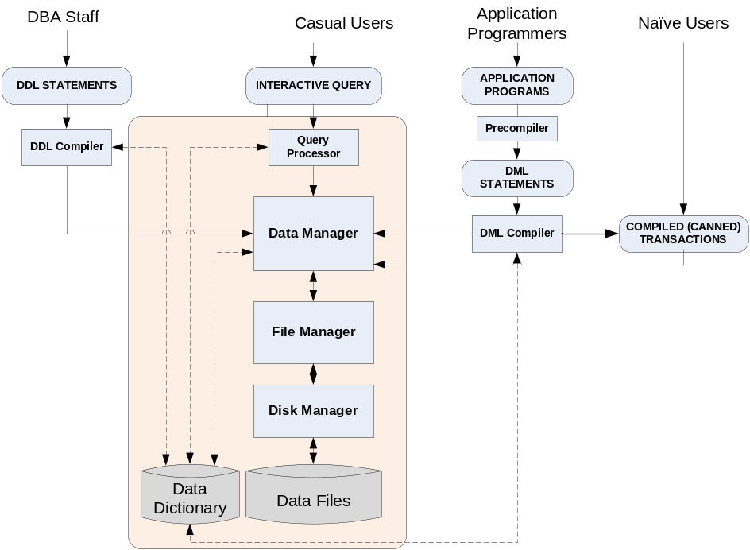
DBMS Components
Major components of a DBMS are:
    Data Manager
    File Manager
    Disk Manager
    Query Processor
    Data Files
    Data Dictionary

Slide 15
DBMS Components
Data Manager
  Data Manager is the central component of DBMS and is responsible for interfacing with file system on users behalf.
  It converts the user requests coming via Query Processor, DML Compiler, DDL Compiler or the canned transactions in an application from user’s logical view to physical file system.
  In addition, enforcing data consistency, integrity and security, backup and recovery, concurrency control etc. are also the functions of Data Manager.
File Manager
  The file manager is responsible for the structure of the file and managing the file space.
  It locates the block containing the required record, and requests this block from the disk manager and returns the requested record to the data manager.
  The file manager could be the OS file manager or a DBMS specific file manager.

Slide 16
DBMS Components
Disk Manager
  Disk Manager is part of the operating system and all physical input and output operations are performed by it.
  The disk manager interfaces with the physical storage media and transfers the block or page requested by the file manager.
Query Processor
  The query processor is used to interpret the online users query and convert it into an efficient series of operations & send it to data manager for execution.
  The query processor uses the data dictionary to find the structure of the relevant portion of the database and uses this information in modifying the query and preparing an optimal plan to access the database.

Slide 17
DBMS Components
Data Files
  The data files contain the data portion of the database.
Data Dictionary (System Catalog)
  The information of database structure and usage of data contained in the database, the metadata, is maintained in a data dictionary.
  The data dictionary stores information concerning the external, conceptual and internal levels of database.
  It contains the source of each data field value, the frequency of its use, and an audit trail about updates including who and when of each update.

Slide 18
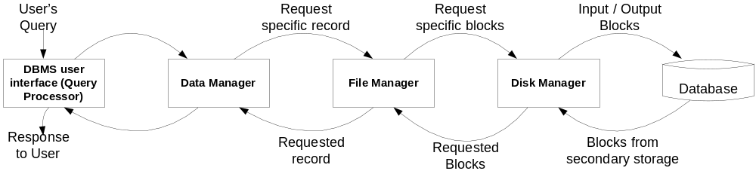
DBMS Components
Steps in Data Access
  A user’s request for data is received by the data manager, which determines the physical record required. The decision as to which physical record is needed is taken by referring to the data dictionary.
  The data manager sends the request for a specific physical record to the file manager.
  The file manager decides which physical block of secondary storage contains the required record and sends the request for the appropriate block to the disk manager.
  The disk manager retrieves the block and sends it to the file manager, which in turn sends the required record to the data manager.

Slide 19
Data Modeling
Data Modeling is the process of creating a logical representation of the structure of database and is an important activity in designing a database.
A data model is a plan for building a database.
The data model represents data conceptually, the way user sees it rather than how computer stores it and they are most often expressed graphically using Entity-Relationship diagrams.
A data model is more generalized and abstract than physical database design and hence is easier to change than a database design.
Four most common data models are: (a) Hierarchical Model (b) Network Model (c) Relational Model and (d) Object Model.
A given DBMS may support one or more of the four models.

Slide 20
Hierarchical Model
Hierarchical data model is the first model proposed to resolve the data integrity and other problems related with traditional file systems.
Hierarchical model organizes the data into a tree structure using parent-child relationships: each parent can have many children but each child has only one parent.
IBM’s Information Management System (IMS) was the first Hierarchical database. IMS allows only one-to-one or one-to-many relationships between entities.
Customer
Order1
Order2
Order3

Slide 21
Hierarchical Model
Advantages:
    Simple to construct and operate on
    Corresponds to many natural hierarchically organized domains (eg. Assemblies in manufacturing, Personal organization in companies)
    Simple language using constructs like GET, GET UNIQUE, GET NEXT, GET NEXT WITHIN PARENT etc.
Disadvantages:
    Navigational and procedural nature of processing
    Database is visualized as a linear arrangement of records
    Little scope for query optimization
    Data inconsistency
    Wastage of space

Slide 22
Network Model
More flexible way of representing objects and their relationships.
In hierarchical model, data is structured as a tree of records with each record having one parent and zero or many children whereas network model allows each record to have multiple parent and child records.
This model was eventually replaced by the relational model.
Charles Bachmann developed first network DBMS at Honeywell called Integrated Data Store ( IDS)
Teacher1
Teacher2
Teacher3
Subject1
Subject2
Subject3
Subject4
Subject5

Slide 23
Network Model
Advantages:
    Network model can model complex relationships
    It can handle most situations for modeling using record types and relationship types.
    Language is navigational using constructs like FIND, FIND MEMBER, FIND OWNER, FIND NEXT, GET etc.
    Programmers can do optimal navigation through the database.
Disadvantages:
    Navigational and procedural nature of processing
    Database contains a complex array of pointers that thread through a set of records.
    Little scope for automated query optimization

Slide 24
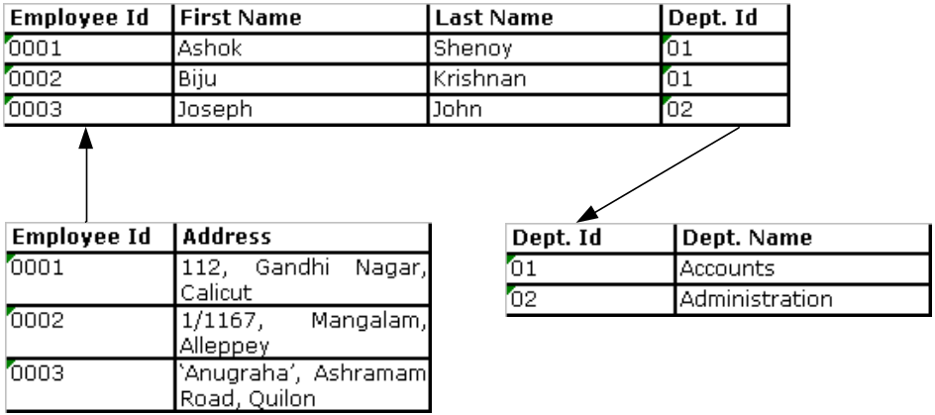
Relational Model
Relational Model describes the database as a collection of tables or relations to represent data and relations.
A table consists of multiple rows and columns with each column having a unique name.
Rows of the relation or table are referred to as tuples of the relation and the columns are its attributes.
In the relational model, the related records are linked together with a key.
Examples of relational DBMS are: Oracle, MS SQL Server etc.

Slide 25
Relational Model
Advantages:
    Simple in principle; relation is the only construct required to represent data entities and their relationships.
    Relational model can be easily derived from E-R diagram.
    Support of a powerful query language – SQL
    High application programmer productivity
    Relatively easy to manipulate (and navigate through) a relational database than a network or hierarchical database, using join operations and SQL.
Disadvantages:
    Join operation is inherently inefficient and demands a considerable amount of processing and retrieval of unnecessary data.
    Inability to handle application areas like geospatial databases and applications involving images, videos, complex arrays / numbers etc.

Slide 26
Object Model
The object model is a database model in which data is represented in the form of objects as used in object oriented programming.
Objects in object oriented programs are transient; ie. they exist only during the program execution. Object-oriented databases help to make these objects persistent so that these objects can be shared by other programs.
Object DBMS add database functionality to object oriented languages and it makes database objects appear as programming language objects in one or more object oriented programming languages.
An object corresponds to an entity in the ER model.
Examples of object database management system are: db4objects, Perst.

Slide 27
Object Model
Advantages:
  Easy to represent real world complex objects consisting of properties and operations.
  Support complex data types
  Integrates with and provide database capabilities for object oriented programming languages
Disadvantages:
  Lower efficiency when data and relationships are simple
  Relational tables are simpler than objects
  Limited availability of standards, tools and support
  Unfamiliarity (causing an added training cost for developers).

Slide 28
Object Relational Model
The object relational model enhances the capabilities of relational model with some of the features of object model.
Object relational database management systems add object storage capabilities to the RDBMS.
The new object storage facilities of ORDBMS integrate management of traditional data, complex objects such as geo spatial data and diverse binary media such as audio, video, image etc.
By encapsulating methods with data structures, an ORDBMS server can execute complex analytical and data manipulation operations to search and transform multi-media and other complex objects.
Leading vendors of ORDBMS are: IBM, Informix and Oracle
An example schema of a student relation which ORDBMS supports is :
STUDENT(fname,lname,ID,sex,major,address,dname,location,picture)
where location and picture are geospatial data and image respectively.

Slide 29
Object Relational Model
Advantages:
  Combines the object storage capabilities of object model with relational model.
  Easy to execute complex analytical and data manipulation operations to search and transform multi-media and other complex objects.
  Query, procedure language and call interfaces are similar to RDBMS.

Slide 30
Data Modeling using Entity Relationship Model
Based on the perception of real world objects called entities and their relationships.
Each entity has its own properties called attributes.
The relationship between entity sets is represented by a named ER relationship and is 1:1, 1:M or M:N mapping from one entity set to another.
The database structure is usually shown pictorially using entity relationship diagrams.

Slide 31
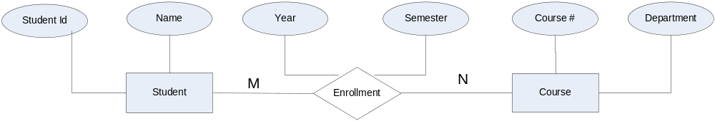
Entity Relationship Diagram
An entity set is shown as a rectangle
A diamond represents the relationship among a number of entities, which are connected to the entities by lines.
The attributes, shown as ovals, are connected to the entities or relationships by lines.
Diamonds, ovals, and rectangles are labeled. The type of relationship existing between the entities is represented by giving the cardinality of the relationship on the line joining the relationship to the entity.

Slide 32
Entity Relationship Diagram
Entity
  An entity is an object of interest to an organization.
  Objects of similar types are characterized by the same set of attributes or properties.
  Such similar objects form an entity set or entity type.
  For example, each of the students is an entity and the rectangle Student represents the Student entity set or entity type.
  An entity set in an ER-diagram will be represented by a table (called relation in relational model) in a database that contains a column for each of its attributes and a row for each instance of the entity (called tuple in relational model).
Key
  A subset of attributes that uniquely identifies an entity is called a key or primary key

Slide 33
Entity Relationship Diagram
Strong Entity Set
  An entity set that has a primary key is termed as a strong entity set
Weak Entity Set
  An entity set that doesn’t have sufficient attributes to form a primary key is called Weak Entity Set
Super Key
  A super key is a set of attributes that, taken collectively, uniquely identify an entity in the entity set.
Candidate Key
  Super keys with minimal subset is known as the candidate key
Primary Key
  Candidate key chosen by the database designer to identify an entity from an entity set

Slide 34
Entity Relationship Diagram
Foreign Key
  A Foreign key in an entity set is a set of attributes that refer to a unique entity in another entity set.
Relationships
  An association among entities is called a relationship
  A collection of relationships of the same type is called a relationship set
  A relationship is a binary relationship if the number of entity sets involved in the relationship is two.
  A relationship that involves N entities is called an N-ary relationship. For example, if a relationship involves three entity sets, it is called a ternary relationship.
  A relationship in an ER-diagram will also be represented by a table in a database which contains the primary keys of all entity sets involved in the relationship along with the attributes of the relationship.

Slide 35
Entity Relationship Diagram
Cardinality
  Number of entities to which another entity can be associated is called cardinality of the relationship which is represented by M:N in the example ER-Diagram shown in previous slide.
Different types of cardinalities are:
  One : One (1:1) - An entity in set A is associated with at most one entity in set B and an entity in set B is associated with at most one entity in set A. Example: Department – Manager relationship.
  One : Many (1:M) - An entity in set A is associated with any number of entities in set B and an entity in set B is associated with at most one entity in set A. Example: Manager – Employee relationship.
  Many : One (M:1) - An entity in set A is associated with at most one entity in set B and an entity in set B is associated with any number of entities in set A. Example: Student – Class relationship.
  Many : Many (M:M) - An entity in set A is associated with any number of entities in set B and an entity in set B is associated with any number of entities in set A. Example: Employee – Project relationship

Slide 36
Questions?

Slide 37
THANK YOU
Please feel free to contact me for further details/clarifications:
K. S. Mathew, Professor, Dept. of CSE, RASET, Kochi-39
Mobile: 9847117818, Email: ksmathew@rajagiritech.ac.in , ksmathew@yahoo.com

