Slide 1

RT503 – Database Management Systems
Module 2 – Relational Databases
S5 CS-A
RAJAGIRI SCHOOL OF ENGINEERING & TECHNOLOGY
Rajagiri Valley, Kakkanad, Kochi, India
Class taken by
K.S.Mathew,
Professor, Dept. of CSE, RASET, Kochi, Kerala
July 2009

Slide 2
Topics
Relational Databases
  Basic Concepts
  Integrity Rules
  Set of Operations
Relational Algebra
  Basic Relational Algebra Operations
Relational Calculus
  Tuple Relational Calculus
  Domain Relational Calculus
Introduction to SQL
  Data Definition Language (DDL) Statements
  Data Manipulation Language (DML) Statements
Views

Slide 3
Relational Databases - Basic Concepts
Relational Model was introduced by Ted Codd of IBM in 1970
Relational Model is a data model based on set theory.
In relational model, all data are represented as mathematical n-ary relations, an n-ary relation being a subset of the Cartesian product of n sets. This is a collection of tables or relations which is assigned a unique name.
A row in the table represents a relationship among a set of values
Basic components of a relational database are:
    Set of domains and set of relations
    Integrity rules
    Set of operations

Slide 4
Relational Databases - Basic Concepts
Tuples - The rows in a relation are called tuples. Each row consists of a sequence of values, one for each column in the table. In addition, each row (or record) in a table must be unique.
Attributes - The column in a relation is called attribute. The attributes represent characteristics of an entity.
Domain – For each attribute there is a set of permitted values called domain of that attribute. A domain is said to be atomic if elements of the domain are considered to be indivisible units.
Database Schema – Logical design of the database is termed as database schema.
Relation schema – The concept of relation schema corresponds to the programming notion of type definition. It can be considered as the definition of a domain of values. The database schema is the collection of relation schemas that define a database. The relation has two parts - a relation schema (header) and a time varying set of tuples (body). Relation is the subset of a Cartesian product of a list of domains.

Slide 5
Relational Databases - Basic Concepts
Degree of the relation is the number of attributes in the relation (also called arity of the relation).
Keys – A key specifying uniqueness. Keys in relational model are primary key, candidate key and super key.
Super Key is defined in a relational model as a set of attributes that, taken collectively, to uniquely identify a tuple in the relation.
Candidate Key – Super keys with minimal subset of attributes is known as the candidate key.
Primary Key is used to denote the candidate key that is chosen by the database designer to uniquely identify a tuple in a relation.
Foreign Key is an attribute or set of attributes of a relation R such that the value of each attribute in this set is that of a primary key of the relation S.

Slide 6
Relational Databases – Integrity Rules
Relational algebra includes two general integrity rules:
  Entity Integrity – This is concerned with primary key values of individual relations. This specifies that instances of entities are distinguishable and no prime attribute value may be NULL.
  Referential Integrity - Referential integrity is specified between two relations and is used to maintain the consistency among tuples of the two relations. The referential integrity constraint states that a tuple in one relation that refers to another relation must refer to an existing tuple in that relation. The attributes in a relation that provides reference to tuple in another relation is called foreign key.

Slide 7
Relational Databases – Set of Operations
The operations of Relational model can be categorized into retrievals and updates:
  Update Operations – There are three basic update operations on relations: INSERT, DELETE and UPDATE or MODIFY.
    INSERT – The INSERT operation is used to insert a new tuple or tuples in a relation. The Insert operation provides a list of attribute values for a new tuple that is to be inserted into a relation.
    Syntax for the INSERT statement is:
    INSERT INTO table_name
    (column-1, column-2,…., column-n)
    VALUES (value-1, value-2,…., value-n);
    Example:
    INSERT INTO EMPLOYEE (FNAME, MNAME, LNAME, SSN, DOB, ADDRESS, SEX, SALARY, DEPT_ID) VALUES (’Derek’,’D’,’Brown’,’348765439’,’1958-05-09’,’1234 Church Road, CA 80134’,’M’,30000,5);

Slide 8
Relational Databases – Set of Operations
Insert can violate any of the following four types of constraints (entity integrity and referential integrity constraints):
  Domain constraints can be violated if an attribute value doesn’t exist in the corresponding domain.
  Unique Key constraints can be violated if the key value of the new tuple already exists in another tuple in the relation.
  Entity integrity can be violated if the primary key of the new tuple is null.
  Referential integrity can be violated if the value of any foreign key in the new tuple refers to a non-existing tuple in the referenced relation.
If an INSERT operation violates one or more constraints, the DBMS rejects the insertion and informs the user about the reason for rejection

Slide 9
Relational Databases – Set of Operations
  DELETE – The DELETE operation is used to delete tuples and the user has to provide a condition on the attributes of the relation to select the tuples to be deleted.
    Syntax for the DELETE statement is:
    DELETE FROM table_name
    WHERE some_column = some_value;
    Example:
    DELETE FROM EMPLOYEE
    WHERE SSN = ‘348765440’;

Slide 10
Relational Databases – Set of Operations
Delete operation can violate the referential integrity, if the tuple being deleted is referenced by the foreign keys from other tuples in the database.
If a DELETE operation violates any referential integrity constraints, then the DBMS rejects the deletion and informs the user about the reason for rejection.
In case of a DELETE operation failure, user will have following two options:
    Attempt to cascade the deletion by deleting tuples that reference the tuple being deleted.
    Modify the referencing attribute values that cause the violation to null

Slide 11
Relational Databases – Set of Operations
  UPDATE – The UPDATE operation is used to change the values of one or more attributes in a tuple or tuples of some relation.
  The user has to specify a condition on the attributes of the relation to select the tuple (or tuples) to be modified.
  Updating a non-key (neither primary key nor foreign key) attribute causes no constraint violations normally, except for the domain constraint violation if the new value of the attribute doesn’t exist in the corresponding domain.
  Modifying a primary key value is similar to deleting one tuple and inserting another in its place. Hence, the constraint violations of INSERT and DELETE could happen in case of modifying a primary key value.
  If a foreign key attribute is modified, the referential integrity constraint violation could happen if the new value is not null and refers to a non-existing tuple in the referenced relation.

Slide 12
Relational Databases – Set of Operations
  Syntax for the UPDATE statement is:
    UPDATE table_name
    SET column1=value, column2=value2,...
    WHERE some_column=some_value;
    Example:
    UPDATE EMPLOYEE
    SET ADDRESS = new_address, SALARY = new_salary
    WHERE SSN = ‘348765440’;

Slide 13
Relational Databases – Set of Operations
  Retrieval Operations – The basic retrieval operation on relations is SELECT, having numerous forms and variations. The relational algebra operations are used to specify the retrieval operations in relational model. Hence, knowledge about relational algebra and its operations are required to understand retrieval operations in relational model.

Slide 14
Relational Algebra
Relational algebra is a procedural query language.
It consists of collection of operations to manipulate relations.
It is similar to normal algebra (as in 2+3*x-y) except that we use relations as values instead of numbers, and the operations and operators are different.
Relations in relational algebra are a set of tuples and hence we can use basic set operations on relations.
The fundamental operations in relational algebra are: SELECT, PROJECT, UNION, SET DIFFERENCE, CARTESIAN PRODUCT, RENAME, INTERSECTION, JOIN, DIVISION and ASSIGNMENT.
Query language used in DBMS (called SQL) are similar to relational algebra operations. Also, some advanced queries like OUTER JOIN require explicit relational algebra operations.
DBMS converts the query language to lower level relational algebra operations to optimize and execute queries.

Slide 15
Relational Algebra
Difference between relational algebra and SQL are:
    SQL is a declarative query language, which means that you tell DBMS what you want, but not how to get it. Relational algebra is procedural (like procedural programming languages C++, Java etc.), which means that you have to state, step by step, exactly how the result should be calculated.
    Relations are seen as set of tuples, which means that duplicates are not allowed. SQL behaves differently in some cases and may produce duplicate tuples (refer the SQL keyword DISTINCT).

Slide 16
Basic Relational Algebra Operations
Data Model also includes a set of operations to manipulate the data in addition to defining the data structure and constraints.
The retrieval operations in relational model are based on relational algebra operations which are divided into two groups:
    Set Operations – UNION, INTERSECTION, SET DIFFERENCE and CARTESIAN PRODUCT
    Operations developed specifically for relational databases – SELECT, PROJECT, JOIN etc.
The relational algebra operations have their own symbols. The set of relational algebra operations {SELECT, PROJECT, UNION, SET DIFFERENCE, CARTESIAN PRODUCT} or {σ, ∏, U, -, X} is a complete set; that is any other relational algebra operations can be expressed as a sequence of operations from this set.

Slide 17
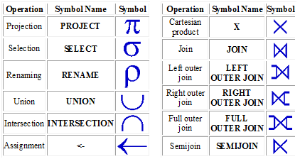
Basic Relational Algebra Operations

Slide 18
Basic Relational Algebra Operations
SELECT Operation (σ )
  The SELECT operation selects tuples that satisfy a given condition
  The SELECT operation is a unary operation which means it is applied to a single relation.
  It can be visualized as a horizontal partition of the relation into two sets of tuples – those tuples that satisfy the condition and are selected and those tuples that do not satisfy the condition and are discarded.
  The general syntax of the SELECT operation is:
      σ<selection condition>(R)
      OR
      SELECT<selection condition>(R)
  where the symbol σ denotes the SELECT operator, and the selection condition is a boolean expression specified on the attributes of the relation R. R could be just the name of a database relation or a relational algebra expression whose result is a relation.

Slide 19
Basic Relational Algebra Operations
SELECT Operation (σ ) –contd..
  The result of the SELECT operation will be another relation having the same attributes (same degree) as R.
  The number of tuples in the resulting relation will always be less than or equal to the number of tuples in R. That is |σc(R)| <= |R|
  The Boolean expression specified in <selection condition> can be a number of clauses of the following forms:
      <attribute name><comparison op><constant value>
      OR
      <attribute name><comparison op><attribute name>
  where <attribute name> is the name of an attribute of R, <comparison op> is normally one of the operators =, <>, <, >, <=, >= and <constant value> is a constant value from the attribute domain.
  The clauses can be connected by the logical operators (OR) and (AND) and NOT (!) to form a general selection condition.
  The fraction of tuples selected by a selection condition is referred to as the selectivity of the condition.

Slide 20
Basic Relational Algebra Operations
SELECT Operation (σ ) –contd..
  The SELECT operation is commutative; that is a cascade of select operations on a relation gives the same result irrespective of the order of different select operations.
  Also, a cascade of SELECT operations can be combined into a single SELECT operation with conditions of all individual select operations connected using AND logical operators.
  Example:
    Select all employees who either work in MKTG department and make over $25000 per year, or work in PROJ department and make over $30000.
      σ(DEPT=’MKTG’ AND SALARY>25000) OR (DEPT=’PROJ’ AND SALARY>30000)(EMPLOYEE)

Slide 21
Basic Relational Algebra Operations
PROJECT Operation (∏)
  The project operation is used to retrieve specific attributes/columns from a relation.
  The PROJECT operation is also a unary operation which means it is applied to a single relation.
  The SELECT operation selects some of the rows from the table while discarding other rows whereas the PROJECT operation selects certain columns from the table and discards the other columns. ie. It projects only the attributes of interest to the user.
  The general syntax of the PROJECT operation is:
      ∏<attribute list>(R)
      OR
      PROJECT<attribute list>(R)
  where the symbol ∏ (pi) is used to denote the PROJECT operator, and the <attribute list> is a list of attributes from the attributes of relation R. R could be just the name of a database relation or a relational algebra expression whose result is a relation.

Slide 22
Basic Relational Algebra Operations
PROJECT Operation (∏) contd..
  The result of the PROJECT operation will be another relation having only the attributes specified in <attribute list> and in the same order as they appear in the list. Hence, its degree is equal to the number of attributes in <attribute list>.
  If the attribute list includes only non-key attributes of R, duplicates tuples are likely to occur and the PROJECT operation removes any duplicate tuples.
  If the projection list includes a super key of R, the resulting relation will have the same number of tuples as R.
  So, the number of tuples in the resulting relation of PROJECT operation is always less than or equal to the number of tuples in R. That is |∏a(R)| <= |R|.
  The PROJECT operation is not commutative.
  Example:
      List each employee’s first name, last name and salary.
        ∏FNAME, LNAME, SALARY(EMPLOYEE)

Slide 23
Basic Relational Algebra Operations
UNION Operation (U)
  The UNION operation is a binary operation and is applied to two relations.
  The union operation results in a relation that includes all tuples that are in either (or both) of the two relations.
  The relations on which union operation is applied should be union compatible. Two relations are union compatible if they have the same arity (degree or number of attributes) and the domains of the corresponding attributes are identical.
  The UNION operation also removes the duplicate tuples from the resulting relation.
  The general syntax of the UNION operation is:
      R = P U Q
  R will have tuples drawn from either P or Q (or both) such that R={t|t € P or t € Q} and max(|P|,|Q|)≤|R|≤ |P|+|Q|.
  The UNION operation is commutative; that is P U Q = Q U P.
  Example: List the name & address of all students and faculty members. It can be written as: ∏_{FNAME,ADDRESS}(STUDENT) U ∏ _{FNAME,ADDRESS}(FACULTY).

Slide 24
Basic Relational Algebra Operations
INTERSECTION Operation (∩)
  The INTERSECTION operation is a binary operation and is applied to two relations.
  The intersection operation results in a relation that includes all tuples that are in both of the two relations. Ie. It selects common tuples in two relations.
  The relations on which intersection operation is applied should be union compatible. Two relations are union compatible if they have the same arity (degree or number of attributes) and the domains of the corresponding attributes are identical.
  The general syntax of the INTERSECTION operation is:
      R = P ∩ Q
  R will have tuples common in both P and Q such that R={t|t € P and t € Q} and 0 ≤|R|≤ min(|P|,|Q|).
  The INTERSECTION operation is commutative; that is P ∩ Q = Q ∩ P.
  Example: List the names and address of all customers who have both a loan and an account. It can be written as: ∏_{FNAME,ADDRESS}(LOAN) ∩ ∏_{FNAME,ADDRESS}(ACCOUNT).

Slide 25
Basic Relational Algebra Operations
SET DIFFERENCE Operation (-)
  The SET DIFFERENCE operation is a binary operation and is applied to two relations.
  The SET DIFFERENCE operation results in a relation that includes all tuples that are in the first relation, but not in the second relation.
  The relations on which SET DIFFERENCE operation is applied should be union compatible. Two relations are union compatible if they have the same arity (degree or number of attributes) and the domains of the corresponding attributes are identical.
  The general syntax of the SET DIFFERENCE operation is:
      R = P - Q
  R will have tuples in P, but not in Q such that R={t|t € P and t not € Q} and 0 ≤|R|≤ |P|.
  The SET DIFFERENCE operation is not commutative. Ie. P - Q <> Q - P.
  Example: List the names and address of all customers (account holders) who doesn’t have a loan. It can be written as: ∏_{FNAME,ADDRESS}(ACCOUNT) - ∏_{FNAME,ADDRESS}(LOAN).

Slide 26
Basic Relational Algebra Operations
CARTESIAN PRODUCT Operation (X)
  The CARTESIAN PRODUCT operation is used to obtain all possible combinations of tuples from two relations. This is a binary operation.
  In general, the result of P(A1,A2,…,An) X Q(B1,B2,…,Bm) is a relation R with n+m attributes R(A1,A2,…,An,B1,B2,….,Bm) in that order. The degree of resulting relation is n+m.
  The resulting relation R has one tuple for each combination of tuples – one from P and one from Q. So, the number of tuples in R will be number of tuples in P multiplied by number of tuples in Q; ie. |P|*|Q|.
  The general syntax of the CARTESIAN PRODUCT operation is:
      R=PXQ such that {t1||t2|t1 € P and t2 € Q} and |R|=|P|*|Q|

Slide 27
Basic Relational Algebra Operations
RENAME Operation (ρ)
  The RENAME operation is used to rename either the relation name, or the attribute names, or both.
  The general RENAME operation when applied to a relation R of degree n is denoted by:
    ρ_{s(B1,B2,…,Bn)}(R) or ρ_{s}(R) or ρ _{(B1,B2,…,Bn)}(R)
  where the symbol ρ (rho) is used to denote the RENAME operator, S is the new relation name, and B1,B2,…Bn are the new attribute names.
  If the attributes of R are (A1,A2,…..,An) in that order, then each Ai is renamed as Bi.

Slide 28
Basic Relational Algebra Operations
JOIN Operation
  The JOIN operation is used to combine related tuples from two relations into single tuples.
  The result of a JOIN operation of two relations P(A1, A2,…,An) and Q(B1,B2 , …, Bm) is a relation R with n+m attributes R(A1,A2,…,An,B1,B2,…,Bm) in that order.
  The join operation retrieves all tuples from the Cartesian product of the two relations with a matching condition.
  The main difference between Cartesian product and JOIN operation is that the JOIN retrieves only combinations of tuples from two relations satisfying the join condition whereas Cartesian product retrieves all combinations of tuples.
  The join condition is specified on attributes from the two relations and is evaluated for each combination of tuples.
  The resulting relation R will have tuples between zero (no tuples matching the join condition) and |P|*|Q| (all tuples match the join condition). Ie. 0≤|R|≤|P|*|Q|.

Slide 29
Basic Relational Algebra Operations
JOIN Operation
  Example: Get the name of the manager of each department in the organization. List the department name and first & last names of department manager.
EQUIJOIN Operation
  Join operations that involve join conditions with equality comparisons (=) only are called EQUIJOINs.
  This is the most common JOIN operation. The result of EQUIJOINs will have one or more pairs of attributes that have identical values in every tuple.
NATURAL JOIN Operation (*)
  NATURAL JOIN is used to eliminate the duplicate superfluous attributes from a EQUIJOIN result relation.
  The NATURAL JOIN requires that the two join attributes (or each pair of join attributes) have the same name in both relations.
  Example: Get the list of all employees including their department manager.

Slide 30
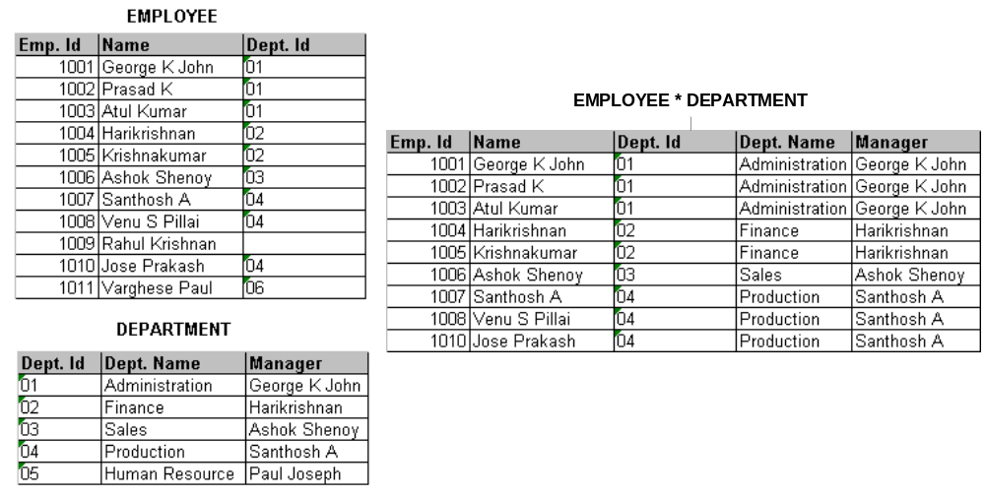
Basic Relational Algebra Operations
NATURAL JOIN Operation (*) (contd..)
  Example: Get the list of all employees including their department manager.

Slide 31
Basic Relational Algebra Operations
SEMI JOIN Operation
  The SEMI JOIN operation joins two relations and only keeps the attributes in the first relation.
OUTER JOIN Operation
  In the normal JOIN operation, only the tuples that matches the join condition are selected. Tuples without a matching (or related) tuple eliminated from the result.
  Tuples with null in the join attributes are also eliminated.
  Set of operations called OUTER JOINs provides the ability to include all the tuples including unmatched tuples in either or both relations in the result of the join.
  The outer join combines the unmatched tuple in one of the relation with an artificial tuple for the other relation; all attributes of artificial tuple set to NULL.

Slide 32
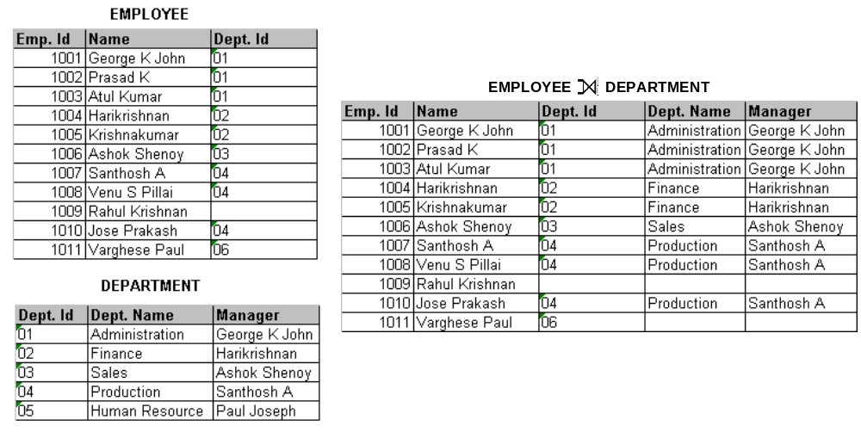
Basic Relational Algebra Operations
LEFT OUTER JOIN Operation
  The result of LEFT OUTER JOIN operation is the set of all combinations of tuples in P & Q that have matching values on their common attributes, in addition to tuples in P that have no matching tuples in Q.
  Example: Get a list of all employees including their department manager.

Slide 33
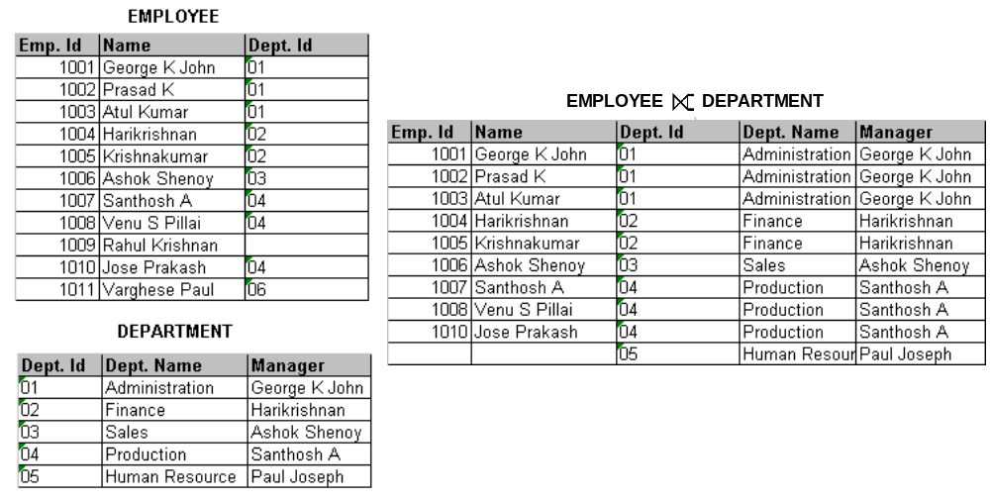
Basic Relational Algebra Operations
RIGHT OUTER JOIN Operation
  The result of RIGHT OUTER JOIN operation is the set of all combinations of tuples in P & Q that have matching values on their common attributes, in addition to tuples in Q that have no matching tuples in P.
  Example: Get a list of all departments and managers including all employees under each department.

Slide 34
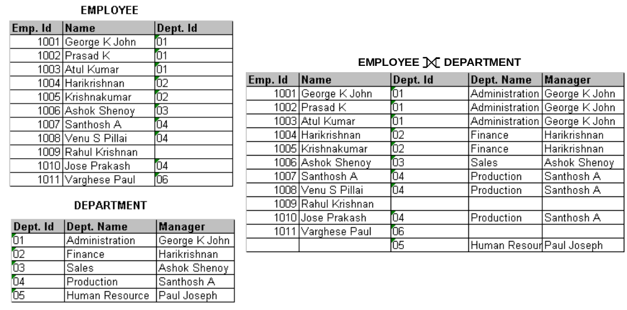
Basic Relational Algebra Operations
FULL OUTER JOIN Operation
  The FULL OUTER JOIN in effect combines the results of the left and the right outer joins.
  The result of the FULL OUTER JOIN operation is the set of all combinations of tuples in P & Q that have matching values on their common attributes, in addition to tuples in P that have no matching tuples in Q and tuples in Q that have no matching tuples in P.
  Example: Get a list of all employees, departments and managers.

Slide 35
Basic Relational Algebra Operations
DIVISION Operation
  The DIVISION is a binary operation. The DIVISION operation is useful for a special kind of query that sometimes occurs in database applications.
  The DIVISION operation is written as P+Q where P and Q are relations such that attributes of P are a super set of attributes of Q.
  The result of the DIVISION operation will be a relation with attributes unique to P; that is attributes in P which are not in Q.
  The tuples in the resulting relation of a DIVISION operation are those tuples in P (excluding the attributes of Q) where there are tuples in combination with every tuple in Q.
  Let r(R) and s(S) be relations and S be the subset of R. Then, the relation r+s is a relation on schema R-S.
  A tuple t is in r+s if for every tuple ts in s there is a tuple tr in r satisfying both of the following:
      tr[S] =ts[S]
      tr[R-S] = t[R-S]
  That is, the R-S portion of a tuple t is in r+s if and only if there are tuples with the r-s portion and the S portion in r for every value of the S portion in relation s.

Slide 36
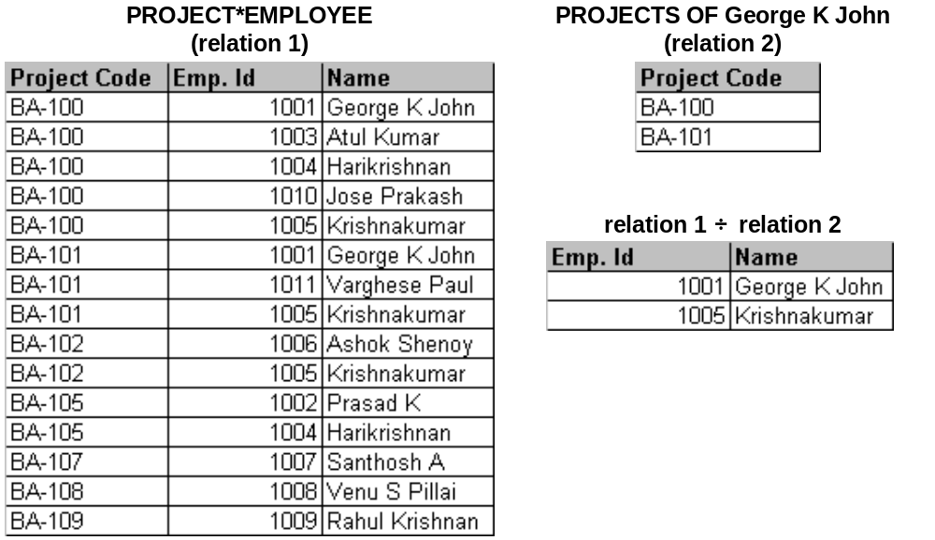
Basic Relational Algebra Operations
DIVISION Operation (contd..)
  Example: Retrieve the names of employees who work on all the projects that Mr. George works on.

Slide 37
Basic Relational Algebra Operations
ASSIGNMENT Operation
  The ASSIGNMENT operation is used to assign the results of other operations to a result relation. It works like assignment in a programming language.
  Example: Assign the result of a PROJECT operation to a relation RESULT.
    RESULT <- ∏FNAME, LNAME, SALARY(EMPLOYEE)

Slide 38
Introduction to SQL
  The Structured Query Language (SQL) is a database language for querying and modifying relational databases.
  It was developed by IBM Research in the mid 70's and standardized by ANSI in 1986.
  SQL language consists of three categories of statements:
    Data Definition Language (DDL) used to create, alter and drop schema objects such as tables and indexes, and
    Data Manipulation Language (DML) used to manipulate the data within those schema objects.
    Transaction Control statements (TCL) COMMIT, ROLLBACK & SAVEPOINT
  Oracle's SQL*Plus is a command line tool that allows a user to type SQL statements to be executed directly against an Oracle database.
  SQL*Plus commands allow a user to do the following activities:
    Enter, edit, store, retrieve, and run SQL statements
    List the column definitions for any table
    Format, perform calculations on, store, and print query results in the form of reports
    Access and copy data between SQL databases

Slide 39
Introduction to SQL
Oracle Database Objects
TABLESPACE - A Tablespace is the physical space (in fact, a physical data file in the hard disk) where tables are stored.
TABLE - Consists of ROWS of data separated into different COLUMNS.
CONSTRAINT – Various constraints like PRIMARY KEY, FOREIGN KEY, UNIQUE & CHECK
VIEW – A virtual relation for specific user group.
INDEX – A search index created for a table to improve query performance.
TRIGGER – A sub program stored in the database that gets executed automatically on a data manipulation event on a table.
SEQUENCE – A database object for creating sequential numbers for use as a primary key, for example.
PROCEDURE / FUNCTION – A sub program stored in the database for a specific application use.
PACKAGE – A collection of stored sub programs (procedures or functions) in the database.
SYNONYM – An alternative name for objects such as tables, views, sequences and other database objects.

Slide 40
Introduction to SQL
PSEUDO COLUMNs in Oracle
ROWID – Returns Rowid of a row that uniquely address each row
ROWNUM – Sequence number of rows selected by a SELECT statement. First row selected will be rownum 1, second row rownum 2 etc.
USER – Returns the user name of the current session.
SYSDATE – Returns the current system date and time.
DUAL Table in Oracle
Dual is a small built-in dummy table in Oracle with just one row and one column. This table is used to display the results of calculations on constant values, variable values etc. (arithmetic calculations, date retrieval and formatting).
Example: SELECT (SYSDATE – ’01-JAN-08’) FROM DUAL;

Slide 41
Introduction to SQL
Data Types in SQL Statements (supported by Oracle 9i)
CHAR(n) - Character string, fixed length n
VARCHAR2(n) - Variable length character string, maximum length n. Maximum length supported is 4000.
NUMBER (p) - Integer numbers with precision p.
NUMBER(p,q) – Floating point numbers with precision p (total number of digits) and q decimal places
DATE - Stores year, month, day, hour, minute and second values. The default date format is dd-mmm-yy (eg. 28-JUL-09)
BLOB – Binary Large OBject (the data type in Oracle for storing binary files like executables, images etc.). Maximum size 4 Gbytes.
LONG – A variable character with size upto 2 Gbytes.
Note: In addition, Oracle 9i supports user defined data types – object types and collection types. An object type serves as a template for objects consisting of a structured set of attributes and the operations (or methods). A collection type is a variable length array (VARRAY) of elements of same data type.

Slide 42
Introduction to SQL
DDL Statements
The DDL statements are used to create and alter the database objects. Common DDL statements are:
  CREATE USER
  ALTER USER
  CREATE TABLE
  ALTER TABLE
  CREATE INDEX
  DROP TABLE
  DROP INDEX
  CREATE SEQUENCE
  CREATE TRIGGER
  CREATE PROCEDURE
  CREATE PACKAGE

Slide 43
Introduction to SQL
To access Oracle database, we need a valid user name and password created by DBA. Oracle provides some built-in users like scott/tiger, system/manager, sys/change-on-install etc. A DBA can create additional users after logging in using system account.
CREATE USER
The CREATE USER statement creates a new database user.
Syntax:
CREATE USER <user name> IDENTIFIED BY <password>
ALTER USER
The ALTER USER statement is used to change the password of a database user.
Syntax:
ALTER USER <user name> IDENTIFIED BY <new password>
Note: PASSWORD command can also be used to change the password of a user.

Slide 44
Introduction to SQL
The new users won’t be able to access the Oracle, unless DBA gives or grants some privileges for the new user. Privileges are grouped as roles in Oracle. Here are some basic roles provided by Oracle.
DBA Role
The DBA role has all system privileges to create new users, add disk space to database, and the ability to create new roles, synonyms, granting privileges to other users.
CONNECT Role
The CONNECT role gives users the ability to login. For accessing tables that belong to other users, user needs additional privileges granted by the table owners.
RESOURCE Role
The RESOURCE role gives users the additional rights to create their own tables, sequences, procedures, triggers etc. The table owners can grant data access/modify privileges to other users.
Normally, after creating the user, the DBA grants the CONNECT & RESOURCE privilege to the user: GRANT RESOURCE, CONNECT to <user>

Slide 45
Introduction to SQL
CREATE TABLE
The CREATE TABLE Statement creates a new database table.
Syntax:
CREATE TABLE <table name> (column1 data type (size), column2 data type (size), column3 data type (size),………);
Constraints
Constraint specifications add additional restrictions on the contents of the table. They are automatically enforced by the DBMS.
Primary Key: Specifies the columns that uniquely identify a row in a table. One or more columns could be part of a primary key.
Syntax:
CREATE TABLE <table name> (column1 data type (size) PRIMARY KEY, column2 data type (size), column3 data type (size),………);

Slide 46
Introduction to SQL
CREATE TABLE (contd..)
NOT NULL: Specifies that the column can't be set to null. Normally, primary key columns are declared as NOT NULL.
Syntax:
CREATE TABLE <table name> (column1 data type (size) NOT NULL, column2 data type (size), column3 data type (size),………);
UNIQUE: Specifies that this column has a unique value or null for all rows of the table.
Syntax:
CREATE TABLE <table name> (column1 data type (size) UNIQUE, column2 data type (size), column3 data type (size),………);

Slide 47
Introduction to SQL
CREATE TABLE (contd..)
Foreign Key: Specifies the set of columns in a table that is used to establish the relationship with another table in the database.
Syntax:
FOREIGN KEY (column-list) REFERENCES referenced-table (column-list)
CHECK: specifies a user defined constraint, known as a check condition. The CHECK specifier is followed by a condition enclosed in parentheses.
Syntax:
CREATE Table <table name> (column1 data type (size) CHECK (Condition), column2 data type (size), column3 data type (size),………);

Slide 48
Introduction to SQL
ALTER TABLE
The ALTER TABLE statement is used to change the table definition.
To add new column
ALTER TABLE <table name> ADD column name datatype (size);
To add Primary key
ALTER TABLE <table name> ADD Column name PRIMARY KEY;
To add Foreign key
ALTER TABLE <table name> ADD CONSTRAINT <constraint name> FOREIGN KEY (column name) REFERENCES <table name> (column name);
To remove a constraint
ALTER TABLE <table name> DROP CONSTRAINT <constraint name>
To rename a table
ALTER TABLE <table name> RENAME TO <new table name>

Slide 49
Introduction to SQL
CREATE INDEX
The CREATE INDEX statement allows the creation of an index for an already existing relation or table.
Syntax:
CREATE [unique] Index <name of index>
On <existing table name> (column name [ascending or descending]
[,column name[asc or desc])

Slide 50
Introduction to SQL
DROP TABLE
The DROP TABLE statement removes a previously created table and its description from the catalog.
Syntax:
DROP TABLE <table-name>
DROP INDEX
The DROP INDEX statement removes a previously created index from the database.
Syntax:
DROP INDEX <index-name>

Slide 51
Introduction to SQL
CREATE SEQUENCE
The CREATE SEQUENCE statement is used to create a sequence to be used in DML statements.
Syntax:
CREATE SEQUENCE <sequence name>
START WITH <start sequence number>
MAXVALUE <maximum value of sequence number>
INCREMENT BY <increment value>
NOCYCLE;

Slide 52
Introduction to SQL
DML Statements
The DML statements are used to manipulate (store and maintain) the data in database tables. Common DML statements are:
  INSERT
  UPDATE
  DELETE
  SELECT
Operators in SQL
DML statements use arithmetic and logical operators. Arithmetic and Logical operators used in DML statements are given below:
    Arithmetic operators: +,-,*,/
    Logical operators: =,!= or <>,>,>=,<,<=
    Relational Operators: AND, OR, NOT

Slide 53
Introduction to SQL
DML Statements (contd..)
Other Operators
LIKE - The LIKE operator implements a pattern match comparison, that is, it matches a string value against a pattern string containing wild-card characters.
The wild-card characters for LIKE are percent -- '%' and underscore -- '_'. Underscore matches any single character. Percent matches zero or more characters.
Example: SELECT * FROM <table name> WHERE <column name> LIKE ‘abc%’
NOT LIKE - It does not matches a string value against a pattern string containing wild-card characters.
Example: SELECT * FROM <table name> WHERE <column name> NOT LIKE 'abc%'

Slide 54
Introduction to SQL
DML Statements (contd..)
Other Operators
BETWEEN - The BETWEEN operator implements a range comparison, that is, it tests whether a value is between two other values.
Example: SELECT * FROM <table name> WHERE qty BETWEEN 50 and 500
NOT BETWEEN- It tests whether a value is not between two other values.
Example: SELECT * FROM <table name> WHERE qty NOT BETWEEN 50 and 500

Slide 55
Introduction to SQL
DML Statements (contd..)
Other Operators
IN - The IN operator implements comparison to a list of values, that is, it tests whether a value matches any value in a list of values
Example: SELECT * FROM <table name> WHERE city IN ('Rome','Paris')
NOT IN - It tests whether a value does not matches any value in a list of values
Example: SELECT * FROM <table name> WHERE city NOT IN ('Rome','Paris')

Slide 56
Introduction to SQL
INSERT
Syntax:
INSERT INTO <table name> (column1,column2,…)
VALUES (value-1, value-2…….)
Examples:
INSERT statement with direct values
  INSERT INTO EMPLOYEE (EMPLOYEE_ID, FIRST_NAME, DATE_OF_BIRTH, SEX,SALARY)
  VALUES (1090,’Anitha’,’10-OCT-1980’,’F’,5000)
INSERT statement with values from another or same table rows
  INSERT INTO EMPLOYEE (EMPLOYEE_ID, FIRST_NAME, DATE_OF_BIRTH, SEX, SALARY)
  SELECT 1091, FIRST_NAME, DATE_OF_BIRTH, SEX, SALARY FROM EMPLOYEE
  WHERE EMPLOYEE_ID = 1090

Slide 57
Introduction to SQL
UPDATE
Syntax:
UPDATE <table name>
SET <attribute_name>=<value>, <attribute name> = <value>,..
WHERE <condition>
Examples:
Update the date of birth of employee 1090 to 15-Oct-1979.
  UPDATE EMPLOYEE
SET DATE_OF_BIRTH = ’15-OCT-1979’
WHERE EMPLOYEE_ID = 1090
Note: WHERE clause can take different forms as listed in SELECT… , including SUB QUERY.

Slide 58
Introduction to SQL
DELETE
Delete Specific rows from a table.
Syntax:
DELETE FROM <table name> [WHERE predicate]
Examples:
Delete all rows from EMPLOYEE table
  DELETE * FROM EMPLOYEE
Delete the record of the employee with employee id 1091.
  DELETE FROM EMPLOYEE WHERE EMPLOYEE_ID = 1091
Note: WHERE clause can take different forms as listed in SELECT… , including SUB QUERY.

Slide 59
Introduction to SQL
SELECT
The SQL SELECT statement queries data from tables in the database. The statement begins with the SELECT keyword. The basic SELECT statement has 3 clauses:
SELECT - specifies the table columns retrieved
FROM - specifies the tables to be accessed
WHERE - specifies which rows in the FROM tables to use
The WHERE clause could be followed by other clauses as listed below:
ORDER BY Clause
This clause is for retrieving rows in the sorted order.
Example: SELECT a from <t> where a LIKE ‘s%’ ORDER BY a;

Slide 60
Introduction to SQL
SELECT (contd..)
Group by Clause
This clause group rows based on distinct values that exist for specified columns.
Having Clause
This is used in conjunction with Group By clause. Filter the groups created by the group by clause.

Slide 61
Introduction to SQL
Group/Aggregate functions in SQL
SUM () gives the total of all the rows, satisfying any conditions, of the given column, where the given column is numeric.
AVG () gives the average of the given column.
MAX () gives the largest figure in the given column.
MIN () gives the smallest figure in the given column.
COUNT() gives the number of rows satisfying the conditions.

Slide 62
Introduction to SQL
Other SQL Functions
ABS() gives the absolute value of the given value
SQRT() gives the square root of the given value
POWER(m,n) gives the result m^{n}
ROUND(n,m) n rounded to m places.
UPPER - Converts to upper case
LOWER – Converts to lower case
SUBSTR – Returns a sub string from the source string
INSTR – Searches for a string in another string.
NVL – Checks for NULL value
TRIM, LTRIM, RTRIM – Trims the given string

Slide 63
Introduction to SQL
Other SQL Functions (contd..)
LPAD, RPAD – Pads the character string with specified number of characters.
TO_NUMBER, TO_CHAR, TO_DATE – Conversion functions
ADD_MONTHS – Adds given number of months to a date
MONTHS_BETWEEN – Gives number of months between two dates.
LAST_DAY – Returns the last date of the month of a given date
DECODE – Very powerful function for decoding.
Note: All the above functions can be used in SQL statements (both on SELECT columns and in WHERE clause).

Slide 64
Introduction to SQL
Syntax of SELECT Statements:
SELECT <field names> FROM <table name> WHERE (condition);
To select all rows use the following syntax
  SELECT * FROM <table name>
To select unique rows from the table
  SELECT DISTINCT select-list
Note: DISTINCT specifies that duplicate rows are discarded.

Slide 65
Introduction to SQL
Examples of SELECT Statements:
Statement to return all columns and rows from EMPLOYEE table
SELECT * FROM EMPLOYEE
Statement to return EMPLOYEE_ID and LAST_NAME columns from EMPLOYEE table
SELECT EMPLOYEE_ID, LAST_NAME FROM EMPLOYEE
Statement to get only distinct employee details
SELECT DISTINCT FIRST_NAME, LAST_NAME, DATE_OF_BIRTH
FROM EMPLOYEE
Statement to get details of employee with employee id = 1023
SELECT FIRST_NAME, LAST_NAME, DATE_OF_BIRTH
FROM EMPLOYEE WHERE EMPLOYEE_ID = 1023

Slide 66
Introduction to SQL
Examples of SELECT Statements (contd..):
Statement to get id and last name of all employees in department 1
SELECT EMPLOYEE_ID, LAST_NAME FROM EMPLOYEE
WHERE DEPARTMENT_ID = 1
Statement to get details of all employees whose first name start with letter A
SELECT FIRST_NAME, LAST_NAME, DATE_OF_BIRTH
FROM EMPLOYEE WHERE FIRST_NAME LIKE ‘A%’
Statement to get details of all employees with employee ids between 1030 and 1050
SELECT EMPLOYEE_ID, LAST_NAME FROM EMPLOYEE
WHERE EMPLOYEE_ID BETWEEN 1030 AND 1050

Slide 67
Introduction to SQL
Examples of SELECT Statements (contd..):
Statement to get details of all employees with employee id greater than 1040
SELECT EMPLOYEE_ID, LAST_NAME FROM EMPLOYEE
WHERE EMPLOYEE_ID > 1040
Statement to get the total number of employees
SELECT COUNT (*) FROM EMPLOYEE
Statement to get the number of employees in dept. 1
SELECT COUNT (EMPLOYEE_ID) FROM EMPLOYEE
WHERE DEPARTMENT_ID = 1

Slide 68
Introduction to SQL
Examples of SELECT Statements (contd..):
Statement to get the lowest (first) employee number
SELECT MIN(EMPLOYEE_ID) FROM EMPLOYEE
Statement to get the highest (last) employee number
SELECT MAX(EMPLOYEE_ID) FROM EMPLOYEE

Slide 69
Introduction to SQL
Examples of SELECT Statements (contd..):
SUB QUERY
  Statement to get details of employees belonging to department 'ACCOUNTS‘
  SELECT EMPLOYEE_ID, LAST_NAME
  FROM EMPLOYEE
  WHERE DEPARTMENT_ID = (SELECT DEPARTMENT_ID FROM DEPARTMENT WHERE DEPARTMENT_NAME = ‘ACCOUNTS’)
  Statement to get details of employees belonging to departments whose manager is ANIL KUMAR
  SELECT EMPLOYEE_ID, LAST_NAME
  FROM EMPLOYEE
  WHERE DEPARTMENT_ID IN (SELECT DEPARTMENT_ID FROM DEPARTMENT WHERE DEPARTMENT_MANAGER = ‘ANIL KUMAR’)

Slide 70
Introduction to SQL
Examples of SELECT Statements (contd..):
Existence Test
  Statement to get the list of employees earning more than 20000 if atleast one employee gets less than 15000
  SELECT EMPLOYEE_ID, LAST_NAME, SALARY
  FROM EMPLOYEE WHERE SALARY > 20000 AND
  EXISTS (SELECT * FROM EMPLOYEE WHERE SALARY < 15000)

Slide 71
Introduction to SQL
Examples of SELECT Statements (contd..):
Sorting
  Statement to get the list of employees sorted in ascending order of their last names
  SELECT EMPLOYEE_ID, LAST_NAME FROM EMPLOYEE
  ORDER BY LAST_NAME
  Statement to get the list of employees sorted in the descending order of their salary
  SELECT EMPLOYEE_ID, LAST_NAME, SALARY
  FROM EMPLOYEE ORDER BY SALARY DESC
  Statement to get the list of employees sorted in the ascending order of their salary
  SELECT EMPLOYEE_ID, LAST_NAME, SALARY
  FROM EMPLOYEE ORDER BY 3 ASC

Slide 72
Introduction to SQL
Examples of SELECT Statements (contd..):
Group Functions
  Statement to get the minimum, maximum, average, sum and number of employees of departments 1 to 3
SELECT DEPARTMENT_ID, MIN(SALARY), MAX(SALARY), AVG(SALARY), SUM(SALARY), COUNT(*)
FROM EMPLOYEE
WHERE DEPARTMENT_ID BETWEEN 1 AND 3
GROUP BY DEPARTMENT_ID
ORDER BY DEPARTMENT_ID

Slide 73
Introduction to SQL
Examples of SELECT Statements (contd..):
Group Functions (contd..)
  Statement to get the minimum and maximum salary of departments with difference of min and max salary is greater than 5000
SELECT DEPARTMENT_ID, MIN(SALARY), MAX(SALARY)
FROM EMPLOYEE
GROUP BY DEPARTMENT_ID
HAVING MAX(SALARY) > (MIN(SALARY) + 5000)
ORDER BY DEPARTMENT_ID

Slide 74
Introduction to SQL
Examples of SELECT Statements (contd..):
Joining Two Tables
  Statement to get the list of employees with their department names
SELECT E.EMPLOYEE_ID, E.LAST_NAME, D.DEPARTMENT_NAME
FROM EMPLOYEE E, DEPARTMENT D
WHERE D.DEPARTMENT_ID = E.DEPARTMENT_ID
Joining a Table to itself
  Statement to get the list of employees with their supervisor names
SELECT E.EMPLOYEE_ID, E.LAST_NAME, S.LAST_NAME
FROM EMPLOYEE E, EMPLOYEE S
WHERE S.EMPLOYEE_ID = E.SUPERVISOR_ID

Slide 75
Introduction to SQL
Examples of SELECT Statements (contd..):
Outer Join
Normal joins returns rows only if there are matching rows in both the joining tables. Outer joins returns the rows even if there are no matching rows in the joining table (with the column from the joining table as Null)
  Statement to get the list of all employees with their department names, even if the department id is not found in department table
SELECT E.EMPLOYEE_ID, E.LAST_NAME, D.DEPARTMENT_NAME
FROM EMPLOYEE E, DEPARTMENT D
WHERE D.DEPARTMENT_ID(+) = E.DEPARTMENT_ID

Slide 76
Introduction to SQL
Examples of SELECT Statements (contd..):
Outer Join (contd..)
  Statement to get the list of all department names and employee names under the department, even if there are no employees under a department.
SELECT D.DEPARTMENT_NAME, E.EMPLOYEE_ID, E.LAST_NAME,
FROM EMPLOYEE E, DEPARTMENT D
WHERE D.DEPARTMENT_ID = E.DEPARTMENT_ID (+)
Note: This outer join syntax using (+) operator is unidirectional, and you can’t put (+) operator on both sides of the join condition. That is, full outer join is not supported using this operator. Work-around is to do a UNION operation of two queries.

Slide 77
Introduction to SQL
Examples of SELECT Statements (contd..):
New Join Syntax
Oracle 9i introduced the ANSI compliant join syntax. This join syntax uses the new keywords INNER JOIN, LEFT OUTER JOIN, RIGHT OUTER JOIN and FULL OUTER JOIN instead of the (+) operator.
  INNER JOIN Example: Statement to get the list of employees and their department names
SELECT E.EMPLOYEE_ID, E.LAST_NAME, D.DEPARTMENT_NAME
FROM EMPLOYEE E INNER JOIN DEPARTMENT D
ON D.DEPARTMENT_ID = E.DEPARTMENT_ID

Slide 78
Introduction to SQL
Examples of SELECT Statements (contd..):
New Join Syntax (contd..)
  LEFT OUTER JOIN Example: Statement to get the list of employees with their department names, even if the department id is not found in department table
SELECT E.EMPLOYEE_ID, E.LAST_NAME, D.DEPARTMENT_NAME
FROM EMPLOYEE E LEFT OUTER JOIN DEPARTMENT D
ON D.DEPARTMENT_ID = E.DEPARTMENT_ID

Slide 79
Introduction to SQL
Examples of SELECT Statements (contd..):
New Join Syntax (contd..)
  RIGHT OUTER JOIN Example: Statement to get the list of all department names and employee names under the department, even if there are no employees under a department.
SELECT D.DEPARTMENT_NAME , E.EMPLOYEE_ID, E.LAST_NAME,
FROM EMPLOYEE E RIGHT OUTER JOIN DEPARTMENT D
ON D.DEPARTMENT_ID = E.DEPARTMENT_ID

Slide 80
Introduction to SQL
Examples of SELECT Statements (contd..):
New Join Syntax (contd..)
  FULL OUTER JOIN Example: Statement to get the list of all department names and all employee names under the department, even if there are no employees under a department or there is no department for an employee.
SELECT D.DEPARTMENT_NAME , E.EMPLOYEE_ID, E.LAST_NAME,
FROM EMPLOYEE E FULL OUTER JOIN DEPARTMENT D
ON D.DEPARTMENT_ID = E.DEPARTMENT_ID

Slide 81
Introduction to SQL
Examples of SELECT Statements (contd..):
UNION
Returns all rows from two or more select statements.
  Statement to get list of all female employees or employees in department 1 without any duplicates
SELECT EMPLOYEE_ID, FIRST_NAME, LAST_NAME FROM EMPLOYEE WHERE SEX = ‘F’
UNION
SELECT EMPLOYEE_ID, FIRST_NAME, LAST_NAME FROM EMPLOYEE WHERE DEPARTMENT_ID = 1

Slide 82
Introduction to SQL
Examples of SELECT Statements (contd..):
UNION (contd..)
  Statement to get list of all female employees or employees in department 1 with duplicates allowed
SELECT EMPLOYEE_ID, FIRST_NAME, LAST_NAME FROM EMPLOYEE WHERE SEX = ‘F’
UNION ALL
SELECT EMPLOYEE_ID, FIRST_NAME, LAST_NAME FROM EMPLOYEE WHERE DEPARTMENT_ID = 1

Slide 83
Introduction to SQL
Examples of SELECT Statements (contd..):
INTERSECT
Returns rows available in (all of) two or more select statements.
  Statement to get list of female employees in department 1
SELECT EMPLOYEE_ID, FIRST_NAME, LAST_NAME
FROM EMPLOYEE WHERE SEX = ‘F’
INTERSECT
SELECT EMPLOYEE_ID, FIRST_NAME, LAST_NAME
FROM EMPLOYEE WHERE DEPARTMENT_ID = 1

Slide 84
Introduction to SQL
Examples of SELECT Statements (contd..):
MINUS
Returns rows from first select statement minus the rows from second select statement.
  Statement to get list of female employees excluding those belong to department 1
SELECT EMPLOYEE_ID, FIRST_NAME, LAST_NAME
FROM EMPLOYEE WHERE SEX = ‘F’
MINUS
SELECT EMPLOYEE_ID, FIRST_NAME, LAST_NAME
FROM EMPLOYEE WHERE DEPARTMENT_ID = 1

Slide 85
Introduction to SQL
VIEWS
  For security and other concerns, sometimes it may be necessary to prevent direct access to the base relations by users.
  It is possible to create ‘virtual relations’, called VIEWS in SQL, from base relations for different groups of users, exposing only the relevant data elements to different groups of users.
  A relation in a view is virtual since no corresponding physical relation exists.
  Views are not stored, since the data in the base relations may change. But, the definition of a view in a create view statement is stored in the system catalog.
  Whenever, such a virtual relation defined by a view is referred by a query, the view is recomputed to refresh the tuples in the virtual relation.
Syntax for creating view:
  Create view <view name> as <query expression>

Slide 86
Introduction to SQL
VIEWS (contd..)
Example: Salary of an employee is confidential in nature and hence not all users are permitted to see the Salary of an employee. So, DBA can create a view EMP_VIEW to prevent viewing Salary by normal users and give access to this view rather than giving direct access to the EMPLOYEE table. EMP_VIEW can be defined as:
Create view EMP_VIEW as (select Emp_Id, Name, Skill from EMPLOYEE)
A view can be deleted from the database by using drop view statement. Syntax of drop view statement is: Drop view <view name>
The tuples in a view can be updated only under certain conditions. When the tuple in a view doesn’t map to a single tuple in the base relation, the update operation may not be possible. Views that involve a join may not be updatable, if they do not include the primary keys of the base relations.

Slide 87
Introduction to SQL
Tips on efficient SQL Coding:
Avoid data conversion in the WHERE clause on indexed columns.
Avoid using SQL functions on the indexed columns used in the WHERE clause.
BETWEEN is more efficient than using >= and <= operators.
Avoid using % at the beginning of a search string in LIKE predicate.
Avoid doing arithmetic within a WHERE clause.
Avoid using the same column for comparison in the WHERE clause more than once.
When joining tables, put the indexed columns on the right side of join.
Make sure that the high order index column is used in the WHERE clause in case of a multi column indexed table search.

Slide 88
Introduction to SQL
Tips on efficient SQL Coding:
When using ORDER BY or GROUP BY, choose columns that have an index defined on them.
Avoid using literals or variables with greater size or precision for comparison in the WHERE clause.
If possible, avoid using combination of IN, LIKE or OR predicates in the WHERE clause.
When LIKE or IN predicates are used in a WHERE clause along with ORDER BY or GROUP BY clauses, a sort of the entire table will occur first before the WHERE clause is executed. This can be avoided by dynamically creating a temporary table, loading with selected rows and then applying ORDER BY or GROUP BY clause to the temporary table.

Slide 89
Introduction to SQL
Exercises for SELECT Statements:
Problem 1
Write a SQL statement to get the list of employees earning the second highest salary in the company.
Problem 2
Write a SQL statement to get the list of employees who earns more salary than his or her supervisor.
Problem 3
Write a SQL statement to get the list of departments having average salary less than the average salary of the company. Include Department ID and Average Salary of Dept. in the list. Exclude departments with less than 3 employees and order the list in the descending order of the department average salary.

Slide 90
Introduction to SQL
ANSWERS:
Problem 1: Write a SQL statement to get the list of employees earning the second highest salary in the company.
SELECT EMPLOYEE_ID, FIRST_NAME
FROM EMPLOYEE
WHERE SALARY = (SELECT MAX(SALARY) FROM EMPLOYEE WHERE SALARY < (SELECT MAX(SALARY) FROM EMPLOYEE))
Problem 2: Write a SQL statement to get the list of employees who earns more salary than his or her supervisor.
SELECT E.EMPLOYEE_ID, E.FIRST_NAME, E.SALARY,
S.FIRST_NAME, S.SALARY
FROM EMPLOYEE E, EMPLOYEE S
WHERE E.SUPERVISOR_ID = S.EMPLOYEE_ID AND
E.SALARY > S.SALARY

Slide 91
Introduction to SQL
ANSWERS:
Problem 3: Write a SQL statement to get the list of departments having average salary less than the average salary of the company. Include Department ID and Average Salary of Dept. in the list. Exclude departments with less than 3 employees and order the list in the descending order of the department average salary.
SELECT DEPARTMENT_ID, AVG(SALARY) FROM EMPLOYEE
GROUP BY DEPARTMENT_ID
HAVING (AVG(SALARY) < (SELECT AVG(SALARY) FROM EMPLOYEE) AND COUNT(*) >= 3)
ORDER BY 2 DESC

Slide 92
Relational Calculus
  Relational Calculus simply means ‘calculating with relations’.
  Relational Calculus provide a declarative way to specify database queries whereas Relational Algebra provides a more procedural way for specifying queries.
  Example:
    The relational algebra might suggest these steps to retrieve the phone numbers and names of book stores that supply “Oracle Hand Book”
      JOIN books and book stores over the BookstoreID.
      Restrict the result of that join to tuples for the book with BookTitle “Oracle Hand Book”
      Project the result of that restriction over StoreName and StorePhone.
    The relational calculus would formulate a descriptive, declarative way for specifying the same query
      Get StoreName and StorePhone of book stores such that there exists a book with same BookStoreID value and with a BookTitle value of “Oracle Hand Book”

Slide 93
Relational Calculus
  In relational calculus, a query is expressed as a formula consisting of a number of variables, constants and an expression involving these variables.
  Formula describes the properties of the result relation to be obtained.
  If the variables represent the tuples from the specified relations, then the query or formula is referred as ‘tuple relational calculus’.
  If the variables represent values drawn from specified domains, then the query or formula is referred as ‘domain relational calculus’.
  The relational calculus is based on the first order logic or predicate (stands for property) calculus which uses the following primitive symbols:
    ∧ - AND
    ∨ - OR
    ¬ - Negation
    → - Implication
    ≡ - Equivallence
    ∀ - Universal quantifier (For All)
    ∃ - Existential quantifier (For Some)
  Notes:
    First-order logic is a formal logic used in mathematics, philosophy, linguistics, and computer science to derive any logically valid implication.

Slide 94
Relational Calculus
  Laws or rules of Relational Calculus are as follows:
    ¬(¬P) ≡ P
    (P ∨ Q) ≡ (¬P → Q)
    Contrapositive Law: (P → Q) ≡ (¬Q → ¬ P)
    De-Morgans Law: ¬(P ∨ Q) ≡ (¬P ∧ ¬Q) and ¬(P ∧ Q) ≡ (¬P ∨ ¬Q)
    Commutative Law: (P ∨ Q) ≡ (Q ∨ P) and (P ∧ Q) ≡ (Q ∧ P)
    Associative Law: ((P ∧ Q) ∧ R) ≡ (P ∧ (Q ∧ R))
    Associative Law: ((P ∨ Q) ∨ R) ≡ (P ∨ (Q ∨ R))
    Distributive Law: P ∨ (Q ∧ R) ≡ (P ∨ Q) ∧ (P ∨ R)
    Distributive Law: P ∧ (Q ∨ R) ≡ (P ∧ Q) ∨ (P ∧ R)

Slide 95
Tuple Relational Calculus
  The queries in tuple calculus are expressed by tuple calculus expression
  {t | P(x)} where P is a formula involving x and x represents a set of tuple variables.
  The expression characterizes a set of tuple of x such that the formula P(x) is true.
  A tuple variable is said to be a free variable unless it is quantified by a ∃ or a ∀. If it is quantified by a ∃ or a ∀, it is said to be bound variable.
  A formula is built of atoms. An atom is one of the following forms.
      s є r , where s is a tuple variable, and r is a relation.
      s[x] θ u[y] where s and u are tuple variables, and x and y are attributes, and θ is a comparison operator .
      s[x] θ c, where c is a constant in the domain of attribute x.

Slide 96
Tuple Relational Calculus
  Examples:
      Find the customers whose loan amount is greater than 100000.
        {t | ∃s є borrow (t[cname] = s[cname] ∧ s[amount] > 100000)}
      In English, we may read this expression s ‘the set of all tuples t such that there exists a tuple, s in the relation borrow for which the values of t and s for the cname attribute are equal and the value of s for the amount attribute is greater than 1200’.
      Find all customers in Alleppey having a loan from the Kochi branch.
        {t | ∃s є borrow (t[cname] = s[cname] ∧ s[branch] = “Kochi”
        ∧ ∃u є customer (u[cname] = s[cname] ∧ u[city] = “Alleppey”))}

Slide 97
Domain Relational Calculus
  The queries in domain calculus are expressed by domain calculus expression
  {<x1, x2,….,xn> | P(x1, x2,…..,xn)} where xi, 1 <= i <= n, represent domain variables and P is a formula involving xi.
  The expression characterizes a set of domain variables of xi such that the formula P(x1,x2,..,xn) is true.
  A domain variable is said to be a free variable unless it is quantified by a ∃ or a ∀. If it is quantified by a ∃ or a ∀, it is said to be bound variable.
  A formula is built of atoms. An atom in the domain relational calculus is of the following forms.
      <x1,x2,…,xn> є r , where r is a relation on n attributes, and xi, 1 <= i <= n, are domain variables or constants.
      x θ y, where x and y are domain variables, and θ is a comparison operator .
      x θ c, where c is a constant in the domain of attribute x.

Slide 98
Domain Relational Calculus
  Examples:
      Find branch name, loan number, customer name and amount for loans of over 100000.
        {<b,l,c,a> | <b,l,c,a> є borrow ∧ a > 100000}
      Find all customers in Alleppey having a loan from the Kochi branch.
        {<c> | ∃b,l,a (<b,l,c,a> є borrow ∧ b = “Kochi”)
        ∧ ∃y(<c,y> є customer ∧ y = “Alleppey”)}
  Notes on TRC/DRC:
      It is possible to write syntactically correct calculus queries that have an infinite number of answers! Such queries are called unsafe queries.
        E.g. {S | ¬(S є Sailors)}
      It is known that every query that can be expressed in relational algebra can be expressed as a safe query in DRC/TRC; the converse is also true.
      Relational Completeness: RDBMS query language (SQL) can express every query that is expressible in relational algebra / relational calculus.

Slide 99
Questions?

Slide 100
THANK YOU
Please feel free to contact me for further details/clarifications:
K. S. Mathew, Professor, Dept. of CSE, RASET, Kochi-39
Mobile: 9847117818, Email: ksmathew@rajagiritech.ac.in , ksmathew@yahoo.com

