Slide 1
CLEAN ROOM SOFTWARE ENGINEERING

Slide 2

Formal design and requirements methods
+
Statistical Usage Testing
___________________________ Little or No Defects

Slide 3
CLEAN ROOM:
MAINLY FOCUSSES ON DEFECT PREVENTION,RATHER THAN DEFECT REMOVAL
NAME D SO TO EVOKE THE CLEANROOMS USED IN THE ELECTRONICS INDUSTRY DURING THE FABRICATION OF SEMICONDUCTORS.

Slide 4
WHY CLEAN ROOM???
QUALITY
MOST SUITABLE FOR CRITICAL APPLICATIONS
INCREASED PRODUCTIVITY
LOW COSTS

Slide 5
CLEANROOM METHOD STEPS
REQUIREMENT ANALYSIS
HIGH-LEVEL DESIGN
DETAILED DESIGN
CODING BY INCREMENT
PRETEST BY INCREMENT
STATISTICAL TESTING

Slide 6
BOX STRUCTURES
BLACK BOX
STATE BOX
CLEAR BOX

Slide 7
Obstacles facing Cleanroom widespread usage
Though there are obvious benefits for using the Cleanroom approach for development, the process has seen limited usage to date mainly because:
Developers believe the mathematical and statistical methodology is to radial for software development
    The methods of SQA and statistical testing are so much different than the conventional method of unit testing and debugging
    It is currently a much more advanced and complex type of development then ad-hoc level of the current industry

Slide 8
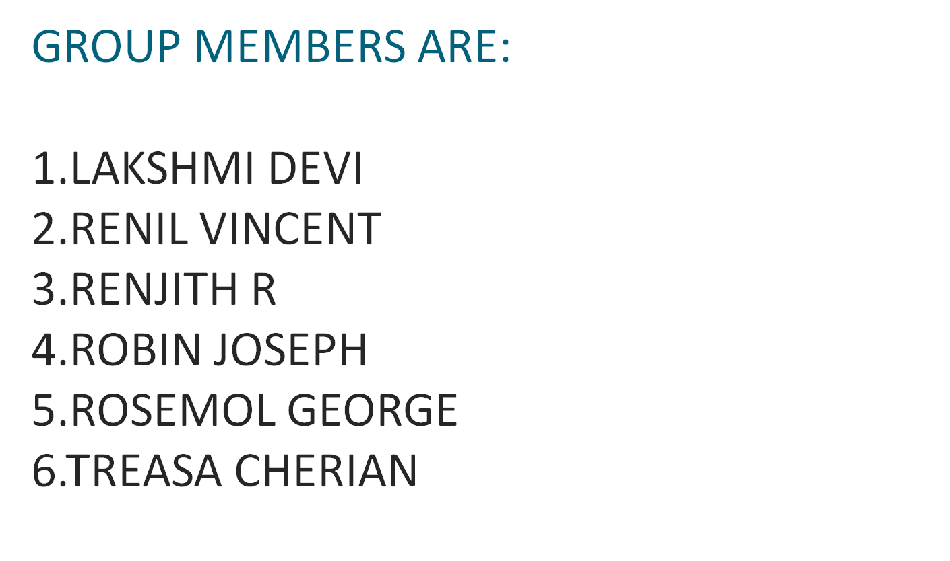

Slide 9


