Slide 1

NEETHU ROSE MATHEW
MELBIN B
LAMYA RAHMAN
THOMAS CHARLES
MEERA JOSE MAMPILLY
MEETHU KRISHNAN

Slide 2

Extreme Programming (XP) is a software development methodology which is intended to improve software quality and responsiveness to changing customer requirements.
The first Extreme Programming project was started March 6, 1996.
Extreme Programming is successful because it stresses customer satisfaction.
Extreme Programming empowers your developers to confidently respond to changing customer requirements, even late in the life cycle.
Extreme Programming emphasizes teamwork

Slide 3
Extreme Programming improves a software project in five essential ways; communication, simplicity, feedback, respect, and courage.
The most surprising aspect of Extreme Programming is its simple rules.
based on sound values and principles.
Unproductive activities have been trimmed to reduce costs and frustration of everyone involved
Extreme Programming implements a simple, yet effective environment enabling teams to become highly productive.

Slide 4

Extreme Programming was created by Kent Beck during his work on the Chrysler Comprehensive Compensation System (C3) payroll project.
The methodology, after all, takes "best practices" to extreme levels.

Slide 5

In traditional system development methods the requirements for the system are determined at the beginning of the development project and often fixed from that point on. This means that the cost of changing the requirements at a later stage (a common feature of software engineering projects) will be high.
XP attempts to reduce the cost of change by having multiple short development cycles, rather than one long one.

Slide 6
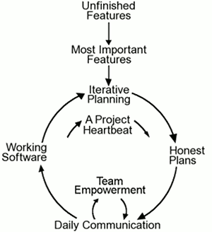
Pictorial Representation

Slide 7

Coding
1. figure out the most suitable solution.
2. figure out the most suitable solution.
Testing
Extreme Programming model’s approach is that if a little testing can eliminate a few flaws, a lot of testing can eliminate many more flaws.
Listening
Programmers must listen to what the customers need the system to do, what "business logic" is needed.
Designing
creating a design structure that organizes the logic in the system.

Slide 8

Extreme Programming improves a software project in five essential ways
Communication
Simplicity
Feedback
Courage
Respect

Slide 9

"Rules of Engagement" which dictate the environment in which software development can take place effectively, and
"Rules of Play" which define the minute-by-minute activities and rules within the framework of the Rules of Engagement.

Slide 10
Thank You
Thank you all for the wonderful cooperation and support !!!!!!

