Slide 1
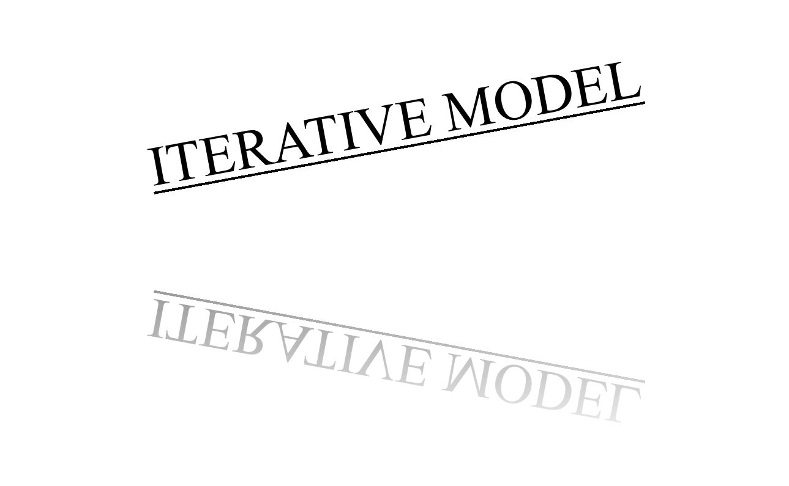

Submitted By :
Lakshmi V
Prajul P T
Priya Sekhar
Rahul Joseph
Rahul Manoharan
Rajesh Paul
Riya Elizabeth Sunny

Slide 2
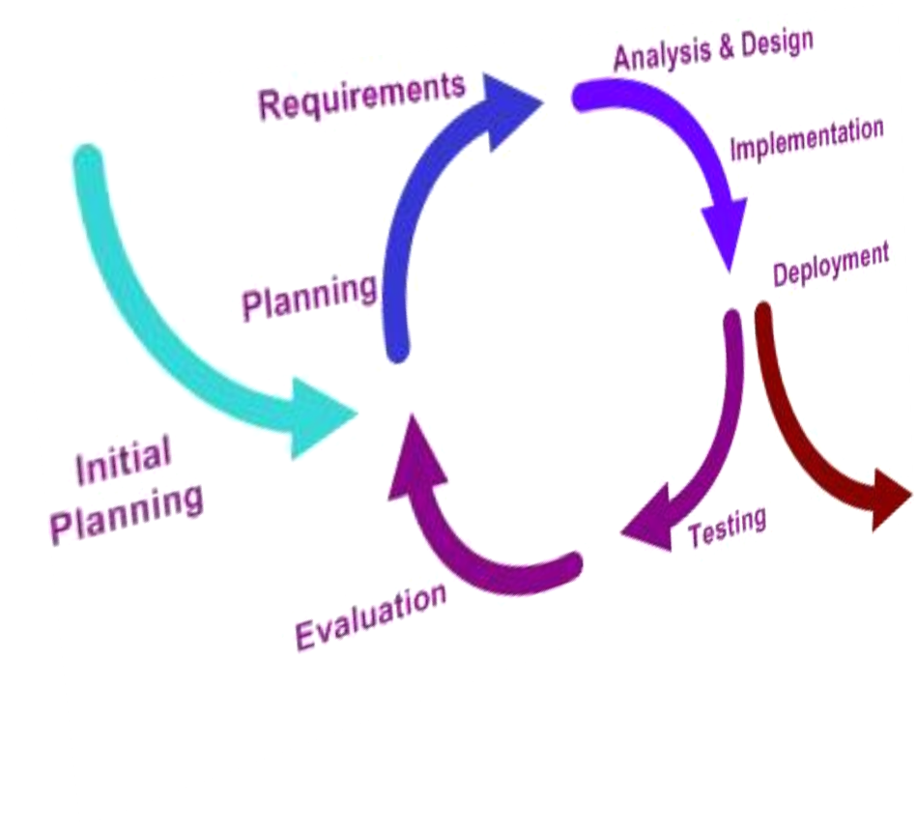
Flow of Operation in a Iterative Model

Slide 3
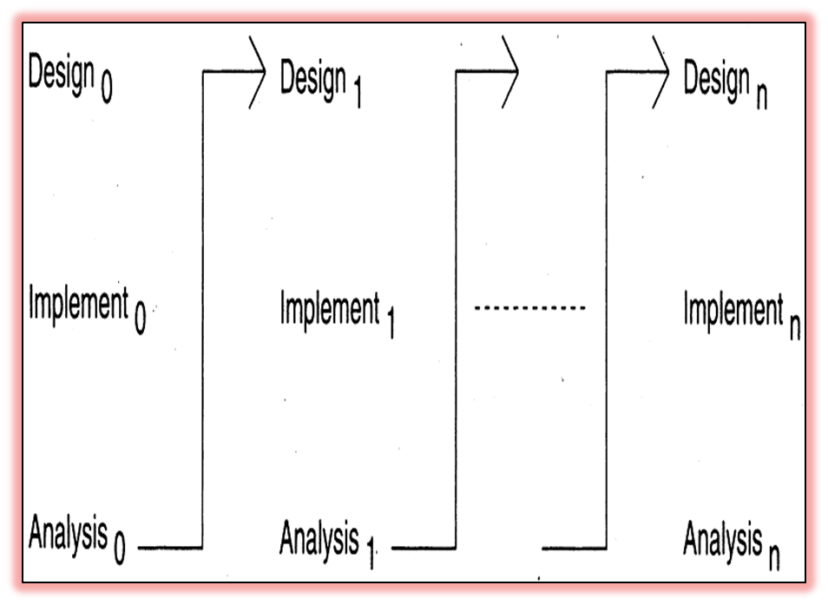
Principle
Develop a software system incrementally
Start with Simple Implementation
Iteratively enhance the evolving sequence
Design modifications are made
New functional capabilities are added

Slide 4
Procedure
Initialization Step
  Creates a base version of system, offers sampling of key aspects of the project, project control list is created, constantly revised in analysis phase
Iteration Step
  Redesign & implementation of task from PCL, may represent major source of documentation. Analysis of iteration is based on user feedback. Involves analysis of structure
Project Control List

Slide 5
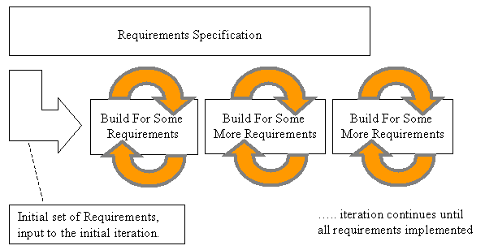
Iterative Model in General

Slide 6
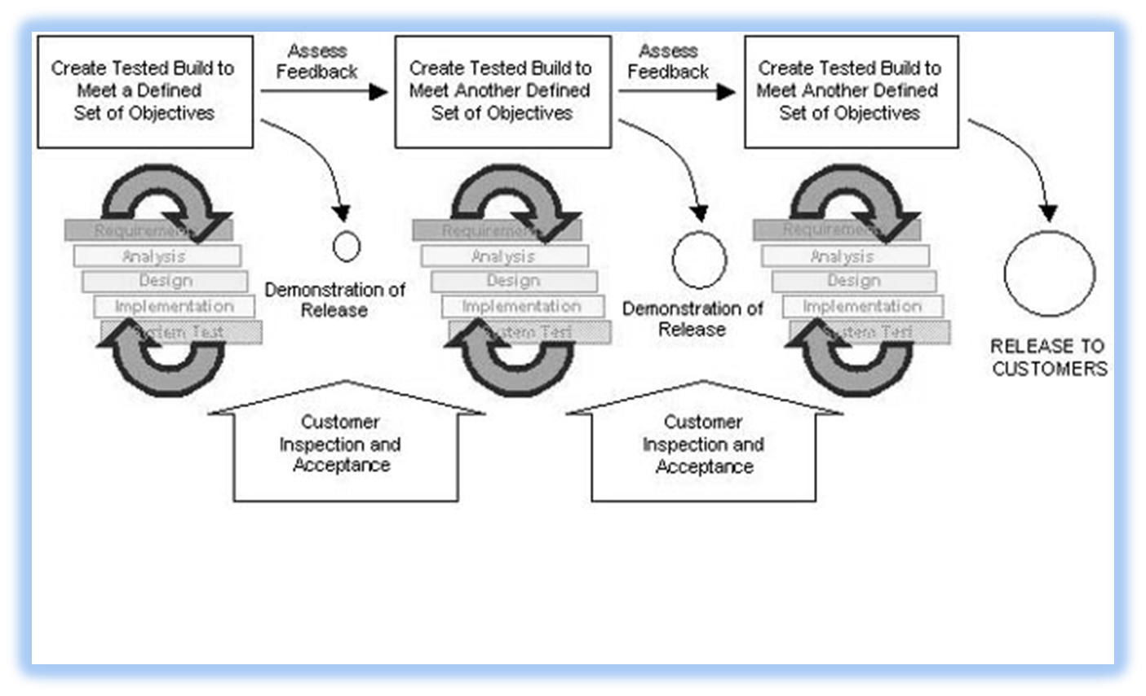
Iterative Model from perspective of Project Manager

Slide 7
Pros
Get as you pay
Obtain feedback for improvement
No risk of all or nothing
Cons
Architectural design may not be optional
Amendments may increase
Total cost of project maybe more

Slide 8
WHY IS IT BETTER THAN THE WATERFALL APPROACH??
It accommodates changing requirements
Integration is not one "big bang" at the end of a project
Early iterations expose risks
Management can make tactical changes to the product
It facilitates reuse
You can find and correct defects over several iterations
It facilitates better use of project personnel
Team members learn along the way
You can refine the development process along the way

Slide 9
Areas of application
Businesses which require quick response for software
Organizations which cannot afford the risk of
all-or-nothing
When all the requirements are not known beforehand.
Organizations which cannot afford the risk of long projects

Slide 10
Summary of what we have learnt
An iterative model of development thus:
Develops and deliver software in increments
Each increment of which is complete in itself
Can be viewed as a sequence of waterfalls
Feedback from iterations is used in the future iterations
Combines benefit of prototyping and waterfall models

Slide 11

The End!

