Slide 1
SOFTWARE DEVELOPMENT MODEL
PROTOTYPING
Presented By,
Group 4

Slide 2
WHAT IS PROTOTYPE ?
A working model that is functionally equivalent to a component of the product.
An incomplete version of the actual software to be developed.
Simulates only a few aspects of the features of the final program.

Slide 3
WHY PROTOTYPING ?
It’s important to be clear about why you’re building what you’re building before you start.
Prototyping is an iterative, trial-and-error process that takes place between the developers and the users.

Slide 4
PROTOTYPING INCLUDES :
Identify basic requirements
Develop Initial Prototype
Review
Revise and Enhance the Prototype

Slide 5
STEPS IN PROTOTYPING :
New system requirements in detail.
Preliminary design.
First prototype construction.
Thorough evaluation of the first prototype.

Slide 6
Modified second prototype construction.
Evaluation of second prototype.
Final prototype through iteration.
Final system construction.
Evaluation and testing of final system.

Slide 7
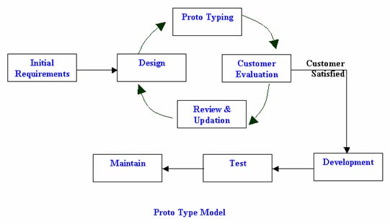

Slide 8
MAIN TYPES OF PROTOTYPING
Throwaway Prototyping
Evolutionary Prototyping
Incremental prototyping
Extreme prototyping

Slide 9
PROJECTS WHERE PROTOTYPING
CAN BE USED
Transaction processing
Batch processing(system with little user interaction)
Designing human-computer interface

Slide 10
ADVANTAGES
Active involvement of users.
A better system to users.
Better understanding through working model.
Easy error detection.

Slide 11
Reliable and better designed.
Quicker user feedback leading to better solutions.
Less development cost.
Easy comparison of software.
Accurate estimates.

Slide 12
DISADVANTAGES
Complexity of the system increases.
Implementing and then repairing way of building systems.
User confusion of prototype and finished system.
Insufficient analysis.

Slide 13
High cost.
Developer misunderstanding of user objectives.
Developer attachment to prototype.
Excessive development time of the prototype.
Expense of implementing prototyping.

Slide 14
THANK YOU !!!

