Slide 1
RAPID APPLICATION DEVELOPMENT
LINU PAUL
MARINA IYPE
KUKOO ANNA MATHEW
TRACY JOSEPH
NITHA K S
TONY JOHNSON

Slide 2
Major Topics
Introduction
History
Core Elements of RAD
Stages of RAD
RAD lifecycle
Advantages and Disadvantages of RAD
When use RAD

Slide 3
Introduction
RAD- software development methodology that focuses on building applications in a very short amount of time
Applications designed and developed within 60-90 days.
It is a process that involves application prototyping and iterative development.

Slide 4
Core Elements of RAD
Prototyping
Iterative development
Time boxing
Team members

Slide 5
Stages of RAD
Requirements Planning
User Design
Construction
Implementation

Slide 6
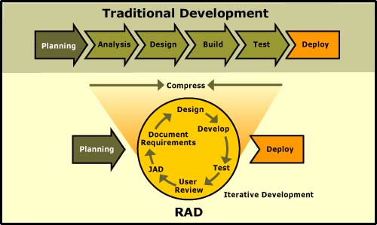
RAD lifecycle

Slide 7
Advantages of RAD
Increased Speed
Addressed through the use of CASE tools and Time Boxing.
Increased Quality
Attempts to deliver on quality through the heavy involving of users in the analysis and particularly the design stages.

Slide 8
Advantages of RAD
Greater flexibility: because developers can redesign almost at will
Early visibility: because of prototyping

Slide 9
Disadvantages of RAD
Reduced Scalability
Focuses is on development of a prototype that is iteratively developed into a full system,so the delivered solution may lack the scalability of a solution that was designed as a full application from the start.
Reduced Features
Due to time boxing, RAD may produce applications that are less full featured than traditionally developed applications.

Slide 10
When use RAD?
Project scope: focused, where the business objectives are well defined and narrow
Project team: very small (six people)
Project decisions: can be made by a small number of people at a faster rate.

Slide 11
THANK YOU

