Slide 1
SCRUM METHODOLOGY
STUDY GROUP VII
ROOPAN ROY JOHN SEBIN JOHN
SERENE M. THOMAS SHALINA AUGUSTINE SHAMLY MATHEW SHARANYA VINOD

Slide 2
WHAT IS SCRUM ?
Scrum is an iterative incremental framework for managing complex work (such as new product development) commonly used with agile software development.
Scrum was intended mainly for management of software development projects, but it can be used to run software maintenance teams, or as a general project/program management approach.

Slide 3
UNDERSTANDING SCRUM…
SCRUM is a management, enhancement and maintenance methodology for an existing system or production prototype.
SCRUM will address totally new or re-engineered legacy systems development efforts at a later date.
Software product releases are planned based on the following variables :
Customer requirements - how the current system needs enhancing.
Time pressure - what time frame is required to gain a competitive advantage.

Slide 4
Competition - what is the competition up to, and what is required to best them.
Quality - What is the required quality, given the above variables.
Vision - what changes are required at this stage to fulfill the system vision.
Resource - what staff and funding are available.

Slide 5
SCRUM PRINCIPLES
Scrum principles are consistent with the agile manifesto.
Small working teams -organized to “maximize communication, minimize overhead and maximize sharing of tacit, informal knowledge”.
The process must be adaptable to both technical and business changes “to ensure the best possible product is produced”
The process yields frequent software increments “that can be inspected, adjusted, tested, documented and built on”.

Slide 6
….PRINCIPLES(contd…)
Development work and the people who perform it are partitioned “into clean , low coupling partitions, or packets”.
Constant testing and documentation is performed as the product is built.
Scrum process provides the “ability to declare a product ‘done’ whenever required(because the competition just shipped, because the company needs the cash, because the user/customer needs the functions, because that was when it was promised…”)

Slide 7
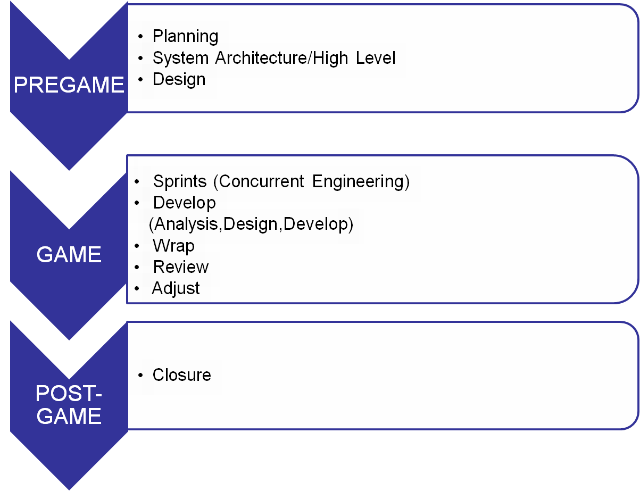
SCRUM METHODOLOGY

Slide 8
SCRUM PLAYERS
Scrum is a “process skeleton,” which contains sets of practices and predefined roles. The main roles in Scrum are:
the “Scrum Master”, who maintains the processes (typically in lieu of a project manager)
the “Product Owner”, who represents the stakeholders
the “Team”, a cross-functional group of about 7 people who do the actual analysis, design, implementation, testing, etc.

Slide 9
PROCESS PATTERNS…
Backlog –a prioritized list of project requirements or features that provide business value for the customer. Items can be added to the backlog at anytime (this is how changes are introduced).
Sprints – consists of work units that are required to achieve a requirement defined in the backlog that must be fit into a predefined time-box (typically 30 days).

Slide 10
Scrum meetings – are short(typically 15 minutes)meetings held daily by the scrum team.Three key questions are asked and answered by all team members
What did you do since the last team meeting?
What obstacles are you encountering?
What do you plan to accomplish by the next team meeting?

Slide 11
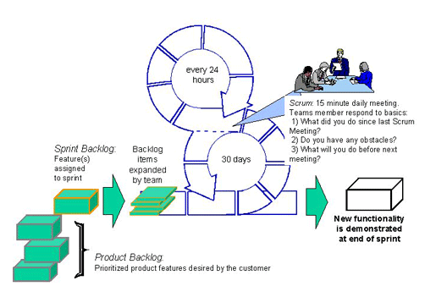
THE SCRUM PROCESS

Slide 12
CHARACTERISTICS OF SCRUM METHODOLOGY
The first and last phases (Planning and Closure) consist of defined processes, where all processes, inputs and outputs are well defined.
The Sprint phase is an empirical process.
Avoids chaos whle maximizing flexibility.
Sprints are nonlinear and flexible.
The project is open to the environment until the Closure phase.

Slide 13
…CHARACTERISTICS
The deliverable can be changed at any time during the Planning and Sprint phases of the project.
The project remains open to environmental complexity, including competitive time,quality, and financial pressures, throughout these phases.
The deliverable is determined during the project based on the environment.

Slide 14
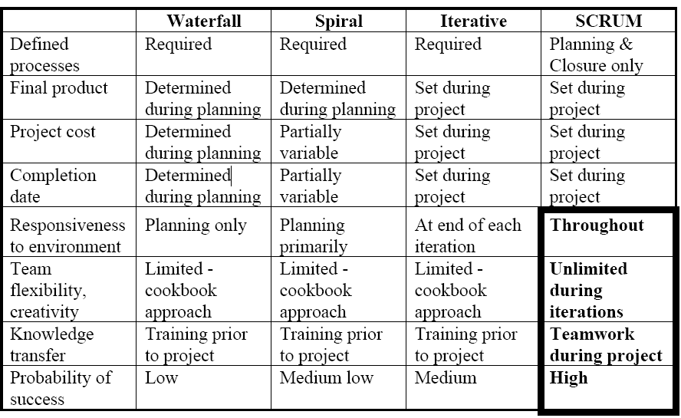
METHODOLOGY COMPARISONS

Slide 15
CHARACTERISTICS OF SCRUM PROJECTS
Flexible deliverable - the content of the deliverable is dictated by the environment.
Flexible schedule - the deliverable may be required sooner or later than initially planned.
Small teams - each team has no more than 6 members. There may be multiple teams within a project.
Frequent reviews - team progress is reviewed as frequently
Collaboration - intra and inter-collaboration is expected during the project.
Object Oriented - each team will address a set of related objects

Slide 16
Advantages of SCRUM methodology
The SCRUM methodology is designed to be quite flexible throughout.
It provides control mechanisms for planning a product release and then managing variables as the project progresses.
The SCRUM methodology frees developers to devise the most ingenious solutions throughout the project.
Small, collaborative teams of developers are able to share tacit knowledge about development processes.
Object Oriented technology provides the basis for the SCRUM methodology.
SCRUM may be selectively applied to procedural systems with clean interfaces and strong data orientation.

Slide 17
OPEN-DISCUSSION
THANK-YOU

