Slide 1
Nvidia CUDA Programming Basics
Xiaoming Li
Department of Electrical and Computer Engineering
University of Delaware

Slide 2
Overview
The Programming model
The Memory model
CUDA API basics
A simple example for a kernel function
Optimization of Gravit

Slide 3
CUDA Programming Model
The GPU is seen as a compute device to execute a portion of an application that
  Has to be executed many times
  Can be isolated as a function
  Works independently on different data
Such a function can be compiled to run on the device. The resulting program is called a Kernel

Slide 4
CUDA Programming Model
The batch of threads that executes a kernel is organized as a grid of thread blocks

Slide 5
CUDA Programming Model
Thread Block
  Batch of threads that can cooperate together
    Fast shared memory
    Synchronizable
    Thread ID
  Block can be one-, two- or three-dimensional arrays

Slide 6
CUDA Programming Model
Grid of Thread Block
  Limited number of threads in a block
  Allows larger numbers of thread to execute the same kernel with one invocation
  Blocks identifiable via block ID
  Leads to a reduction in thread cooperation
  Blocks can be one- or two-dimensional arrays

Slide 7
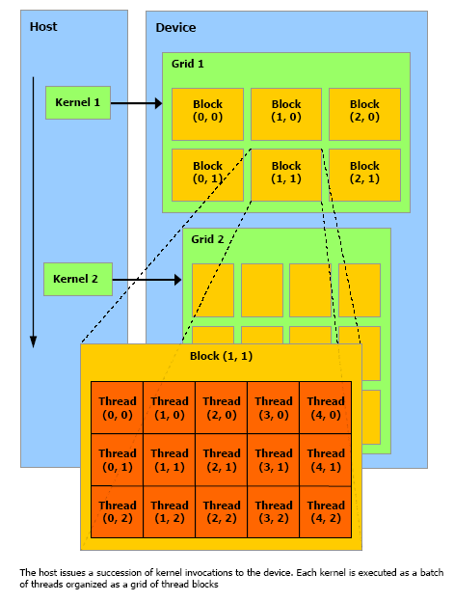
CUDA Programming Model

Slide 8
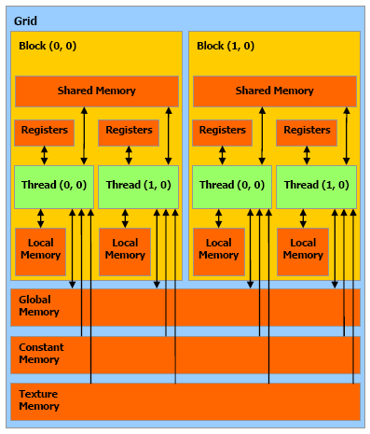
CUDA Memory Model

Slide 9
CUDA Memory Model
Shared Memory
  Is on-chip:
    much faster than the local and global memory,
    as fast as a register when no bank conflicts,
    divided into equally-sized memory banks.
  Successive 32-bit words are assigned to successive banks,
  Each bank has a bandwidth of 32 bits per clock cycle.

Slide 10
CUDA Memory Model
Shared Memory
    Reminder: warp size is 32, number of banks is 16
    memory request requires two cycles for a warp
      One for the first half, one for the second half of the warp
      No conflicts between threads from first and second half

Slide 11
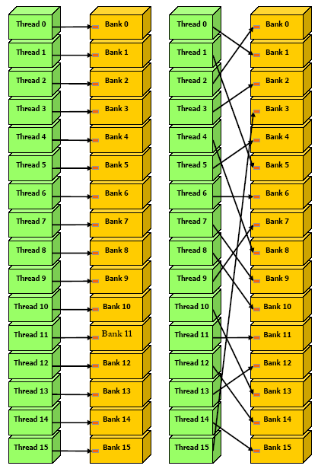
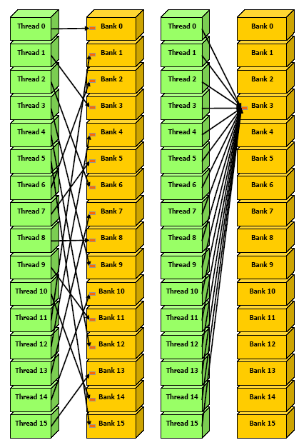
CUDA Memory Model
Shared Memory

Slide 12
CUDA API Basics
An Extension to the C Programming Language
  Function type qualifiers to specify execution on host or device
  Variable type qualifiers to specify the memory location on the device
  A new directive to specify how to execute a kernel on the device
  Four built-in variables that specify the grid and block dimensions and the block and thread indices

Slide 13
CUDA API Basics
Function type qualifiers
__device__
    Executed on the device
    Callable from the device only.
__global__
    Executed on the device,
    Callable from the host only.
__host__
    Executed on the host,
    Callable from the host only.

Slide 14
CUDA API Basics
Variable Type Qualifiers
__device__
    Resides in global memory space,
    Has the lifetime of an application,
    Is accessible from all the threads within the grid and from the host through the runtime library.
__constant__ (optionally used together with __device__)
    Resides in constant memory space,
    Has the lifetime of an application,
    Is accessible from all the threads within the grid and from the host through the runtime library.
__shared__ (optionally used together with __device__)
    Resides in the shared memory space of a thread block,
    Has the lifetime of the block,
    Is only accessible from all the threads within the block.

Slide 15
CUDA API Basics
Execution Configuration (EC)
  Must be specified for any call to a __global__ function.
  Defines the dimension of the grid and blocks
  specified by inserting an expression between function name and argument list:
  function:
  __global__ void Func(float* parameter);
  must be called like this:
  Func<<< Dg, Db, Ns >>>(parameter);

Slide 16
CUDA API Basics
Execution Configuration (EC)
  Where Dg, Db, Ns are :
  Dg is of type dim3 → dimension and size of the grid
    Dg.x * Dg.y = number of blocks being launched;
  Db is of type dim3 → dimension and size of each block
    Db.x * Db.y * Db.z = number of threads per block;
  Ns is of type size_t → number of bytes in shared memory that is dynamically allocated in addition to the statically allocated memory
    Ns is an optional argument which defaults to 0.

Slide 17
CUDA API Basics
Built-in Variables
  gridDim is of type dim3 →dimensions of the grid.
  blockIdx is of type uint3 → block index within the grid.
  blockDim is of type dim3 → dimensions of the block.
  threadIdx is of type uint3 → thread index within the block.

Slide 18
Example: Scalar Product
Calculate the scalar product of
  32 vector pairs
  4096 elements each
An efficient way to run that on the device is to organize the calculation in
  A grid of 32 blocks
  With 256 threads per block
This gives us 4096/265 = 16 slices per vector

Slide 19
Example: Scalar Product
The data will be handed to the device as two data arrays and the results will be saved in a result array
Each product of a vector pair An, Bn will be calculated in slices, which will be added up to obtain the final result
…
Vector A0
Vector A1
Vector AN-1
Vector B0
Vector B1
…
Vector BN-1
Results 0 to N-1
slice 0
slice 1
…
slice S-1
Vector A0
Vector B0
Partial results 0 to S-1
Results 0
Results 1

Slide 20
Example: Scalar Product
The host programm
int main(int argc, char *argv[]){
CUT_CHECK_DEVICE();
…
h_A = (float *)malloc(DATA_SZ);
…
cudaMalloc((void **)&d_A, DATA_SZ);
…
cudaMemcpy(d_A, h_A, DATA_SZ, cudaMemcpyHostToDevice);
…
ProdGPU<<<BLOCK_N, THREAD_N>>>(d_C, d_A, d_B);
…
cudaMemcpy(h_C_GPU, d_C, RESULT_SZ, cudaMemcpyDeviceToHost);
…
CUDA_SAFE_CALL( cudaFree(d_A) );
free(h_A);
…
CUT_EXIT(argc, argv);
}

Slide 21
Example: Scalar Product
The Kernel Function
Parameters:
  d_C: pointer to result array
  d_A, d_B pointers to input data
Local data arrays:
  t[]: results of single threads
  r[]: slice cache
I: Thread Id in block
__global__ void ProdGPU(float *d_C, float *d_A, float *d_B){
__shared__ float t[THREAD_N];
__shared__ float r[SLICE_N];
const int I = threadIdx.x;
for(int vec_n=blockIdx.x; vec_n<VECTOR_N; vec_n+=gridDim.x){
int base = ELEMENT_N * vec_n;
for(int slice = 0; slice < SLICE_N; slice++, base += THREAD_N){
t[I] = d_A[base + I] * d_B[base + I];
__syncthreads();
for(int stride = THREAD_N / 2; stride > 0; stride /= 2){
if(I < stride) t[I] += t[stride + I];
__syncthreads();
}
if(I == 0) r[slice] = t[0];
}
for(int stride = SLICE_N / 2; stride > 0; stride /= 2){
if(I < stride) r[I] += r[stride + I];
__syncthreads();
}
if(I == 0) d_C[vec_n] = r[0];
}
}

Slide 22
Example: Scalar Product
The Kernel Function
Run through every pair of input vectors
For our numbers it will only be executed once since:
Grid dimension == number of vectors
→ vector number = block Id
__global__ void ProdGPU(float *d_C, float *d_A, float *d_B){
__shared__ float t[THREAD_N];
__shared__ float r[SLICE_N];
const int I = threadIdx.x;
for(int vec_n=blockIdx.x; vec_n<VECTOR_N; vec_n+=gridDim.x){
int base = ELEMENT_N * vec_n;
for(int slice = 0; slice < SLICE_N; slice++, base += THREAD_N){
t[I] = d_A[base + I] * d_B[base + I];
__syncthreads();
for(int stride = THREAD_N / 2; stride > 0; stride /= 2){
if(I < stride) t[I] += t[stride + I];
__syncthreads();
}
if(I == 0) r[slice] = t[0];
}
for(int stride = SLICE_N / 2; stride > 0; stride /= 2){
if(I < stride) r[I] += r[stride + I];
__syncthreads();
}
if(I == 0) d_C[vec_n] = r[0];
}
}

Slide 23
Example: Scalar Product
The Kernel Function
Run through every slice of input vectors
Each thread calculates a single product and saves it
__global__ void ProdGPU(float *d_C, float *d_A, float *d_B){
__shared__ float t[THREAD_N];
__shared__ float r[SLICE_N];
const int I = threadIdx.x;
for(int vec_n=blockIdx.x; vec_n<VECTOR_N; vec_n+=gridDim.x){
int base = ELEMENT_N * vec_n;
for(int slice = 0; slice < SLICE_N; slice++, base += THREAD_N){
t[I] = d_A[base + I] * d_B[base + I];
__syncthreads();
for(int stride = THREAD_N / 2; stride > 0; stride /= 2){
if(I < stride) t[I] += t[stride + I];
__syncthreads();
}
if(I == 0) r[slice] = t[0];
}
for(int stride = SLICE_N / 2; stride > 0; stride /= 2){
if(I < stride) r[I] += r[stride + I];
__syncthreads();
}
if(I == 0) d_C[vec_n] = r[0];
}
}

Slide 24
Example: Scalar Product
The Kernel Function
Calculate the partial result for the slice
Save the partial result
__global__ void ProdGPU(float *d_C, float *d_A, float *d_B){
__shared__ float t[THREAD_N];
__shared__ float r[SLICE_N];
const int I = threadIdx.x;
for(int vec_n=blockIdx.x; vec_n<VECTOR_N; vec_n+=gridDim.x){
int base = ELEMENT_N * vec_n;
for(int slice = 0; slice < SLICE_N; slice++, base += THREAD_N){
t[I] = d_A[base + I] * d_B[base + I];
__syncthreads();
for(int stride = THREAD_N / 2; stride > 0; stride /= 2){
if(I < stride) t[I] += t[stride + I];
__syncthreads();
}
if(I == 0) r[slice] = t[0];
}
for(int stride = SLICE_N / 2; stride > 0; stride /= 2){
if(I < stride) r[I] += r[stride + I];
__syncthreads();
}
if(I == 0) d_C[vec_n] = r[0];
}
}
t[0] += t[128]
t[1] += t[129] t[0] += t[64]
t[2] += t[130] t[1] += t[65] … t[0] += t[1]
… …
… t[64]+= t[127]
t[127]+= t[255]

Slide 25
Example: Scalar Product
The Kernel Function
Add up the results for all slices
Save result to device memory
__global__ void ProdGPU(float *d_C, float *d_A, float *d_B){
__shared__ float t[THREAD_N];
__shared__ float r[SLICE_N];
const int I = threadIdx.x;
for(int vec_n=blockIdx.x; vec_n<VECTOR_N; vec_n+=gridDim.x){
int base = ELEMENT_N * vec_n;
for(int slice = 0; slice < SLICE_N; slice++, base += THREAD_N){
t[I] = d_A[base + I] * d_B[base + I];
__syncthreads();
for(int stride = THREAD_N / 2; stride > 0; stride /= 2){
if(I < stride) t[I] += t[stride + I];
__syncthreads();
}
if(I == 0) r[slice] = t[0];
}
for(int stride = SLICE_N / 2; stride > 0; stride /= 2){
if(I < stride) r[I] += r[stride + I];
__syncthreads();
}
if(I == 0) d_C[vec_n] = r[0];
}
}

Slide 26
A CUDA implementation of the Gravit

Slide 27
Basic Implementation
Each thread calculates the forces on one single particle
  Simple n² algorithm
  Set of particles can easily be divided into blocks
  Each block steps through all particles in slices and mirrors them into shared memory
  No communication needed between blocks
  Synchronization between threads only needed to guarantee shared memory consistency

Slide 28
Basic Implementation
Block 1
Block 2
…
Shared memory
Shared memory
Shared memory
positions and masses
velocities
Global Memory

Slide 29
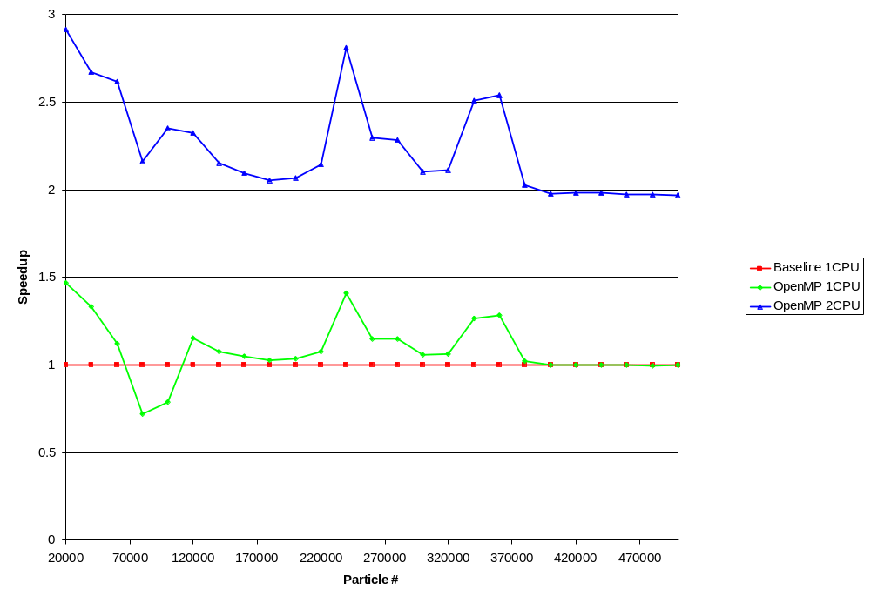
CPU/GPU Comparison

Slide 30
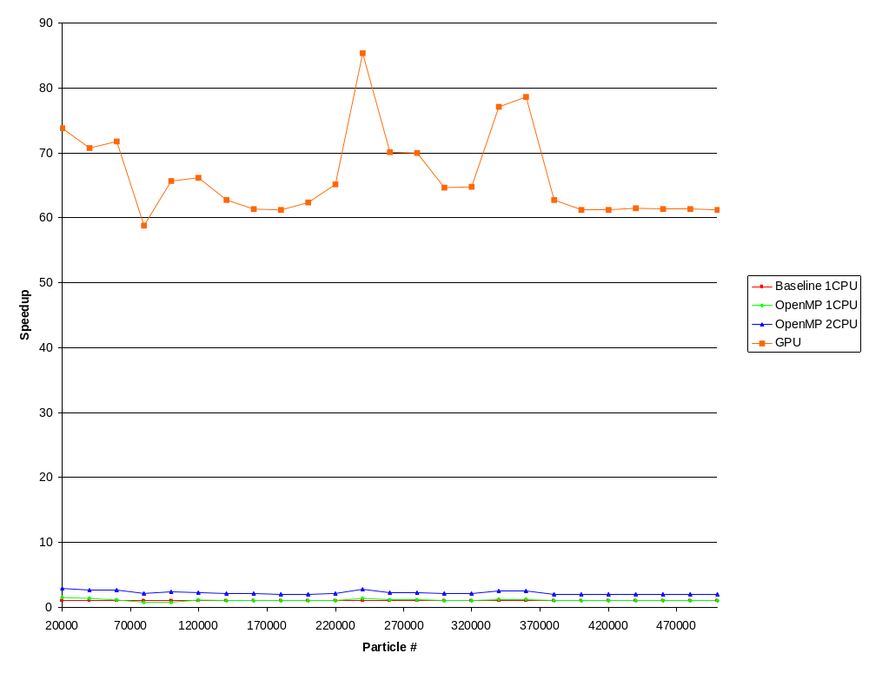
CPU/GPU Comparison

Slide 31
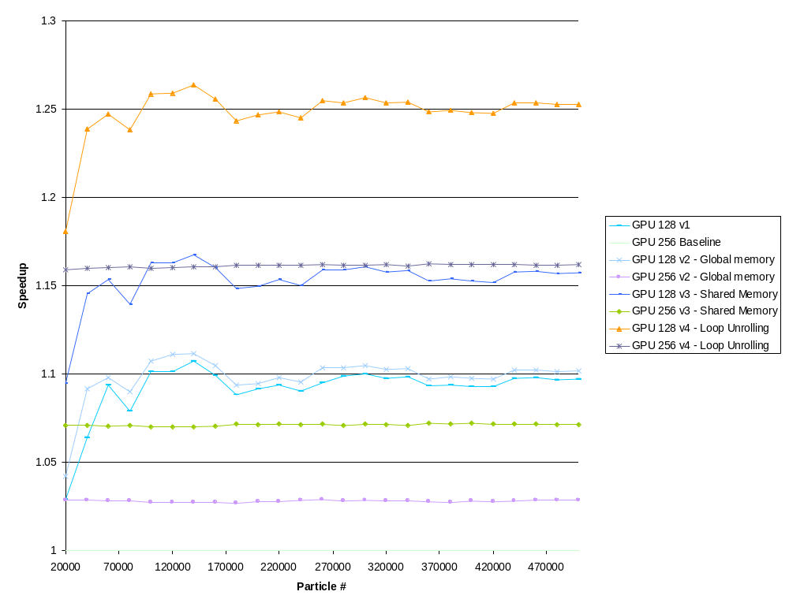
CPU/GPU Comparison

Slide 32
CPU/GPU Comparison
GPU Baseline speedup is approximately 60x
For 500,000 particles that is a reduction in calculation time from
33 minutes to 33 seconds!

Slide 33
Spatial Subdivision
Till now no benefit from this approach
  All different approaches till now didn’t lead to any improvement or didn’t work at all
Problems:
  Recursion
  Inter block communication/synchronization
  Memory usage → unknown sizes of result sets
  Few particles that travel versus infinity

Slide 34
Spatial Subdivision
Static subdivision → infinity problem

Slide 35
Conclusion / Future Work
Without optimization we already got an amazing speedup on CUDA
N² algorithm is “made” for CUDA
Optimizations are hard to predict in advance → tradeoffs
Some approaches to the spatial subdivision showed potential
There are ways to dynamically distribute workloads across a fixed number of blocks
Biggest problem: how to handle dynamic results in global memory

Slide 36
Questions?

