Slide 1
CIS 700/010: GPU Programming and Architecture
Suresh Venkatasubramanian
(suvenkat@saul.cis.upenn.edu)

Slide 2

ATI Animusic Demo

Slide 3
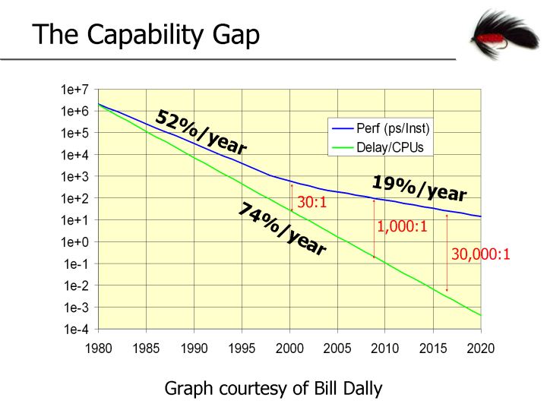
CPU performance growth is slowing

Slide 4
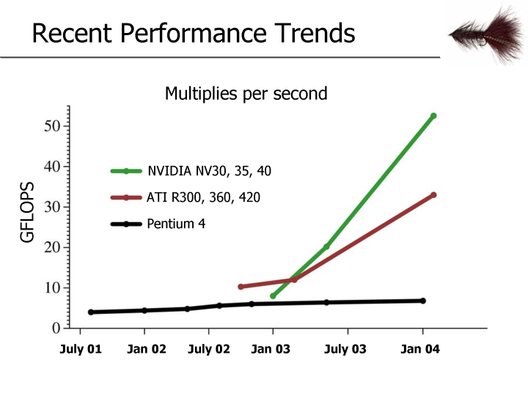
Why Program on the GPU ?
From ‘Stream Programming Environments’ – Hanrahan, 2004.

Slide 5
How has this come about ?
Game design has become ever more sophisticated.
Fast GPUs are used to implement complex shader and rendering operations for real-time effects.
In turn, the demand for speed has led to ever-increasing innovation in card design.
The NV40 architecture has 225 million transistors, compared to about 175 million for the Pentium 4 EE 3.2 Ghz chip.

Slide 6
GPU = Fast co-processor ?
GPU speed increasing at cubed-Moore’s Law.
This is a consequence of the data-parallel streaming aspects of the GPU.
GPUs are cheap ! Put enough together, and you can get a super-computer.
So can we use the GPU for general-purpose computing ?

Slide 7
Yes ! Wealth of applications
Data Analysis
Motion Planning
Voronoi Diagrams
Particle Systems
Geometric Optimization
Force-field simulation
Molecular Dynamics
Graph Drawing
Physical Simulation
Matrix Multiplication
Database queries
Conjugate Gradient
Sorting and Searching
Range queries
Signal Processing
… and graphics too !!

Slide 8
When does “GPU=fast co-processor” work ?
Real-time visualization of complex phenomena
The GPU (like a fast parallel processor) can simulate physical processes like fluid flow, n-body systems, molecular dynamics

Slide 9
When does “GPU=fast co-processor” work ?
Interactive data analysis
For effective visualization of data, interactivity is key

Slide 10
When does “GPU=fast co-processor” work ?
Rendering complex scenes (like the Animusic demo)
Procedural shaders can offload much of the expensive rendering work to the GPU. Still not the Holy Grail of “80 million triangles at 30 frames/sec*”, but it helps.
* Alvy Ray Smith, Pixar.

Slide 11
Follow the language
GPU architecture details hidden (unlike CPUs).
OpenGL (or DirectX) provides a state machine that represents the rendering pipeline.
Early GPU programs used properties of the state machine to “program” the GPU.
Tools like Renderman provided sophisticated shader languages, but these were not part of the rendering pipeline.

Slide 12
A Unifying theme: Streaming
All the language models share basic properties:
They view the frame buffer as an array of “pixel computers”, with the same program running at each pixel (SIMD)
Fragments are streamed to each pixel computer
The pixel programs have limited state.

Slide 13
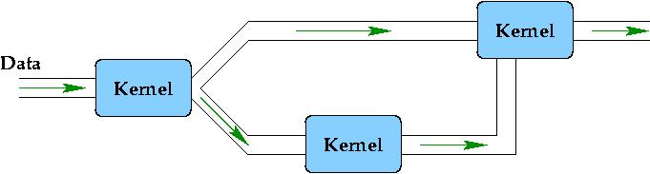
What is stream programming?
A stream is a sequence of data (could be numbers, colors, RGBA vectors,…)
A kernel is a (fragment) program that runs on each element of a stream, generating an output stream (pixel buffer).

Slide 14
Stream Program => GPU
Kernel = vertex/fragment program
Input stream = stream of fragments or vertices or texture data
Output stream = frame buffer or pixel buffer or texture.
Multiple kernels = multi-pass rendering sequence on the GPU.

Slide 15
To program the GPU, one must think of it as a (parallel) stream processor.

Slide 16
The GPGPU Challenge
Be cognizant of the stream nature of the GPU.
Design algorithms that minimize cost under streaming measures of complexity rather than traditional measures.
Implement these algorithms efficiently on the GPU, keeping in mind the limited resources (memory, program length) and various bottlenecks (geometry, fill rate) on the card.

