Slide 1
GPU COMPUTING
By:
K.GEETHIKA
S7 CSE
RSET
24.09.2010

Slide 2
CONTENTS
Introduction
GPU architecture
GPU computing
Software Environments
Conclusion
References

Slide 3
INTRODUCTION
GPU -processor optimized for 2D/3D graphics, video, visual computing, and display.
Highly parallel, highly multithreaded multiprocessor.
The use of a GPU (graphics processing unit) to do general purpose scientific and engineering computing.

Slide 4
INTRODUCTION(contd..)
Transformation of the traditional fixed function processor to the highly parallel programmable processor.
Traditional GPUs were built around the graphics pipeline.
Excelled at 3D graphics alone.
Present systems are programmable and powerful.

Slide 5
GPU ARCHITECTURE
Graphics Pipeline :
Input : list of geometric primitives(triangles) in the world coordinate system
Output : final picture on the screen.
Steps in the pipeline:
1.Vertex operations
2.Primitive assembly
3.Rasterization
4.Fragment operations
5.Composition

Slide 6
GPU ARCHITECTURE(contd.)
host
interface
vertex
processing
triangle
setup
pixel
processing
memory
interface
Fig. Block diagram of a graphics pipeline

Slide 7
GPU ARCHITECTURE(contd.)
Host Interface
Communication bridge between the CPU and the GPU.
Receives commands from the CPU and also pulls geometry information from system memory.
Outputs a stream of vertices in object space with all their associated information (normals, texture coordinates, per vertex color etc) .

Slide 8
GPU ARCHITECTURE(contd.)
Vertex Processing
Receives vertices from the host interface in object space and outputs them in screen space
May be a simple linear transformation, or a complex operation involving morphing effects
No new vertices are created in this stage, and no vertices are discarded

Slide 9
GPU ARCHITECTURE(contd.)
Triangle Setup
In this stage geometry information becomes raster information (screen space geometry is the input, pixels are the output)
Prior to rasterization, triangles located outside the viewing frustrum are rejected

Slide 10
GPU ARCHITECTURE(contd.)
Fragment Processing
Each fragment provided by triangle setup is fed into fragment processing as a set of attributes which are used to compute the final color for this pixel
The computations taking place here include texture mapping and math operations
Typically the bottleneck in modern applications

Slide 11
GPU ARCHITECTURE(contd.)
Memory Interface
Fragment colors provided by the previous stage are written to the framebuffer
Used to be the biggest bottleneck before fragment processing took over
Before the final write occurs, some fragments are rejected by the zbuffer, stencil and alpha tests
On modern GPUs, z and color are compressed to reduce framebuffer bandwidth(but not size)

Slide 12
GPU ARCHITECTURE(contd.)
Evolution of GPU architecture: The fixed function pipeline lacked the capability to express operations for complex effects. Hence the development of more capable vertex and fragment programs.
Evolution of shader model for current GPUs.
Programmable engine surrounded by supporting fixed function units.

Slide 13
GPU ARCHITECTURE(contd.)
Architecture of modern GPUs: divides the resources of the processor among the different stages, such that the pipeline is divided in space.
Reasons for this to be successful in fixed function GPUs:
1.exploit data parallelism within that stage, processing multiple elements at the same time.

Slide 14
GPU ARCHITECTURE(contd.)
2.could be customized with special-purpose hardware for its given task, allowing substantially greater compute and area efficiency over a general-purpose solution.
Therefore, a lengthy, feed-forward GPU pipeline with many stages, each typically accelerated by special purpose parallel hardware.
The major disadvantage of the GPU task-parallel pipeline is load balancing.

Slide 15
GPU ARCHITECTURE(contd.)
Unified shader model
All programmable units in the pipeline share a single programmable hardware unit.
The programmable units now divide their time among vertex work, fragment work, and geometry work.
Can exploit both task and data parallelism.

Slide 16
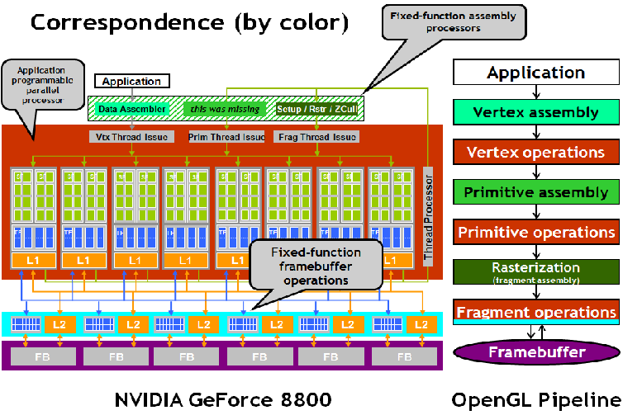

Slide 17
GPU COMPUTING
The GPU Programming Model
follow a single program multiple-data (SPMD) programming model.
Processes many elements in parallel using the same program for efficiency.
‘Gather’ and ‘scatter’ operations.
SIMD programs.

Slide 18
GPU COMPUTING(contd.)
B. General-Purpose Computing on the GPU
1)Programming a GPU for Graphics
2) Programming a GPU for General-Purpose Programs(Old)
3) Programming a GPU for General-Purpose Programs (New)

Slide 19
SOFTWARE ENVIRONMENTS
Cg/HLSL/GLSL
-With DirectX 9,higher level shader programming possible through HLSL.
-NVIDIAs’ Cg compiles to multiple targets and 1st HLL for OpenGL.
-GLSL-the standard shading language for OpenGL.
-Inherently shading languages.
BrookGPU and Sh
-stream programming model.
-offline compilation.

Slide 20
SOFTWARE ENVIRONMENTS(contd.)
Microsofts’ Accelerator
-array based language on C#.
-JIT compilation.
RapidMind
-Much more focused on computation.
-delayed evaluation and online compilation.
Peakstream
-designed around operations on arrays.
-first to provide profiling and debugging support.

Slide 21
SOFTWARE ENVIRONMENTS(contd.)
AMDs’ HAL and CAL
-No graphic specific features are exported.
-HAL-assembly level access to fragment engines(stream processors) along with assembler and command buffers to control execution on the hardware.
-CAL adds more higher level constructs.
NVIDIAs’ CUDA
-C like syntax for executing on the GPU.
-offline compilation.
-exposes 2 levels of parallelism.

Slide 22
CONCLUSION
Future computing systems will be parallel core GPUs combined with multi-core CPUs.
GPUs are hence designed for certain applications with these characteristics:
-Large computational requirements.
-Throughput is more important than latency.
-Parallelism is substantial.

Slide 23
REFERENCES
[1] John D. Owens, Mike Houston, David Luebke, Simon Green, John E. Stone, and James C. Phillips, GPU Computing, Proceedings of the IEEE, Vol. 96, No. 5, May 2008,page no:879-899.
[2] http://www.nvidia.com/object/GPU_Computing. html
[3] Prof. Roger Crawfis ,Modern GPU architectures: Game Design and Project, CSE 694G

Slide 24
THANK YOU

Slide 25
Questions??

