Slide 1
Bezier Curves
CS 319
Advanced Topics in Computer Graphics
John C. Hart

Slide 2
Parametric Curves
p(t)
Function p of single parameter t
  p(t) = (t,x(t)) (explicit) function curve
  p(t) = (x(t), y(t)) plane curve
  p(t) = (x(t), y(t), z(t)) space curve
Tangent
  p’(t) points in tangent direction
  p’(t) = (x’(t), y’(t), z’(t))
  p’(t)/||p’(t)|| – tangent direction
  ||p’(t)|| – parametric velocity
t = 0
t = 1
p(t)
p’(t)
t = 0
t = 1

Slide 3
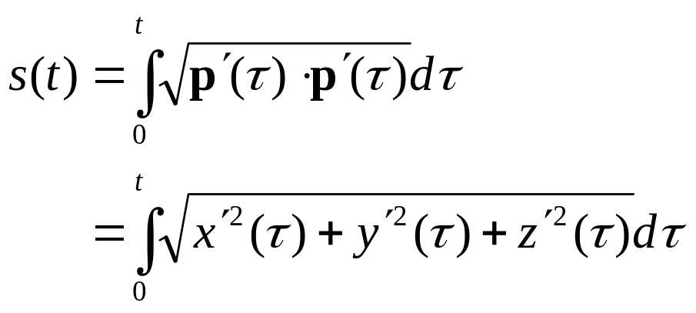
Arc Length
p(t)
p’(t)
Arc length parameterization
Parameter s defined as parameter t where length of curve from p(0) to p(t) equals s
p(s) = {p(t) : s(t) = s}
Velocity |p’(s)| = 1
t = 0
t = 1
p(s)
p’(s)
s = 0
s = curve length

Slide 4
Arc Length Example
Circular helix
p(t) = (r cos t, r sin t, c t)
  Parameter r controls radius of spiral
  Parameter c controls how quickly p winds around the z axis
Tangent
p’(t) = (-r sin t, r cos t, c)
Square
p’(t)⋅p’(t) = (r² + c²)
Integrate
s(t) = t (r² + c²)^{1/2}

Slide 5
Curvature
p(s)
p’(s)
Extrinsic Curvature
  Arc length
κ = ||p’’(s)||
  Plane curve
κ = (x’(t) y’’(t) – y’(t) x’’(t))/(x’²(t) + y’²(t))^{3/2}
  Space curve
κ = ||p’(t) × p’’(t)|| / |p’(t)|³
Osculating circle
  Radius of curvature ρ(s) = 1/κ(s)
  Curvature units: 1/m
s = 0
s = curve length

Slide 6
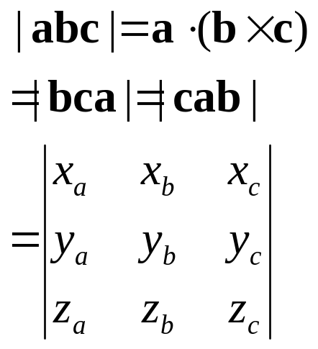
Torsion
Triple Scalar Product
τ(s) = ρ(s) p’(s)⋅(p’’(s) × p’’’(s))
= ρ(s) |p’(s) p’’(s) p’’’(s)|
Positive for “right handed” curves
Negative for “left handed” curves

Slide 7
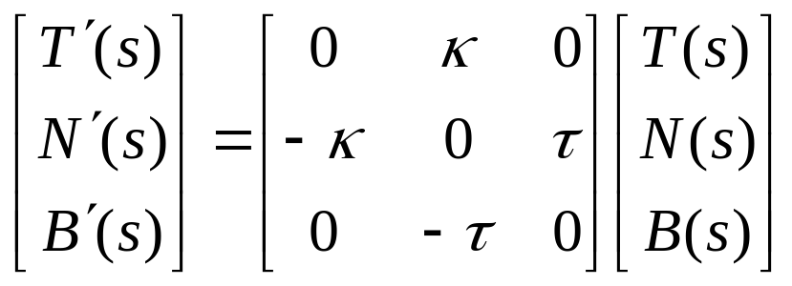
Frenet Frame
p(s)
p’(s)
p’’(s)
Tangent: T(s) = p’(s)
  Already unit length since parameterized by arc length
Normal: N(s) = p’’(s)/||p’’(s)||
  Normal points “inside” curve
  Also p’’(s)/κ(s) or ρ(s) p’’(s)
Binormal: B(s) = T(s)×N(s)
Frenet Frame: (T(s),N(s),B(s))
s = 0
s = curve length
Frenet Formulas

Slide 8
Bezier Curves
p₁ = x₁,y₁
p₂ = x₂,y₂
p(t) = Σ_{i=0..3} B_{i}(t) p_{i}
B_{i}(t) = (³_{i}) t^{i} (1-t)^{3-i}
p₀ = x₀,y₀
p₃ = x₃,y₃
p(t) = (1-t)³p₀ + 3(1-t)²tp₁ + 3(1-t)t²p₂ + t³p₃
coordinate
system
dependent!
x(t) = (1-t)³x₀ + 3(1-t)²tx₁ + 3(1-t)t²x₂ + t³x₃
y(t) = (1-t)³y₀ + 3(1-t)²ty₁ + 3(1-t)t²y₂ + t³y₃

Slide 9
Bernstein Polynomials
B₀³(t)
B₃³(t)
B₁³(t)
B₂³(t)
Defined for any degree
B_{i}^{n}(t) = (^{n}_{i}) t^{i} (1-t)^{n-i}
n choose i
(^{n}_{i}) = n!/(i!(n – i)!) = (^{n}_{i}⁻ ¹) + (^{n}_{i}⁻₋¹₁)
Partition of unity
  Sum to one for any t in [0,1]
Σ_{i=1..n} B_{i}^{n}(t) = 1
Higher degrees lerps of lower degrees
B_{i}^{n}(t) = (^{n}_{i}) t^{i} (1-t)^{n-i}
= (^{n}_{i}⁻ ¹) t^{i} (1-t)^{n-i} + (^{n}_{i}⁻₋¹₁) t^{i} (1-t)^{n-i}
= (1-t)B_{i}^{n-1}(t) + tB_{i}^{n}₋⁻₁¹(t)
1 2 3 … i i+1… n-2 n-1 n
(1 2 3 … i) (1 2 3 … n-i)
=
i+1… n-2 n-1 i i+1… n-2 n-1
1 2 3 … n-i-1 1 2 3 … n-i
+
Hint: Multiply left
term by (n-i)/(n-i)

Slide 10
Building Bernsteins
B_{i}^{n}(t) = (1-t)B_{i}^{n-1}(t) + tB_{i}^{n}₋⁻₁¹(t)
=
B₀²(t) = (1-t) B₀¹(t)
=
+
B₁²(t) = (1-t) B₁¹(t) + t B₀¹(t)
=
B₂²(t) = t B₁¹(t)

Slide 11
Bezier Properties
p₁
p₂
Affine invariance
  Barycentric combination
Control points form convex hull
  Bernstein basis in [0,1]
Endpoint interpolation
B₀^{n}(0) = 1; B_{n}^{n}(1) = 1
Symmetry
B_{i}^{n}(t) = B_{n}^{n}_{- i}(1 – t)
Derivatives
B’_{i}^{n}(t) = n(B_{i}^{n}₋⁻₁¹(t) – B_{i}^{n-1}(t))
p₀
p₃
B₀³(t)
B₃³(t)
B₁³(t)
B₂³(t)

Slide 12
de Casteljau Algorithm
p₁
p₁₂
p₀₁₂
p₂
1-t
Cascading lerps
  p₀₁ = (1-t) p₀ + t p₁
  p₁₂ = (1-t) p₁ + t p₂
  p₂₃ = (1-t) p₂ + t p₃
  p₀₁₂ = (1-t) p₀₁ + t p₁₂
  p₁₂₃ = (1-t) p₁₂ + t p₂₃
  p₀₁₂₃ = (1-t) p₀₁₂ + t p₁₂₃
Subdivides curve at p₀₁₂₃
  p₀ p₀₁ p₀₁₂ p₀₁₂₃
  p₀₁₂₃ p₁₂₃ p₂₃ p₃
Repeated subdivision converges to curve
p₁₂₃
p₀₁₂₃
p₀₁
t
p₂₃
p₀
p₃
coordinate
free!

Slide 13
Degree Elevation
p₁
1/2
q₂
1/2
1/4
p₂
q₁
Used to add more control
over a curve
Start with
Σ p_{i} (^{n}_{i}) t^{i} (1-t)^{n-i} = Σ q_{i} (^{n}_{i}⁺ ¹) t^{i} (1-t)^{n+1-i}
Now figure out the q_{i}
(t+(1-t)) Σ p_{i} (^{n}_{i}) t^{i} (1-t)^{n-i}
= Σ p_{i} (^{n}_{i}) (t^{i} (1-t)^{n+1-i} + t^{i+1} (1-t)^{n-i})
Compare coefficients
q_{i}(^{n}_{i}⁺ ¹) = p_{i}(^{n}_{i}) + p_{i-1}(^{n}_{i-1})
q_{i} = (i/(n+1))p_{i-1} + (n+1-i/(n+1))p_{i}
Repeated elevation converges to curve
1/4
q₃
3/4
3/4
p₀=q₀
p₃=q₄

Slide 14
Blossoms
Defines a polar form f(…) for a polynomial F(t)
Number of blossom parameters = degree of polynomial (n)
Symmetric
  f(t₁,t₂,t₃) = f(t₂,t₁,t₃) = f(t₃,t₂,t₁)
Multiaffine
  f(…,Σ a_{i} t_{i},…) = Σ a_{i} f(…, t_{i},…)
Evaluation by diagonalization
  F(t) = f(t,t,…,t)
  F^{(q)}(t) = n!/(n-q)! f(t,t,…,t,1,…,1)
q

Slide 15
Bezier Blossoming
f(0,0,1)
f(0,t,1)
f(0,t,t)
f(0,1,1)
f(t,t,t)
f(t,t,1)
f(0,0,t)
p(t) = f(t,t,t)
f(t,1,1)
f(0,0,0)
f(1,1,1)
p(t) = f(t,t,t) = (1-t) f(t,t,0) + t f(t,t,1)
= (1-t)[(1-t) f(t,0,0) + t f(t,0,1)] + t [(1-t) f(t,0,1) + t f(t,1,1)]
= (1-t)² f(t,0,0) + 2 (1-t) t f(t,0,1) + t² f(t,1,1)
= (1-t)³ f(0,0,0) + 3 (1-t)² t f(0,0,1) + 3 (1-t) t² f(0,1,1) + t³ f(1,1,1)

Slide 16
Systolic Array
f(t,t,t)
(1-t)
t
f(0,t,t)
f(t,t,1)
(1-t)
t
(1-t)
t
f(0,0,t)
f(0,t,1)
f(t,1,1)
(1-t)
t
(1-t)
t
(1-t)
t
f(0,0,0)
f(0,0,1)
f(0,1,1)
f(1,1,1)

