Slide 1
Last Time
Many, many modeling techniques
  Polygon meshes
  Parametric instancing
  Hierarchical modeling
  Constructive Solid Geometry
  Sweep Objects
  Octrees
  Blobs and Metaballs and other such things
  Production rules

Slide 2
Today
Parametric curves
  Hermite curves
  Bezier curves
Homework 5 Due
Project 3 Available

Slide 3
Shortcomings So Far
The representations we have looked at so far have various failings:
  Meshes are large, difficult to edit, require normal approximations, …
  Parametric instancing has a limited domain of shapes
  CSG is difficult to render and limited in range of shapes
  Implicit models are difficult to control and render
  Production rules work in highly limited domains
Parametric curves and surfaces address many of these issues
  More general than parametric instancing
  Easier to control than meshes and implicit models

Slide 4
What is it?
Define a parameter space
  1D for curves
  2D for surfaces
Define a mapping from parameter space to 3D points
  A function that takes parameter values and gives back 3D points
The result is a parametric curve or surface
Mapping:F:t→(x,y)
0
1
t

Slide 5
Why Parametric Curves?
Parametric curves are intended to provide the generality of polygon meshes but with fewer parameters for smooth surfaces
  Polygon meshes have as many parameters as there are vertices (at least)
Fewer parameters makes it faster to create a curve, and easier to edit an existing curve
Normal fields can be properly defined everywhere
Parametric curves are easier to animate than polygon meshes

Slide 6
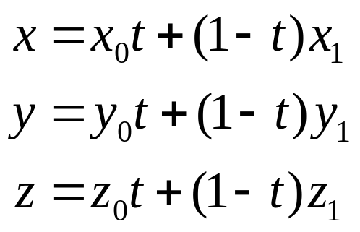
Parametric Curves
We have seen the parametric form for a line:
Note that x, y and z are each given by an equation that involves:
  The parameter t
  Some user specified control points, x₀ and x₁
This is an example of a parametric curve

Slide 7
Hermite Spline
A spline is a parametric curve defined by control points
  The term spline dates from engineering drawing, where a spline was a piece of flexible wood used to draw smooth curves
  The control points are adjusted by the user to control the shape of the curve
A Hermite spline is a curve for which the user provides:
  The endpoints of the curve
  The parametric derivatives of the curve at the endpoints (tangents with length)
    The parametric derivatives are dx/dt, dy/dt, dz/dt
  That is enough to define a cubic Hermite spline, more derivatives are required for higher order curves

Slide 8
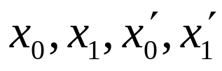

Hermite Spline (2)
Say the user provides
A cubic spline has degree 3, and is of the form:
  For some constants a, b, c and d derived from the control points, but how?
We have constraints:
  The curve must pass through x₀ when t=0
  The derivative must be x’₀ when t=0
  The curve must pass through x₁ when t=1
  The derivative must be x’₁ when t=1

Slide 9
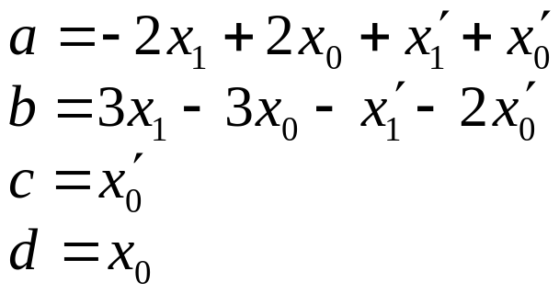
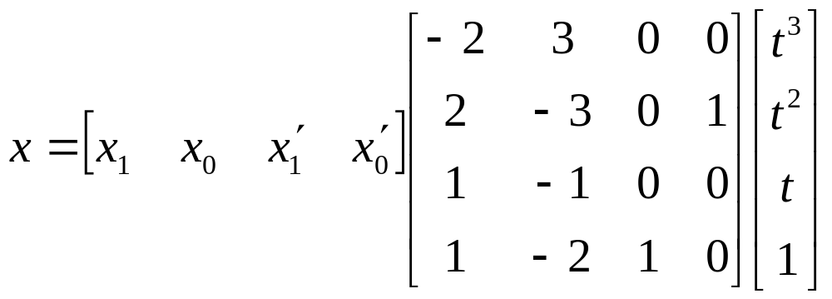
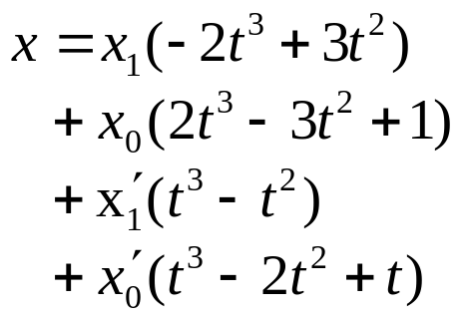
Hermite Spline (3)
Solving for the unknowns gives:
Rearranging gives:
or

Slide 10
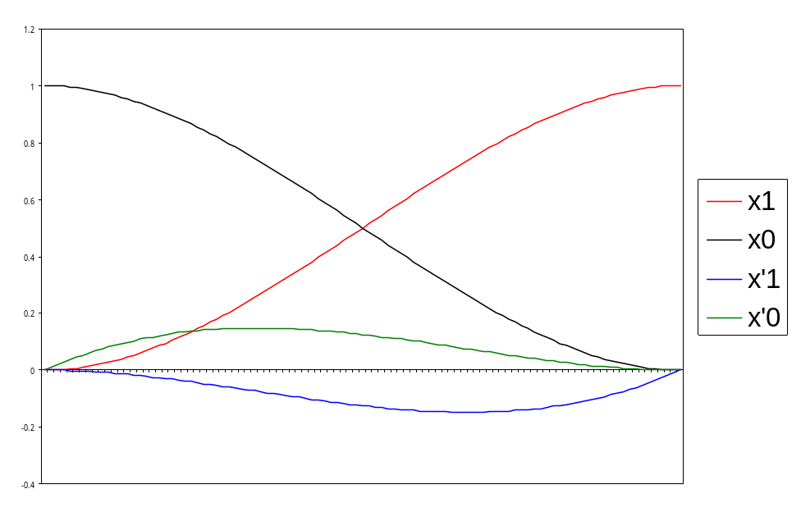
Basis Functions
A point on a Hermite curve is obtained by multiplying each control point by some function and summing
The functions are called basis functions

Slide 11
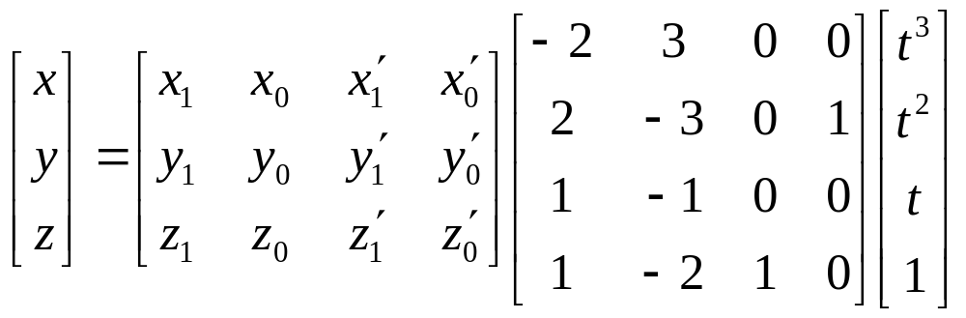
Splines in 2D and 3D
We have defined only 1D splines: x=f(t:x₀,x₁,x’₀,x’₁)
For higher dimensions, define the control points in higher dimensions (that is, as vectors)

Slide 12
Bezier Curves (1)
Different choices of basis functions give different curves
  Choice of basis determines how the control points influence the curve
  In Hermite case, two control points define endpoints, and two more define parametric derivatives
For Bezier curves, two control points define endpoints, and two control the tangents at the endpoints in a geometric way

Slide 13
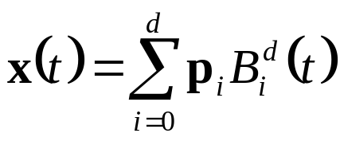
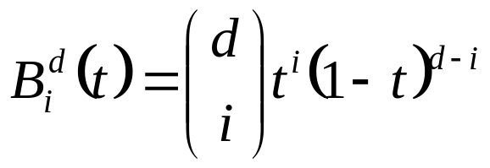
Bezier Curves (2)
The user supplies d control points, p_{i}
Write the curve as:
The functions B_{i}^{d} are the Bernstein polynomials of degree d
  Where else have you seen them?
This equation can be written as a matrix equation also
  There is a matrix to take Hermite control points to Bezier control points

Slide 14
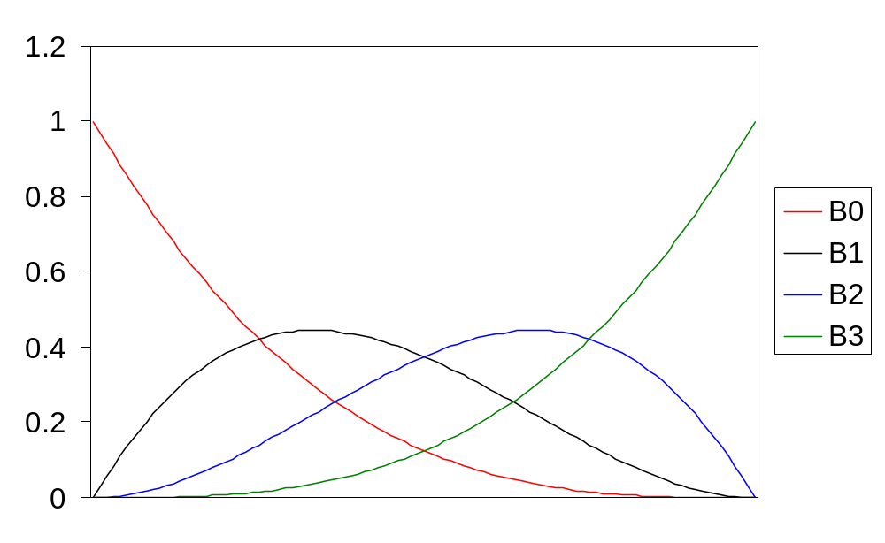
Bezier Basis Functions for d=3

Slide 15
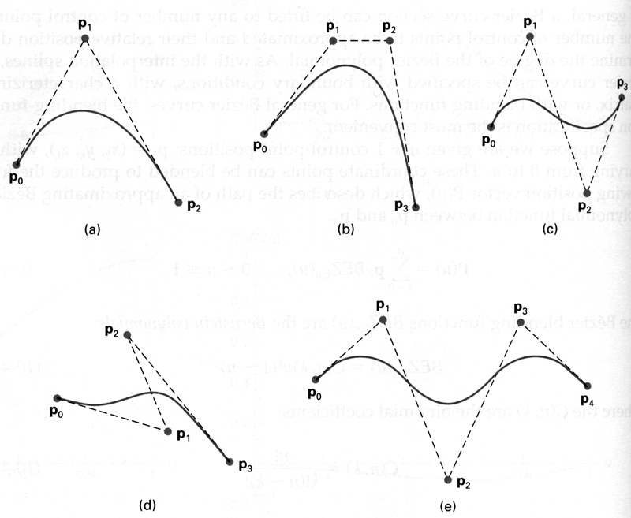
Some Bezier Curves

Slide 16
Bezier Curve Properties
The first and last control points are interpolated
The tangent to the curve at the first control point is along the line joining the first and second control points
The tangent at the last control point is along the line joining the second last and last control points
The curve lies entirely within the convex hull of its control points
  The Bernstein polynomials (the basis functions) sum to 1 and are everywhere positive
They can be rendered in many ways
  E.g.: Convert to line segments with a subdivision algorithm

Slide 17
Rendering Bezier Curves (1)
Evaluate the curve at a fixed set of parameter values and join the points with straight lines
Advantage: Very simple
Disadvantages:
  Expensive to evaluate the curve at many points
  No easy way of knowing how fine to sample points, and maybe sampling rate must be different along curve
  No easy way to adapt. In particular, it is hard to measure the deviation of a line segment from the exact curve

Slide 18
Rendering Bezier Curves (2)
Recall that a Bezier curve lies entirely within the convex hull of its control vertices
If the control vertices are nearly collinear, then the convex hull is a good approximation to the curve
Also, a cubic Bezier curve can be broken into two shorter cubic Bezier curves that exactly cover the original curve
This suggests a rendering algorithm:
  Keep breaking the curve into sub-curves
  Stop when the control points of each sub-curve are nearly collinear
  Draw the control polygon - the polygon formed by the control points

Slide 19
Sub-Dividing Bezier Curves
Step 1: Find the midpoints of the lines joining the original control vertices. Call them M₀₁, M₁₂, M₂₃
Step 2: Find the midpoints of the lines joining M₀₁, M₁₂ and M₁₂, M₂₃. Call them M₀₁₂, M₁₂₃
Step 3: Find the midpoint of the line joining M₀₁₂, M₁₂₃. Call it M₀₁₂₃
The curve with control points P₀, M₀₁, M₀₁₂ and M₀₁₂₃ exactly follows the original curve from the point with t=0 to the point with t=0.5
The curve with control points M₀₁₂₃ , M₁₂₃ , M₂₃ and P₃ exactly follows the original curve from the point with t=0.5 to the point with t=1

Slide 20
Sub-Dividing Bezier Curves
M₁₂
P₁
P₂
M₀₁₂
M₀₁₂₃
M₁₂₃
M₀₁
M₂₃
P₀
P₃

Slide 21
Sub-Dividing Bezier Curves
P₁
P₂
P₀
P₃

Slide 22
de Casteljau’s Algorithm
You can find the point on a Bezier curve for any parameter value t with a similar algorithm
Say you want t=0.25, instead of taking midpoints take points 0.25 of the way
M₁₂
P₁
P₂
M₂₃
t=0.25
M₀₁
P₀
P₃

Slide 23
Invariance
Translational invariance means that translating the control points and then evaluating the curve is the same as evaluating and then translating the curve
Rotational invariance means that rotating the control points and then evaluating the curve is the same as evaluating and then rotating the curve
These properties are essential for parametric curves used in graphics
It is easy to prove that Bezier curves, Hermite curves and everything else we will study are translation and rotation invariant
Some forms of curves, rational splines, are also perspective invariant
  Can do perspective transform of control points and then evaluate the curve

