Slide 1
Rendering Bezier Curves (1)
Evaluate the curve at a fixed set of parameter values and join the points with straight lines
Advantage: Very simple
Disadvantages:
  Expensive to evaluate the curve at many points
  No easy way of knowing how fine to sample points, and maybe sampling rate must be different along curve
  No easy way to adapt. In particular, it is hard to measure the deviation of a line segment from the exact curve

Slide 2
Rendering Bezier Curves (2)
Recall that a Bezier curve lies entirely within the convex hull of its control vertices
If the control vertices are nearly collinear, then the convex hull is a good approximation to the curve
Also, a cubic Bezier curve can be broken into two shorter cubic Bezier curves that exactly cover the original curve
This suggests a rendering algorithm:
  Keep breaking the curve into sub-curves
  Stop when the control points of each sub-curve are nearly collinear
  Draw the control polygon - the polygon formed by the control points

Slide 3
Sub-Dividing Bezier Curves
Step 1: Find the midpoints of the lines joining the original control vertices. Call them M₀₁, M₁₂, M₂₃
Step 2: Find the midpoints of the lines joining M₀₁, M₁₂ and M₁₂, M₂₃. Call them M₀₁₂, M₁₂₃
Step 3: Find the midpoint of the line joining M₀₁₂, M₁₂₃. Call it M₀₁₂₃
The curve with control points P₀, M₀₁, M₀₁₂ and M₀₁₂₃ exactly follows the original curve from the point with t=0 to the point with t=0.5
The curve with control points M₀₁₂₃ , M₁₂₃ , M₂₃ and P₃ exactly follows the original curve from the point with t=0.5 to the point with t=1

Slide 4
Sub-Dividing Bezier Curves
M₁₂
P₁
P₂
M₀₁₂
M₀₁₂₃
M₁₂₃
M₀₁
M₂₃
P₀
P₃

Slide 5
Sub-Dividing Bezier Curves
P₁
P₂
P₀
P₃

Slide 6
Invariance
Translational invariance means that translating the control points and then evaluating the curve is the same as evaluating and then translating the curve
Rotational invariance means that rotating the control points and then evaluating the curve is the same as evaluating and then rotating the curve
These properties are essential for parametric curves used in graphics
It is easy to prove that Bezier curves, Hermite curves and everything else we will study are translation and rotation invariant
Some forms of curves, rational splines, are also perspective invariant
  Can do perspective transform of control points and then evaluate the curve

Slide 7
Longer Curves
A single cubic Bezier or Hermite curve can only capture a small class of curves
One solution is to raise the degree
  Allows more control, at the expense of more control points and higher degree polynomials
  Control is not local, one control point influences entire curve
Alternate, most common solution is to join pieces of cubic curve together into piecewise cubic curves
  Total curve can be broken into pieces, each of which is cubic
  Local control: Each control point only influences a limited part of the curve
  Interaction and design is much easier

Slide 8
Piecewise Bezier Curve
P_{0,1}
P_{0,2}
“knot”
P_{0,0}
P_{1,3}
P_{0,3}
P_{1,0}
P_{1,2}
P_{1,1}

Slide 9
Continuity
When two curves are joined, we typically want some degree of continuity across the boundary (the knot)
  C⁰, “C-zero”, point-wise continuous, curves share the same point where they join
  C¹, “C-one”, continuous derivatives, curves share the same parametric derivatives where they join
  C², “C-two”, continuous second derivatives, curves share the same parametric second derivatives where they join
  Higher orders possible
Question: How do we ensure that two Hermite curves are C¹ across a knot?
Question: How do we ensure that two Bezier curves are C⁰, or C¹, or C² across a knot?

Slide 10
Achieving Continuity
For Hermite curves, the user specifies the derivatives, so C¹ is achieved simply by sharing points and derivatives across the knot
For Bezier curves:
  They interpolate their endpoints, so C⁰ is achieved by sharing control points
  The parametric derivative is a constant multiple of the vector joining the first/last 2 control points
  So C¹ is achieved by setting P_{0,3}=P_{1,0}=J, and making P_{0,2} and J and P_{1,1} collinear, with J-P_{0,2}=P_{1,1}-J
  C² comes from further constraints on P_{0,1} and P_{1,2}

Slide 11
Bezier Continuity
P_{0,1}
P_{0,2}
P_{0,0}
P_{1,3}
J
P_{1,2}
P_{1,1}
Disclaimer: PowerPoint curves are not Bezier curves, they are interpolating piecewise quadratic curves! This diagram is an approximation.

Slide 12
DOF and Locality
The number of degrees of freedom (DOF) can be thought of as the number of things a user gets to specify
  If we have n piecewise Bezier curves joined with C⁰ continuity, how many DOF does the user have?
  If we have n piecewise Bezier curves joined with C¹ continuity, how many DOF does the user have?
Locality refers to the number of curve segments affected by a change in a control point
  Local change affects fewer segments
  How many segments of a piecewise cubic Bezier curve are affected by each control point if the curve has C¹ continuity?
  What about C²?

Slide 13
Geometric Continuity
Derivative continuity is important for animation
  If an object moves along the curve with constant parametric speed, there should be no sudden jump at the knots
For other applications, tangent continuity might be enough
  Requires that the tangents point in the same direction
  Referred to a G¹ geometric continuity
  Curves could be made C¹ with a re-parameterization
  The geometric version of C² is G², based on curves having the same radius of curvature across the knot
What is the tangent continuity constraint for a Bezier curve?

Slide 14
Bezier Geometric Continuity
P_{0,1}
P_{0,2}
P_{0,0}
P_{1,3}
J
P_{1,1}
P_{1,2}

Slide 15
B-splines
To piece many Bezier curves together with continuity requires satisfying a large number of constraints
  The user cannot arbitrarily move control vertices and automatically maintain continuity
B-splines automatically take care of continuity, with exactly one control vertex per curve segment
  Many types of B-splines: degree may be different (linear, quadratic, cubic,…) and they may be uniform or non-uniform
  We will only look closely at uniform B-splines
  With uniform B-splines, continuity is always one degree lower than degree of curve pieces
    Linear B-splines have C⁰ continuity, cubic have C², etc

Slide 16
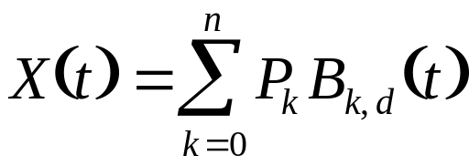
B-spline Curves
Curve:
  n is the total number of control points
  d is the order of the curves, 2 ≤ d ≤ n+1
  B_{k,d} are the B-spline blending functions of degree d-1
  P_{k} are the control points
  Each B_{k,d} is only non-zero for a small range of t values, so the curve has local control
  Each B_{k,d} is obtained by a recursive definition, with “switches” at the base of the recursion
    The switches make sure that the curve is 0 most of the time

Slide 17
B-Spline Knot Vectors
Knots: Define a sequence of parameter values at which the blending functions will be switched on and off
  Knot values are increasing, and there are n+d+1 of them, forming a knot vector: (t₀,t₁,…,t_{n+d}) with t₀ ≤ t₁ ≤ … ≤ t_{n+d}
  Curve only defined for parameter values between t_{d-1} and t_{n+1}
  These parameter values correspond to the places where the pieces of the curve meet
  More precise definition than the one given for the Bezier case

Slide 18
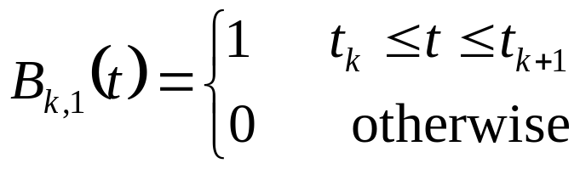
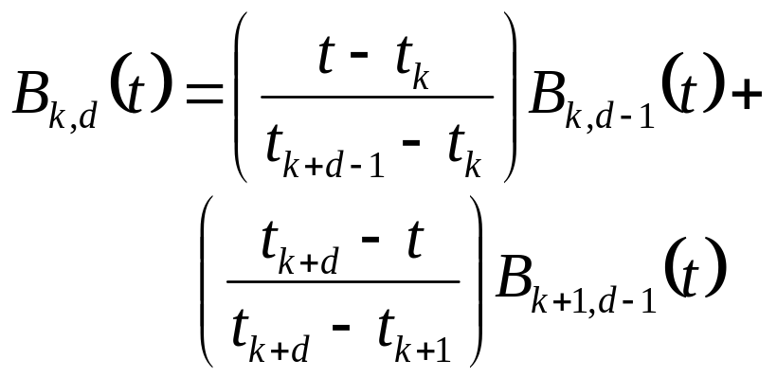
B-Spline Blending Functions
The recurrence relation starts with the 1st order B-splines, just boxes, and builds up successively higher orders
This algorithm is the Cox - de Boor algorithm
  Carl de Boor is in the CS department here at Madison

Slide 19
Uniform Cubic B-splines
Uniform cubic B-splines arise when the knot vector is of the form (-3,-2,-1,0,1,…,n+1)
Each blending function is non-zero over a parameter interval of length 4
All of the blending functions are translations of each other
  Each is shifted one unit across from the previous one
  B_{k,d}(t)=B_{k+1,d}(t+1)
The blending functions are the result of convolving a box with itself d times, although we will not use this fact

