Slide 1
CS 445 / 645
Introduction to Computer Graphics
Lecture 23
Bézier Curves

Slide 2
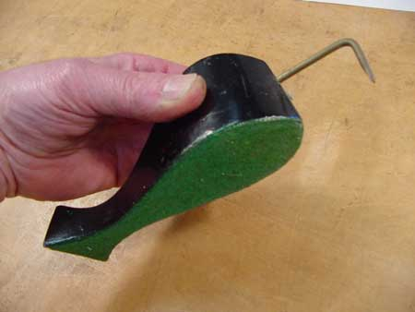
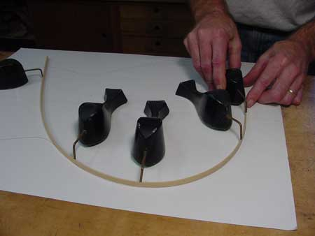
Splines - History
Draftsman use ‘ducks’ and strips of wood (splines) to draw curves
Wood splines have second-order continuity
And pass through the control points
A Duck (weight)
Ducks trace out curve

Slide 3
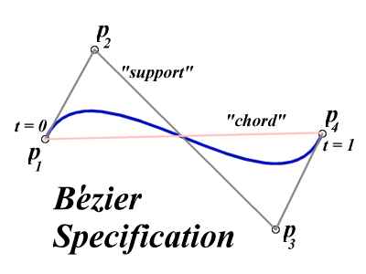
Bézier Curves
Similar to Hermite, but more intuitive definition of endpoint derivatives
Four control points, two of which are knots

Slide 4
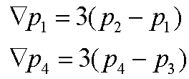
Bézier Curves
The derivative values of the Bezier Curve at the knots are dependent on the adjacent points
The scalar 3 was selected just for this curve

Slide 5
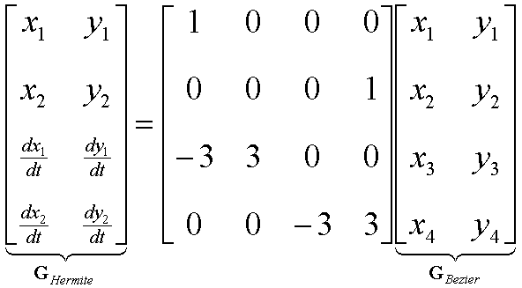
Bézier vs. Hermite
We can write our Bezier in terms of Hermite
  Note this is just matrix form of previous equations

Slide 6
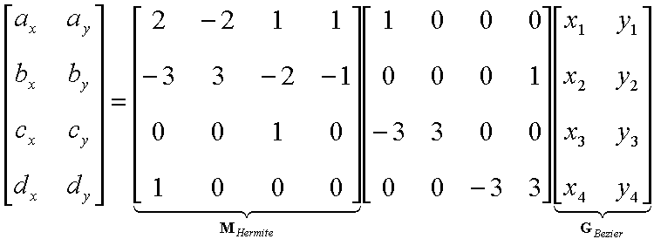
Bézier vs. Hermite
Now substitute this in for previous Hermite
M_{Bezier}

Slide 7
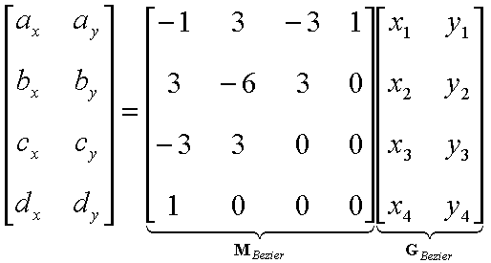
Bézier Basis and Geometry Matrices
Matrix Form
But why is M_{Bezier} a good basis matrix?

Slide 8
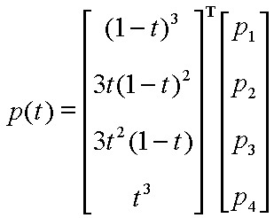
Bézier Blending Functions
Look at the blending
functions
This family of
polynomials is called
order-3 Bernstein
Polynomials
  C(3, k) t^{k} (1-t)^{3-k}; 0<= k <= 3
  They are all positive in interval [0,1]
  Their sum is equal to 1

Slide 9
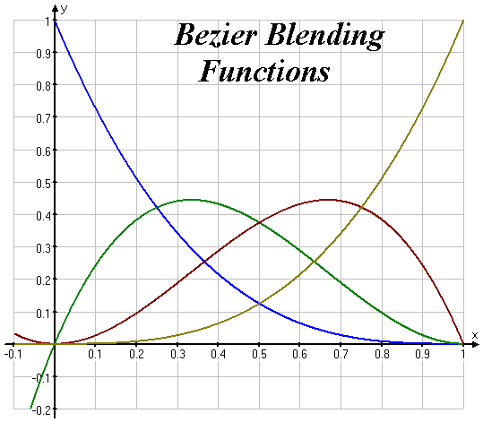
Bézier Blending Functions
Thus, every point on curve is linear combination of the control points
The weights of the combination are all positive
The sum of the weights is 1
Therefore, the curve is a convex combination of the control points

Slide 10
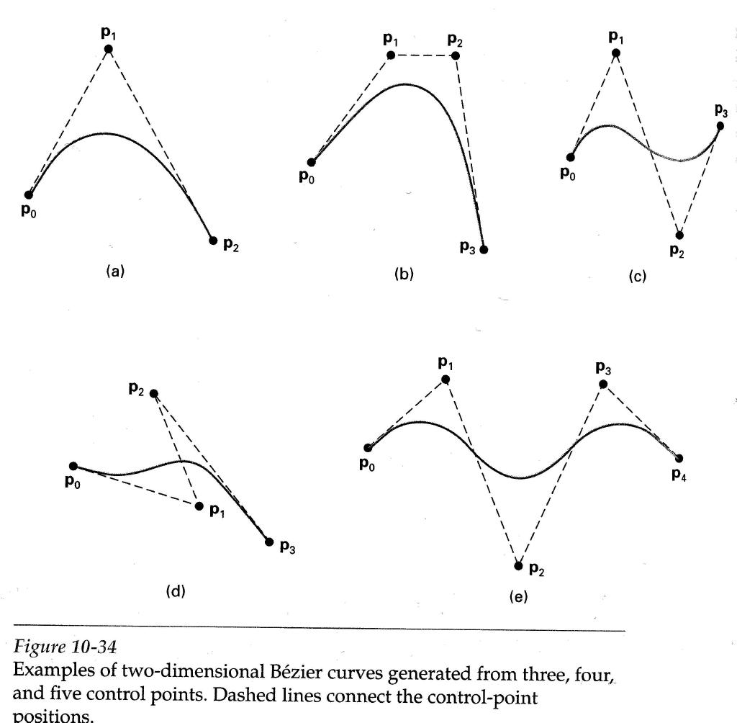
Convex combination of control points
Will always remain within bounding region (convex hull) defined by control points

Slide 11
Bézier Curves
Bezier

Slide 12
Why more spline slides?
Bezier and Hermite splines have global influence
  One could create a Bezier curve that required 15 points to define the curve…
    Moving any one control point would affect the entire curve
  Piecewise Bezier or Hermite don’t suffer from this, but they don’t enforce derivative continuity at join points
B-splines consist of curve segments whose polynomial coefficients depend on just a few control points
  Local control
Examples of Splines

Slide 13
B-Spline Curve (cubic periodic)
Start with a sequence of control points
Select four from middle of sequence (p_{i-2}, p_{i-1}, p_{i}, p_{i+1}) d
  Bezier and Hermite goes between p_{i-2} and p_{i+1}
  B-Spline doesn’t interpolate (touch) any of them but approximates going through p_{i-1} and p_{i}
p₁
Q₄
p₂
p₆
t₄
Q₅
t₅
Q₃
t₆
p₃
Q₆
p₀
t₃
p₄
t₇
p₅

Slide 14
Uniform B-Splines
Approximating Splines
Approximates n+1 control points
  P₀, P₁, …, P_{n}, n ¸ 3
Curve consists of n –2 cubic polynomial segments
  Q₃, Q₄, … Q_{n}
t varies along B-spline as Q_{i}: t_{i} <= t < t_{i+1}
t_{i} (i = integer) are knot points that join segment Q_{i} to Q_{i+1}
Curve is uniform because knots are spaced at equal intervals of parameter, t

Slide 15
Uniform B-Splines
First curve segment, Q₃, is defined by first four control points
Last curve segment, Q_{m}, is defined by last four control points, P_{m-3}, P_{m-2}, P_{m-1}, P_{m}
Each control point affects four curve segments

Slide 16
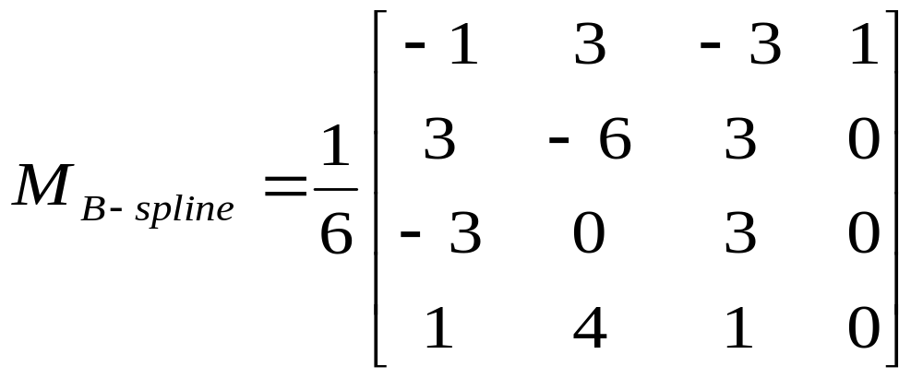
B-spline Basis Matrix
Formulate 16 equations to solve the 16 unknowns
The 16 equations enforce the C₀, C₁, and C₂ continuity between adjoining segments, Q

Slide 17

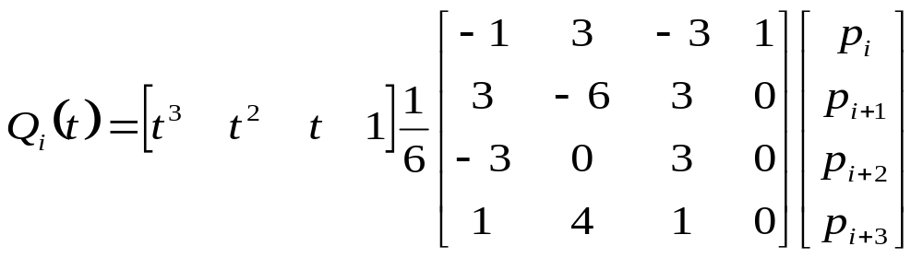
B-Spline
Points along B-Spline are computed just as with Bezier Curves

Slide 18
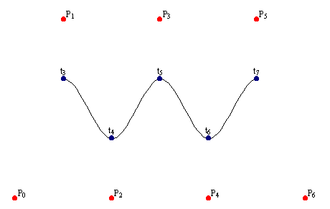
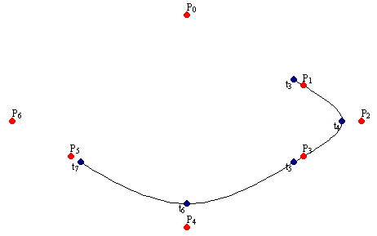
B-Spline
By far the most popular spline used
C₀, C₁, and C₂ continuous

Slide 19
Nonuniform, Rational B-Splines
(NURBS)
The native geometry element in Maya
Models are composed of surfaces defined by NURBS, not polygons
NURBS are smooth
NURBS require effort to make non-smooth

Slide 20
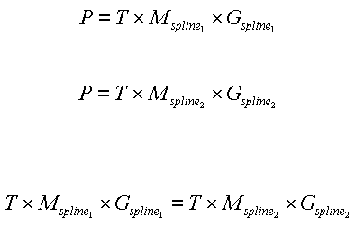
Converting Between Splines
Consider two spline basis formulations for two spline types

Slide 21
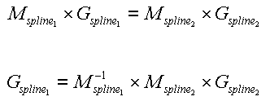
Converting Between Splines
We can transform the control points from one spline basis to another

Slide 22
Converting Between Splines
With this conversion, we can convert a B-Spline into a Bezier Spline
Bezier Splines are easy to render

Slide 23
Rendering Splines
Horner’s Method
Incremental (Forward Difference) Method
Subdivision Methods

Slide 24
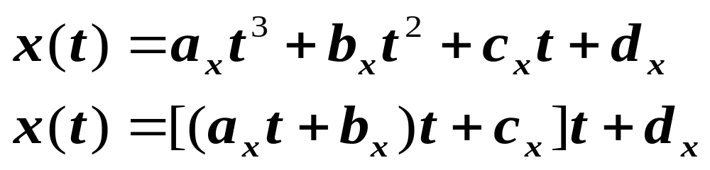
Horner’s Method
Three multiplications
Three additions

Slide 25
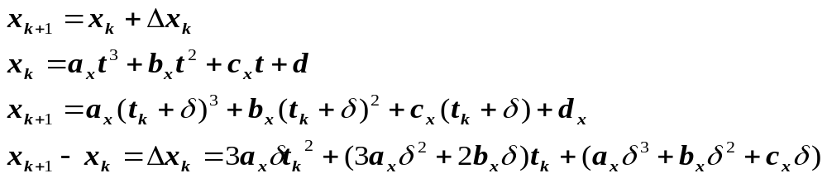
Forward Difference
But this still is expensive to compute
  Solve for change at k (Δ_{k}) and change at k+1 (Δ_{k+1})
  Boot strap with initial values for x₀, Δ₀, and Δ₁
  Compute x₃ by adding x₀ + Δ₀ + Δ₁

Slide 26
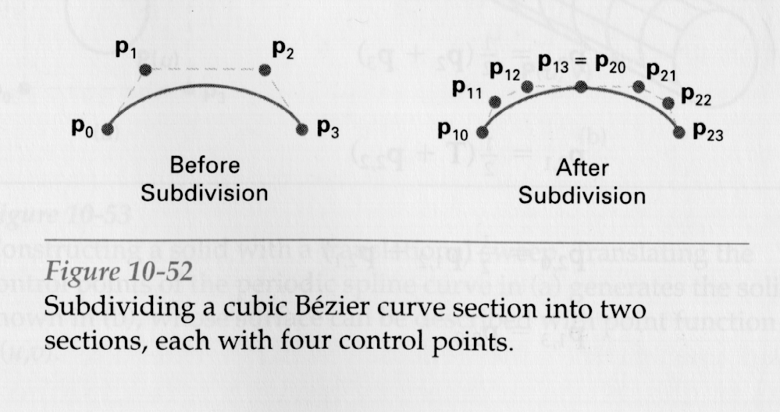
Subdivision Methods
Bezier

Slide 27
Rendering Bezier Spline
public void spline(ControlPoint p0, ControlPoint p1,
ControlPoint p2, ControlPoint p3, int pix) {
float len = ControlPoint.dist(p0,p1) + ControlPoint.dist(p1,p2)
+ ControlPoint.dist(p2,p3);
float chord = ControlPoint.dist(p0,p3);
if (Math.abs(len - chord) < 0.25f) return;
fatPixel(pix, p0.x, p0.y);
ControlPoint p11 = ControlPoint.midpoint(p0, p1);
ControlPoint tmp = ControlPoint.midpoint(p1, p2);
ControlPoint p12 = ControlPoint.midpoint(p11, tmp);
ControlPoint p22 = ControlPoint.midpoint(p2, p3);
ControlPoint p21 = ControlPoint.midpoint(p22, tmp);
ControlPoint p20 = ControlPoint.midpoint(p12, p21);
spline(p20, p12, p11, p0, pix);
spline(p3, p22, p21, p20, pix);
}

Slide 28
Do you want a 5th assignment?

Slide 30
Assignment 5
Spline-generated paths
  Create a six-sided room with textured walls, floor, ceiling
  Import from a file the description of a 2-D spline
    Could be Hermite or Bezier
  Create a texture mapped character that follows the spline in the room
  Create a simple user interface so the camera can either be under user control or follow the character automatically

Slide 31
Virtual Trackball
Can we use the mouse to control the 2-D rotation of a viewing volume?
Imagine a track ball
  User moves point on ball from (x, y, z) to (a, b, c)
Imagine the points projected onto the ground
  User moves point on ground from (x, 0, z) to (a, 0, c)

Slide 32
Trackball
Movement of points on track ball can be inferred from mouse drags on screen
Inverse problem
  Where on trackball does (a, 0, c) hit?
  Ball is unit sphere, so ||x, y, z|| = 1.0
  x = a, z = c, y = solve for it

Slide 33
Trackball
User defines two points
  Place where first clicked X = (x, y, z)
  Place where released A = (a, b, c)
Ball rotates along axis perp to line defined by these two points
  compute cross produce of lines to origin: (X – O) x (A – O)
Ball rotates by amount proportional to distance between lines
  magnitude of cross product tells us angle between lines (dot product too)
  |sin θ| = ||cross product||
Compute rotation matrix and use it to rotate world

