Slide 1
SIMD Array Processor
Array processors:
A synchronous array of parallel processors.
Consists of multiple processing elements (PEs) under the supervision of one control unit.
Can handle single instruction and multiple data (SIMD) streams.
SIMD machines are designed to perform vector computations over matrices or arrays of data.

Slide 2
SIMD Array Processor
SIMD computers appear in two basic architectural configurations:
  Array processors (random- access memory)
  Associative processors ( content-addressable or associative) memory.

Slide 3
SIMD Computer organizations
An array processor may assume any of the two configuration mentioned below
Configuration I
Configuration II

Slide 4
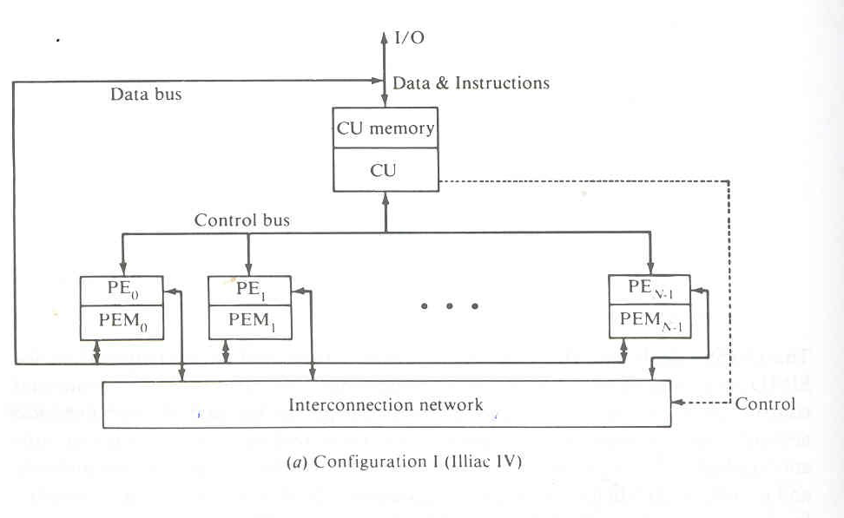
Configuration I ( Illiac IV)

Slide 5
Configuration I
Configuration 1 is structured with N synchronized PEs.
All PEs are under the control of one CU.
Each PEi is essentially an ALU with attached working registers and local memory PEM _{i} for the storage of distributed data.
The CU also has its own main memory for storage of programs.
The function of CU is to decode all instruction and determine where the decoded instructions should be executed.
Scalar or control type instructions are directly executed inside the CU.
vector instructions are send to the PEs for distributed execution to achieve parallelism.

Slide 6
Configuration I
Vector operands are distributed to the PEMs.
The distributed data can be loaded into the PEMs from an external source via system data bus or via CU using Control bus.
Masking schemes are used to control the status of each PE during the execution of a vector instruction.
During an instruction cycle, each PE may be either active or disabled. For this a masking vector is used to control the status of all PEs.
Only enabled PE performs execution of a vector instruction.

Slide 7
Configuration I
Inter – PE communication network:
  performs data exchanges among PEs.
  Performs data-routing and manipulation functions.
  This interconnection network is under the control of the control unit

Slide 8
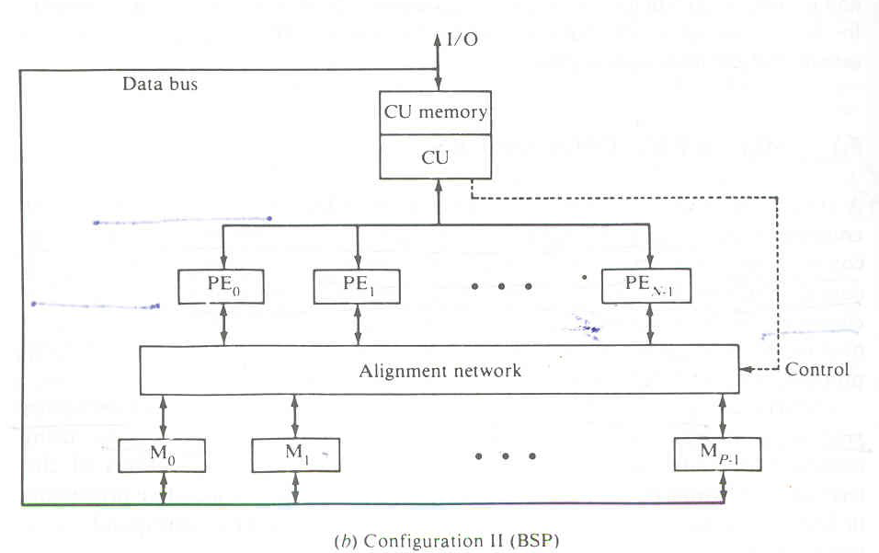
Configuration II

Slide 9
Configuration II
Configuration II differs from configuration I in two aspects:
First the local memories attached to the PEs are replaced by parallel memory modules shared by all the PEs through an alignment network.
Second the inter PE connection network is
replaced by inter PE memory alignment network.
The Alignment network is a path switching network between PEs and parallel memories.
A good example of configuration II SIMD machine is Burroughs scientific processor.

Slide 10
Set of parameters in a SIMD Computer
An SIMD computer is characterized by following set of parameters
C=<N,F,I,M>
where C is an SIMD computer
N=Number of PEs in the system.
      N= 64(Illiac IV)
      N=16(BSP)
F=A set of data routing functions.
I=Set of machine instructions
M=Set of masking schemes

Slide 11
Masking and Data Routing
Figure 5.2
Each PE I is processor with its own memory PEMi. It has a set of working registers and flags names Ai, Bi ,Ci.
It contains an Arithmetic and Logic unit Si and a local index register Ii, an address register Di and a data routing register Ri.
The Ri of each PEi is connected to the Rj of other PEs via the interconnection network.
When data transfer among PEs occurs, it is the content of Ri registers that are being transferred.

Slide 12
Some array processor may use 2 routing register, one for input and the other for output.
Each PEi is either active or in the inactive mode during each instruction cycle.
If a PEi is active, it executes the instruction broadcast to it by the CU.
If a PEi is inactive, it will not execute the broadcast instruction.
The masking schemes are used to specify the status flag Si of PEi. The conventions Si = 1 is chosen for an active PEi and Si = 0 for an inactive PEi.
In the CU, there is a global index register I and a Masking register M. The M register has N bits.

Slide 13
Inter PE Communications
These are fundamental decisions in determining the appropriate structure of an interconnection network for an SIMD machine.
The decisions are made between
Operation Modes
Control Strategies
Switching methodologies
Network Topologies

Slide 14
Operation Mode
The operations modes of interconnection networks can be of 3 categories
Synchronous
Asynchronous
Combined.
Synchronous communication is needed for establishing communication paths synchronously for either a data manipulating function or for a data instruction broadcast.
Asynchronous communication is needed for multiprocessing in which connection requests are issued dynamically.
A system may also be designed to facilitate both synchronous and asynchronous operations.

Slide 15
Control Strategy
A typical interconnection networks consists of number of switching elements and interconnecting links.
Interconnection functions are realized by properly setting control of the switching elements.
The control setting function can be of 2 types
Distributed Control managed by individual
switching element.
Centralized Control managed by a
centralized controller.

Slide 16
Switching Technology
The 2 major switching methodologies are
• Circuit switching
• Packet switching
In circuit switching
a physical path is actually established between source and destination before transmission of data.
This is suitable for bulk data transmission.
In packet switching,
data is put in a packet and routed through interconnection network without establishing a physical connection path.
This is suitable for short messages.

Slide 17
Network Topology
A network can be depicted by a graph which nodes represent switching points and edges
represent communication links.
The topologies can be of 2 types
• Static
• Dynamic
In static link between 2 processors are passive and dedicated buses cannot be reconfigured for
direct connection to other processors.
In dynamic link, configuration can be made by setting the network's active switching elements.

