Slide 1
Cube interconnection network
Dimensionality of a cube “n” = log2N
Communication links connect each pair of PEs with addresses that differ in 1 bit only (distance of 1).

Slide 2
Cube interconnection network
Cube network for SIMD machines can be implemented as
  -Recirculating network
  or
  - Multistage network

Slide 3
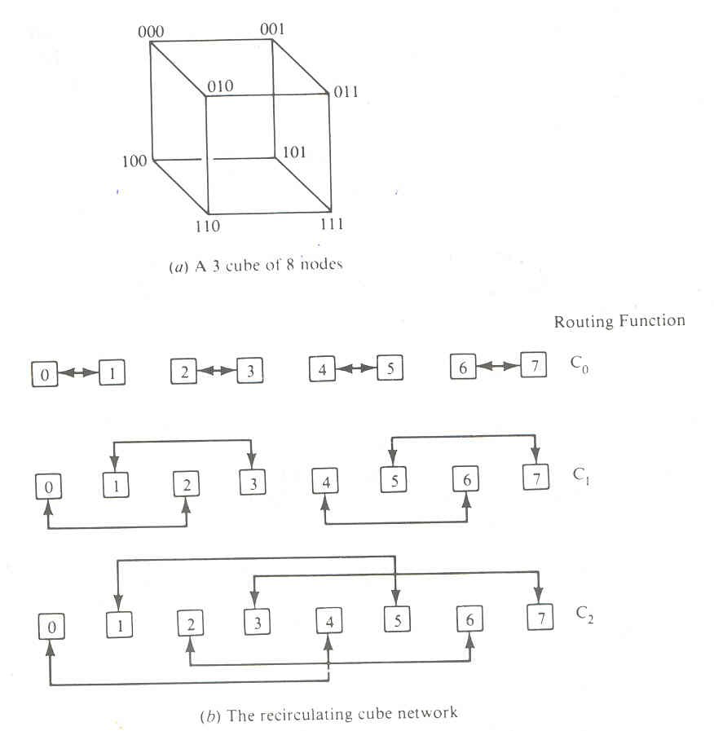
Cube interconnection network

Slide 4
Routing by least significant bit C0
Routing by middle bit C1
Routing by most significant bit C2

Slide 5
Cube interconnection network
Vertical lines connect vertices whose address differ in the most significant bit position.
Vertices at both ends of the diagonal lines differ in the middle bit position.
Horizontal lines differ in the least significant bit position

Slide 6
Routing functions are formerly described as:
Ci (a_{n-1} …. a₁ a₀)= a_{n-1}…a_{i+1} a’_{i} a_{i-1}……a₀
for i =0,1,2,…,n-1
Example: N=8 => n=3

Slide 7
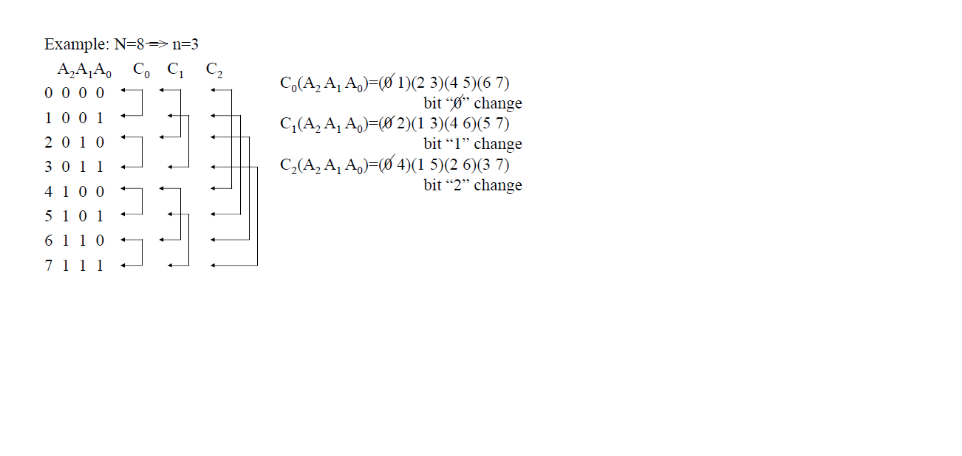

Slide 8
Figure 5.10

