Slide 1
Language features to exploit parallelism
A parallel program for a multiprocessor consists of two or more interacting processes.
A process is a sequential program that executes concurrently with other processes.
Processes are concurrent if their executions overlap in time.
Two processes are concurrent if the first operation of one process starts before the last operation of the other process terminates.
One way to denote concurrency is to use FORK and JOIN statements.

Slide 2
FORK and JOIN
FORK spawns a new process
JOIN waits for a previously created process to terminate.
FORK operation is specified in 3 ways:
  FORK A
  FORK A, J
  FORK A, J,
  The execution of FORK A statement initiates other process at address A and continues the current process.
  The execution of FORK A,J statement causes same action as FORK A and also increments a counter at address J.
  The execution of FORK A, J, N causes same action as FORK A
  and sets the counter at address J to N.

Slide 3
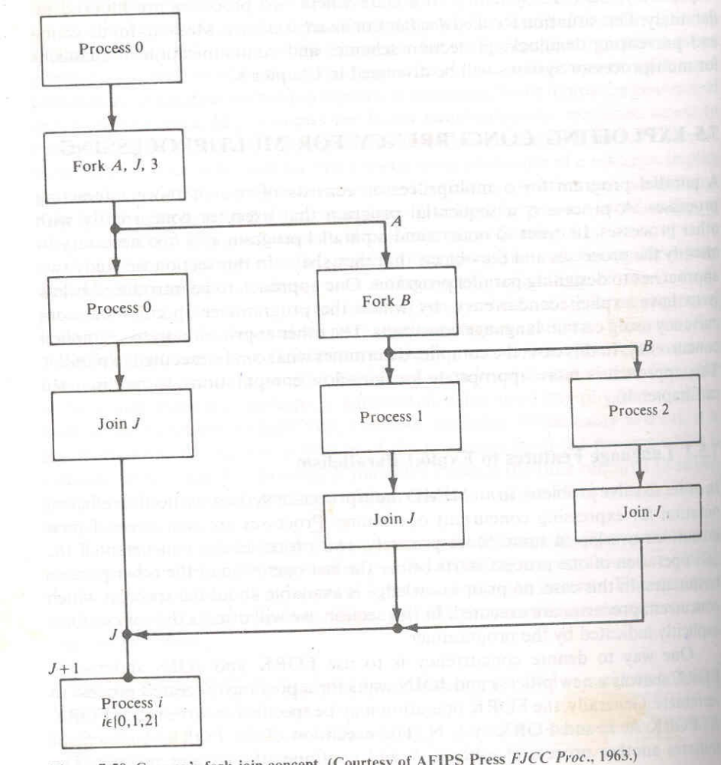

Slide 4
An equivalent extension of the FORK-JOIN concept is the block – structured language.
In this case, each process is a set of n processes S1, S2,…Sn can be executed concurrently by using cobegin and coend (parbegin- parend) language constructs.
All the statements which are in between these constructs are executed in parallel.

Slide 5
begin
  S0;
  cobegin S1;S2; …Sn; coend
  S_{n+1} ;
  end
  cobegin declares explicitly the parts of a program that may execute concurrently.
  Thus we can distinguish the local and shared variables.

Slide 6
Precedence graph of nested concurrent processes
Concurrent statements can be nested in the following example which is illustrated in figure 7.52
Figure 7.52

