Slide 1
multiprocessors
Characterized by two attributes:
1) a multiprocessor is a single computer that
includes multiple processors.
2) processors may communicate and
cooperate at different levels in solving a
given problem.
The communication may occur
by sending messages from one processor to the other.
or
by sharing a common memory.

Slide 2
Architectural Models of Multiprocessor
Two different architectural models of Multiprocessor are
  Tightly Coupled System
  Loosely Coupled System

Slide 3
Architectural Models of Multiprocessor
Tightly Coupled System
- Tasks and/or processors communicate in a highly synchronized fashion
- Communicates through a common shared memory
- Shared memory system

Slide 4
Architectural Models of Multiprocessor
Loosely Coupled System
- Tasks or processors do not communicate in a synchronized fashion
- Communicates by message passing packets
- Overhead for data exchange is high
- Distributed memory system

Slide 5
Loosely Coupled System
each processor has a set of input-output devices and a large local memory from where instructions and data are accessed.
A Computer Module consists of
Processor
Local Memory
I/O Interface
A Message Transfer System (MTS) is there for exchanging messages.
The Degree of coupling is very Loose. Hence it is often referred as distributed system.
Loosely coupled system is usually efficient when the interactions between tasks are minimal.

Slide 6
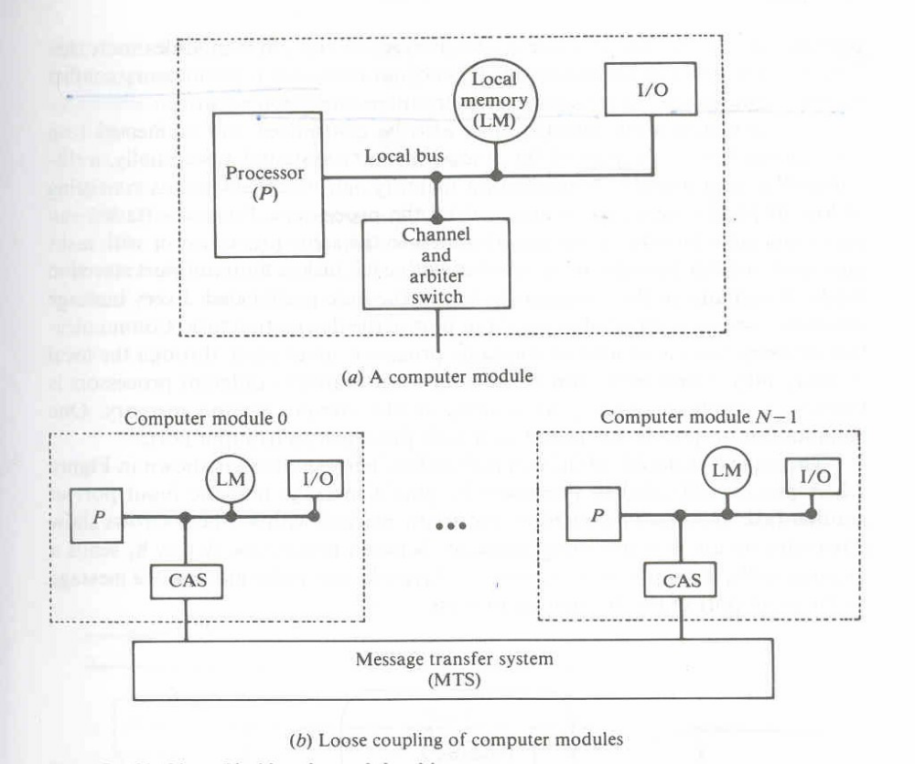
Figure 7.1 Non-Hierarchical Loosely coupled Multiprocessor System

Slide 7
Non-Hierarchical Loosely coupled Multiprocessor System
It consists of a
processor
local memory
Local Input-output devices
Interface to other computer Modules

Slide 8
The interface may contain a channel and arbiter switch (CAS)
If requests from two or more different modules collide in accessing a physical segment of the MTS, the arbiter is responsible for choosing one of the simultaneous requests according to a given service discipline.
It is also responsible for delaying requests until the servicing of the selected request is completed.
The channel within the CAS may have a high speed communication memory which is used for buffering block transfers of messages.
The message transfer system is a time shared bus or a shared memory system.

Slide 9
The Cm* Architecture
The example of LCS is the Cm* architecture.
Each computer module of the Cm* includes a local switch called the Slocal.
The switch is somewhat similar to the CAS.
The Slocal intercepts and routes the processor's requests to the memory and I/O devices outside the computer module via a map bus.
It also accepts references from other computer modules to its local memory and I/O devices.

Slide 10
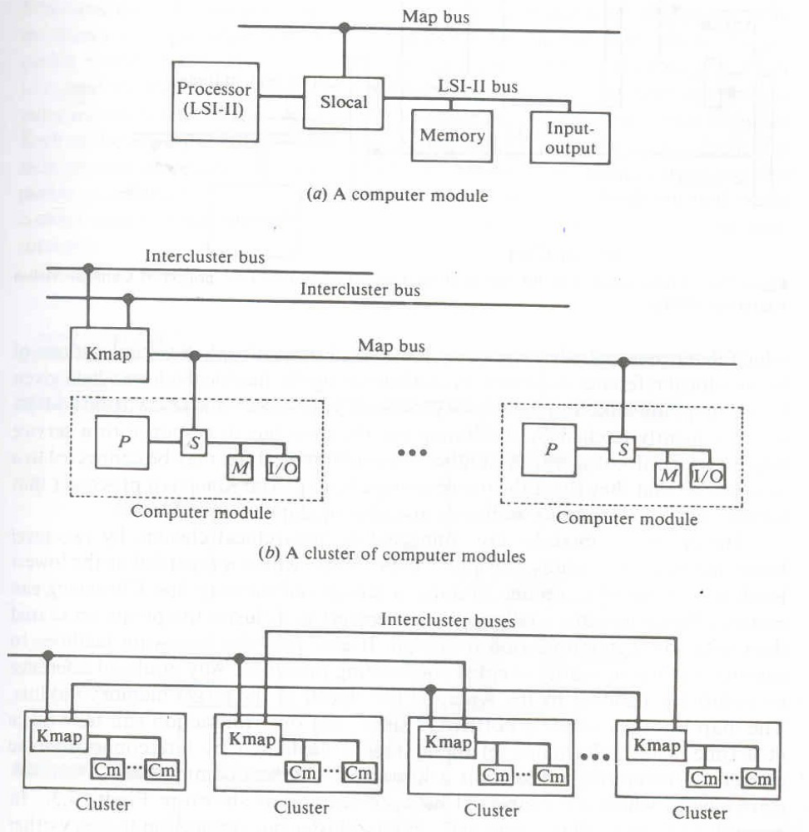

Slide 11
The address translation: fig 7.4
It uses the four high-order bits of the processor's address along with the current address space, as indicated by the X -bit of the LSI-II processor status word (PSW), to access a mapping table which determines whether the reference is local or nonlocal.
A virtual address of the nonlocal reference is formed by concatenating the nonlocal address field given by the mapping table and the source processor's identification.
This virtual address is subsequently fetched by the Kmap via the map bus in 'response to a service request for nonlocal access.

Slide 12
A number of computer modules may be connected to a map bus so that they share the use of a single KMap.
The Kmap is a processor that is responsible for mapping addresses and routing data between Slocals.

Slide 13
Computer modules are connected in hierarchical clusters by two level buses
Fig : b, c
Cluster is made up of computer modules, a Kmap and the map bus.
Clusters communicate via intercluster buses which are connected between kmaps.

Slide 14
Components of kmap in Cm*
Figure 7.5
The three processors in the Kmap are the Kbus, the Linc and the Pmap.
The KBus is the bus controller which arbitrates requests to the map bus.
Linc manages commn between Kmap and other Kmap.
The Pmap is the mapping processor which responds to requests from the Kbus and Linc.
It also performs most of the request processing.
The Pmap communicates with the computer modules in its cluster via the map bus which is a
packet switched bus.

Slide 15
