Slide 1
Mesh-Connected Illiac Network
A single stage recirculating network has been implemented in the Illiac IV array processor with 64 PEs.
Each PEi is allowed to send data to
PE i+1,PE i-1,PE i+r, PE i-r where r=√N. and N=no: of PE s.

Slide 2
four routing functions of Illiac IV
R+1(i)=(i+1)mod N
R-1(i)=(i-1)mod N
R+r(i)=(i+r) mod N
R-r (i) =(i–r) mod N
      Where 0≤ i≤ N-1

Slide 3
Mesh-Connected Illiac Network
Consider the reduced version (N=16, actually N=64)
r=4.

Slide 4
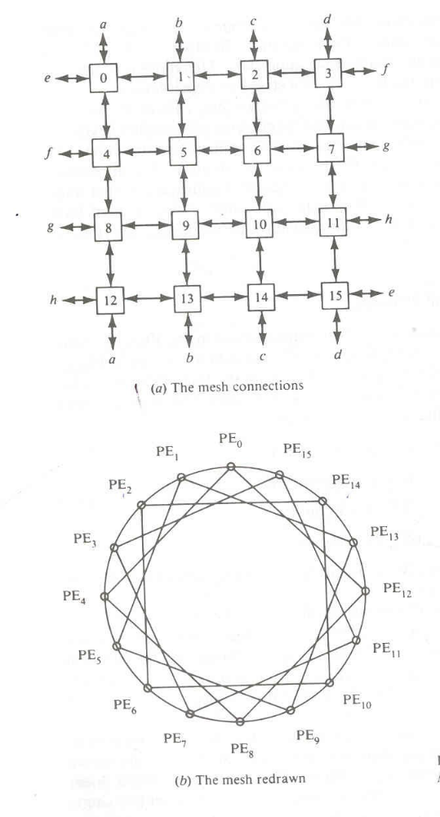
an illiac network with N=16 PEs.

Slide 5
Description of topology
The topology is formerly described by the four routing functions:
R+ : i--> i+1 mod N=> (0,1,2…,14,15)
R- : i-->i-1 mod N=> (15,14,…,2,1,0)
R+r: i-->i+r mod N=> (0,4,8,12)(1,5,9,13)(2,6,10,14)(3,7,11,15)
R-r: i-->i-r mod N=> (12, 8,4,0) (13,9,5,1)(14,10,6,2)(15,11,7,3)

