Slide 1
SIMD Interconnection Networks
The SIMD networks classified into 2 categories based on topologies called as
Static Networks and Dynamic Networks.

Slide 2
Static Networks
Topologies in the static networks can be classified according to the dimension required for layout.
One dimensional topologies include
• Linear array
Two dimensional topologies include
• The ring
• Star
• Tree
• Mesh
• Systolic Array
Thee dimensional topologies include
• Completely connected chordal ring
• 3 cube
• 3 cube connected cycle

Slide 3
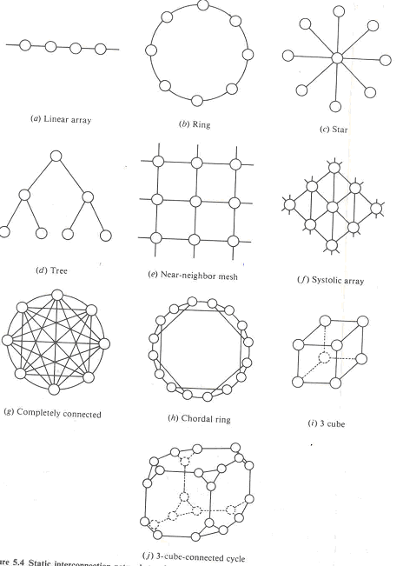

Slide 4
Dynamic Networks
2 classes of dynamic networks are
• single stage
• multi stage

Slide 5
single stage
A single stage switching network with N input selectors (IS) and N output selectors (OS).
Each is essentially a 1- to-D demultiplexer and each OS is an M-to-1 multiplexer. Cross bar network is a single stage network.
The single stage network is also called as recirculating network.
Data items may have to recirculate through the single stage several times before reaching their final destinations.
The number of recirculation depends on the connectivity in the single stage network

Slide 6
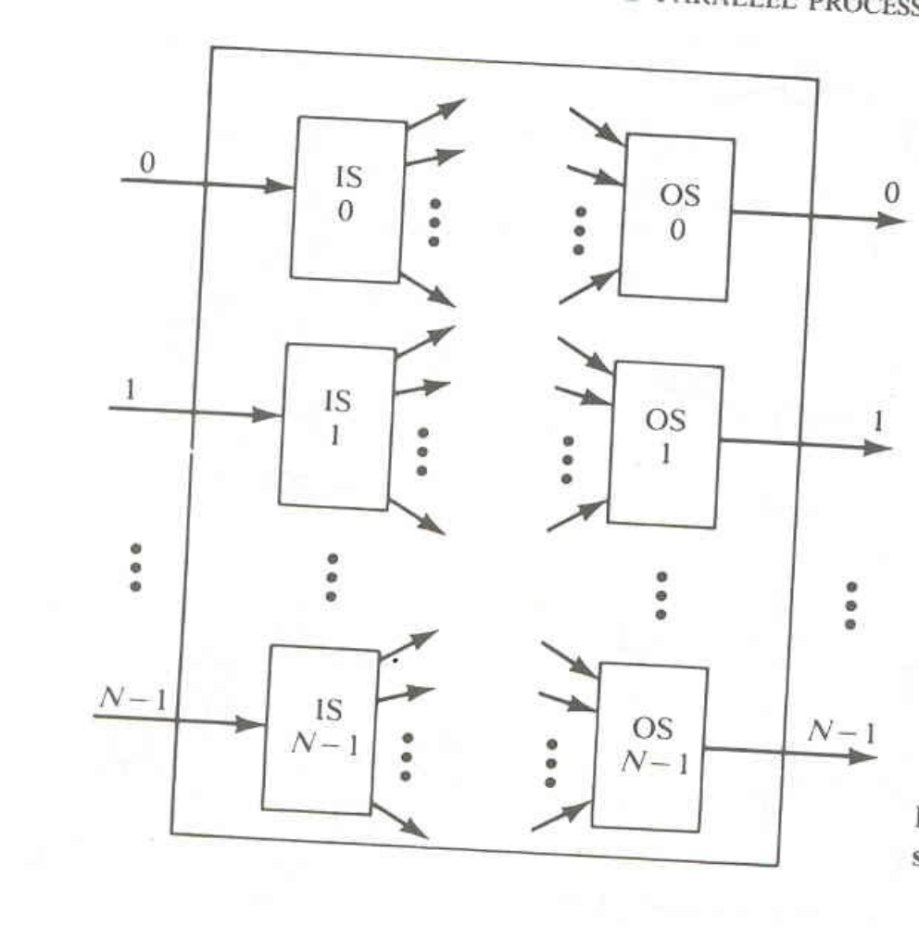
Conceptual view of a single stage interconnection network.

Slide 7
Multistage Networks
Many stages of interconnected switches form a multistage SIMD networks.
Three characterizing feature describe multistage networks
• The Switch Box
• Network Topology
• Control Structure

Slide 8
The Switch Box
Each box is essentially an interchange device with 2 inputs and 2 outputs.
There are 4 states in a switch box.
They are
• Straight
• Exchange
• Upper Broadcast
• Lower broadcast
Figure 5.6

Slide 9
A multistage network is capable of connecting an arbitrary input terminal to an arbitrary output
terminal. Multistage networks can be
• One sided
• Two Sided
The one sided network called as full switches, have input-output ports on the same side.
The two sided network have an input side and output side and can be divided into three classes
• Blocking
• Re-arrangeable
• Non- Blocking

Slide 10
Blocking networks
In Blocking networks, simultaneous connections of more than one terminal pair may result in conflicts in the use of network communication links.
Examples : Data Manipulator, Flip, N cube, omega, baseline etc.

Slide 11
rearrangeable network
A network is called rearrangeable network, if it can perform all possible connections between inputs and outputs by rearranging its existing connections so that a connection path for a new input-output pair can always be established.
Example : Benes Network

Slide 12
Non- Blocking
A non –blocking can handle all possible connections without blocking.
Example : Clos Network

Slide 13
Generally a multistage network consists of n stages
  Where N( no of input and output lines)=2^{n}
  Each stage may use N/2 switch boxes.

Slide 14
Control structures
Two types:
  Individual stage control:
    Uses the same control signal to set all switch boxes in the same stage.
  Individual box control
    Uses separate control signal to set the state of each switch box.

