Slide 1
Tightly Coupled Multiprocessors
The throughput of the hierarchical loosely coupled multiprocessor may be too slow for some applications that require fast response times.
If high speed or real time processing is required the TCS may be used.
Two typical models

Slide 2
Tightly Coupled Multiprocessors
In the first model, it consists of
p processors
l memory modules
d input-output channels
The above units are connected through a set of three interconnection networks namely the
processor-memory interconnection network
(PMIN)
I/O processor interconnection network
(IOPIN)
Interrupt Signal Interconnection Network (ISIN)

Slide 3
The PMIN is a switch which can connect every processor to every module. It has pl set of cross points. It is a multistage network.
A memory can satisfy only one processor’s request in a given memory cycle. Hence if more than one processors attempt to access the same memory module, a conflict occurs and it is resolved by the PMIN.
Another method to resolve the conflict is to associate a reserved storage area with each
processor and it is called as ULM unmapped local memory. It helps in reducing the traffic in PMIN.

Slide 4
Since each memory references goes through the PMIN, it encounters delay in the processors memory switch so this can be overcome by using a private cache with each processor.

Slide 5
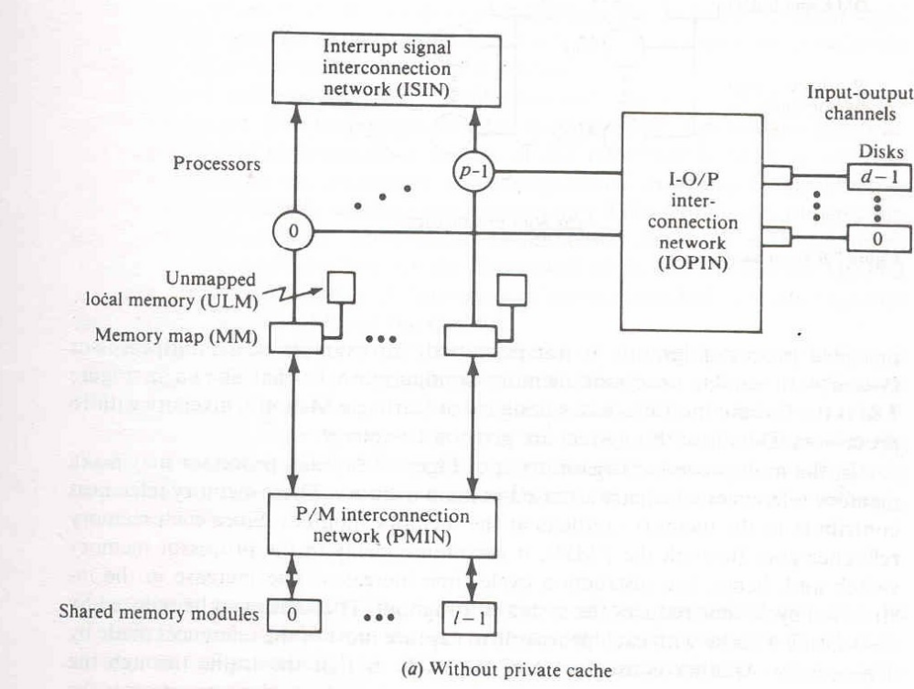

Slide 6
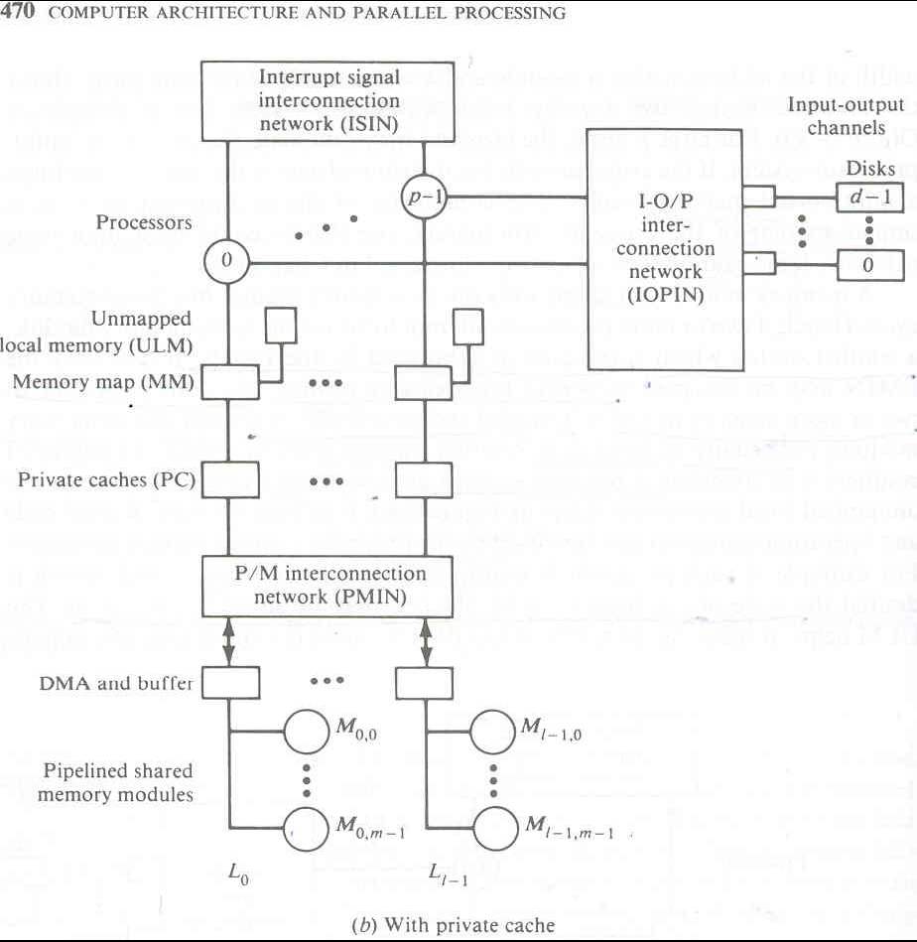

Slide 7
Without private cache
each processor may make memory references which are accessed in main memory.
Since each memory references go through the PMIN ,it encounters delay in the processor memory switch, and hence instruction cycle time increases,this reduces the system throughput.

Slide 8
With private cache
by associating a cache with each processor to capture most of the references made by a processor the delay in the processor memory switch can be reduced.
This multiprocessor organization encounters the cache coherence problem.
More than one consistent copy of data may exist in the system.

Slide 9
An example of a tightly coupled multiprocessor system is the Cyber-170
This configuration has 2 subsystems.
The central processing sub system
The peripheral processing sub system
These two subsystems can share a common memory known as central memory.
There is also an optional memory called
Extended core memory.
The Central memory controller has the combined features of PMIN,IOPIN,ISIN.

Slide 10
