Slide 1
Parallel computer structures
Parallel computers are those systems that emphasize parallel processing.
3 types
Pipeline computers
Array processors
Multiprocessor systems

Slide 2
Pipeline computers
a pipeline is a set of data processing elements connected in series, so that the output of one element is the input of the next one.
The elements of a pipeline are often executed in parallel or in time-sliced fashion; in that case, some amount of buffer storage is often inserted between elements.

Slide 3
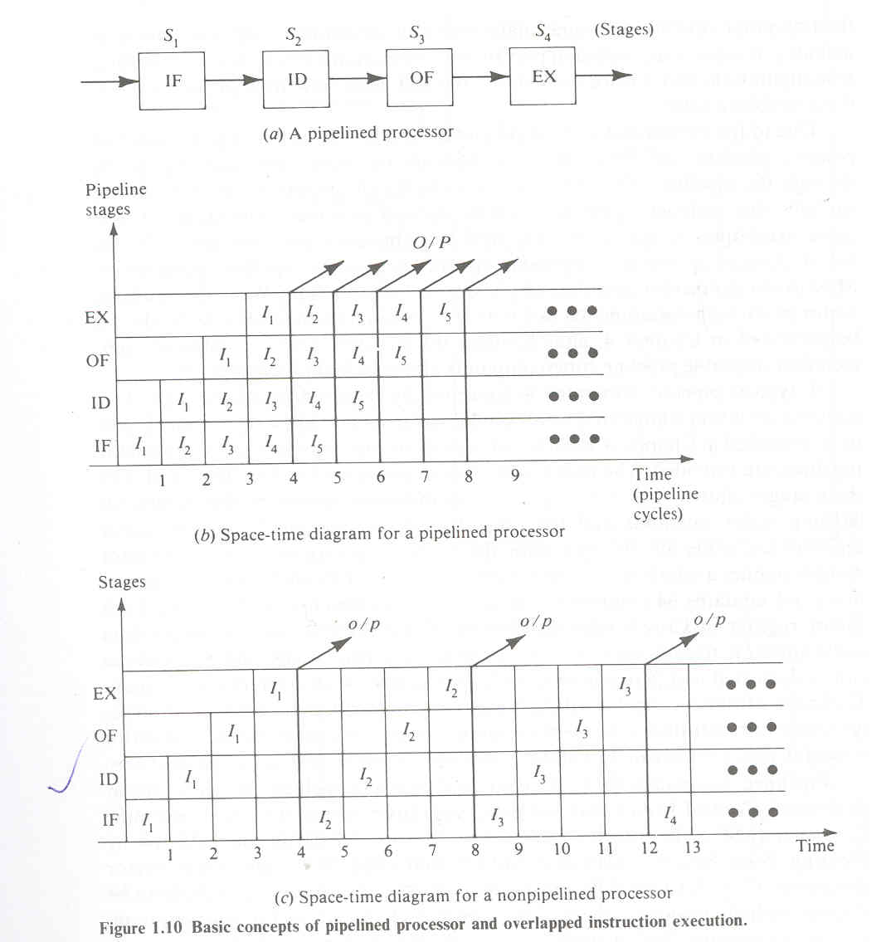

Slide 4
Computer-related pipelines
Computer-related pipelines include
  Instruction pipelines
  Graphics pipelines
  Software pipelines

Slide 5
Instruction pipelines
classic RISC pipeline
are used in processors to allow the parallel execution of two or more consecutive instructions from a nominally sequential stream.
the processing elements are the logical circuits that implement the various stages of an instruction (address decoding and arithmetic, register fetching, cache lookup, etc)

Slide 6
Graphics pipelines
found in most graphics cards
consist of multiple arithmetic units, or complete CPUs, that implement the various stages of common rendering operations (perspective projection, window clipping, color and light calculation, rendering, etc.)

Slide 7
Software pipelines
consisting of multiple processes arranged so that the output stream of one process is automatically and promptly fed as the input stream of the next one.
Unix pipelines are the classical implementation of this concept.

Slide 8
Array Processors
A computer, or extension to its arithmetic unit, that is capable of performing simultaneous computations on elements of an array of data in some number of dimensions.
Common uses include rotation of 3D objects as well as data retrieval, in which elements in a database are scanned simultaneously

Slide 9
Multiprocessor systems
system contains two or more processors of approximately comparable capabilities.
All processors share access to common sets of memory modules, I/O channels and peripheral devices.
Besides the shared memories and I/O devices each processor has its own local memory and private devices.
Interprocessor communications can be done through the shared memories.

Slide 10
Architecture classification schemes
Flynn’s classification is based on the multiplicity of instruction streams and data streams in a computer system.
Feng’s scheme is based on serial versus parallel processing.
Handler’s classification is determined by the degree of parallelism and pipelining in various subsystem levels.

Slide 11
Multiplicity of Instruction-Data streams
according to the multiplicity of instruction and data streams digital computers may be classified in to 4 categories.
SISD computer organization
SIMD computer organization
MISD computer organization
MIMD computer organization

Slide 12
SISD computer organization
Instructions are executed sequentially but may be overlapped in their execution stages.
Most SISD uniprocesor systems are pipelined.
An SISD computer may have more than one functional unit in it.
All the functional units are under supervision of one control unit

Slide 13
SIMD computer organization
This corresponds to array processors.
Here multiple processing elements supervised by the same control unit.
All PEs receive the same instruction broadcast from the control unit but operate on different data sets from distinct data streams

Slide 14
MISD computer organization
There are n processor units, each receiving distinct instructions operating over the same data stream and its derivatives.
The results of one processor become the input of the next processor in the macropipe.
This structure has received much less attention and has been challenged as impractical by some computer architects

Slide 15
MIMD computer organization
Most multiprocessor systems and multiple computer systems can be classified in this category.
An intrinsic MIMD computer implies interactions among the n processors because all memory streams are derived from the same data space shared by all processors.

Slide 16
Serial Versus Parallel Processing
The maximum number of binary digits that can be processed within a unit time by a computer system is called the maximum parallelism degree P.
The maximum parallelism degree P(C)of a given computer system C is represented by the product of the word length n and the bit slice length m; that is P(C)=n. m

Slide 17
There are 4 types of processing methods.
WSBS
WPBS
WSBP
WPBP

Slide 18
WSBS has been called bit serial processing because one bit (n=m=1) is processed at a time, a rather slow process. This was done only in the first generation computers.
WPBS (n=1, m>1) has been called bis processing because an m bit slice is processed at a time.
WSBP (n>1, m=1) as found in most existing computers, has been called word slice processing because one word of n bits is processed at a time.
Finally WPBP (n>1,m>1)is known as fully parallel processing, in which an array of n.m bits is processed at one time, the fastest processing mode of the four.

Slide 19
Parallelism versus pipelining
Wolfgang Handler has proposed a classification scheme for identifying the parallelism degree and pipelining degree built into the hardware structures of a computer system.
He considers parallel pipeline processing at three subsystem levels
Processor Control unit (PCU)
Arithmetic logic unit (ALU)
Bit level circuit (BLC)

Slide 20
Each PCU corresponds to one processor or one CPU. The ALU is equivalent to Processor Element (PE).
The BLC corresponds to combinational logic circuitry needed to perform 1 bit operations in the ALU.
A computer system C can be characterized by a triple containing six independent entities
T(C) = <K x K', D x D', W x W' >
Where K = the number of processors (PCUs) within the computer
D = the number of ALUs under the control of one CPU
W = the word length of an ALU or of a PE
W' = The number of pipeline stages in all ALUs or in a PE
D' = the number of ALUs that can be pipelined
K' = the number of PCUs that can be pipelined

