Slide 1
Subprogram Control
Subprogram Control :
interaction among subprograms
how subprograms pass data among themselves
Subprogram Sequence Control
Attributes of Data Control
Parameter passing
Explicit Common Environments

Slide 2
Subprogram Sequence Control
Simple subprogram call return
    Copy rule view of subprograms:
    the effect of a call statement is the same as if the subprogram were copied and inserted into the main program.

Slide 3
Assumptions
    Subprograms cannot be recursive
    Explicit call statements are required
    Subprograms must execute completely at each call
    Immediate transfer of control at point of call
    Single execution sequence

Slide 4
Simple flow of execution
CALL
RETURN

Slide 5
Simple call-return subprograms
Execution of subprograms
    Subprogram definition.
    Subprogram activation.

Slide 6
Subprogram definition
    The definition is translated into a template,
    used to create an activation each time a subprogram is called.

Slide 7
Subprogram activation
    a code segment (the invariant part) -
    executable code and constants,
    an activation record (the dynamic part) -
    local data, parameters.
created anew each time
the subprogram is called,
        destroyed when the subprogram returns.

Slide 8
System-defined pointers
    Current-instruction pointer – CIP address of the next statement to be executed
    Current-environment pointer – CEP pointer to the activation record.

Slide 9
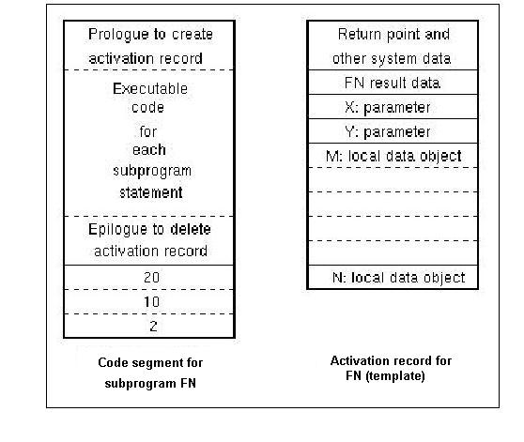

Slide 10
On call instruction
    An activation record is created
    Current CIP and CEP are saved in the created activation record as return point
    CEP is assigned the address of the activation record.
    CIP gets the address of the first instruction in the code segment
    The execution continues from the address in CIP

Slide 11
On return
    The old values of CIP and CEP are retrieved.
    The execution continues from the address in CIP
Restrictions of the model:
at most one activation of any subprogram

Slide 12
The simplest implementation
Allocate storage for a single activation record statically as an extension of the code segment.
Used in FORTRAN and COBOL.
The activation record is not destroyed - only reinitialized for each subprogram execution.
Hardware support - CIP is the program counter,
CEP is not used, simple jump executed on return.

Slide 13
Stack-based implementation
The simplest run-time storage management technique
call statements : push CIP and CEP
return statements : pop CIP and CEP off of the stack.
Used in most C implementations
LISP: uses the stack as an environment.

Slide 14
Recursive Subprograms
    Specification
    Syntactically - no difference
      Semantically - multiple activations of the same subprogram exist simultaneously at some point in the execution.
    E.G. the first recursive call creates a second activation within the lifetime of the first activation.

Slide 15
Implementation
    Stack-based -
    CIP and CEP are stored in stack, forming a dynamic chain of links.
    A new activation record is created for each call and destroyed on return.
    The lifetimes of the activation records cannot overlap - they are nested.

Slide 16
Attributes of Data Control
Data control features determine the accessibility of data at different points during program execution.
Central problem:
the meaning of variable names, i.e. the correspondence between names and memory locations.

Slide 17
Names and Referencing Environments
Two ways to make a data object available as an operand for an operation
Direct transmission
Referencing through a named data object

Slide 18
Direct transmission
    A data object computed at one point as the result of an operation may be directly transmitted to another operation as an operand
    Example: x = y + 2*z;
    The result of multiplication is transmitted directly as an operand of the addition operation

Slide 19
Referencing through a named data object
    A data object may be given a name
    when it is created,
    the name may then be used to designate it as an operand of an operation.

Slide 20
Program elements that may be named
To be discussed next
    Variables
    Formal parameters
    Subprograms
    resolved at translation time:
    Defined types
    Defined constants
    Labels
    Exception names
    Primitive operations
    Literal constants

Slide 21
Associations and Referencing Environments
Association: binding identifiers to particular data objects and subprograms
Referencing environment: the set of identifier associations for a given subprogram.
Referencing operations during program execution: determine the particular data object or subprogram associated with an identifier

Slide 22
Local referencing environment
    The set of associations created on entry to a subprogram
    formal parameters,
    local variables, and
    subprograms defined only within that subprogram

Slide 23
Non-local referencing environment
    The set of associations for identifiers
    used within a subprogram
    not created on entry to it
Global referencing environment:
associations created at the start of execution of the main program, available to be used in a subprogram
Predefined referencing environments:
predefined associations in the language definition

Slide 24
Associations
Visibility of associations
Associations are visible if they are
part of the referencing environment.
Otherwise associations are hidden
Dynamic Scope of associations
The set of subprogram activations within which the association is visible

Slide 25
Aliases for Data Objects
    Multiple names of a data object
      separate environments - no problem
      in a single referencing environment - called aliases.
    Problems with aliasing
      Can make code difficult to understand
      Implementation difficulties at the optimization step - difficult to spot interdependent statements - not to reorder them

Slide 26
Example of aliasing
Program main;
var I: integer;
procedure Sub1 ( var J: integer);
begin
……… (* I and J refer to same data object *)
end;
begin
…. Sub1(I);
….
end.

Slide 27
Static and Dynamic Scope
The dynamic scope of an association for an identifier:
the set of subprogram activations in which the association is visible during execution.
tied to the dynamic chain of subprogram activations.
The static scope of a declaration
the part of the program text where the declared identifier is used.

Slide 28
Dynamic scope rules
Static scope rules
Dynamic scope rules :
Relate references with associations for names during program execution
Static scope rules :
relate references with declarations of names in the program text.

Slide 29
Block structure
Block-structured languages :
    Each program or subprogram is organized as a set of nested blocks.
    Each block introduces a new local referencing environment.

Slide 30
Subprogram A
Declaration of X
Declaration of Y
Subprogram B
Declaration of Y
Declaration of Z
Use of Y
Use of X
Use of Z
Static scope rules for block-structured programs
Hidden to A

Slide 31
Local Data and Local Referencing Environments
Local environment of a subprogram:
various identifiers declared in the subprogram :
variables, parameters, subprogram names.
Static scope rules: implemented by means of a table of the local declarations
Dynamic scope rules:
Retention - Associations and the bound values are retained after execution
Deletion - Associations are deleted

Slide 32
Implementation of dynamic scope rules
By means of a local environment table to associate names, types and values.
Retention: the table is kept as part of the code segment
Deletion: the table is kept as part of the activation record, destroyed after each execution.

