Slide 1
Springboard Foundations in Data Science
Arun S Bharadwaj
Thanks to my mentor Thomas Hopper, community manager Guy Maskall and student adviser Kane
September 1, 2017

Slide 2
Dota 2 Capstone
Introduction
Dota (Defense of the Ancients) is a very popular online, multiplayer game
Game is divided into 2 teams: Radiant and Dire
Each team can have maximum 5 players
Each player chooses a unique hero out of more than 100 heroes
Heroes are divided into STR (strength), INT (intelligence) and AGI (agility)
Heroes generate gold by killing other heroes, destroying buildings and killing creeps
Heroes use gold to purchase more than 100 available items that improve their performance
Game ends when either team captures the base of other team after destroying all towers guarding other team`s base

Slide 3
Dota 2 Capstone
Dataset
- Kaggle dataset courtesy Valve Corporation
Information about 50,000 matches that has final result, player skill level, hero choice, team choice, game duration, gold generated by each player, items bought by players and their heroes, tower damage, building damage, player geographic region etc
18 different csv files featuring more than million rows of data
Rich dataset with numeric, character, factor and logical observations. Allows for data wrangling, feature engineering, exploratory data analysis and machine learning

Slide 4
Dota 2 Capstone
Approach to solving the problem
Identify problem statement
What questions should be answered using the dataset to solve this problem
Data Wrangling
Feature Engineering
Exploratory data analysis
Machine Learning
Conclusions
Recommendations

Slide 5
Dota 2 Capstone
Problem Statement
Goal is to identify potential biases in the gameplay structure of Dota 2
What is gameplay structure
Dota 2 allows players to choose from a choice of more than 100 heroes and 100 items
Why and for whom is this problem statement important
Game developers must ensure that their games have no loopholes or opportunities for gamers to win using
defects in gameplay
To identify potential biases in gameplay, we explore the effect of hero selection, hero combination and inventory items on winnability

Slide 6
Steps in Data Wrangling
Data Wrangling
Identify important CSV files
Eliminate columns that do not add value to analysis
Check if data points of some important variables make sense
Convert incorrect negative values to 0
Nullify columns with very high percentage of NA`s

Slide 7
Steps in Feature Engineering
Feature Engineering
Combine some small CSV files with larger files to make data visualization easier
Instead of having more than 100 id`s in hero_id column, convert them to STR, AGI and INT classes
Remove rows in players_csv and players_ratings_csv where account_id = 0
Replace 0-4 and 128-132 in players_csv1 to Radiant and Dire respectively
Convert observations in columns item_0 and item_5 in players_csv3 from numbers to class of items. This reduces number of factors
player_ratings_csv2 created which only has account_id`s that have played 5 games or more

Slide 8
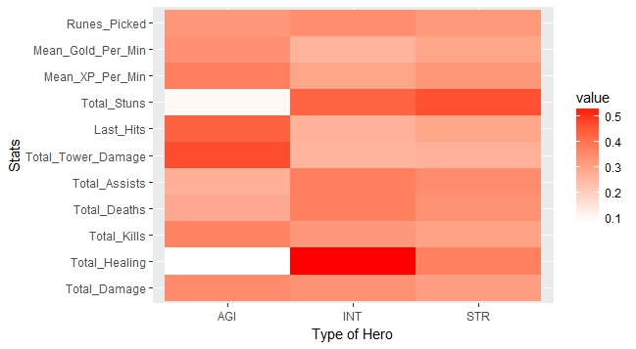
Exploratory Data Analysis (Hero Stats)
Scaled statistics show that on an absolute basis, INT heroes heal the most, AGI heroes have highest tower damage, AGI heroes have highest last hits and STR heroes have highest stuns

Slide 9
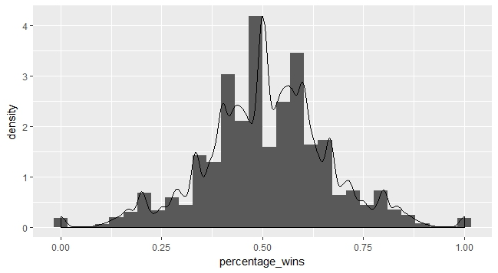
Exploratory Data Analysis (percentage of wins)
Majority of players win more than half the games they play. Even larger amount win 40-60% of the games they play.

Slide 10
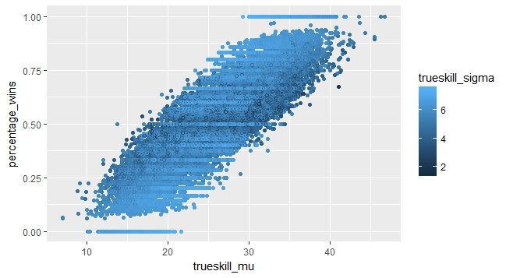
Exploratory Data Analysis (trueskill_mu and percentage of wins)
trueskill_mu and percentage of wins have some amount of positive correlation. Higher skill, overall implies better probability of winning. But the trueskill_sigma color variable does not have a definite association with percentage_wins.

Slide 11
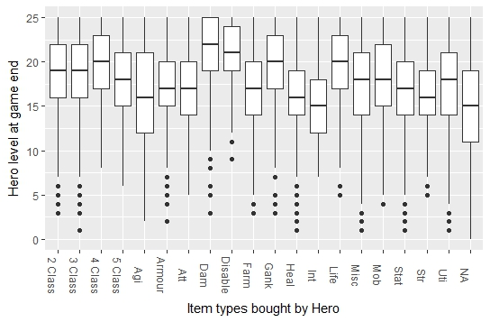
Exploratory Data Analysis (Player level and item purchase)
Players/heroes who bought Damage and Disable type items reached highest levels at game end. Do damage and disable items help heroes reach high levels? Or, do only high level heroes buy these items since they can only be purchased late in the game?

Slide 12
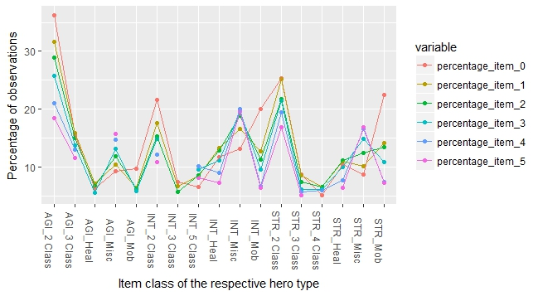
Exploratory Data Analysis (Hero type and item purchase)
Each hero has 6 different inventory slots. Sum of item types bought by a class of hero equals 100%. Item types that constituted less than 5% of hero`s total purchasing were removed.
Damage and disable items are not seen in the x-axis. So, they constitute less than 5% each. If players knew that buying damage or disable is successful strategy for level up, they would have done that. Absence of these items shows that minority amount of players, who have already levelled up, only buy these items.

Slide 13
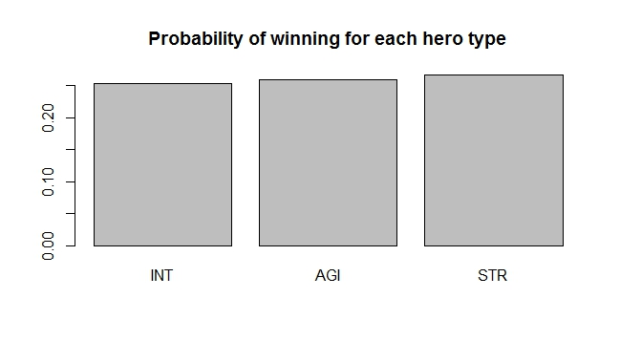
Exploratory Data Analysis (Individual hero and winning probability)
STR heroes have slightly higher probability of winning although the differences are very small.

Slide 14
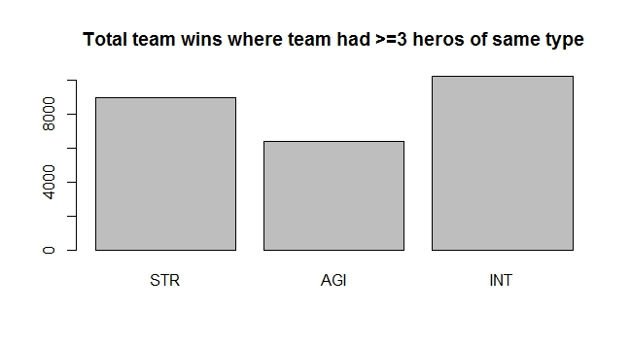
Exploratory Data Analysis (Team hero combinations and winning)
Teams where 3 or more players chose INT heroes won substantially more games, followed by teams where 3 or more players chose STR heroes.

Slide 15
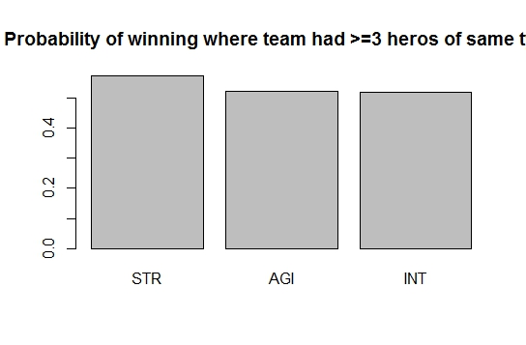
Exploratory Data Analysis (Team hero combinations and probability of winning)
Probability of winning is highest when >= 3 STR heroes are chosen. This is followed by AGI and then INT. This is very different from the previous plot, where on absolute basis, >= 3 INT heroes won highest number of games.

Slide 16
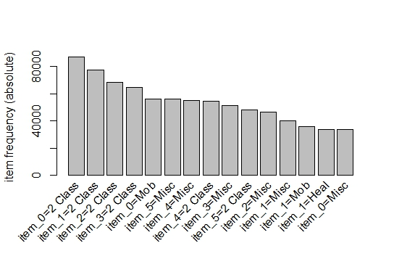
Exploratory Data Analysis (Item purchase frequency plot)
2 Class items are most frequently purchased, followed by mobility and miscellaneous items.

Slide 17
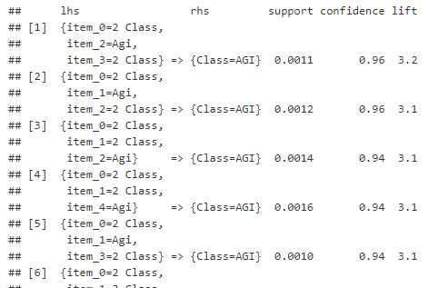
Exploratory Data Analysis (Association rules between hero type and item purchase)
AGI heroes have 96% probability of buying 2 Class items. Only AGI heroes have such high probabilities for buying any item. Top 10 highest associations dominated by AGI heroes.

Slide 18
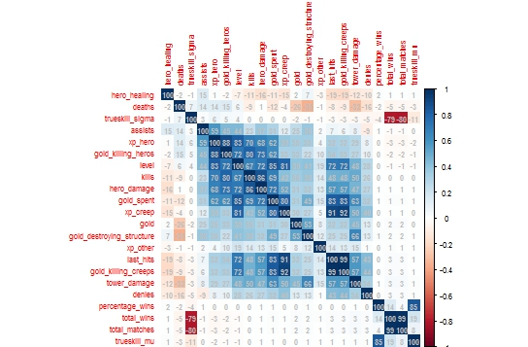
Machine Learning (Linear Regression with trueskill_mu as predictor)
Correlated variables are removed before performing linear regression.

Slide 19
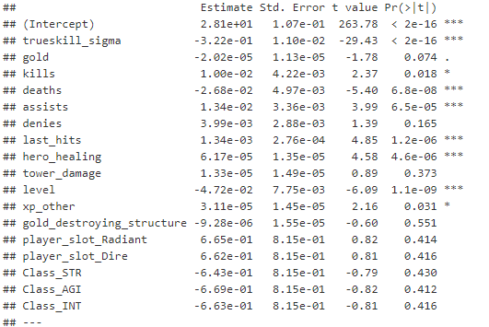
Machine Learning (Linear Regression with trueskill_mu as predictor)
Hero class, team selection (radiant or dire) are statistically not significant.

Slide 20
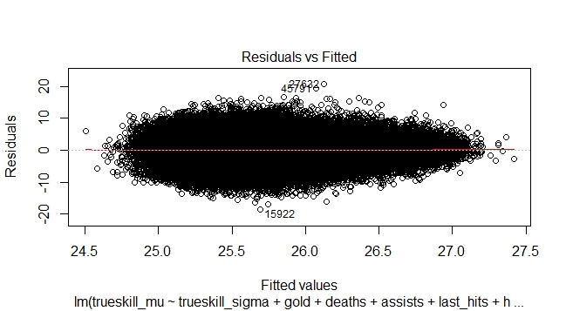
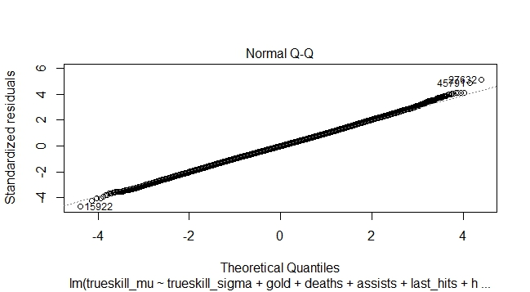
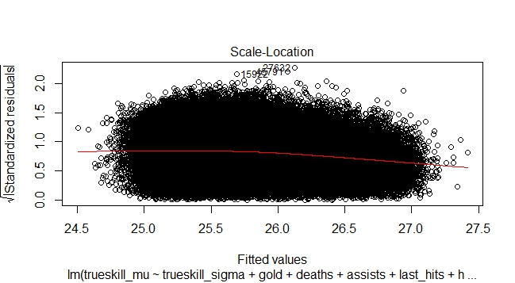
Machine Learning (Linear Regression with trueskill_mu as predictor)
Residuals versus Fitted curve shows some correlation between fitted values and residuals. Normal Q-Q curve shows that residuals are normally distributed.
Neither a bad model nor a great model

Slide 21
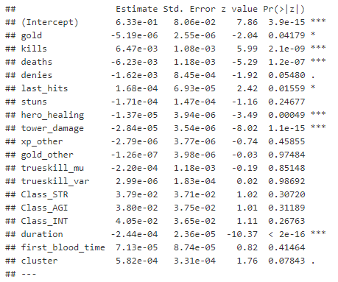
Machine Learning (Logistic Regression with radiant_win as dependent variable)
Logistic regression developed after removing correlated variables. Again, hero type is not statistically significant. Even trueskill_mu and sigma are not significant.

Slide 22
Machine Learning (Logistic Regression with radiant_win as dependent variable)
Logistic regression developed after removing correlated variables. Again, hero type is not statistically significant. Even trueskill_mu and sigma are not significant.
Logistic regression model accuracy is found to be 53.5%

Slide 23
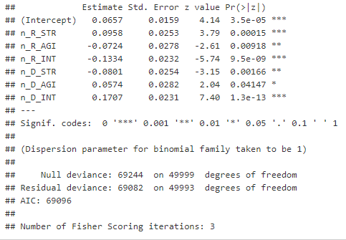
Machine Learning (Logistic Regression with radiant_win as dependant variable and >= 3 heroes of same type as independent variable)
n_R_STR and other 5 independent variables are binary. If a radiant team chose >= 3 INT heroes, n_R_INT equals 1, else 0.
All 6 variables are statistically significant. n_R_STR`s positive co-efficient shows that by choosing >= 3 STR heroes, a radiant team increases its chances of winning. n_D_STR`s negative co-efficient shows that by choosing >= 3 STR heroes, a dire team reduces the radiant team`s chances of winning.
This logistic regression`s AIC (69096) is substantially lower than first two regressions (>85000) showing that this model is better

Slide 24
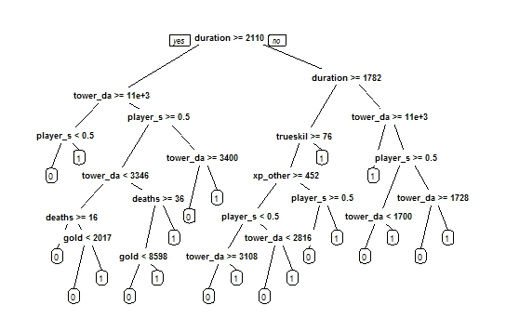
Machine Learning (Decision tree with radiant_win as predictor)
Decision tree model is used to predict probability of radiant (1) or dire (0) winning.

Slide 25
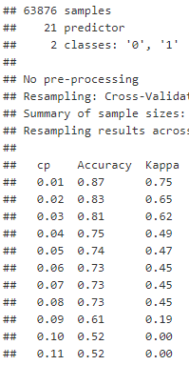
Machine Learning (Decision tree cross validation)
Optimal cp = 0.01 based on decision tree cross validation.
New decision tree using this cp value is built.
Decision tree model accuracy is found to be 87.7%

Slide 26
Conclusions and some recommendations
CONCLUSIONS
Hero selection makes no difference to gameplay and winnability
Team selection alone makes no difference to probability of winning
Teams with >= 3 STR heroes have higher probability of winning
Trueskill_sigma variable does not have a major impact on player skill level
AGI heroes are very likely to purchase 2 Class items. STR heroes are very likely to purchase mobility items
INFERRED FROM
Linear and Logistic regression
Logistic Regression
Exploratory Data Analysis and Logistic regression
Decision tree, exploratory data analysis, linear and logistic regression
Association rules
Recommendations include : 1) Bonus for radiant teams in shorter duration games since duration is significant with negative co-efficient in logistic regression 2) trueskill algorithm requires review 3) Relook into metrics of STR heroes

