Slide 1


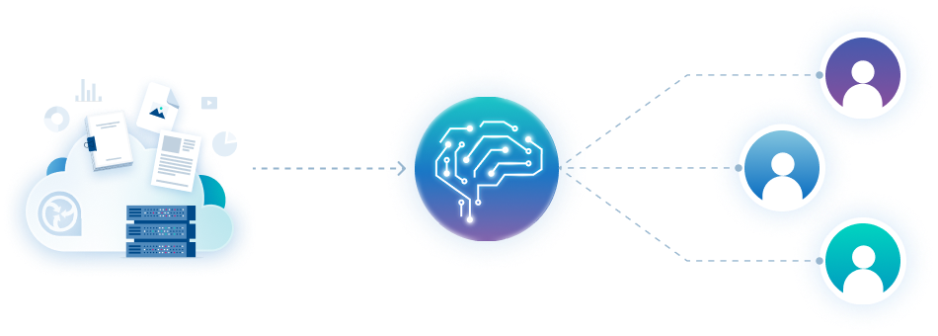





AI Prediction Tool
Key Features
Use approved consent to create individually tailored predictions for each and every HCP
Improve HCP engagement by providing relevant content they’ll want to read
Delivered in a way you know they will receive
Knowledge is power: the more you know, the more insightful you can be for every HCP
Customise how you use your collected data, so it best serves you
AI Prediction Tool
Our AI leverages your HCP engagement data to formulate personalised predictions for each HCP. This process improves as your interactions with HCPs deepen. Enhanced content recommendations foster stronger relationships and trust - resulting in measurable outcomes. The synergy of intelligence and foresight.
Related modules |
Read-Through
-Rate
Web Portal
inforMedGo
Consent
Automail

