Slide 1


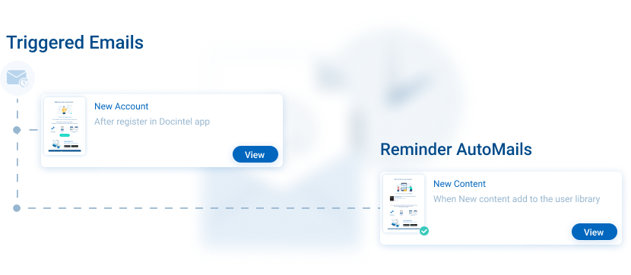




AutoMail
Key Features
Two levels of AutoMail offerings
Essential
Predictive
Automated post-registration emails, reminders, etc
Predictive personalised automated emails
Increased engagement with pre-approved content
Customisable AutoMail settings
AutoMail
Automate personalised email reminders and AI-recommended content for HCPs, who haven't been reached within your KPI timeframe. Streamline time-consuming tasks associated with standard HCP interactions to save you time and effort, ultimately enhancing HCP engagement. Designed exclusively for the life sciences sector, our comprehensive feature set makes this email tool the ultimate choice for enhancing relationships with HCPs
Related modules |
inforMedGo
Email Engine
Consent
AI Prediction Tool

