Slide 1


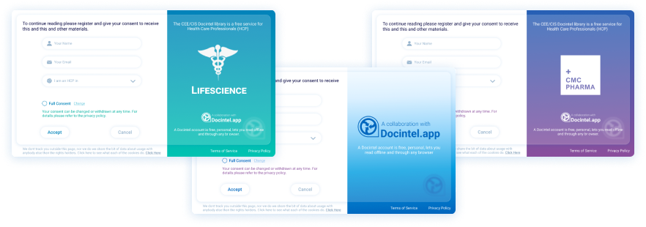




Consent
Key Features
Consent is at the core and powers every module
Provides a personalised experience for each HCP
HCPs can provide or withdraw consent directly through their Docintel account
Simplicity, transparency and trust supports enduring relationships
Consent
Build better relationships with consent - so you can analyse engagement data to give you precise predictions about HCPs' interests. Our method is in use on every continent and can be modified to any specific requirement. This integration of consent, usage and AI results in tailored content for your HCPs.
Related modules |
Web Portal
inforMedGo
Docintel.app
AI Prediction Tool

