Slide 1


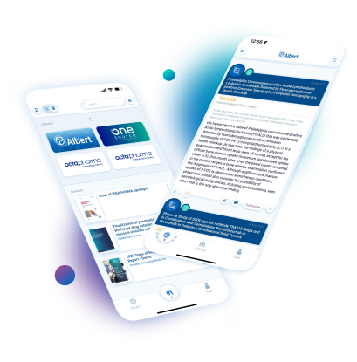




Docintel.app
Key Features
HCPs read on & offline, in any browser or in the app
Secure instant HCP consent
RTR tracks every second spent on individual pages
Stay consistent with your visual identity
Push content or give HCPs a code new content in app
Personalised AI predictive content for your HCPs
Docintel.app
Beyond the elegant and user-friendly interfaces lies perhaps the most sophisticated and versatile technology accessible to pharmaceutical marketers. Tailorable consent mechanisms, usage tracking that fuels AI, multimedia content choices and interactivity are all designed to enhance the digital rapport between you and HCPs.
Related modules |
Read-Through
-Rate
Web Portal
Consent
Rating Tool

