Slide 1


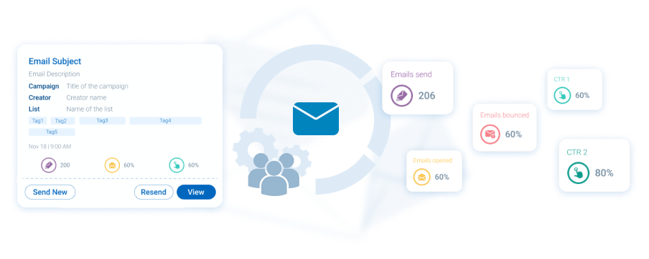



Email engine
Key Features
Easy to use - built with life science industry partners
Dynamic SmartLists save you from Excel-hell
Track if HCPs read what you send
Content & email engagement synced in our CRM
AutoMail add-on for AI-automation and content recommendations
Email engine
Personal emails are powerful, they feel like a direct outreach from a trusted source. Our email engine, tailored for the life sciences sector, seamlessly integrates with other modules' data to easily reach an individual or a segment of HCPs. You can even let it monitor a group and automatically email individual follow ups or apply AI-assisted recommendations for new content. Saves you time and effort, and simple to use.
Related modules |
Survey Engine
Docintel.app
Automail

