Slide 1


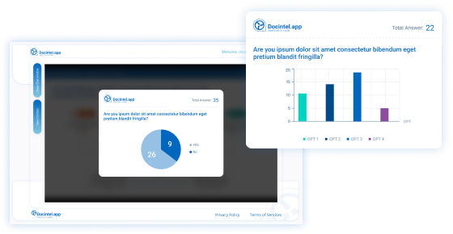




Q&Poll
Key Features
Real-time interaction and queries
Screen questions before they reach the panel
Get to know your HCPs better (by knowing what’s got them thinking)
Instantaneous HCP engagement with no interruptions
Automatically integrate Q&Poll data and download easily
Enhance HCP engagement at events. Add polls to presentations for personalised speaker-audience interaction. Immediate Q&A involvement empowers each HCP. Integrating votes and questions into CRM timelines aids post-event personalisation.
Related modules |
Web Portal
Webinar Portal
Survey Engine
Automail

