Slide 1


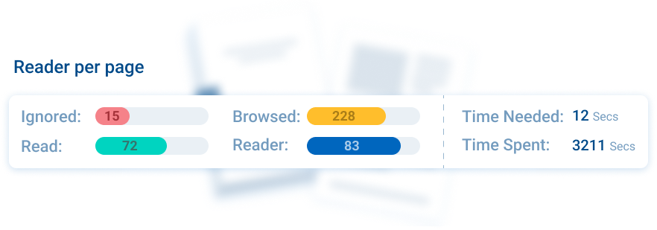



Read-Through-Rate
Key Features
First captures each HCP’s consent
Track HCPs’ reading on- and offline, on a browser or in app
Track every engagement down to the second - spent on individual pages
Data integrated into CRM Timeline
Collects key data for personalising AI predictions
Read-Through-Rate
Our proprietary Read-Through-Rate metric lets you determine the level of HCP engagement. Utilise this data to send reminders, recommendations, or equip your representatives so they can have more informed conversations based on the specific interests and engagement patterns of healthcare professionals.
Related modules |
Docintel.app
Consent
AI Prediction Tool

