Slide 1


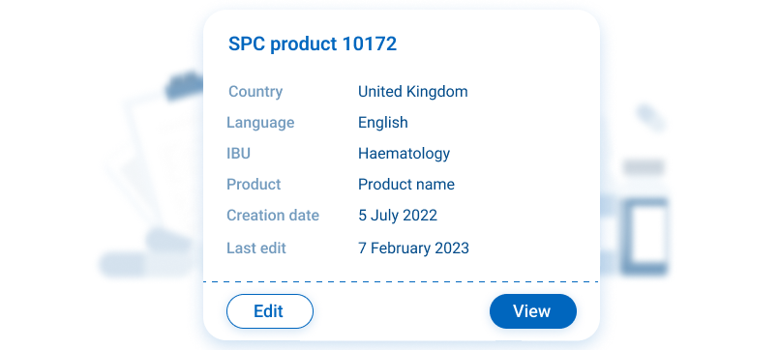




SPC Engine
Key Features
Automatically matches the correct SPC with the HCP’s country
Continuously updated, giving you peace of mind for every account
Feel secure that every HCP has the latest SPC for all their content, old or new
Takes only 5 minutes to update an SPC
SPC Engine
Reclaim your time and end the worry about correct SPCs on older content. The SPC engine automatically attaches the correct country and product SPC to each piece of content, keeping your library up-to-date and easy to navigate. Simple to set up and update. This ensures HCPs always have access to the latest SPC information. No more worry about compliance and superseded SPCs
Related modules |
inforMedGo
Docintel.app
Email Engine
Automail

