Slide 1


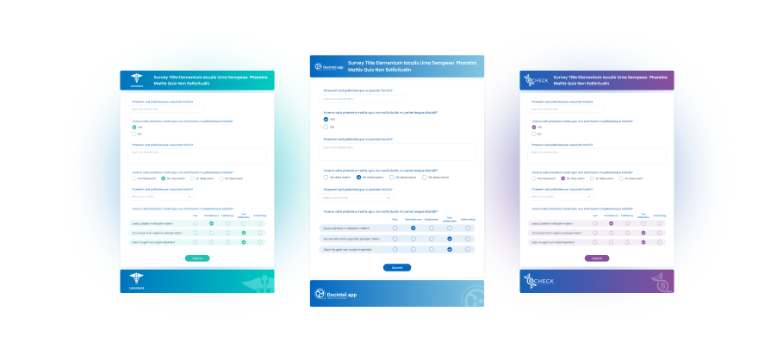



Survey engine
Key Features
Gain invaluable real-time feedback from your HCPs
Customise your survey - let your brand shine through at every point
Integrate into your pages - creating a seamless experience
Build better data for your AI
Survey engine
Reveal valuable HCP insights with custom surveys.
Create your questions, target specific segments and instantly gain deeper understanding about each HCP by seeing their answers. The survey engine syncs with the CRM data and the email module enables easy resend to non-openers - integrate with AutoMail for efficiency.
Related modules |
Q & Poll
Docintel.app
Email Engine

