Slide 1


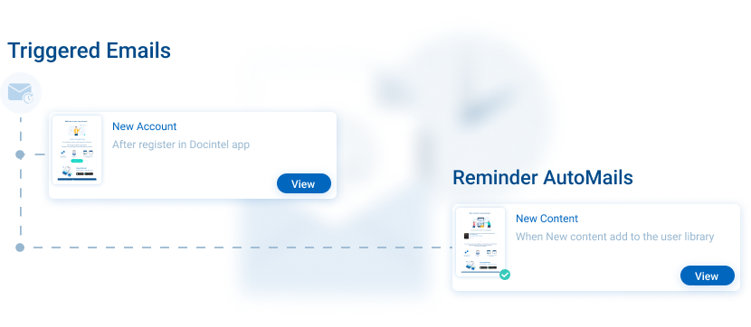




AutoMail
Key Features
Automated confirmation email
Alert to both sales & production
Nearing expiration
Nearing quantity limit
Customisable AutoMail settings
AutoMail
We keep track of all your licensed content with confirmation emails and the limits you’ve agreed with your clients, You receive alerts prior to reaching limits, whether they are expiration or quantity-based.
Related modules |
inforMedGo
Email Engine
Consent
AI Prediction Tool

