Slide 1


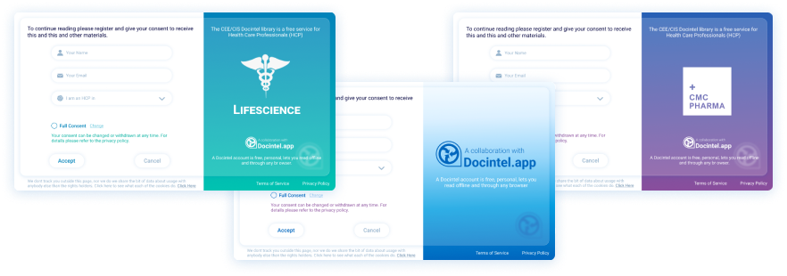




Consent
Key Features
Three standard consent forms makes it easy
Any language possible
Change online at any time
Personalised experienced for the HCPs
HCPs can withdraw consent through their Docintel account
Consent
Clients often realize their consent needs only after receiving the eprint. Our platform enables you and them to modify consent forms and language online anytime.
Related modules |
Web Portal
inforMedGo
Docintel.app
AI Prediction Tool

