Slide 1


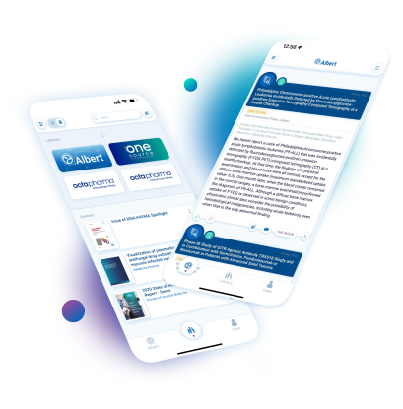




Docintel.app
Key Features
Secure and track limits agreed with client
Multimedia options to satisfy any clients wish
HCPs read on & offline, in any browser or in the app
Track every engagement down to each second spend on individual pages
Docintel.app
Beyond our elegant and user-friendly interfaces lies perhaps the most sophisticated and versatile technology accessible to publishers. Letting HCPs read on any device means flexibility for your clients and freedom to drive usage. Tailorable consent mechanisms, usage tracking, live analytics, multimedia content choices, and interactivity are all designed to enhance your client offer.
Related modules |
Read-Through
-Rate
Web Portal
Consent
Rating Tool

