Slide 1


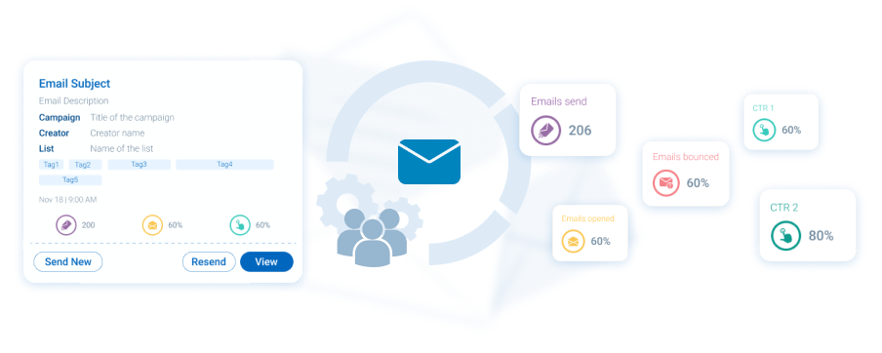



Email engine
Key Features
Easy to use - built for the industry
Dynamic SmartLists save you from excel-hell
Track if HCP reads what you send
Email & content engagement stored in CRM
Add-on AutoMail for AI-automation
Email engine
Our email platform caters to the life science industry, designed for sending bulk emails with automated follow-ups tailored to each HCP's actions. It's commonly employed to invite HCPs to events or content launches using purchased lists, subject to email limits.
Related modules |
Survey Engine
Docintel.app
Automail

