Slide 1


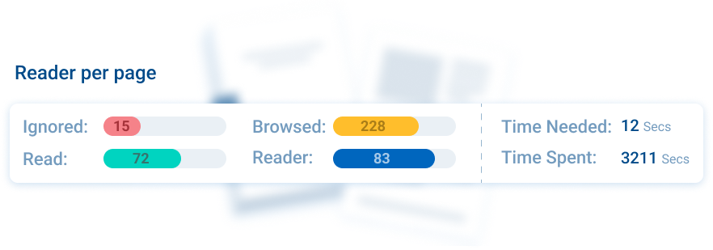


Read-Through-Rate
Key Features
First captures each HCP’s consent
Track every engagement down to each second spend on individual pages
Track HCPs reading on & offline, in browser or in app
True engagement data
Read-Through-Rate
Leverage our proprietary Read-Through-Rate metric to gauge the level of engagement. Show your clients which pages are read so they can encourage HCPs to engage more and gain more usage. Knowledge is power - how will you help your clients?
Related modules |
Docintel.app
Consent

