Slide 1


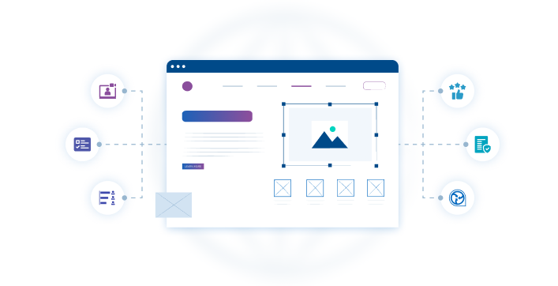




Web portal
Key Features
Enhancing content pages
On demand for when the HCP want to know more
Let HCPs take what they want offline in their personal Docintel app account
Combining Local and Global users for promotion
Customise to clients visual identity
Web portal
Offering complete creative freedom to build custom libraries of your content and add options for your clients that enhance the HCP experience. Implement secure consent mechanisms and comprehensive interaction tracking to gauge ROI and refine your offerings.
Related modules |
Webinar Portal
Rating Tool
Docintel.app
Consent

