Slide 1


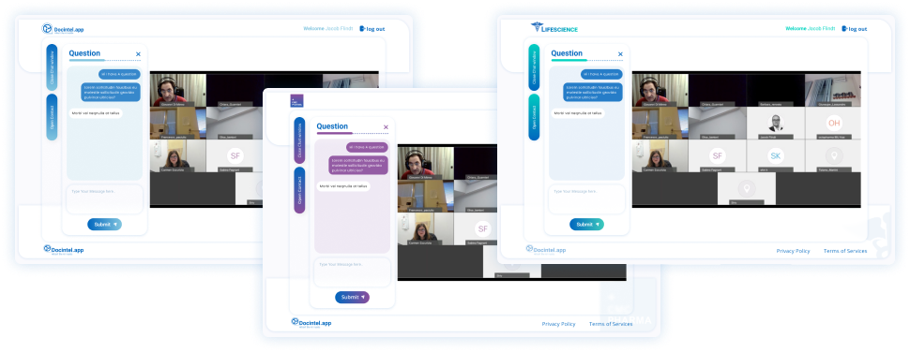





Webinar Portal
Key Features
Online Webinar Platform every HCP will find easy to use
Registration & Consent to suit any regulation
Automated Calendar Reminders helping the HCPs be on time
Automated personalised emails with single-click-login ensure easy access for each HCP
Take the interaction to the next level & allow
HCPs to ask real-time questions
Learn who stayed and engaged to prove ROI
Webinar Portal
Transform your clients webinars with creative freedom and engagement tools that resonates and make HCPs feel valued and active participants. Convert the recordings into valuable content that can be distributed in a user-friendly format, fostering post-event engagement and stronger relationships with HCPs.
Related modules |
Read-Through
-Rate
Webinar Portal
inforMedGo
Consent
Automail

