Slide 1
AIVA Manuscript — Complete Figure Audit & Recreation
All 5 manuscript figures verified against raw data · Redrawn in matching color scheme
Figure 1
CORRECT
Architecture schematic — no numerical data
Figure 2
2 ERRORS
122 genes → 109 (body says 108) · 34 VCEPs → 35
Figure 3A
CORRECT
All Recall@K values match CSV exactly
Figure 3B
N LABELS ✗
Known-Gene Disease shows N=250 (correct: N=422); KG+KD shows N=250 (correct: N=234)
Figure 3C
CORRECT
Already corrected to n=387 with matching colors
Figure 4
CORRECT
All F1 scores verified against TSV — exact match
Figure S1
CORRECT
Already reflects corrected 3-class mapping values

Slide 2
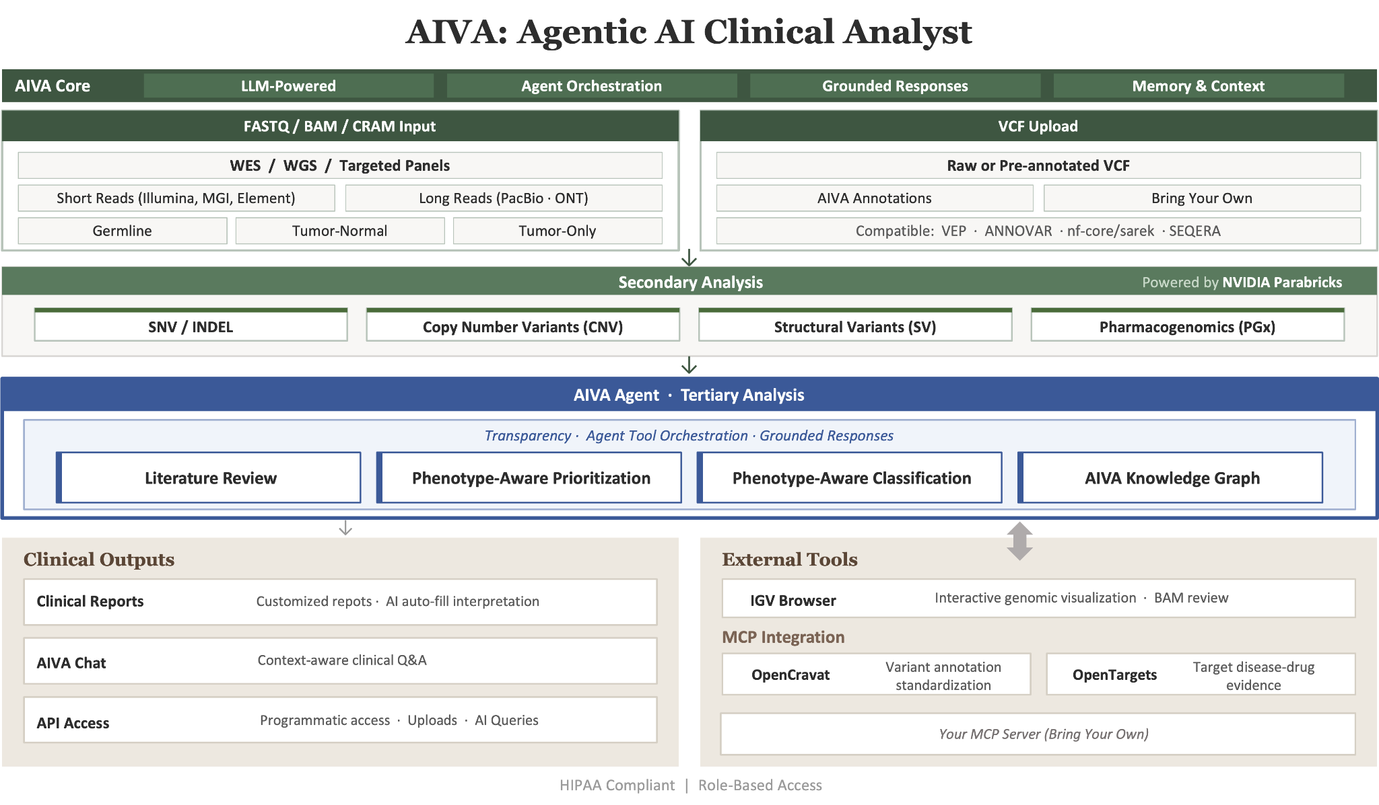
Figure 1 — AIVA System Architecture
✓ Correct — schematic only, no data to verify

Slide 3
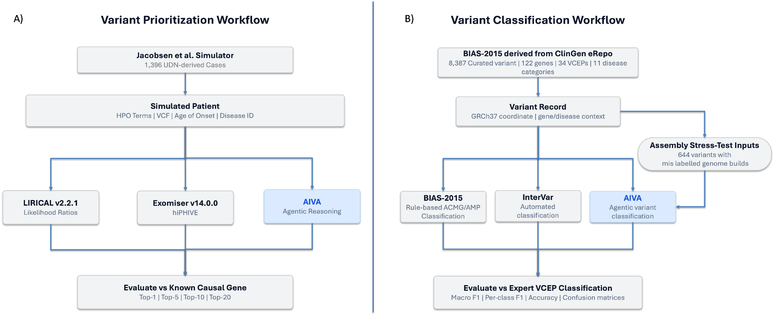
Figure 2 — Benchmark Design ⚠ 2 Corrections Required
Right panel (B): '122 genes' should be 109 (body text says 108) · '34 VCEPs' should be 35
❌ '122 genes' → should be 109 (data) / 108 (body text)
❌ '34 VCEPs' → should be 35 (confirmed from data)

Slide 4
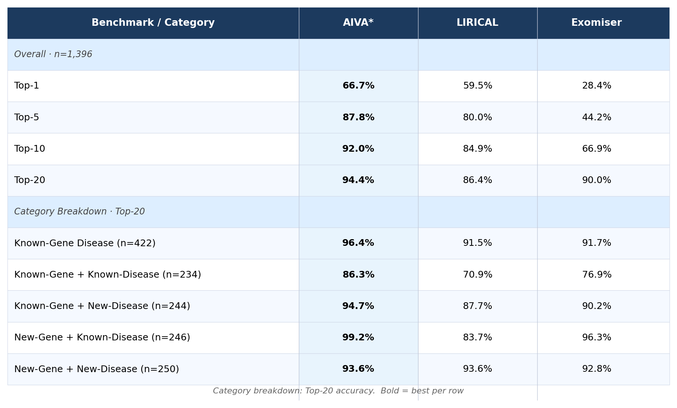
Figure 3A — Recall@K Benchmark Table
✓ All values verified against comparison_metrics.csv · N values corrected for all categories

Slide 5
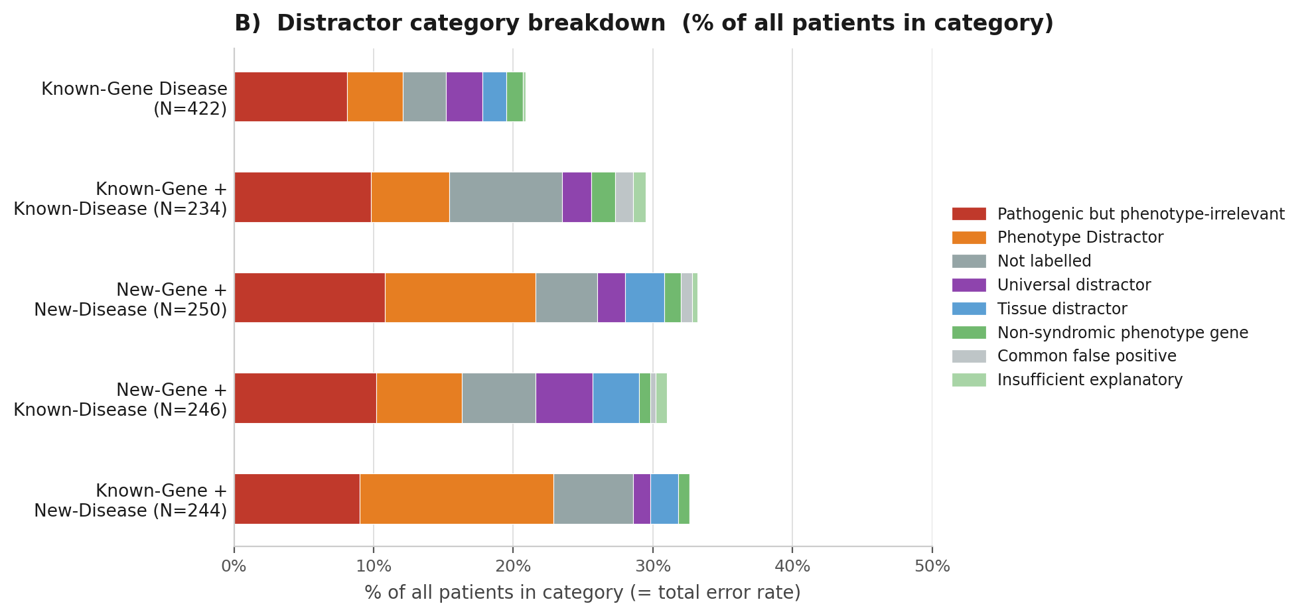
Figure 3B — Distractor Category Breakdown by Disease Category
⚠ Original figure had wrong N labels for Known-Gene Disease (250→422) and KG+KD (250→234) — corrected here

Slide 6
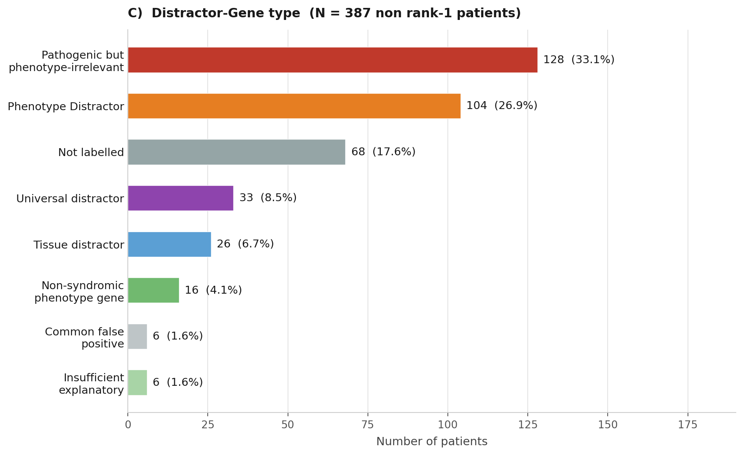
Figure 3C — Distractor-Gene Type Distribution (n=387)
✓ Corrected from n=397 → 387 · Exact original colors · Labels show count (%) format

Slide 7
Figure 3 — Combined (Panels B & C)
Matching original layout · All corrections applied · Colors match original figure

Slide 8
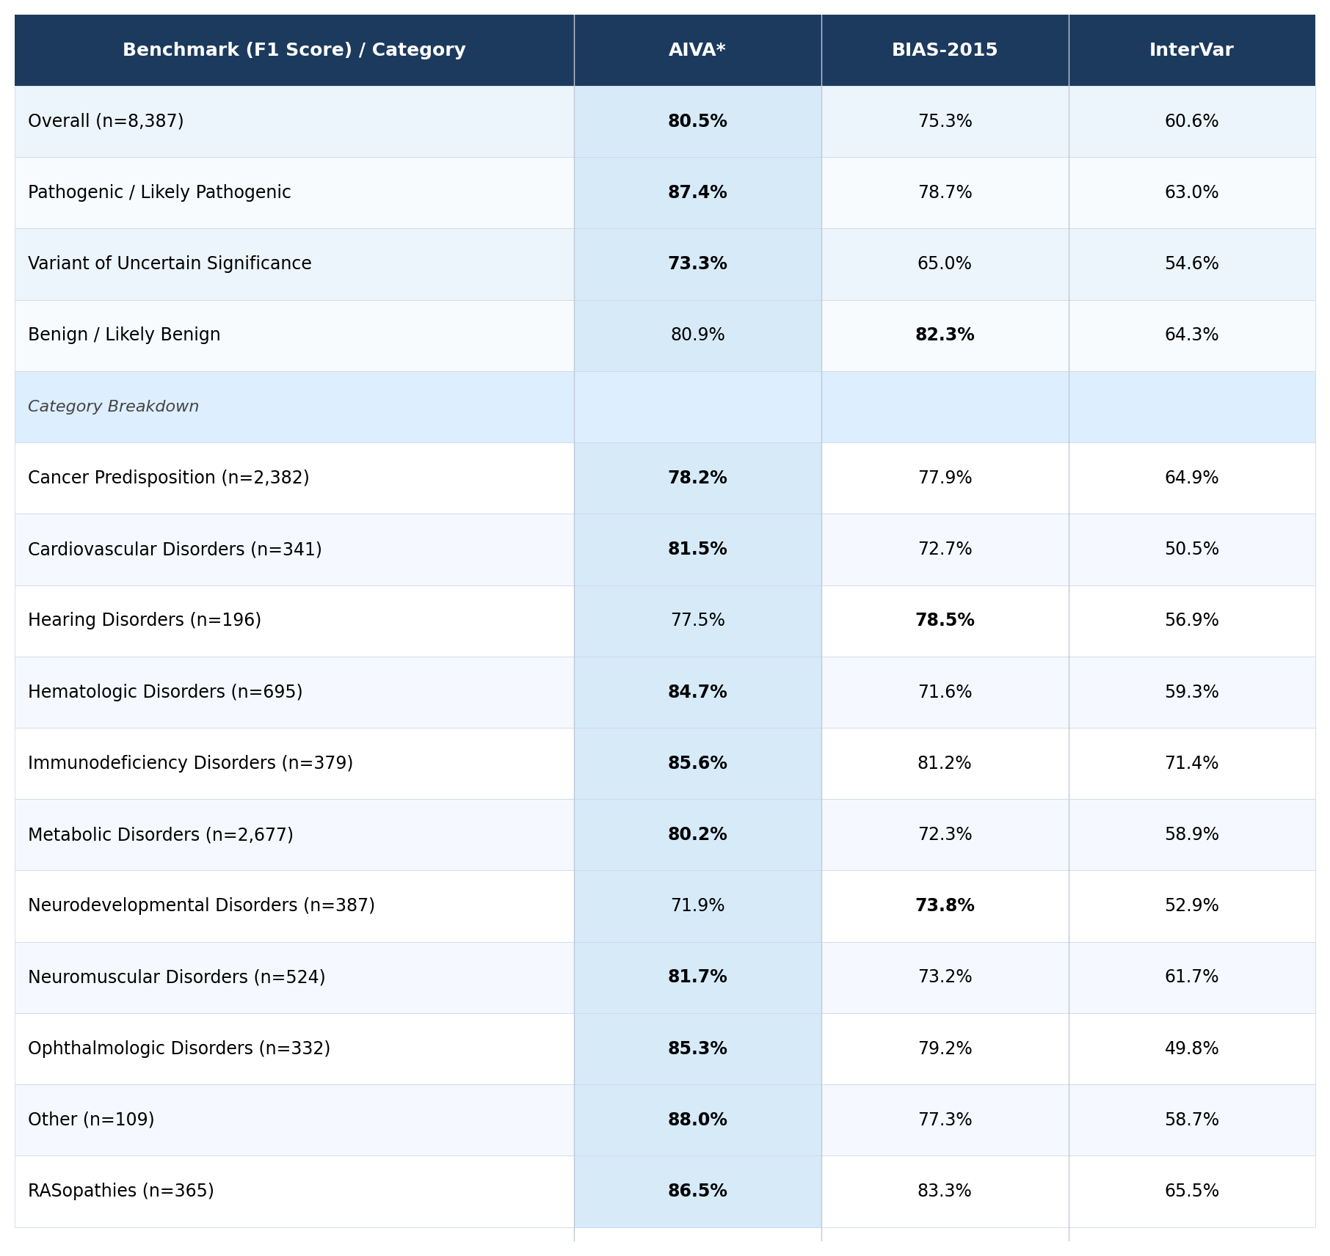
Figure 4A — Variant Classification F1 Score Benchmark
✓ All per-class and per-category F1 values verified against metrics_by_category.tsv

Slide 9
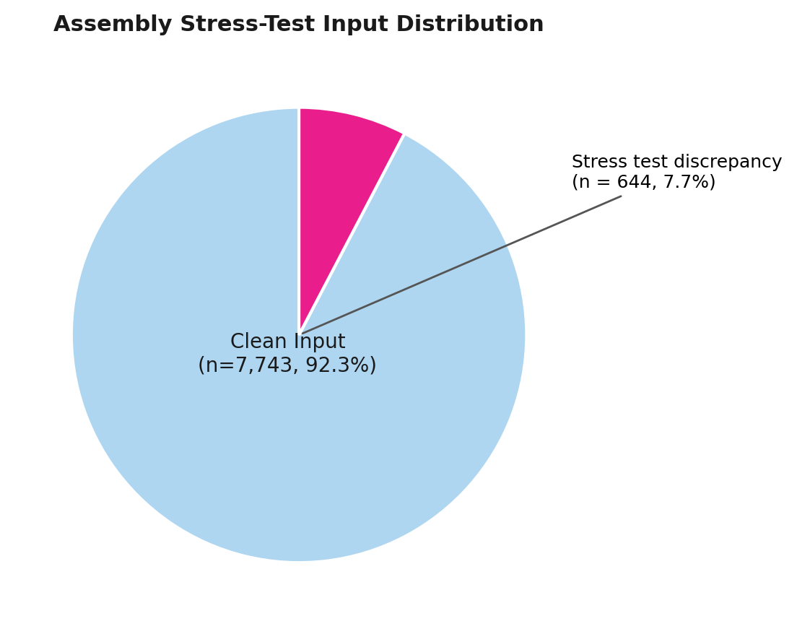
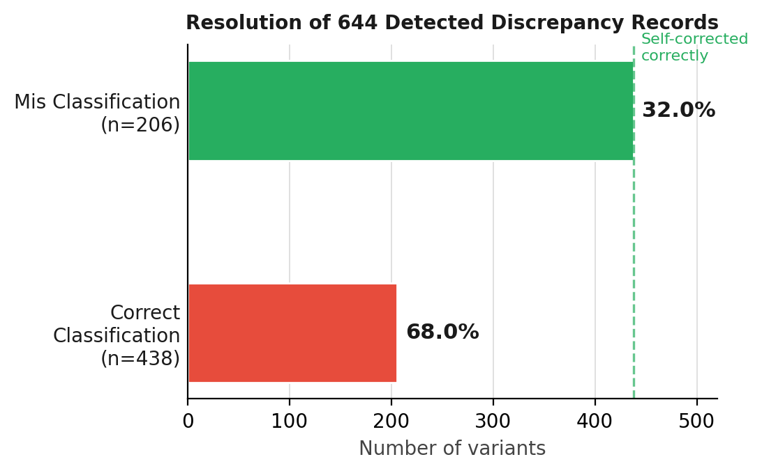
Figure 4B & 4C — Assembly Stress-Test Analysis
✓ All values verified: 7,743 clean + 644 discrepancy = 8,387 · 438 correct + 206 mis = 644

Slide 10
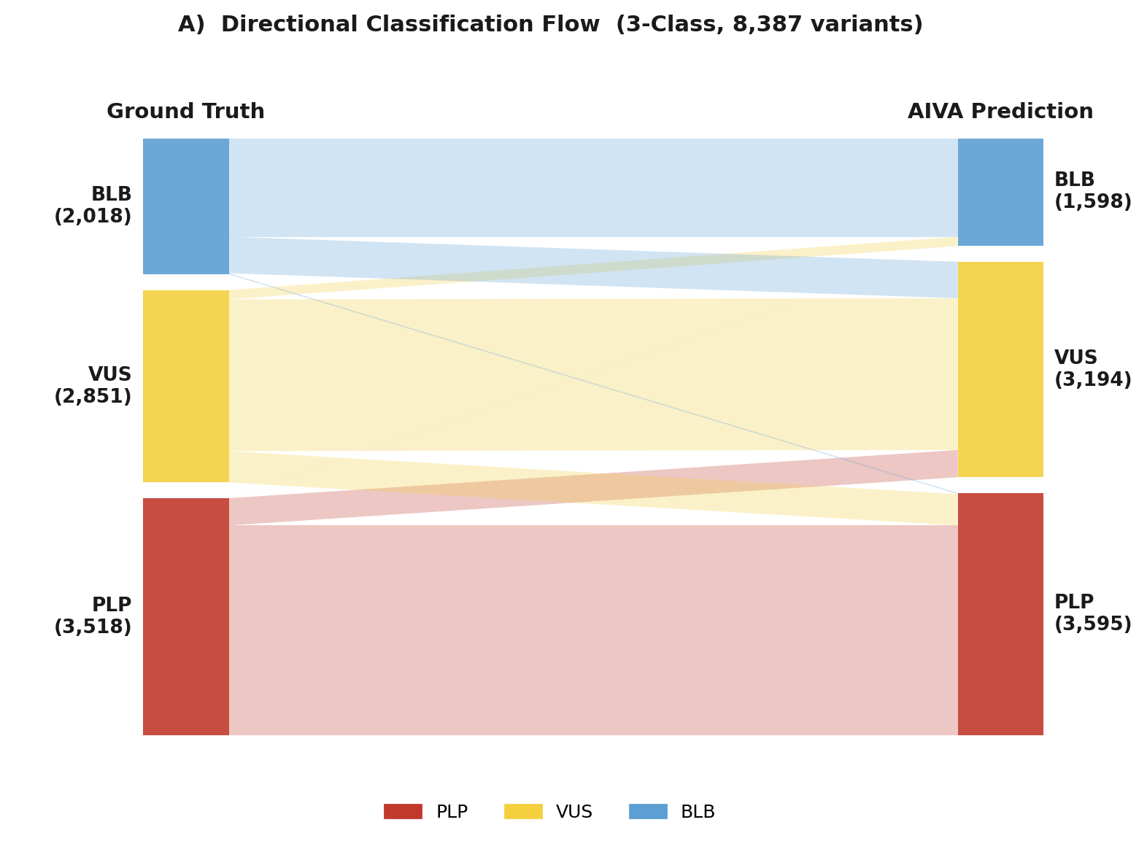
Figure S1A — Directional Classification Flow (Sankey)
✓ Totals verified: 3,518 P/LP + 2,851 VUS + 2,018 B/LB = 8,387 variants

Slide 11
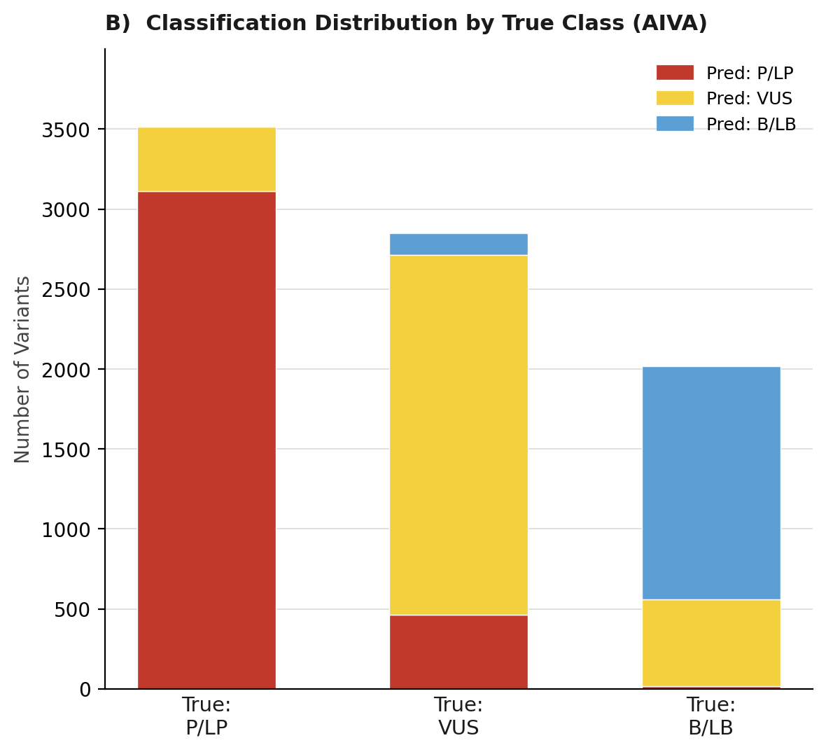
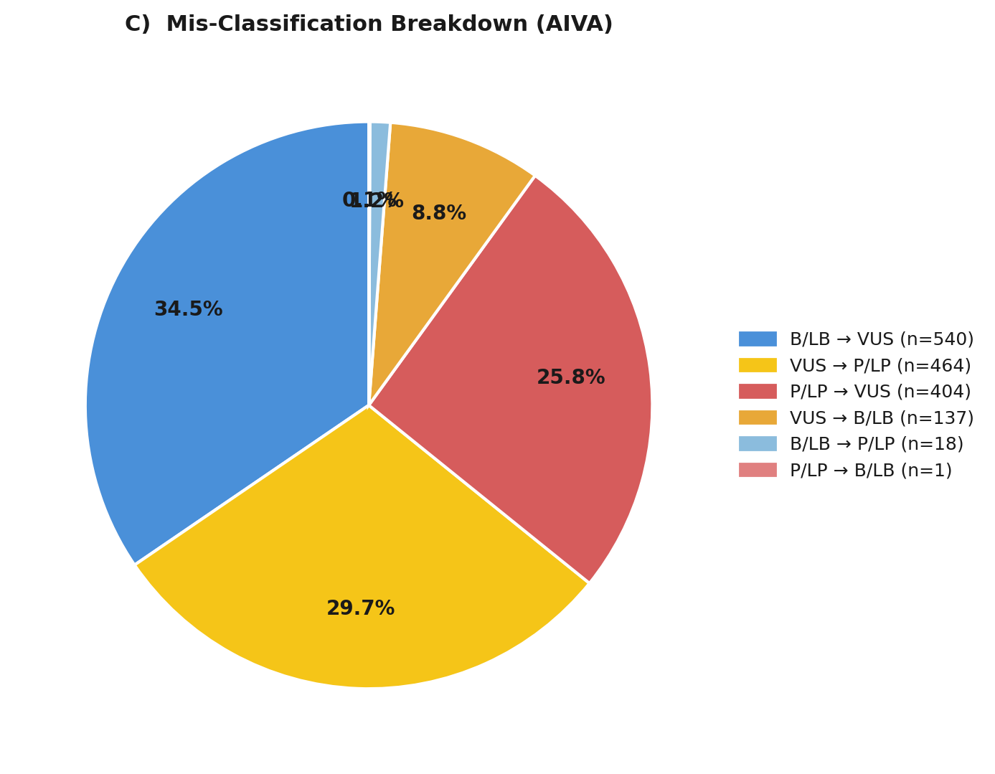
Figure S1B & S1C — Misclassification Analysis
✓ Original figure already reflects corrected values (88.5%, 72.3%, 26.8%) · Pie: 34.5% = % of all misclassification events

