Slide 1
Learning in a Small World
Chaganty A., Gaur, P., Ravindran B.; Learning in a Small World; To appear in AAMAS '12

Slide 2
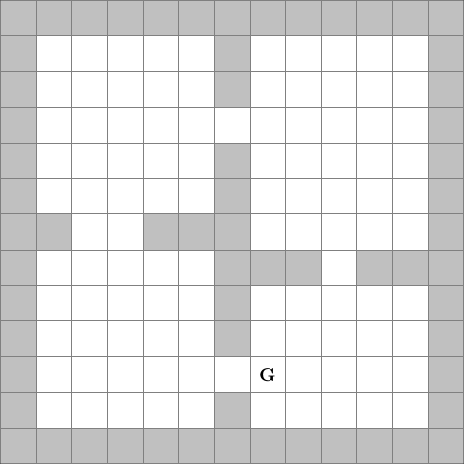
Generalising over Tasks
Each task has a different reward structure in the state space
Notes:
Describe the rooms domain, and the kind of tasks in the domain

Slide 3
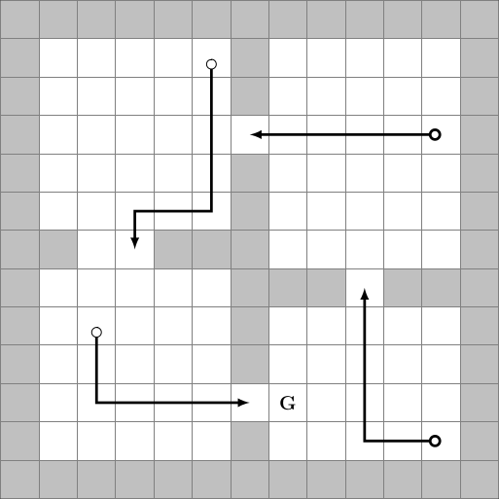
Generalising over Tasks
Each task has a different reward structure in the state space
Options provide a model for subtasks.
Notes:
Motivate the question – which options should we learn?

Slide 4
Small Worlds
A network model where every node is reachable in O(log(n)) hops from a node.
More importantly, the O(log(n)) path can be discovered using a decentralised algorithm.
Stanley Milgram's Experiment

Slide 5
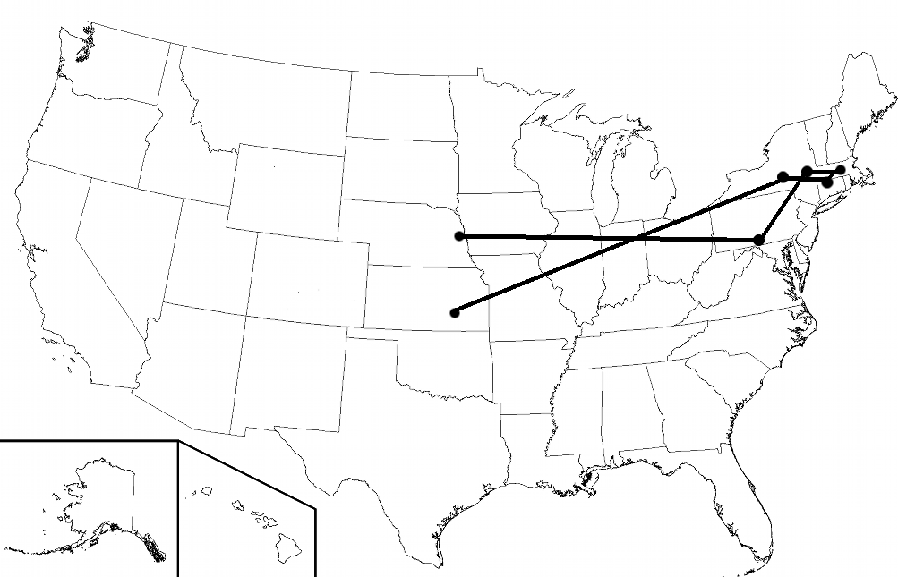
Small Worlds
Notes:
Motivate why “decentralised” is important from the Stanley Milgram experiment

Slide 6
Small Worlds
A network model where every node is reachable in O(log(n)) hops from a node.
More importantly, the O(log(n)) path can be discovered using a decentralised algorithm.
Stanley Milgram's Experiment
Kleinberg's key insight: Power-law distributed neighbours

Slide 7
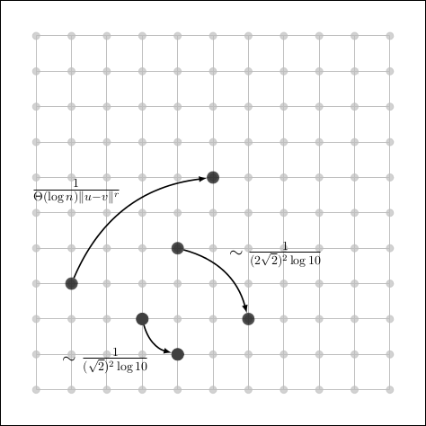
Small Worlds
A r-dimensional lattice graph
Edges distributed inversely proportional to distance

Slide 8
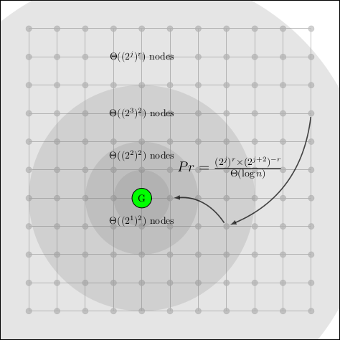
Small Worlds
A r-dimensional lattice graph
Edges distributed inversely proportional to distance
A greedy agent will move from one neighbourhood to another in log(n) time

Slide 9
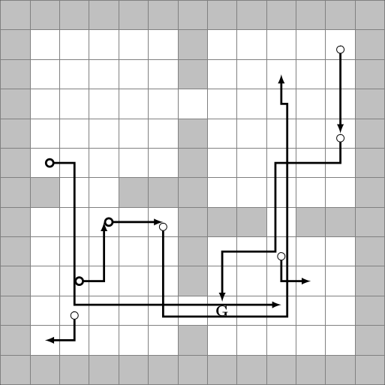
Small Worlds in RL
Construct “path options” that take an agent from state s to s'.
s' is chosen according to the power-law.
Value and state-space distance are related
Note: We add only one extra option per state

Slide 10
Small Worlds in RL
Many options required; how do we effectively learn them?
Key Insight: The important point is to move to an exponentially smaller neighbourhood of target.
  Use cheap, possibly inaccurate options
Algorithm:
  Train an agent on T different tasks.
  For each task, save path options using two states distributed according to the power-law, and following the policy gradient.
Does not require complete knowledge of the MDP, nor does it need to build a model

Slide 11
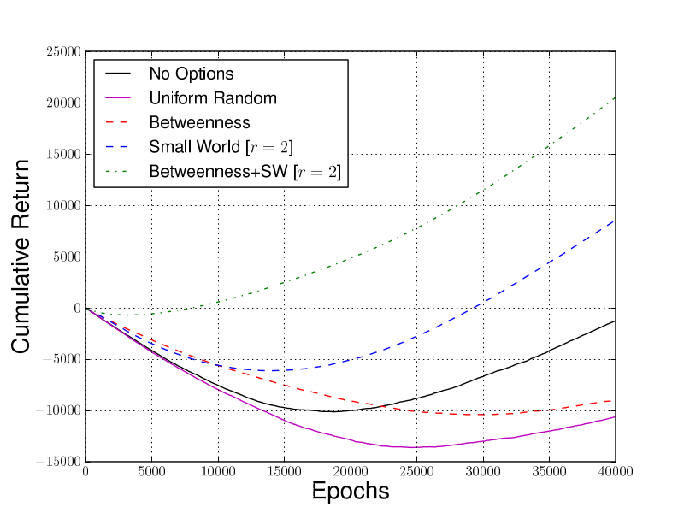
Experimental Results
Rooms: Cumulative Return with 200 options

Slide 12
Experimental Results
 | Arbitrary Navigation | Rooms | Taxi
None | -31.82 | -1.27 | -16.90
Random | -31.23 | -10.76 | -18.83
Betweenness | -18.28 | -8.94 | 80.48
Small World | -14.24 [r = 4] | 8.54 [r = 2] | 0.66 [r = 0.75]

Slide 13
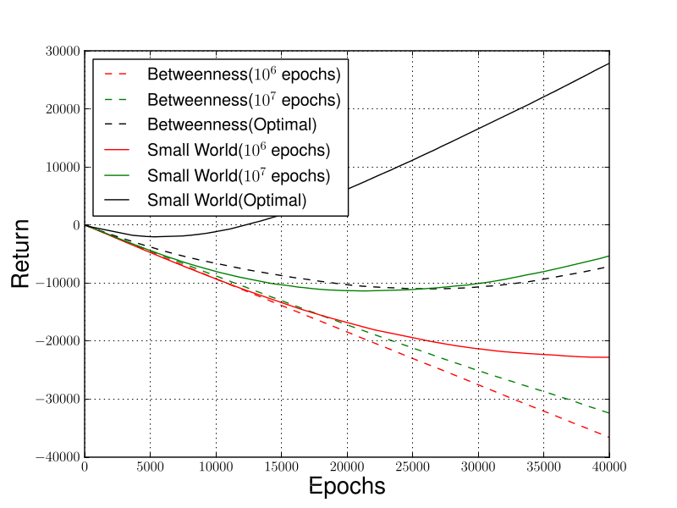
Experimental Results
Rooms: Options Learnt on a Budget

Slide 14
Conclusions
A new option generation scheme with theoretically motivated generalisation properties.
An efficient algorithm to learn “small world” options solely from experience on a few tasks.
Competitive performance on standard domains

Slide 15
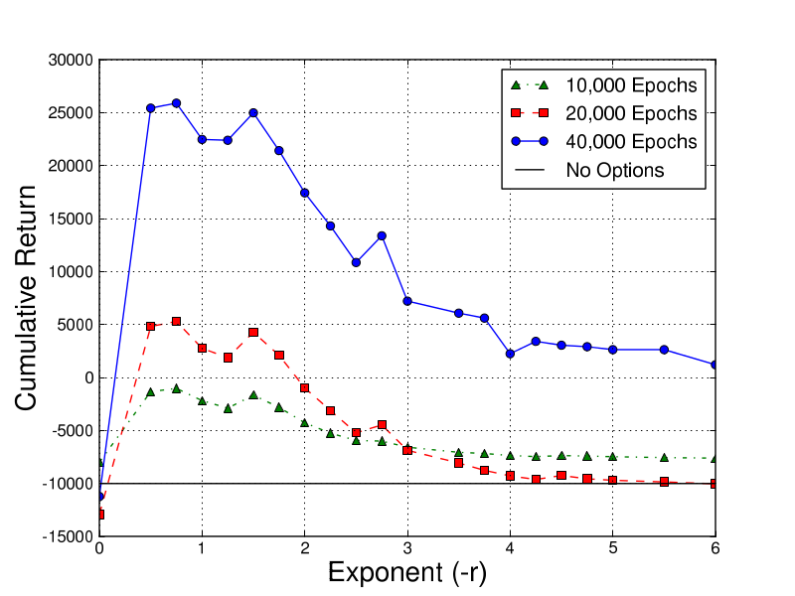
Future Work
Extending small world options to continuous domains
Experiments on more diverse domains
What factors affect the power-law exponent r?
Adding options online
Exploring implications on learning bounds
Rooms: r vs. Cumulative Return

